Slide 1

Daily Sales & Inventory Dashboard
Interactive dashboard with KPIs, trends, and forecasting

Slide 2
Data & Key Performance Indicators
Dataset Description:
- Date, Units Sold, Ending Inventory, Unit Price
- Calculated Sales Amount (Units Sold × Unit Price)
KPIs Defined:
- Total Sales
- Average Daily Units
- Days of Inventory

Slide 3
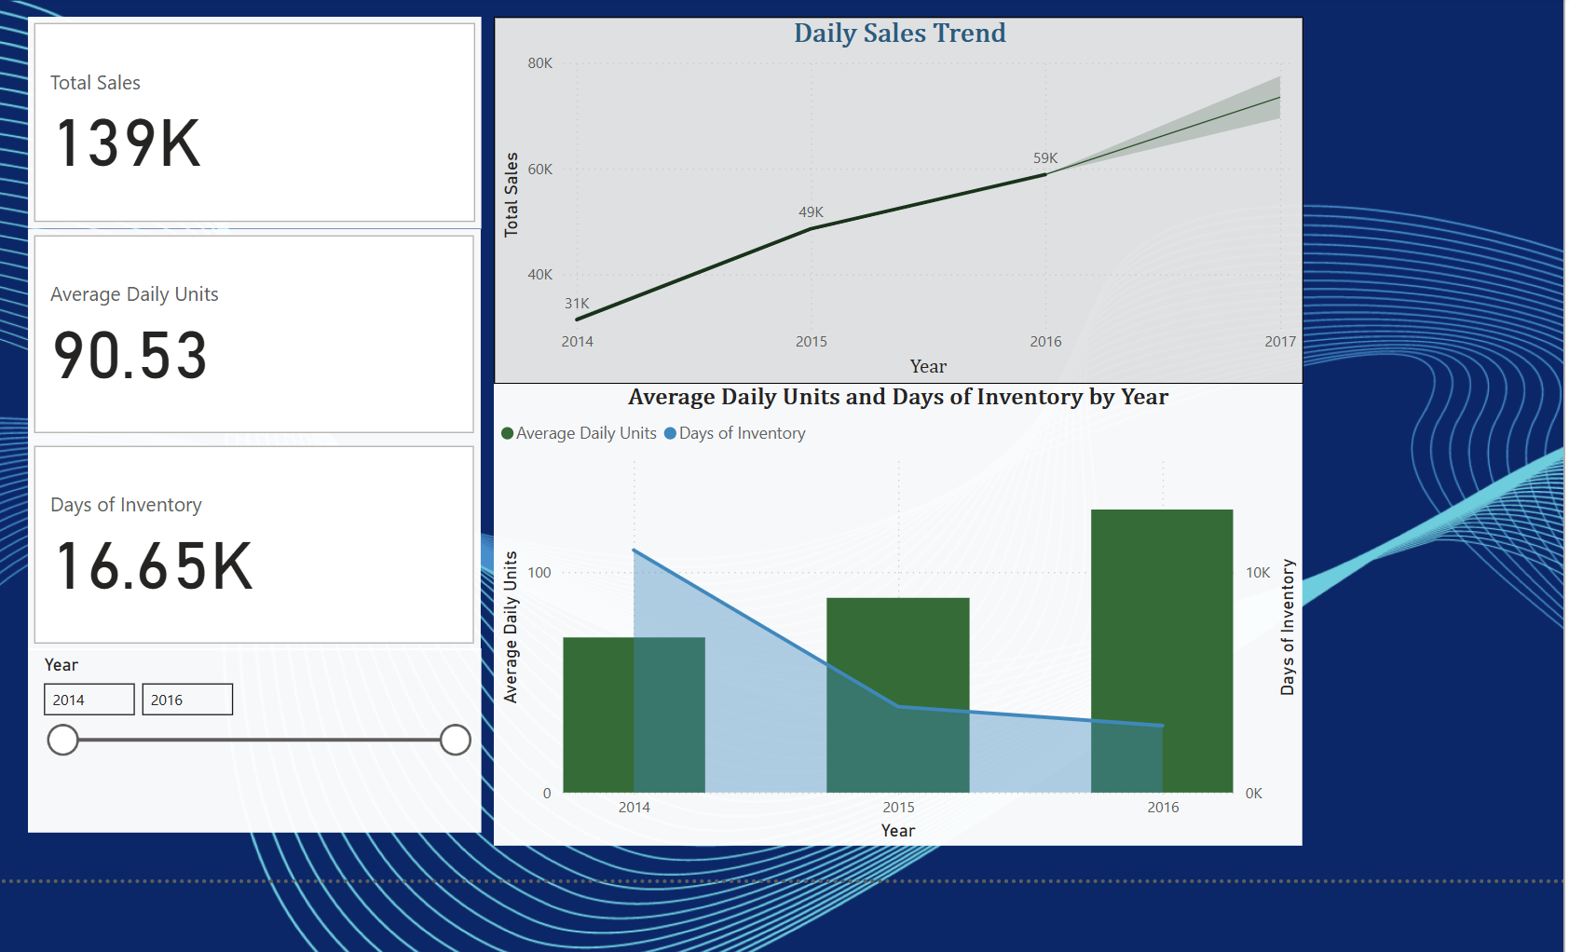
Dashboard Overview

Slide 4
Key Insights
Sales trending up month-over-month
Average days of inventory steady at 7 days
Forecast predicts a slight uptick in the next 30 days

Slide 5
Thank you!

