Slide 1

A3-PS035-TC026
Evidence-Based Operator Network Fault Localisation
PL Shwetha Uma- pl.shwetha@btech.chrisuniversity.in
Yuktha Kiran V- yuktha.kiran@btech.christuniversity.in
Neethu Mariam (Mentor)- neethu.mariam@christuniversity.in
AIORI Hackathon 3
October 12, 2026

Slide 2
AIORI 3
Abstract
Problem Description
Problem Statement
Network failures can arise from link failures, packet loss, excessive latency, access-control blocks and application service failures. These faults can produce similar symptoms, making it difficult for network operators to identify the actual root cause.
Network topology, operator logs and active measurements often need to be analysed together to distinguish the underlying fault from its downstream symptoms.
Problem to address: How can multiple sources of network evidence be correlated to identify, rank and explain the most probable causes of a network failure?
A3-PS035-TC026 · October 12, 2026

Slide 3
AIORI 3
Background
Background
Network fault localisation identifies the device, link or service responsible for a network failure.
Diagnostic evidence:
Topology: Network nodes, links and paths.
Logs: Interface errors, firewall blocks and service events.
Measurements: Ping, TCP/HTTP connectivity, latency and packet loss.
Proposed optimisation: Correlate these sources to narrow down fault locations, improve diagnosis and identify incomplete or contradictory evidence.
A3-PS035-TC026 · October 12, 2026

Slide 4
AIORI 3
Literature & RFC Review
Literature & RFC Review
IETF Hackathon: Network fault-localisation initiative exploring evidence correlation. [1]
RFC 5424: Standardises syslog messages for event logging. [2]
RFC 2680: Defines a one-way packet-loss metric. [3]
RFC 8639: Defines a framework for network notifications. [4]
Research direction: Combine topology-aware reasoning, machine learning and explainable fault ranking in a controlled network testbed.
A3-PS035-TC026 · October 12, 2026

Slide 5
AIORI 3
Proposed Solution
Proposed Solution
TRACE
TRACE correlates topology, network logs and active measurements to identify probable network faults.
Workflow:
Simulate five fault scenarios in a five-node network.
Collect and clean diagnostic data.
Extract and correlate relevant features.
Classify faults using Random Forest.
Apply topology-aware analysis to rank fault hypotheses.
Display explanations and confidence estimates in a dashboard.
Purpose: Support operator decisions without automatic remediation.
A3-PS035-TC026 · October 12, 2026

Slide 6
AIORI 3
Solution Optimization
Proposed Optimization
Conventional approach | Proposed TRACE approach
Separate evidence analysis | Correlated topology, logs and measurements
Manual fault investigation | Ranked fault hypotheses
Limited diagnostic explanation | Evidence-backed predictions
Unclear uncertainty | Flag missing or conflicting evidence
Evaluation: Compare a rule-based baseline with the combined approach using top-1 accuracy, top-3 accuracy and macro-F1.
A3-PS035-TC026 · October 12, 2026

Slide 7
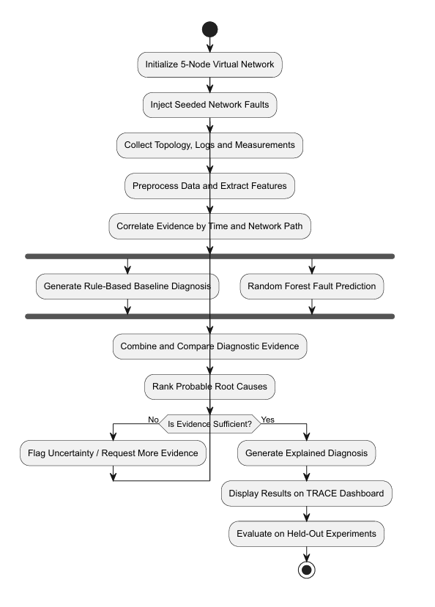
AIORI 3
Solution Architecture & Design
Architecture Design (UML Diagram)
Data Collection: Gather topology, logs and network measurements.
Feature Engineering: Clean data and extract relevant features.
Fault Detection: Compare rule-based diagnosis with Random Forest predictions.
Evidence Correlation: Rank probable root causes using network paths and diagnostic evidence.
Diagnosis & Evaluation: Explain results, flag uncertainty and evaluate performance.
  Figure: System Architecture UML Diagram
A3-PS035-TC026 · October 12, 2026

Slide 8
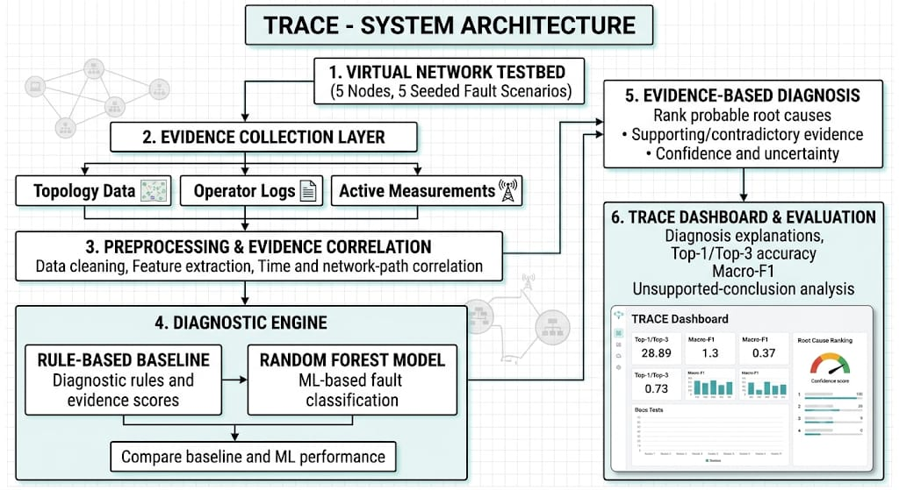
Data Flow Diagram
AIORI 3 Data Flow Diagram
Figure: Data Flow Diagram (DFD)
A3-PS035-TC026 · October 12, 2026

Slide 9
AIORI 3
Deployment Timeline
Deployment Timeline
Testbed setup: Configure five nodes and baseline connectivity.
Fault simulation: Implement five scenarios and collect data.
Feature engineering: Prepare labelled training and test datasets.
Model development: Build the baseline and Random Forest classifier.
Integration: Implement topology-aware analysis and dashboard.
Evaluation: Measure accuracy, macro-F1 and top-3 accuracy.
Methodology: Iterative development, controlled experiments and held-out testing.
A3-PS035-TC026 · October 12, 2026

Slide 10
Bibliography I
Bibliography
[1] IETF Hackathon — Network Fault Localisation
https://wiki.ietf.org/en/meeting/126/hackathon
[2] RFC 5424 — The Syslog Protocol
https://www.rfc-editor.org/rfc/rfc5424
[3] RFC 2680 — One-way Packet Loss Metric
https://www.rfc-editor.org/rfc/rfc2680
[4] RFC 8639 — Subscription to YANG Notifications
https://www.rfc-editor.org/rfc/rfc8639
A3-PS035-TC026 · October 12, 2026

Slide 11
Thank You
TRACE
Topology-aware Root-cause Analysis with Correlated Evidence
AIORI-3 Online Hackathon 2026
Team Code: A3-PS035-TC026

