Slide 1
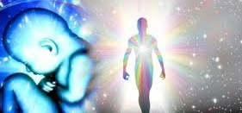
Reincarnation(rebirth)

Slide 2
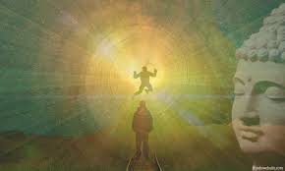
Do you believe in Rebirth?

Slide 3
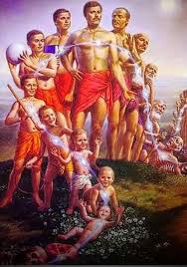
Introduction to Reincarnation
Reincarnation is the religious concept that the soul or spirit can be reborn into new bodies over multiple lifetimes.

Slide 4
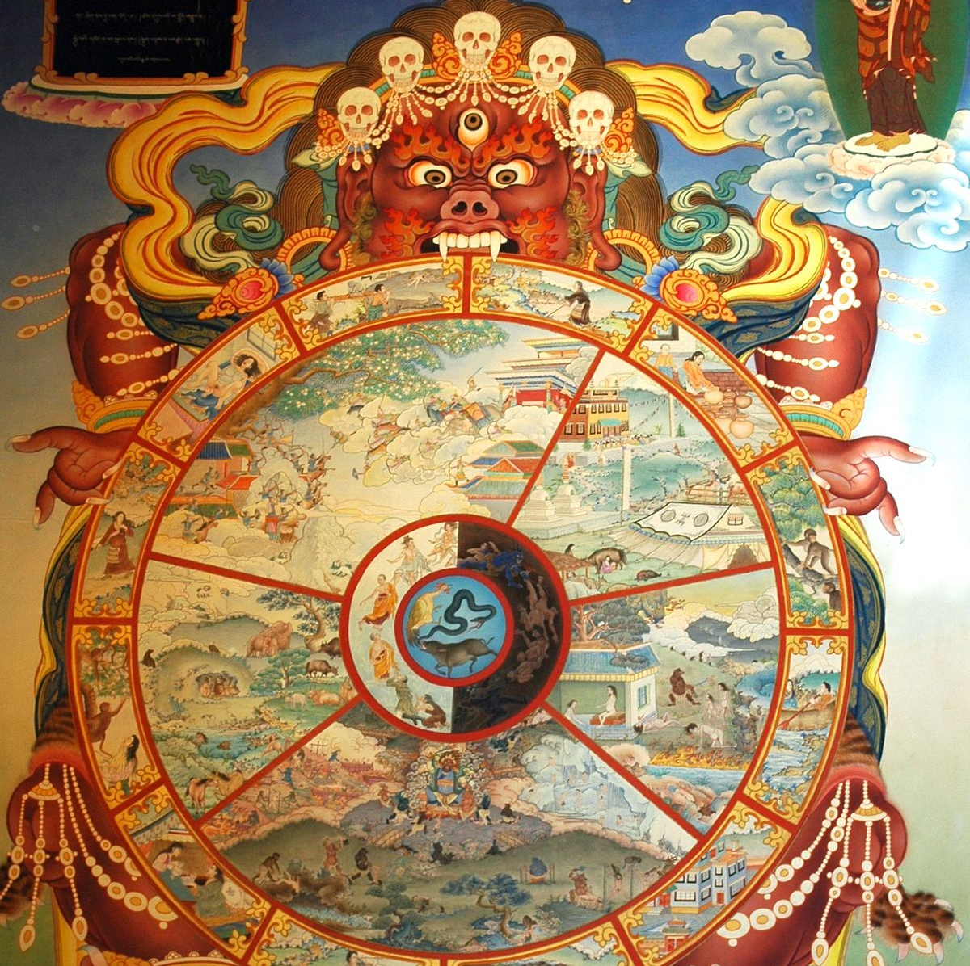
Beliefs in Hinduism
Hinduism views reincarnation as a fundamental concept.
The cycle of birth,death and rebirth is called ‘Samsara’.
Samsara is a continuous cycle in which the soul is reborn over and over again according to the law of action and reaction.

Slide 5
Samsara
“Just as a man discards old clothes and buys new ones
the man discards worn out bodies and enters new ones.”
– Bhagavatgita.

Slide 6
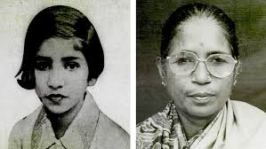

The story of Shanti Devi
Shanti Devi claimed to remember her past life in Mathura.
She recalled details from her previous life,leading to verification of her claims.
Her past life name was Shanti Devi who born as ‘lugdi’ in presentlife around 1925.

Slide 7
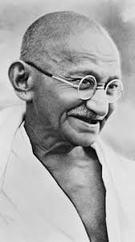
The story of Mahatma Gandhi
Gandhi believed in the principle of Karma.
His teachings often revolved around the concept of reincarnation.
He was very curious about shanti devi story and asked her to meet in person.
He made a ‘Committee of Inquiry’ of 15 members to prove the story of rebirth.

Slide 8
CONCLUSION
Reincarnation remains a deeply rooted belief in Indian culture and spirituality.
The diverse stories and beliefs enrich India’s cultural tapestry.
Through real-life examples like shanti devi we see how beliefs in past lives and karma continue to influence beliefs,behaviours, and cultural practices.

Slide 9

Thank You

