Slide 1
INSTRUCTIONS
Use Font size 22 to 28 and Font Style Times New Roman (body)
Do not change the Template: Heading / Title of the slides
Do not change font style or colours
Do not copy paste paragraphs: use only Bullet Points
Maximum slide Limit is 20 only
As per the number of supervisor allotted adopt slide-2 or slide-3
Please display the required meaningful Content or images or tables
Change the footer accordingly using insert tab then click on header & footer tab and edit it
Save the PPT with Register No, Dept and Review no, example: 23xxxxxxxxx_CSE

Slide 2

Title: Student Library Book Management Portal
Student Name: Yuktha Alumuri
Student ID: 2520090093
Cluster:04
Section: 15
Under the Guidance
of
Supervisor Name: Surekha.P
Assistant Professor
Department of CSE

Slide 3
OUTLINE
Abstract
Existing System
Proposed System
System Architecture
Project Modules
Objectives
Co’s Attainments - FWD
Co1
Co2 …….. 5. Co5
Co’s Attainments - DSA
Co1
Co2 …….. 5. Co5
Screen Shots for FWD & DSA
Conclusion
Geo-Tagged Photos

Slide 4
Abstract
The Trove — A Treasure of Books project is a web-based library management system designed to simplify the management of books, students, and library activities.
The website provides separate interfaces for admin and students, allowing efficient handling of library operations such as adding books, managing student records, issuing and returning books, and viewing library statistics.
The system also includes features like searching, filtering, notifications, book browsing, and student dashboards to improve user experience.

Slide 5
Existing System
Manual library management using registers
Book issuing and returning takes more time
Difficult to track available and issued books
No automated notification for due dates
Managing large number of books is difficult
Risk of data loss or record errors

Slide 6
Proposed System
Web based library management portal
Automated book issue and return process
Admin can manage books and student records
Students can search and browse books easily
Notification system for due dates
Dashboard for library statistics

Slide 7
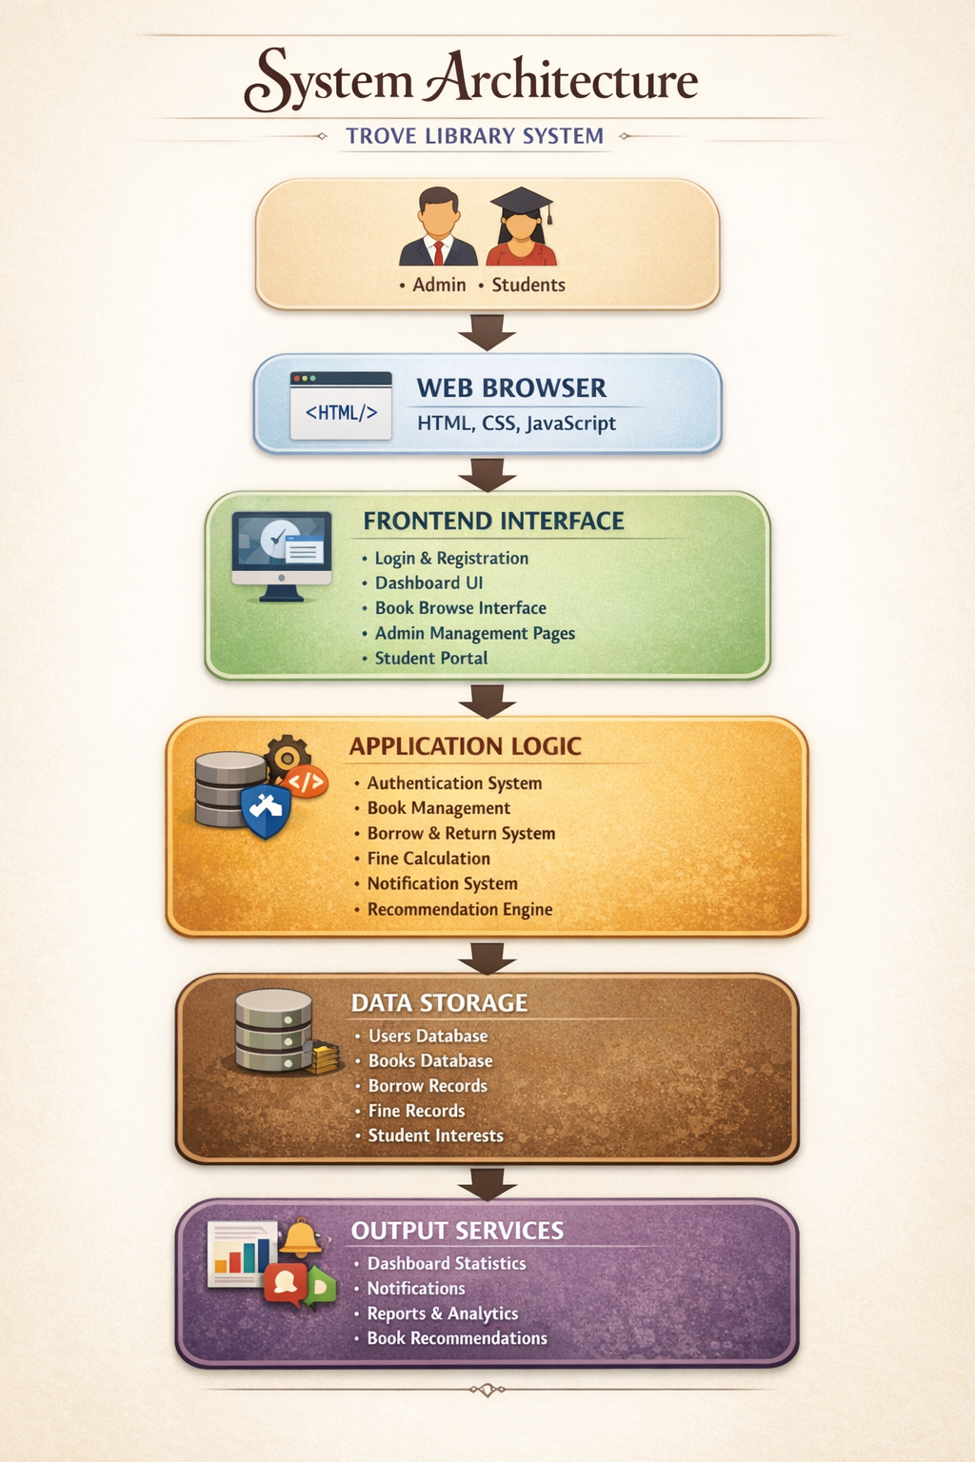
System Architecture

Slide 8
Project Modules
Authentication Module – Admin and student login
Admin Module – Manage books and student records
Book Management – Add edit delete books
Issue and Return Module – Track book transactions
Search Module – Search books by title or author
Notification Module – Alerts for due dates

Slide 9
Objectives
Digitize library management operations
Reduce manual work and paperwork
Provide quick access to book information
Improve tracking of issued and available books
Enhance user experience for students and admin

Slide 10
Co’s Attainments - FWD
CO1: Used HTML document structure, headings, paragraphs, links, and basic CSS styling (colors, typography, margin, padding, borders) to design the basic layout of the TROVE website.
CO2: Implemented HTML forms, semantic tags, tables, Flexbox/Grid layouts, media queries, and CSS transitions/animations to create responsive pages for login, student registration, and book management.
CO3: Applied JavaScript fundamentals such as variables, conditions, loops, functions, objects, and arrays to manage book data, user inputs, and website functionality.
CO4: Used DOM manipulation, event handling, browser storage (local Storage), and asynchronous features to dynamically update the interface and store user/book information.
CO5: Integrated JavaScript form validation, API/library usage (Chart.js), and optimized page structure to enhance interactivity and improve the overall performance of the TROVE web project.

Slide 11
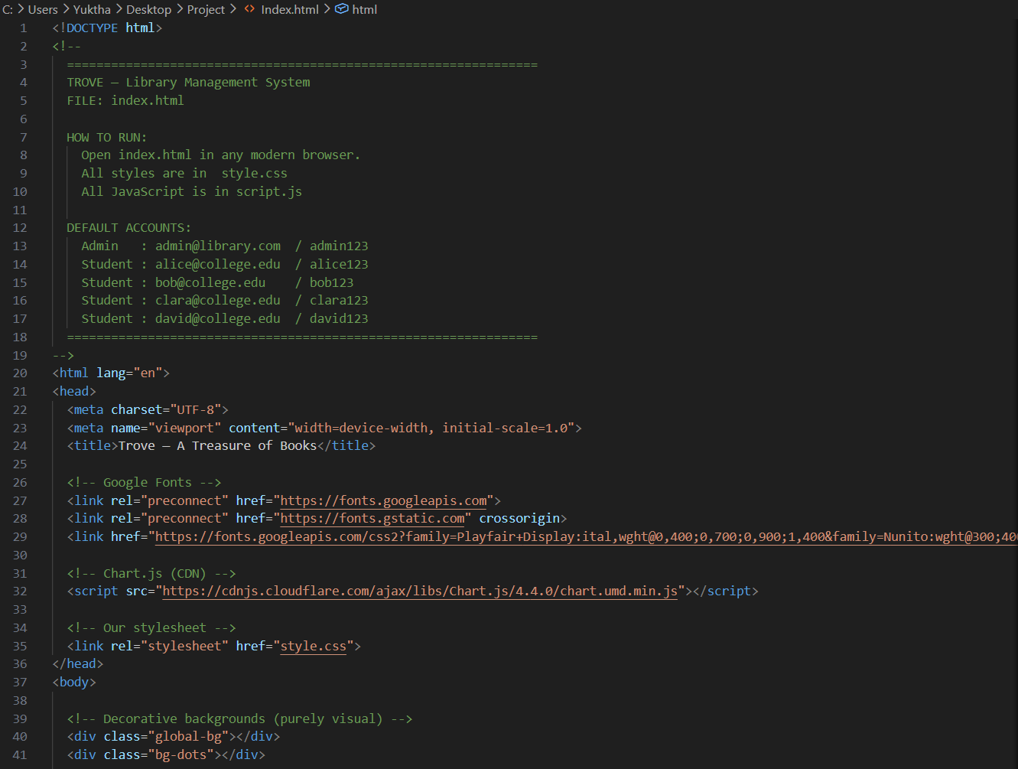
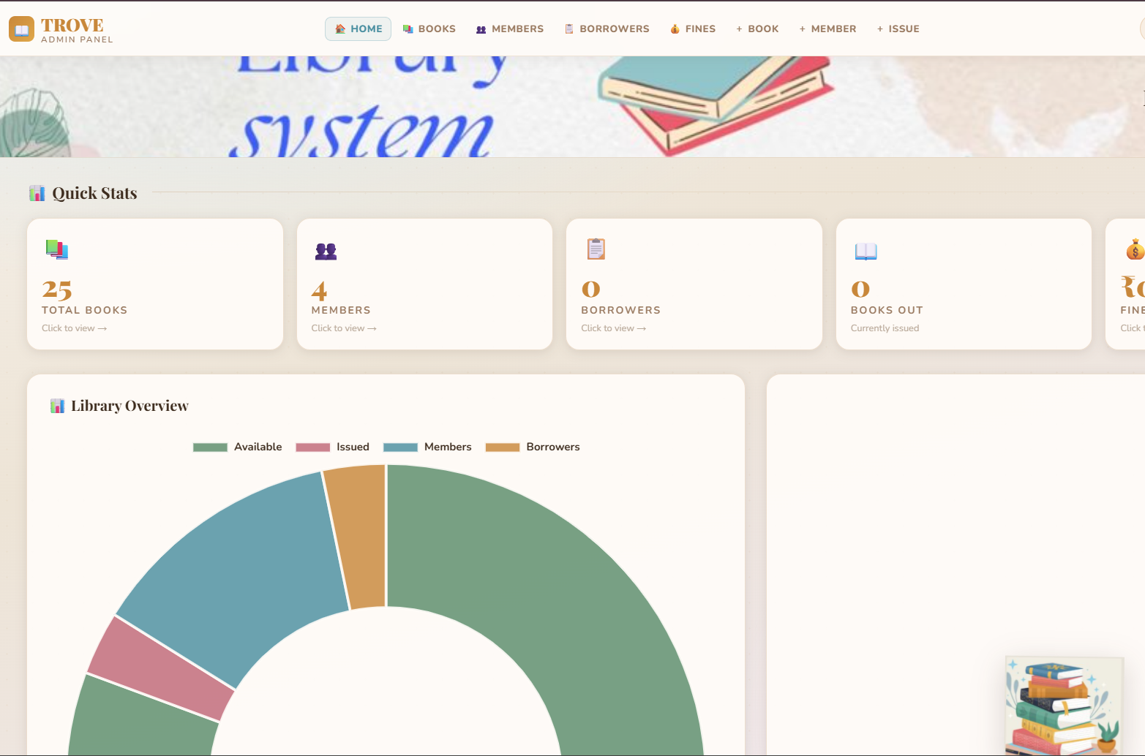
Screenshots for FWD

Slide 12
Conclusion
TROVE simplifies library management activities
Reduces manual work and improves accuracy
Provides easy access to library resources
Improves efficiency for admin and students
System can be enhanced with database integration

Slide 13
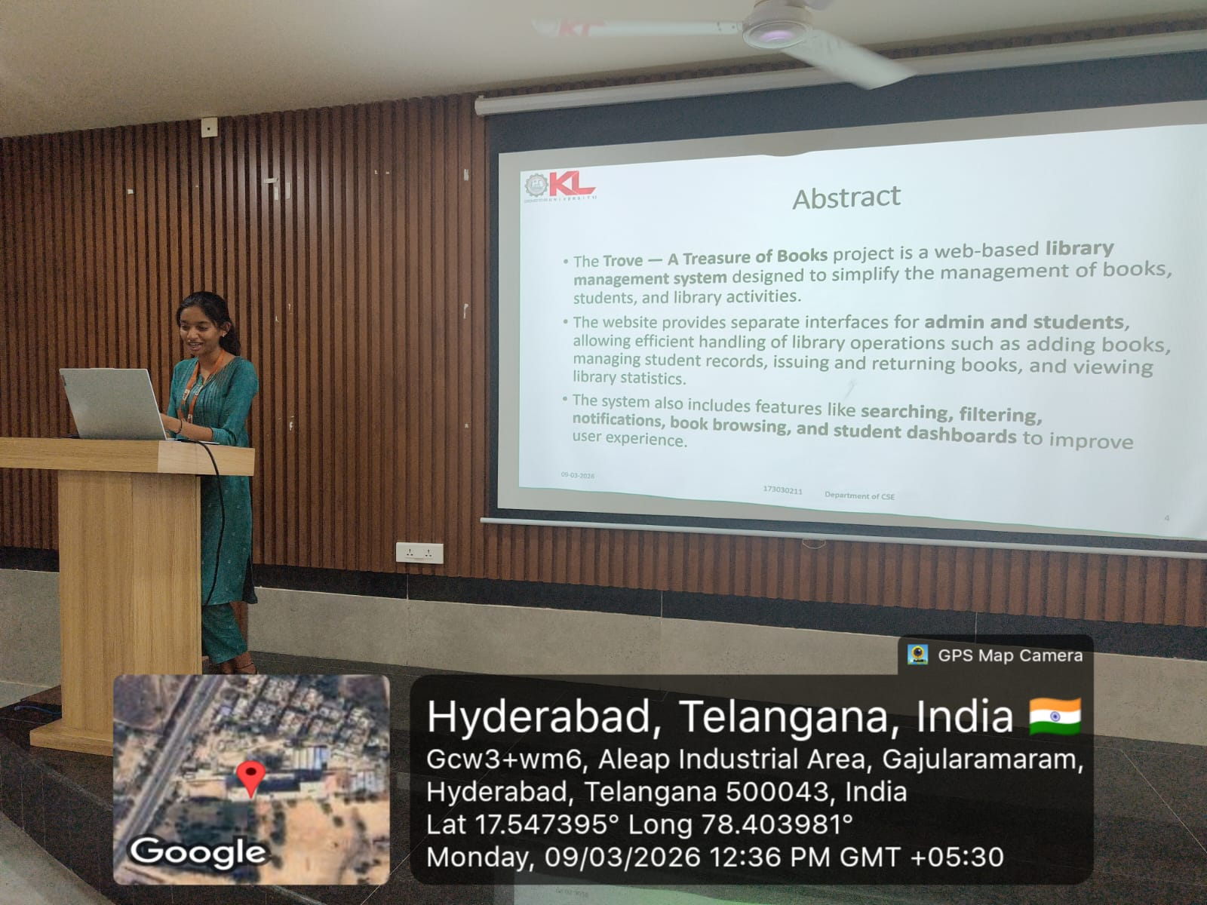
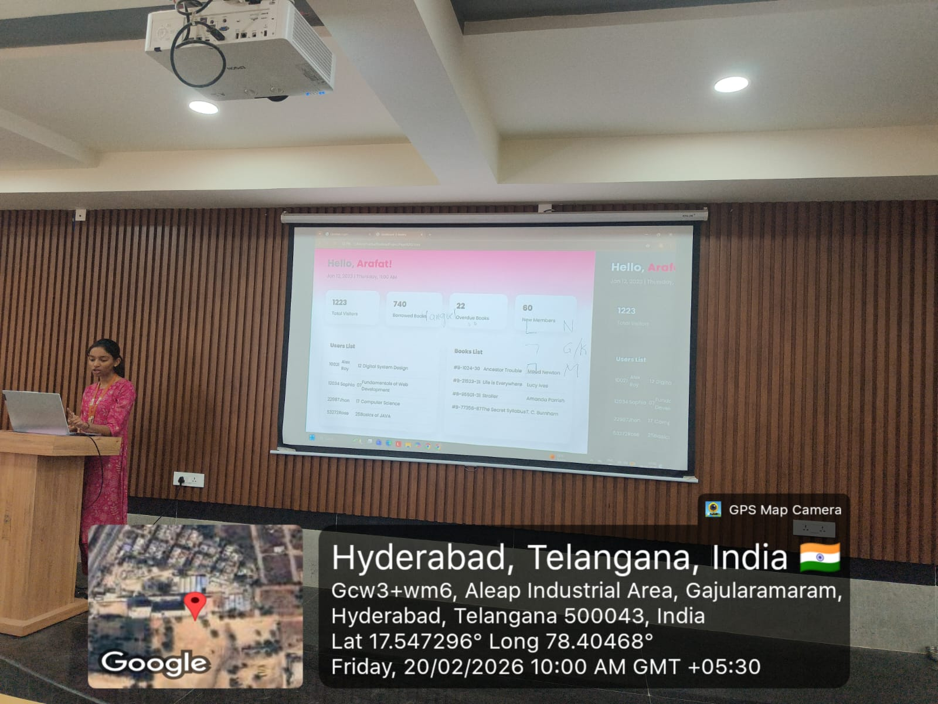
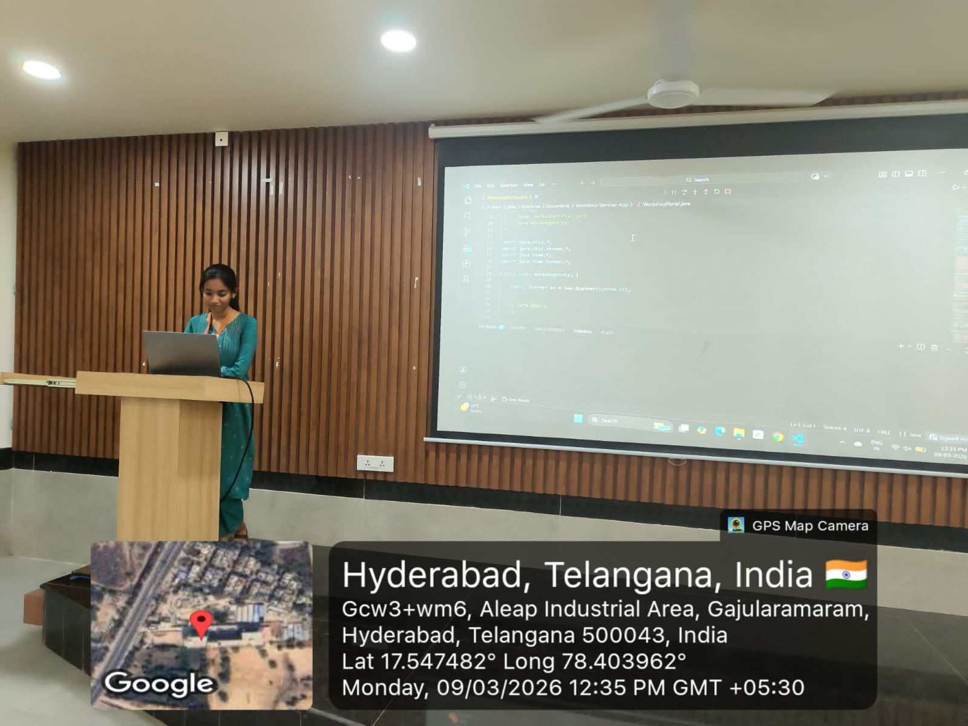
Geo- Tag Photos

Slide 14
THANK YOU

