Slide 1


SafeRoute
The AI-Powered Sentinel Network

Slide 2
THE CHALLENGE
Current navigation apps lack safety focus
They optimize for speed, completely ignoring unlit streets or danger zones.
Emergency response is too slow
Unlocking a phone, opening an app, and dialing takes precious seconds.
No real-time crowd intelligence
Users cannot see live threat zones or dispersing crowds ahead of time.

Slide 3
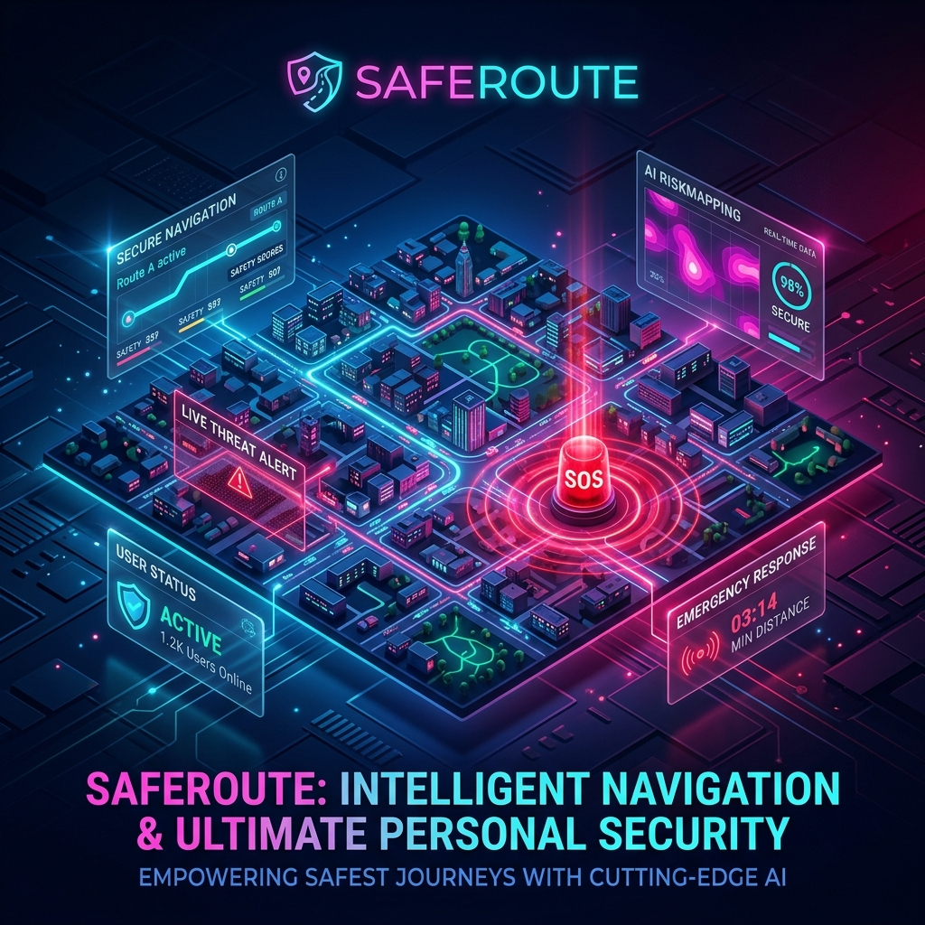
OUR SOLUTION
AI Threat Routing
Dynamically re-calculates paths to avoid identified 'Threat Zones'.
The Sentinel Network
A decentralized mesh of trusted contacts providing live updates.
ARIA (AI Guardian)
A built-in AI assistant that pre-scans zones for proactive defense.

Slide 4
TECHNOLOGY STACK
Frontend Application
React + Vite with advanced Glassmorphism UI.
Backend Systems
Python FastAPI + SQLite for high-speed data processing.
Critical Integrations
Twilio REST API for sub-second SOS SMS broadcasting.
Leaflet & OSRM for dynamic mapping.

Slide 5
LIVE DEMONSTRATION
1. Plot a Route
Showcase dynamic navigation and threat avoidance algorithms.
2. Trigger Guardian Pulse
Use the secret instant double-tap feature.
3. Real-World Alert
Receive physical Twilio SMS with live coordinates instantly.

