Slide 1
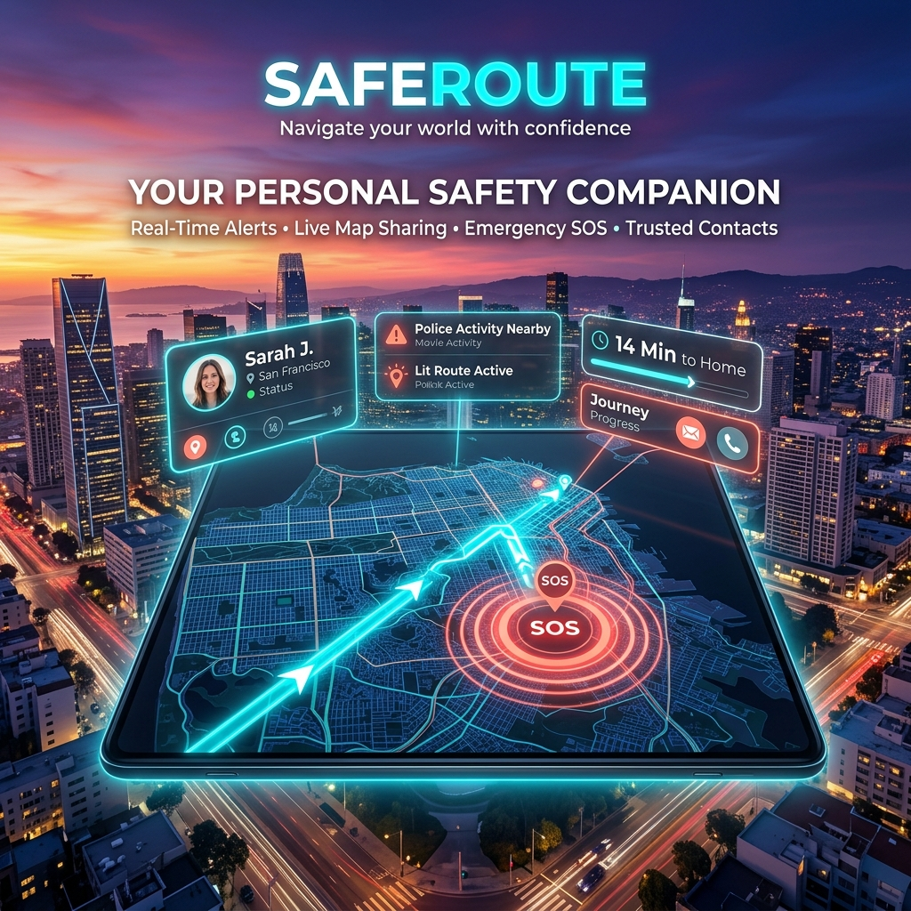
SafeRoute
The AI-Powered Sentinel Network

Slide 2
The Problem
Current navigation apps optimize for speed, completely ignoring safety.
In emergencies, unlocking a phone and opening an app takes too long.
Users have no real-time visibility into crowd behaviors or unlit streets.

Slide 3
The Solution
AI Threat Routing:
Re-calculates routes dynamically to avoid known 'Threat Zones'.
The Sentinel Network:
A decentralized mesh of trusted contacts and nearby users.
ARIA (AI Guardian):
A built-in AI assistant that pre-scans zones for danger.

Slide 4
The Tech Stack
Frontend
React + Vite
Tailwind CSS (Glassmorphism)
Backend & Integrations
Python FastAPI + SQLite
Twilio REST API (Instant SOS)
Leaflet & OSRM (Dynamic Maps)

Slide 5
Live Demo
1. Plot a Route
Showcase dynamic navigation and threat avoidance.
2. Trigger Guardian Pulse
Use the instant double-tap feature.
3. Real-World Alert
Receive physical Twilio SMS with live coordinates instantly.

