Slide 1

THE STOCK PREDICTOR
GUIDED BY
Mrs. SWARNA LATHA. P
PRESENTED BY
TRISHA SOWMIKA. A (03)
RAKSHITHA RAO. N (39)
SAI VINAY. P (47)
SANTANU SUDHANSU SEKHAR (50)

Slide 2
DOMAIN
MACHINE LEARNING

Slide 3

OBJECTIVE
Stock market as we know, is a very important trading platform which affect everyone at an individual and national level. The basic principle is quite simple, Companies will list their shares in the companies as small commodities called Stocks. They do so in order to raise money for the firm. A company lists its stock at a price called the IPO or initial public offering. This is the offer price at which the company sells the stock and raises money.

Slide 4

ABSTRACT
Impact of many factors on the stock prices makes the stock prediction a difficult and highly complicated task. In this project, We propose Linear Regression, Random Forest Regressor ,Decision Tree Regressor,SVR,Lasso Regression,Ridge Regressor for the stock price .Prediction in order to over come such difficulties. It is easy to predict the stock market trends and estate the prices by using the proposed methods. KNN is used to predict future stock market indices by computing k-weighted nearest neighbor from the historical dataset.

Slide 5

INTRODUCTION
Predicting the Stock Market has been the bane and goal of investors since its existence. Everyday billions of dollars are traded on the exchange, and behind each dollar is an investor hoping to profit in one way or another. Entire companies rise and fall daily based on the behavior of the market. Should an investor be able to accurately predict market movements, it offers a tantalizing promises of wealth and influence.

Slide 6
Literature Survey
[1] E. F. Fama, Efficient Capital Markets: A Review of Theory and Empirical Work. Journal of Finance, Volume 25, Issue 2, Papers and Proceedings of the Twenty-Eighth Annual Meeting of the American Finance Association, New York, N.Y. pp. 383-417, May 1970.
[2] R. A. Haugen, The New Finance: The Case Against Efficient Markets, Prentice Hall, 1999.
[3] C. A. Los, Nonparametric efficiency testing of Asian markets using weekly data. Advances in Econometrics, volume 14, pp. 329-363, 2000.
[4] J. J. Murphy, Technical Analysis of the Financial Markets, New York Institute of Finance, 1999.
[5] T. M. Cover and P. E. Hart, Nearest neighbor pattern classification, IEEE Trans. Inform. Theory, vol. 13, pp. 21-27, 1967.

Slide 7
DRAWBACKS
Stock prices prediction is interesting and challenging research topic. Developed countries' economies are measured according to their power economy. Currently, stock markets are considered to be an illustrious trading field because in many cases it gives easy profits with low risk rate of return

Slide 8
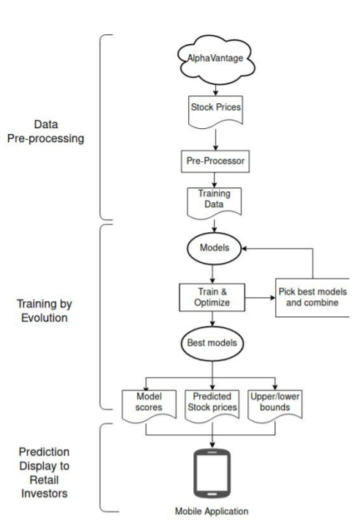
PROPOSED SYSTEM
In this project, We propose Linear Regression, Random forest, Decision Tree, SVR, Lasso, Ridge for the stock price
Prediction in order to over come such difficulties. It is easy to predict the stock market trends and estate the prices by using the proposed methods.

Slide 9
ALGORITHMS
Linear Regression
Random Forest Regressor
Decision Tree Regressor
SVR
Lasso Regression
Ridge Regressor

Slide 10
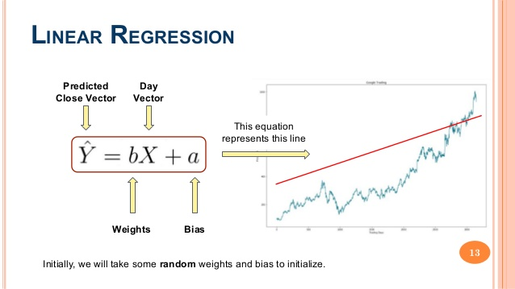
LINEAR REGRESSION
Linear regression is a statistical Technique use to predict the relationship between the dependent and independent variable and is represented as V=Y+WX where V is the dependent variable and X is the independent variable, Y is a constant and W is the slope of the regression line.

Slide 11
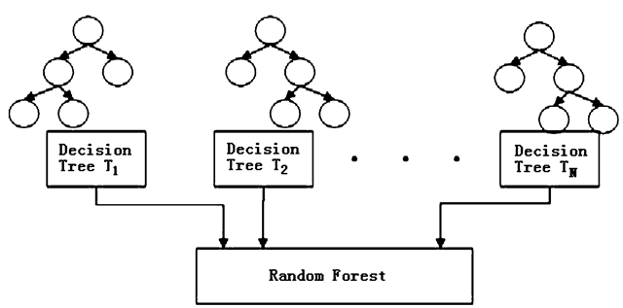
RANDOM FOREST
The accuracy of ensemble models is better than the accuracy of individual models due to the fact that it compiles the results from the individual models and provides a final outcome.

Slide 12
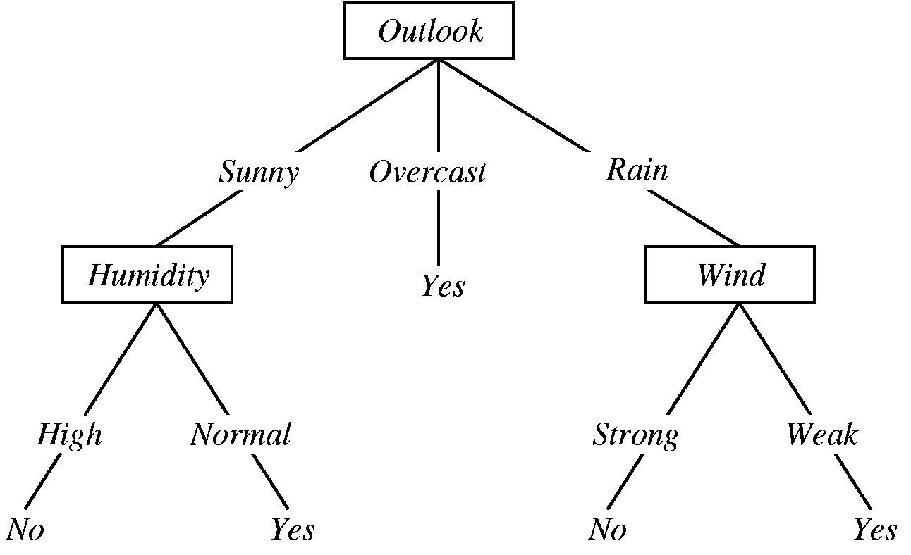
Decision Tree Regressor
A decision tree is a flowchart-like structure in which each internal node represents a test on a feature, each leaf node represents a class label and branches represent conjunctions of features that lead to those class labels. The paths from root to leaf represent classification rules.

Slide 13
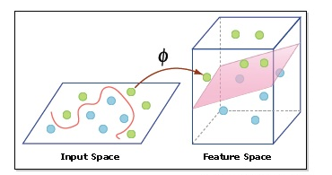
SVR
As in classification, support vector regression (SVR) is characterized by the use of kernels, sparse solution, and VC control of the margin and the number of support vectors. Although less popular than SVM, SVR has been proven to be an effective tool in real-value function estimation.

Slide 14
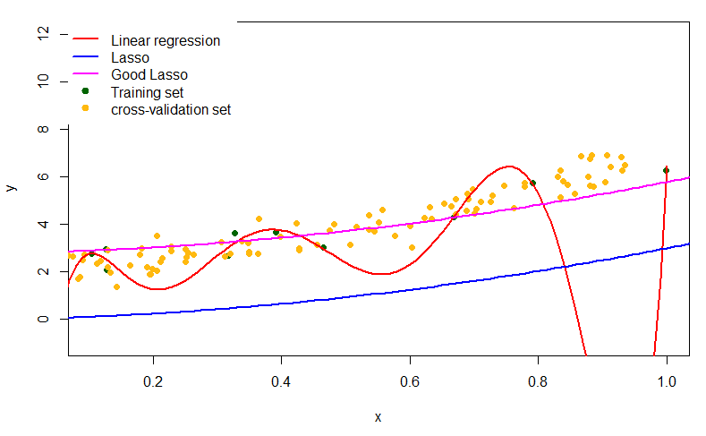
Lasso Regression
Lasso regression is a type of linear regression that uses shrinkage. Shrinkage is where data values are shrunk towards a central point, like the mean. The lasso procedure encourages simple, sparse models

Slide 15
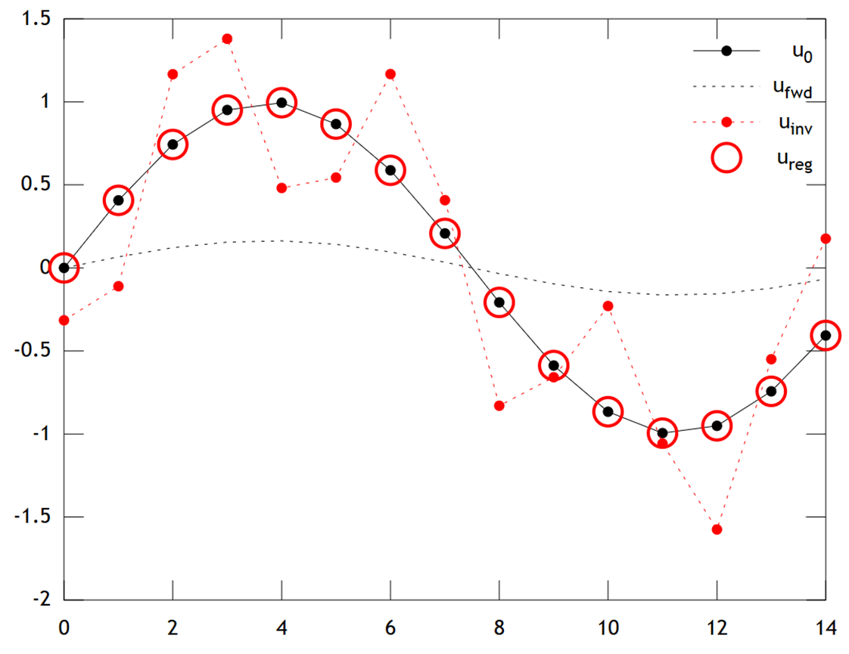
Ridge Regressor
Ridge regression is a way to create a parsimonious model when the number of predictor variables in a set exceeds the number of observations, or when a data set has multicollinearity

Slide 16
SOFTWARE REQUIREMENTS
Operating system : Windows 7,8,10.
Coding Language : python
IDE navigator : anaconda navigator
Browser : google chrome

Slide 17
HARDWARE REQUIREMENTS
System : Pentium IV 2.4 GHz Or above.
Hard Disk : 500 GB.
Ram : 2 GB.

Slide 18

UML DIAGRAM

Slide 19
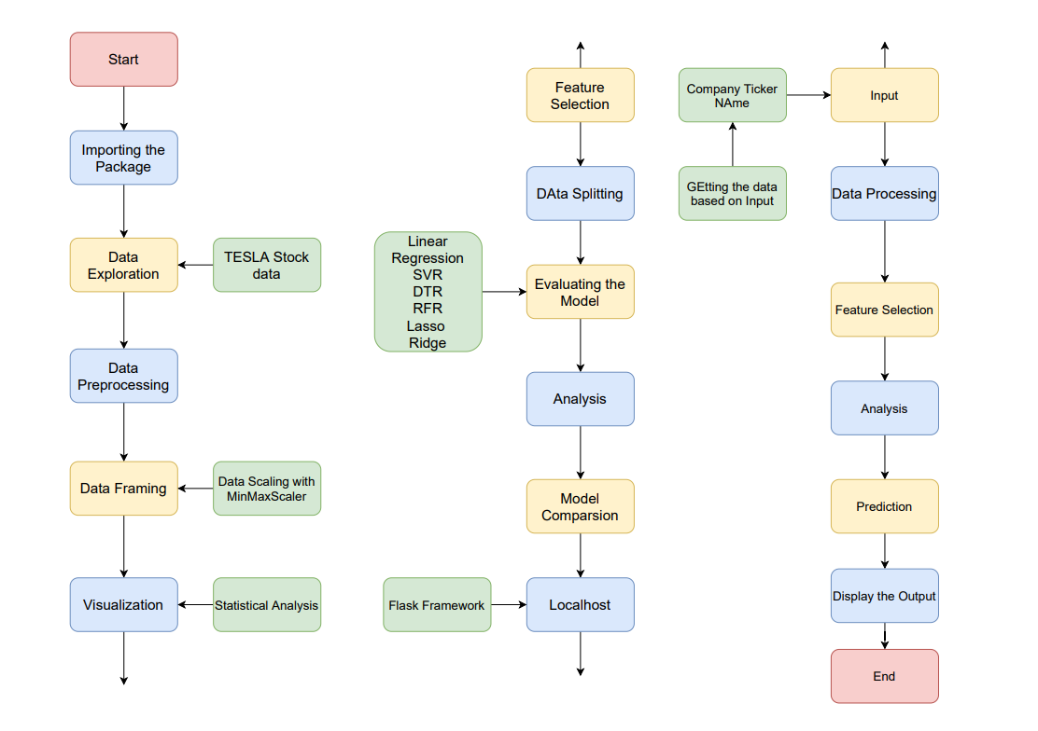
State chart Diagram

Slide 20
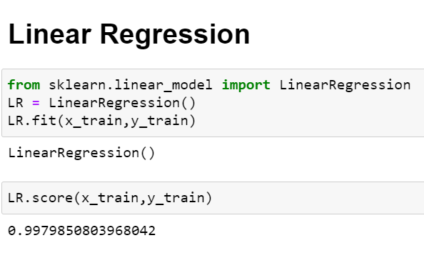
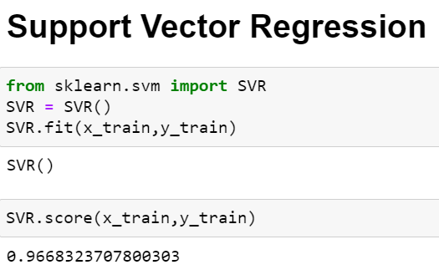
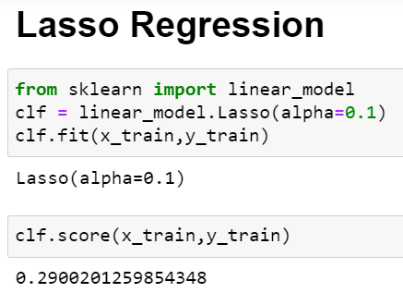
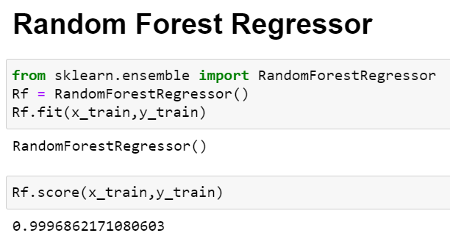
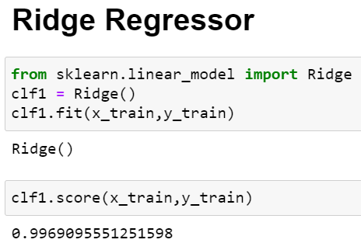
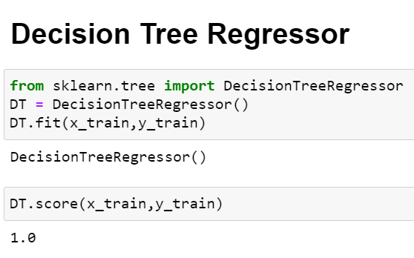
Code snippets:

Slide 21

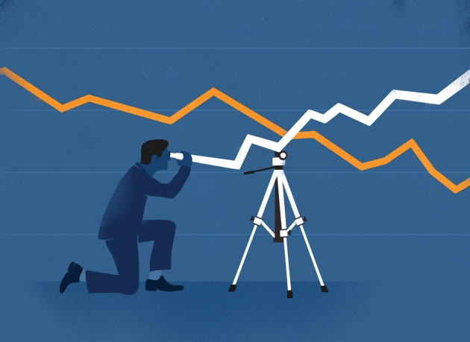

Slide 22
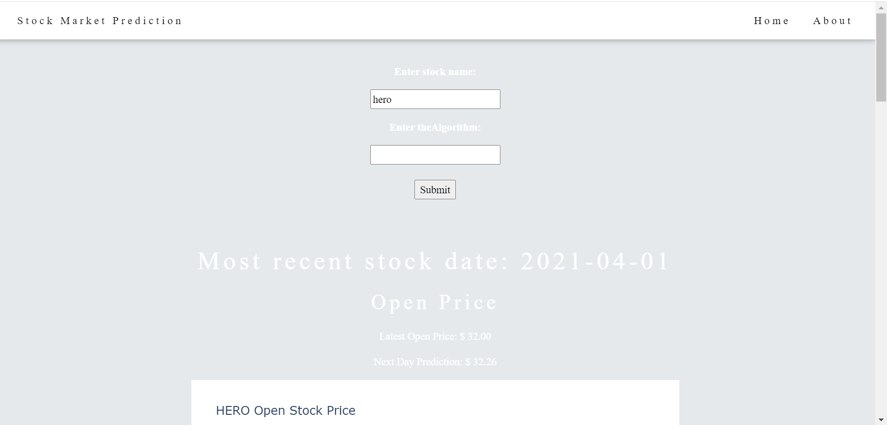
Entry Feilds

Slide 23
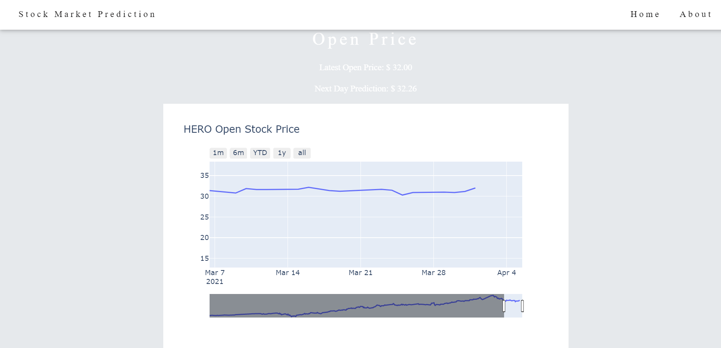
Open Stock Price

Slide 24
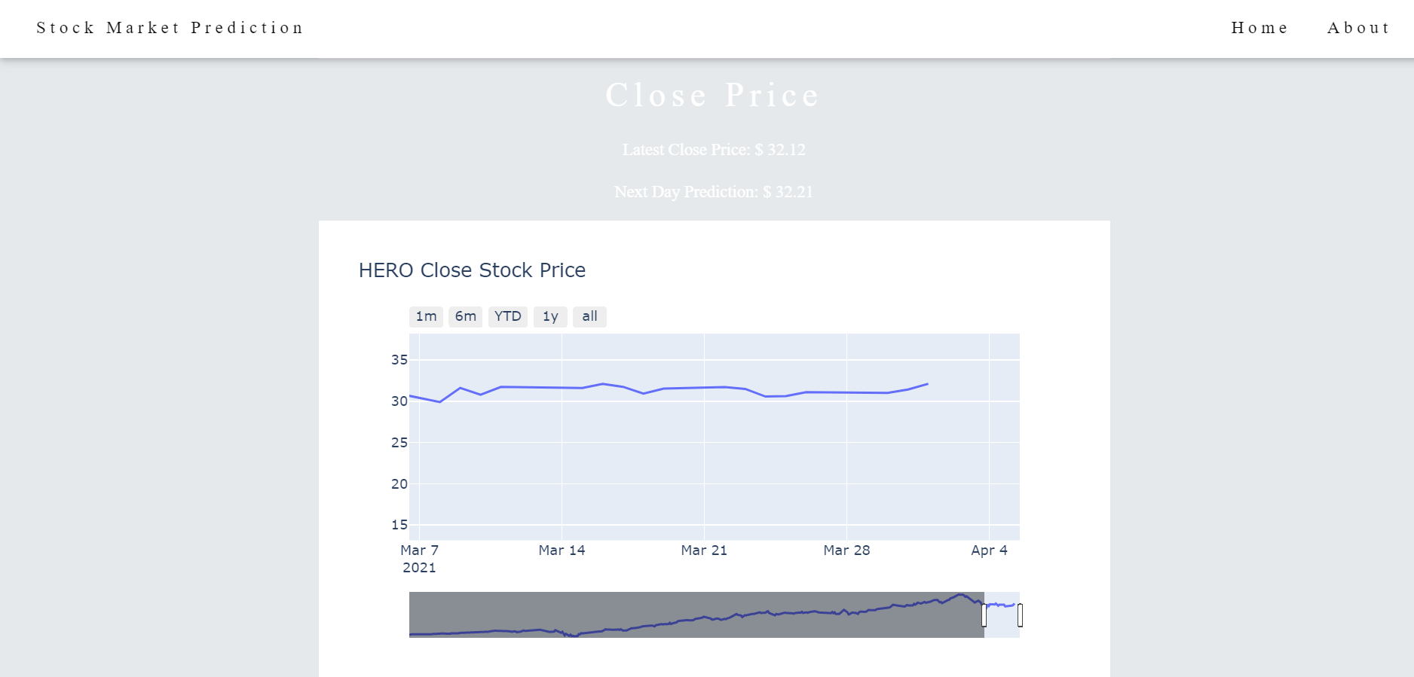
Close Stock Price

Slide 25
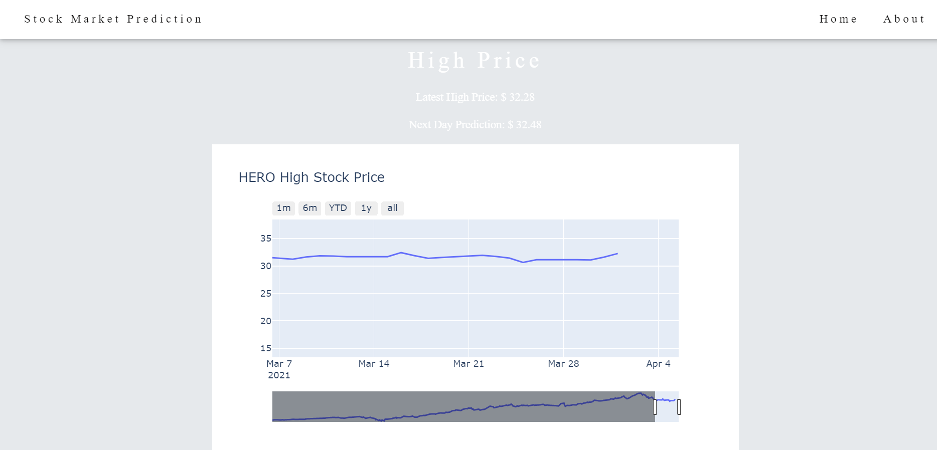
High Stock Price

Slide 26
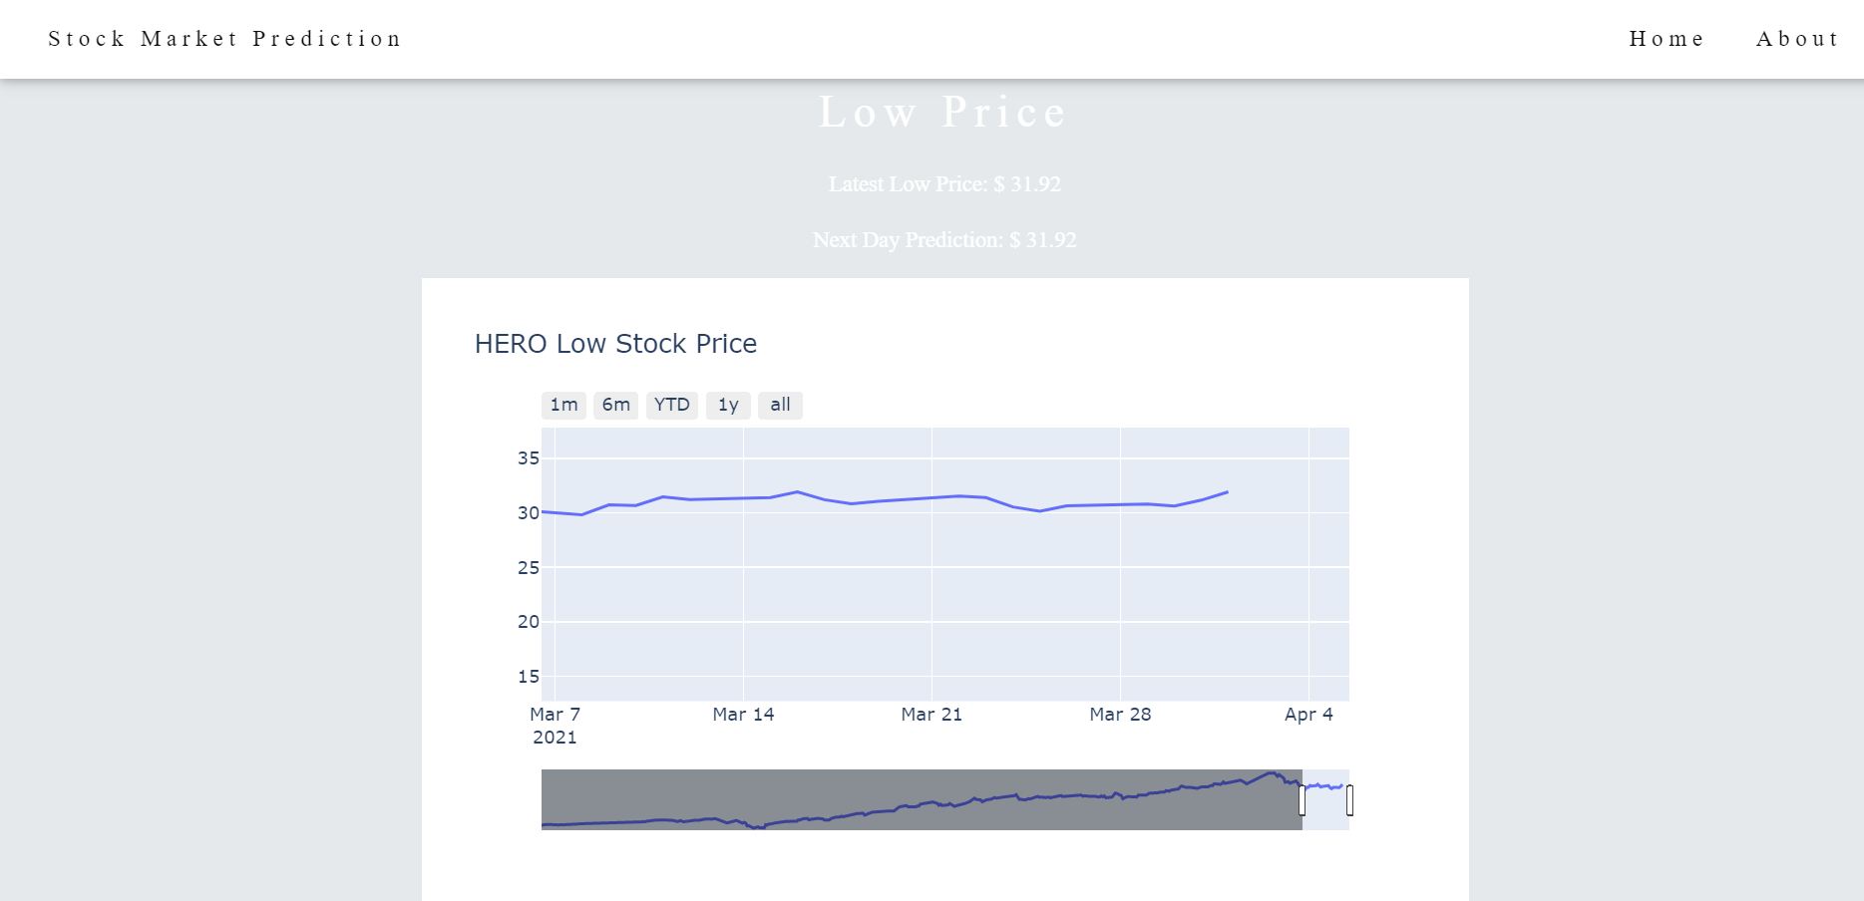
Low Stock Price

Slide 27
REFERENCES
[1] E. F. Fama, Efficient Capital Markets: A Review of Theory and Empirical Work. Journal of Finance, Volume 25, Issue 2, Papers and Proceedings of the Twenty-Eighth Annual Meeting of the American Finance Association, New York, N.Y. pp. 383-417, May 1970.
[2] R. A. Haugen, The New Finance: The Case Against Efficient Markets, Prentice Hall, 1999.
[3] C. A. Los, Nonparametric efficiency testing of Asian markets using weekly data. Advances in Econometrics, volume 14, pp. 329-363, 2000.
[4] J. J. Murphy, Technical Analysis of the Financial Markets, New York Institute of Finance, 1999.
[5] T. M. Cover and P. E. Hart, Nearest neighbor pattern classification, IEEE Trans. Inform. Theory, vol. 13, pp. 21-27, 1967.
[6] Y. Kwon and B. Moon, A Hybrid Neurogenetic Approach for Stock Forecasting, IEEE Transactions on Neural Networks, Vol. 18, No. 3, pp. 851-864, 2007.
[7] H. White, Economic prediction using neural networks: a case of IBM daily stock returns, IEEE Int. Conference on Neural Networks, vol. 2, pp. 451-458, 1988.

Slide 28






Thank you

