Slide 1
LLM Recommender - Data Flow Diagram (DFD)
Caze Labs | Avial-AI-002

Slide 2
System Overview
The LLM Recommender takes user input (prompt or file), processes it, and suggests the most suitable large language models (LLMs) for the use case. The backend handles parsing, summarization (if needed), and recommendation based on a metadata database.

Slide 3
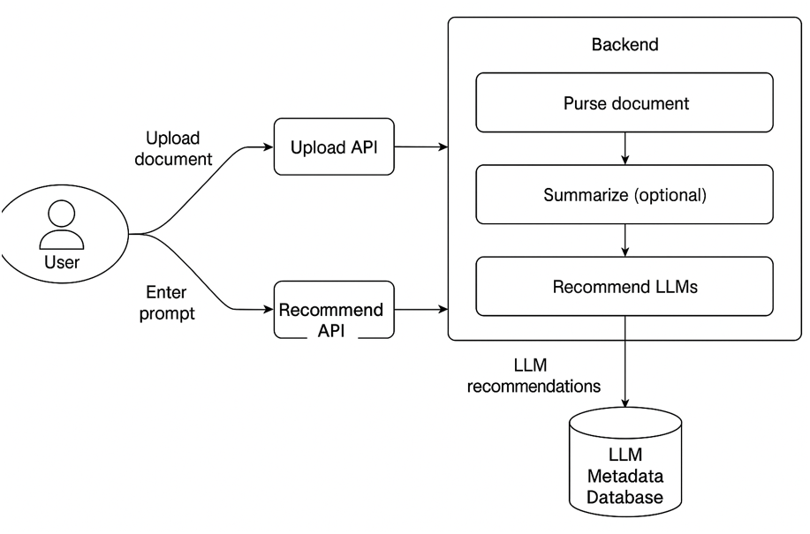
Data Flow Diagram (DFD)

Slide 4
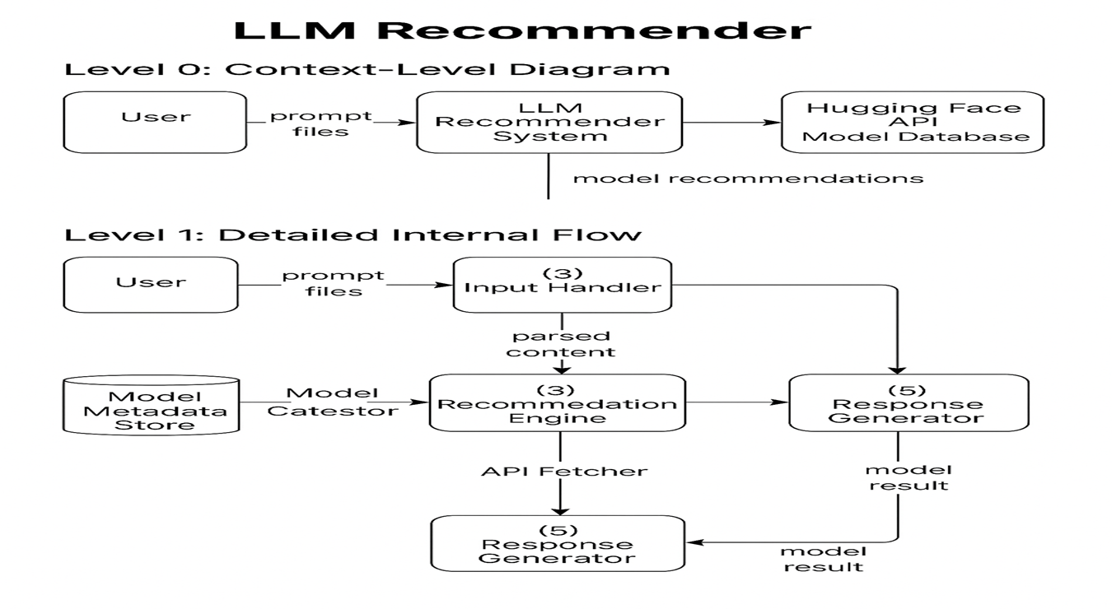
Pase 2

