Slide 1
HIBERNATE

Slide 2
Index
What is Hibernate ?
Persistence Objects
Configuration
Execution and Programming with Hibernate

Slide 3
General DB Interactions WAY
Load the RDBMS specific JDBC driver because this driver actually communicates with the database.
Open the connection to database which is then used to send SQL statements and get results back.
Create JDBC Statement object. This object contains SQL query.
Execute statement which returns resultset(s). ResultSet contains the tuples of database table as a result of SQL query.
Process the result set.
Close the connection.

Slide 4
Hibernate WAY
itself opens/close connection to database,
converts HQL (Hibernate Query Language) statements to database specific statement.
receives result set.
then performs mapping of these database specific data to Java objects which are directly used by Java application.
Reduce Database hits with help of Cache mechanism
Little modification is needed in your java application for any change in database.

Slide 5
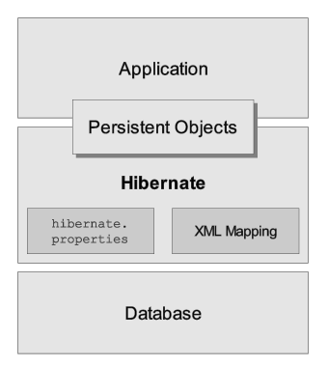
What IS HIBERNATE
Hibernate basically sits between the DB and your code
Object-Relational Mapping(ORM) solution for JAVA
maps Java classes to database tables and from Java data types to SQL data types
open source persistent framework

Slide 6
Why Use Hibernate?
Work with classes and objects instead of queries and result sets
– More OO, less procedural
Strong support for caching
Handles all create-read-update-delete (CRUD) operations using simple API; no SQL
Does not require any web server/Application server to run
Supports over 20 RDBMS; change the database by tweaking configuration files

Slide 7
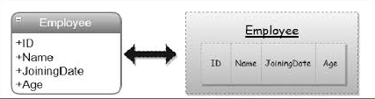
Object(Class) Mapping

Slide 8
Supported Databases
few of the database engines supported by Hibernate:
HSQL Database Engine
DB2/NT
MySQL
PostgreSQL
FrontBase
Oracle
Microsoft SQL Server Database
Sybase SQL Server
Informix Dynamic Server

Slide 9
Configuration
Database Connection: handled through one or more configuration files supported by Hibernate.
Class Mapping Setup: component creates the connection between the Java classes and database tables

Slide 10
Key Hibernate Classes
Configuration – uses mapping and database connection metadata to create SessionFactory
SessionFactory – thread-safe cache of compiled mappings for database; created once at application startup (expensive)
Session – represents a “conversation” between application and database; holds 1st level cache of objects

Slide 11
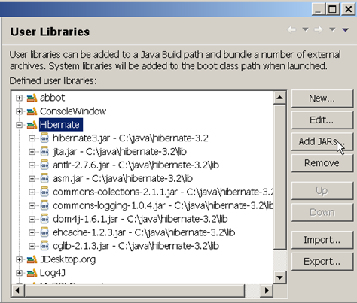
Create a Hibernate Library in Eclipse
1. Project -> Properties -> Java Build Path
2. select Libraries tab.
3. Click "Add Library..." and select "User Library", Next>
4. Create a new user library named "Hibernate"
5. Add Jar files

Slide 12
Add Library or jar for Database Driver
For Embedded Derby Database
/path-to-derby/lib/derby.jar
For MYSQLDB
/path-to-mysqldb/lib/mysql-connector-java-5.1.20-bin.jar

Slide 13
hibernate.cfg.xml for MySQL
<?xml version='1.0' encoding='utf-8'?>
<!DOCTYPE hibernate-configuration PUBLIC
"-//Hibernate/Hibernate Configuration DTD 3.0//EN"
"http://hibernate.sourceforge.net/hibernate-configuration-3.0.dtd">
<hibernate-configuration>

Slide 14
Continued …
<session-factory>
<!-- Database connection settings -->
<property name="connection.driver_class">com.mysql.jdbc.Driver</property>
<property name="connection.url">jdbc:mysql://localhost:3306/hibernatedemo</property>
<property name="connection.username">ericsson</property>
<property name="connection.password">ericsson</property>

Slide 15
First HIBERNATE EXAMPLE

Slide 16
CRUD
INSERT
UPDATE
SELECT
DELETE

Slide 17
Hibernate Object States
Transient
Persistent
Detached

Slide 18
NamedQueries
technique to group the HQL statements in single location.
can be accessed and used from several places which increase re-usability.
named query and prints the informations based on the query.
isolate all the queries with unique name

Slide 19
CRITERIA
used to fetch the records based on the specific criteria.
object of Criteria can be obtained by calling the createCriteria() method of Session interface.

Slide 20
Entity Relationships
Unidirectional one-to-one
ex. EMPLOYEE 1--->1 Phones
Bidirectional one-to-one
ex. EMPLOYEE 1 <--->1 Phones
Unidirectional one-to-many
ex. Address 1 --->* EMPLOYEE
Bidirectional one-to-many
Bidirectional many-to-one
ex. Address 1<--->* EMPLOYEE
Unidirectional many-to-many
ex. EMPLOYEE *--->* CERTIFICATION
Bidirectional many-to-many
ex. EMPLOYEE *<--->* CERTIFICATION

Slide 21
ONE TO ONE
TABLE A has one to one relationship with TABLE B if
each row in TABLE A is Linked to each row in TABLE B
Number of rows in TABLE A= Number of rows in TABLE B

Slide 22
MANY TO ONE
TABLE A has many to one relationship with TABLE B if
many record in TABLE A can be Linked with a single record in TABLE B
TABLE B has one to many relationship with TABLE A if
single record in TABLE B can be Linked with 0, 1 or many records in TABLE A

Slide 23
MANY TO MANY
TABLE A has many to many relationship with TABLE B if
0, 1 or many records in TABLE A can be Linked with 0, 1 or many records in TABLE B.

Slide 24
Hibernate CACHE
First Level Cache
session
Second Level Cache
Across Sessions in an application
Across Applications
Across Cluster

