Slide 1
Nosql Mongo DB
Fundamental and Basics
Raghav Krishna Agarwal
7th September 2016

Slide 2
Agenda
What is NoSQL
Why NoSQL
NoSQL Pros AND Cons
Overview MongoDB
RDBMS and MongoDB
CRUD Operations
SQL vs MongoDB
References

Slide 3
What is NOSQL
NOSQL - Defined by what it is Not
“Any database that is not a Relational Database”
The term was coined at a meetup with the creators behind some prominent emerging databases
“Non-Relational Databases” might be more correct
But it’s a mouthful!
Then there was a conference, and here we are with the name
‘NOSQL’ (NO to SQL), It’s not about saying that SQL should never be used, or that SQL is dead...
Not Only SQL, It’s about recognizing that for some problems other storage solutions are better suited!

Slide 4
why NOsql
WE ARE STORING MORE DATA NOW THAN WE EVER HAVE BEFORE
CONNECTIONS BETWEEN OUR DATA ARE GROWING ALL THE TIME
WE DON’T MAKE THINGS KNOWING THE STRUCTURE FROM DAY 1
SERVER ARCHITECTURE IS NOW AT A STAGE WHERE WE CAN TAKE ADVANTAGE OF IT

Slide 5
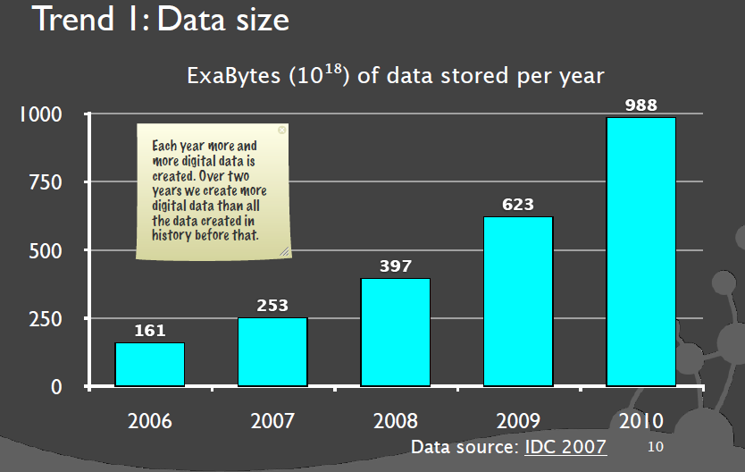


Data Trend analysis

Slide 6
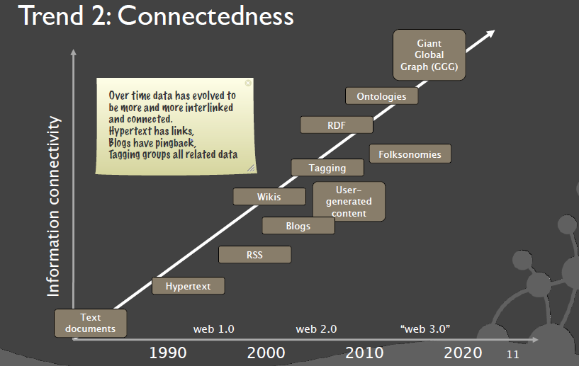
Connectedness

Slide 7
Nosql Use Cases
LARGE DATA VOLUMES
MASSIVELY DISTRIBUTED ARCHITECTURE REQUIRED TO STORE THE DATA
EXTREME QUERY WORKLOAD
IMPOSSIBLE TO EFFICIENTLY DO JOINS AT THAT SCALE WITH AN RDBMS
SCHEMA EVOLUTION
SCHEMA FLEXIBILITY IS NOT TRIVIAL AT A LARGE SCALE BUT IT CAN BE WITH NO SQL
GOOGLE, AMAZON, FACEBOOK, 100K SERVERS

Slide 8
NOSQL PROS AND CONS
PROS
Massive Scalability
High Availability
Schema Flexibility
CONS
Limited Query Capabilities
Not Standardized
Still a developing technology
Lower Cost
High read and write throughput
it’s faster than SQL
Lack of relations from one key to another

Slide 9
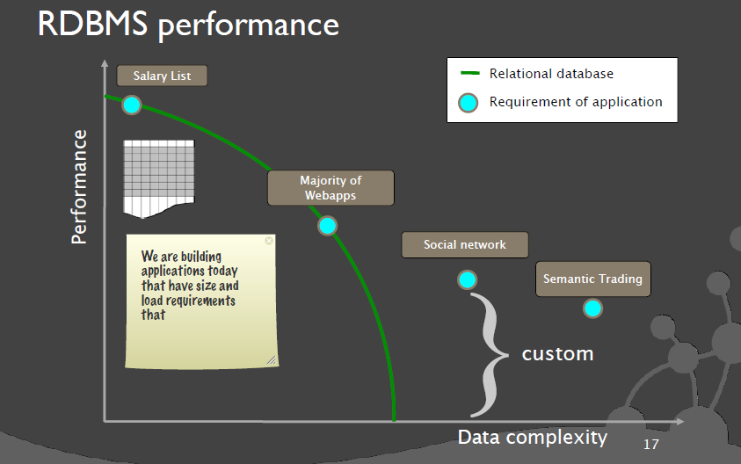
When to use nosql

Slide 10
MongoDB Overview
Emerging Trends in NoSQL Databases
BIGTABLE
e.g. Hbase, Hypertable, Cassandra etc.
KEY VALUE
e.G Dynomite, Voldermort, Tokyo etc.
GRAPHDB
e.g. AllegroGraph, Neo4j etc.
DOCUMENT
e.g. Redis, CouchDB, MonogoDB etc.

Slide 11
MongoDB Overview
MongoDB is an open-source document database and leading NoSQL database
Stores data in JSON format
Support nested looping
Document enclosed in circular braces
JSON supports Numbers, Strings, Objects, Array
Sample Document
{
_id: ObjectId(7df78ad8902c)
a: ‘1’,
b: ‘2’
}

Slide 12
RDBMS and MongoDB
Database
Physical Container of Collection
Collections
Collection is a group of MongoDB documents
Equivalent of an RDBMS table
Document
Set of key-value pairs
Documents have dynamic schema
Collections do not enforce a schema
It is simple RDMBS database
Field
Equivalent to RDBMS column
Equivalent to RDBMS table rows

Slide 13
CRUD Operations
Create DB and Collections
To display the database you are using, type db
By default it shows `test`, which is default database
You can switch to non-existing databases. When you first store data in the database, such as by creating a collection, MongoDB creates the database

Slide 14
CRUD Operations
Example:
Following creates both the database myNewDatabase and the collection myCollection during the insert() operation:
use myNewDatabase;
db.myCollection.insert( { x: 1 } );

Slide 15
CRUD Operations
Insert Documents
MongoDB provides the following methods for inserting documents
db.collection.insertOne()
db.collection.insertMany()
db.collection.insert()

Slide 16
CRUD Operations
Example:
db.users.insertMany(
... [
... { name: "bob", age: 42, status: "A", },
... { name: "ahn", age: 22, status: "A", },
... ]
... )
Output:
{
"acknowledged" : true,
"insertedIds" : [
ObjectId("57cd3a3a08a47317844a320c"),
ObjectId("57cd3a3a08a47317844a320d"),
]
}

Slide 17
CRUD Operations
Query Document
MongoDB provides the db.collection.find() method to read documents from a collection
Syntax: db.collection.find( <query filter>, <projection> );
a query filter to specify which documents to return.
a query projection to specifies which fields from the matching documents to return. The projection limits the amount of data that MongoDB returns to the client over the network.
To format the printed result, you can add the .pretty() to the operation, as in the following:
db.collection.find( <query filter>, <projection> ).pretty();

Slide 18
CRUD Operations
Update Document
MongoDB provides the following methods for updating documents in a collection
db.collection.updateOne() | Updates at most a single document that match a specified filter even though multiple documents may match the specified filter
db.collection.updateMany() | Update all documents that match a specified filter
db.collection.replaceOne() | Replaces at most a single document that match a specified filter even though multiple documents may match the specified filter.

Slide 19
CRUD Operations
Delete Documents
MongoDB provides the following methods to delete documents in a collection
db.collection.remove() | Delete a single document or all documents that match a specified filter.
db.collection.deleteOne() | Delete at most a single document that match a specified filter even though multiple documents may match the specified filter.
db.collection.deleteMany() | Delete all documents that match a specified filter.

Slide 20
SQL vs mongodb
SQL SELECT Statements | MongoDB find() Statements
SELECT * FROM users | db.users.find()
SELECT id, user_id, status FROM users | db.users.find( { }, { user_id: 1, status: 1 } )
SELECT user_id, status FROM users | db.users.find( { }, { user_id: 1, status: 1, _id: 0 } )
SELECT * FROM users WHERE status = "A" | db.users.find( { status: "A" } )
SELECT user_id, status FROM users WHERE status = "A" | db.users.find( { status: "A" }, { user_id: 1, status: 1, _id: 0 } )
SELECT * FROM users WHERE status != "A" | db.users.find( { status: { $ne: "A" } } )
SELECT * FROM users WHERE status = "A" AND age = 50 | db.users.find( { status: "A", age: 50 } )
SELECT * FROM users WHERE status = "A" OR age = 50 | db.users.find( { $or: [ { status: "A" } , { age: 50 } ] } )
SELECT * FROM users WHERE age > 25 | db.users.find( { age: { $gt: 25 } } )

Slide 21
SQL vs mongodb
SELECT * FROM users WHERE age < 25 | db.users.find( { age: { $lt: 25 } } )
SELECT * FROM users WHERE age > 25 AND age <= 50 | db.users.find( { age: { $gt: 25, $lte: 50 } } )
SELECT * FROM users WHERE user_id like "%bc%" | db.users.find( { user_id: /bc/ } )
SELECT * FROM users WHERE user_id like "bc%" | db.users.find( { user_id: /^bc/ } )
SELECT * FROM users WHERE status = "A" ORDER BY user_id ASC | db.users.find( { status: "A" } ).sort( { user_id: 1 } )
SELECT * FROM users WHERE status = "A" ORDER BY user_id DESC | db.users.find( { status: "A" } ).sort( { user_id: -1 } )
SELECT COUNT(*) FROM users | db.users.count() or db.users.find().count()
SELECT COUNT(user_id) FROM users | db.users.count( { user_id: { $exists: true } } ) or db.users.find( { user_id: { $exists: true } } ).count()

Slide 22
References
MongoDB website reference
https://www.mongodb.com/
Documentation
https://docs.mongodb.com/manual/
Mongo Customers
https://www.mongodb.com/who-uses-mongodb
Installation Guide for Windows
https://www.youtube.com/watch?v=K_5mj3-_uJQ

Slide 23
Thank you!
{
“status” : “over and out”,
“mood” : “:)”,
“coming_up” : “Q & A”
“contact”: {
“email” : “raghav.krishna.agarwal@ericsson.com”,
}
}

