Slide 1
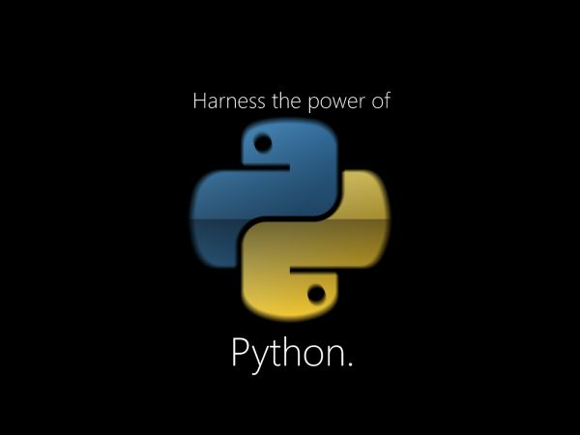

Slide 2
Agenda
History
Introduction
Why Python?
Language Basics
Applications

Slide 3
Brief History of Python
Invented in the Netherlands, early 90s by Guido van Rossum
Named after Monty Python
Open sourced from the beginning
Considered a scripting language, but is much more
Scalable, object oriented and functional from the beginning
Used by Google from the beginning
Increasingly popular

Slide 4
Scripting versus Programming
Scripted languages are interpreted.
Programmed languages are compiled into a more compact form that does not need to be interpreted by another application in the same way. The compiled result is stand-alone.

Slide 5


Interpreter vs Compiler

Slide 6
Language Introduction
Python is a dynamic language
Python source files use the ".py" extension and are called "modules
There are no type declarations of variables, parameters, functions, or methods in source code
Python tracks the types of all values at runtime and flags code that does not make sense as it runs

Slide 7
Why Python?
Designed to be easy to learn and master
Clean, clear syntax
Very few keywords
Highly portable
Runs almost anywhere - high end servers and workstations, down to windows CE
Uses machine independent byte-codes
Extensible
Designed to be extensible using C/C++, allowing access to many external libraries

Slide 8
Installing
Python is pre-installed on most Unix systems, including Linux and MAC OS X
The pre-installed version may not be the most recent one
Download from http://python.org/download/
Python comes with a large library of standard modules
There are several options for an IDE
IDLE – works well with Windows
Emacs with python-mode or your favorite text editor
Eclipse with Pydev (http://pydev.sourceforge.net/)

Slide 9
The Basics

Slide 10
Basic Syntax
Indentation matters to code meaning
Block structure indicated by indentation
First assignment to a variable creates it
Variable types don’t need to be declared.
Python figures out the variable types on its own.
Assignment is = and comparison is ==
For numbers + - * / % are as expected
Special use of + for string concatenation and % for string formatting (as in C’s printf)
Logical operators are words (and, or, not) not symbols
The basic printing command is print

Slide 11
Whitespace
Whitespace is meaningful in Python: especially indentation and placement of newlines
Use a newline to end a line of code
Use \ when must go to next line prematurely
No braces {} to mark blocks of code, use consistent indentation instead
First line with less indentation is outside of the block
First line with more indentation starts a nested block
Colons start of a new block in many constructs, e.g. function definitions, then clauses
Unlike C, C++ and Java, there is no semicolon in Python

Slide 12
Grouping Indentation
0
Bingo!
---
---
---
3
---
---
---
6
---
---
---
9
---
---
---
12
---
---
---
15
Bingo!
---
---
---
18
---
---
In C:
for (i = 0; i < 20; i++)
{
if (i%3 == 0) {
printf("%d\n", i);
if (i%5 == 0) {
printf("Bingo!\n"); }
}
printf("---\n");
}
In Python:
for i in range(20):
if i%3 == 0:
print i
if i%5 == 0:
print "Bingo!"
print "---"

Slide 13
Control Structures
if condition:
statements
[elif condition:
statements] ...
else:
statements
while condition:
statements
for var in sequence:
statements
break
continue

Slide 14
Sequence types: Tuples, Lists, and Strings

Slide 15
Sequence Types
Tuple: (‘john’, 32, [CMSC])
A simple immutable ordered sequence of items
Items can be of mixed types, including collection types
Strings: “John Smith”
Immutable
Conceptually very much like a tuple
List: [1, 2, ‘john’, (‘up’, ‘down’)]
Mutable ordered sequence of items of mixed types

Slide 16
Lists
Flexible arrays
a = [99, "bottles of beer", ["on", "the", "wall"]]
Same operators as for strings
a+b, a*3, a[0], a[-1], a[1:], len(a)
Item and slice assignment
a[0] = 98
a[1:2] = ["bottles", "of", "beer"]
-> [98, "bottles", "of", "beer", ["on", "the", "wall"]]
del a[-1] # -> [98, "bottles", "of", "beer"]

Slide 17
Comments
Start comments with #, rest of line is ignored
Can include a “documentation string” as the first line of a new function or class you define
Development environments, debugger, and other tools use it: it’s good style to include one
def fact(n):
“““fact(n) assumes n is a positive integer and returns facorial of n.””” assert(n>0)
return 1 if n==1 else n*fact(n-1)

Slide 18
Applications for Python
Python is used in many application domains
Web Programming
Scientific and Numeric
Software Development
Education

Slide 19
Web Programming
Python offers many choices :
Frameworks such as Django and Pyramid.
Micro-frameworks such as Flask and Bottle.
Advanced content management systems such as Plone and django CMS.

Slide 20
Web and Internet Development
Server Programming
Client Programming
Python's standard library supports many Internet protocols:
HTML and XML
JSON
E-mail processing.
Support for FTP, IMAP, and other Internet protocols.
Easy-to-use socket interface.

Slide 21
Server-side Programming
Uses
Process user input.
Display pages.
Structure web applications.
Interact with permanent storage (SQL, files).
Example Languages
PHP
Python
ASP.Net in C#, C++, or Visual Basic.

Slide 22
Client-side programming
Uses
Make interactive webpages.
Make stuff happen dynamically on the web page.
Interact with temporary storage, and local storage (Cookies, localStorage).
Send requests to the server, and retrieve data from it
Provide a remote service for client-side applications, such as software registration, content delivery, or remote multi-player gaming.
Example languages
JavaScript (primarily)
HTML*
CSS*

Slide 23
Scientific and Numeric Computing
SciPy is a collection of packages for mathematics, science, and engineering.
Pandas is a data analysis and modeling library.
IPython is a powerful interactive shell.

Slide 24
Software Development
SCons for build control.
Buildbot for automated continuous compilation and testing.
Roundup or Trac for bug tracking and project management.

Slide 25
Education
Python is a superb language for teaching programming, both at the introductory level and in more advanced courses

Slide 26
References
https://www.python.org/about/gettingstarted
https://www.python.org/about/apps/
https://developers.google.com/edu/python/introduction#prelude

Slide 27

Shilpa.K

