Slide 1
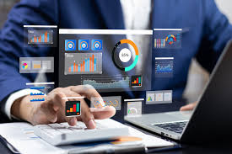
YUKTI-AI
Business Automation
Platform
Automate • Integrate • Standardize • Scale
ENTERPRISE
API READY
CLOUD READY
From incoming business data to clean records, CRM actions, reporting and mobile visibility.
Yukti-Ai Business Automation
YUKTI-AI BUSINESS AUTOMATION
1

Slide 2
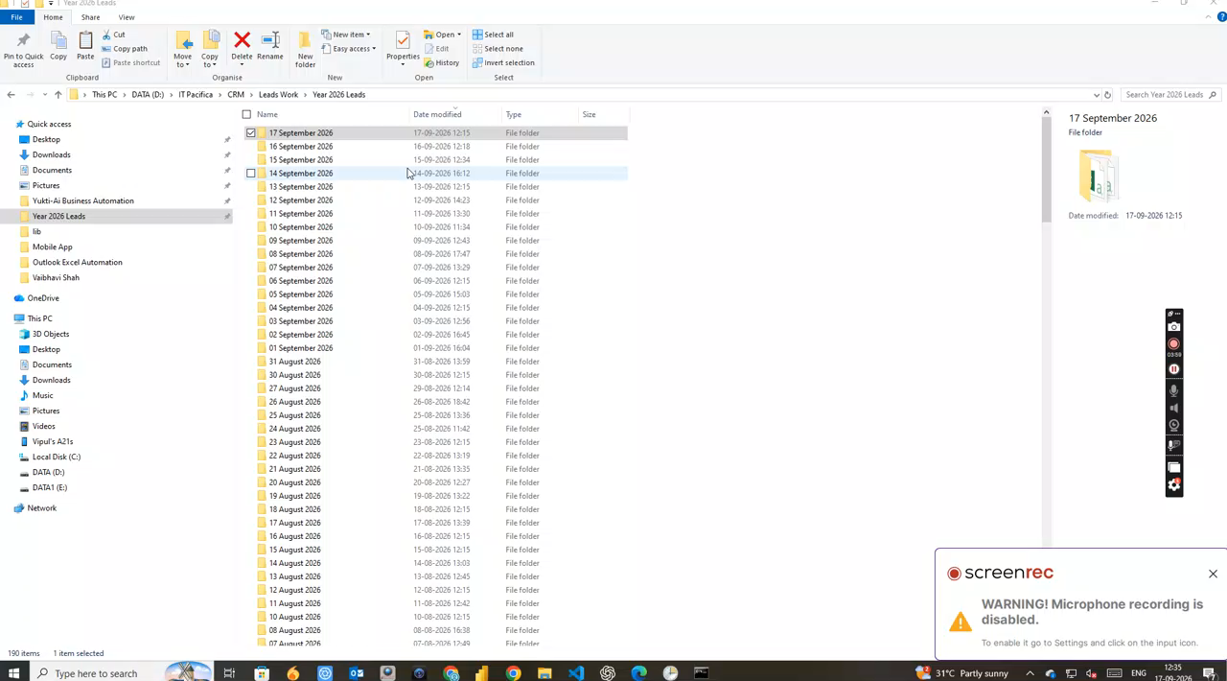
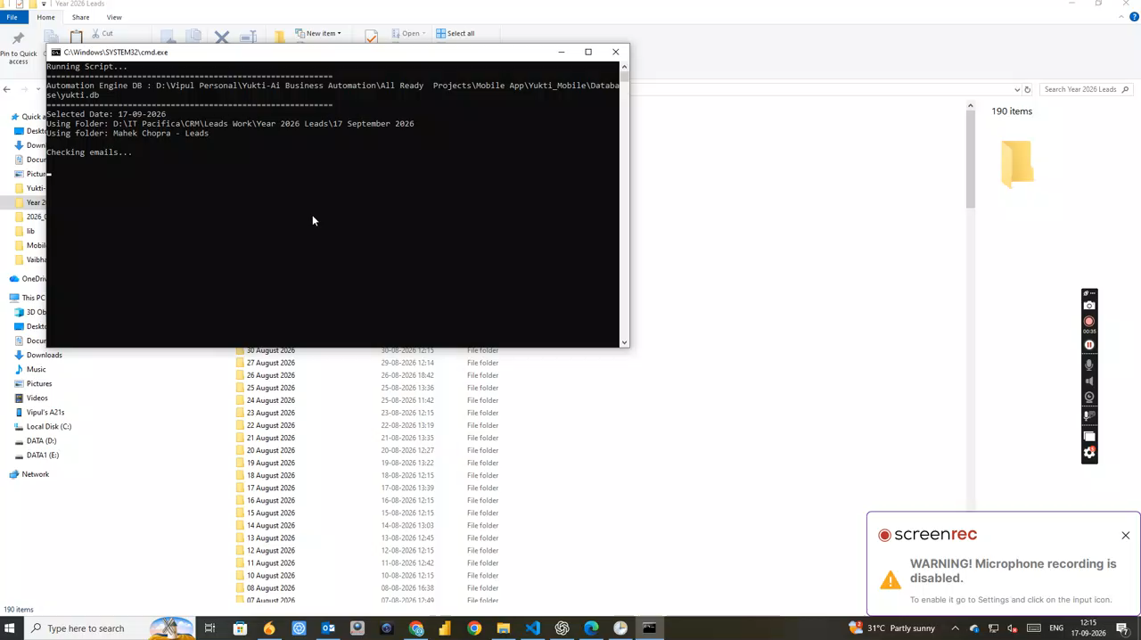
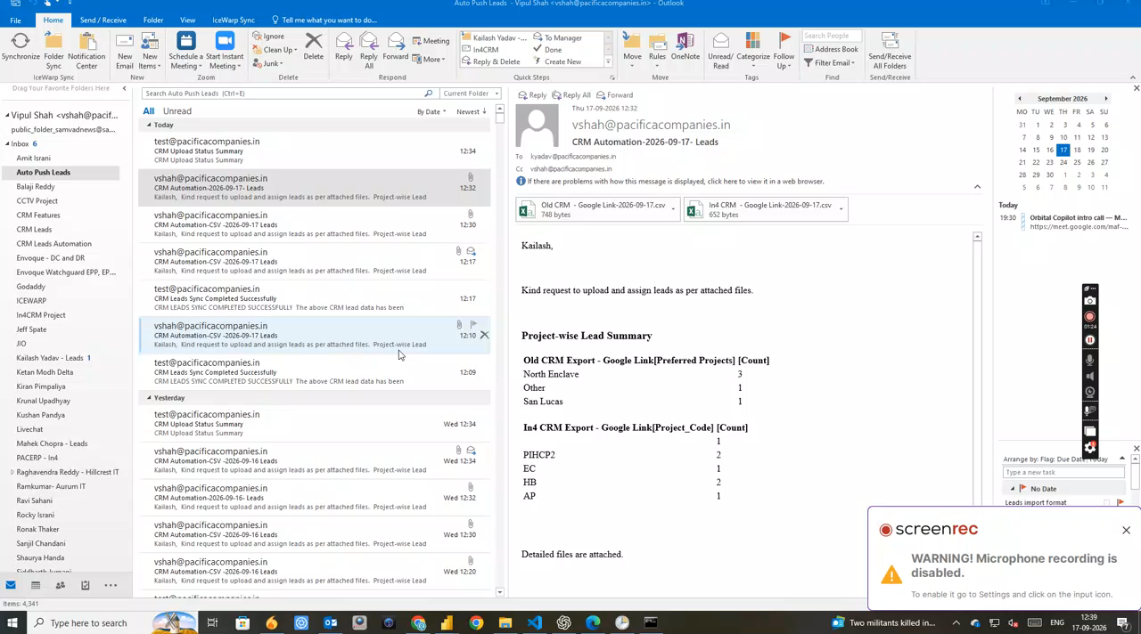
What Yukti-Ai Does
A unified automation layer for repetitive, rule-driven business operations
1. Capture
2. Process
3. Execute
Email attachments, CSV files, Google Sheets, APIs and CRM sources.
Clean, validate, normalize, map and check data using repeatable rules.
Create master outputs, push data to CRM, generate summaries and trigger actions.
YUKTI-AI BUSINESS AUTOMATION
2

Slide 3
The Operational Problem
Manual lead and data handling consumes time and creates inconsistency
Fragmented inputs
Manual reconciliation
Raw data quality
Email, CSV, spreadsheets, CRM and vendors.
Download, merge, clean, map and validate.
Names, mobile numbers, projects and sources need normalization.
Delayed reporting
Duplicate risk
Non-productive work
Management waits for manual consolidation.
Repeated records create unnecessary effort.
Employees spend time on data entry instead of follow-up.
YUKTI-AI BUSINESS AUTOMATION
3

Slide 4
End-to-End Automation Flow
A controlled path from raw input to business action
01
02
03
04
05
06
SOURCE
CAPTURE
CLEAN
VALIDATE
DELIVER
VISUALIZE
Email • CSV • Sheets • API
Automatic intake
Normalize & standardize
Rules & duplicate checks
CRM • Master File • Email
Dashboard • Mobile
RAW DATA → ACTION → VISIBILITY
YUKTI-AI BUSINESS AUTOMATION
4

Slide 5
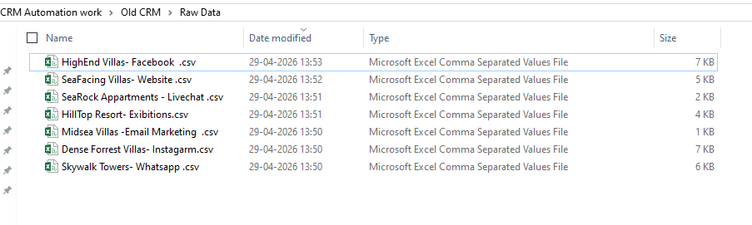
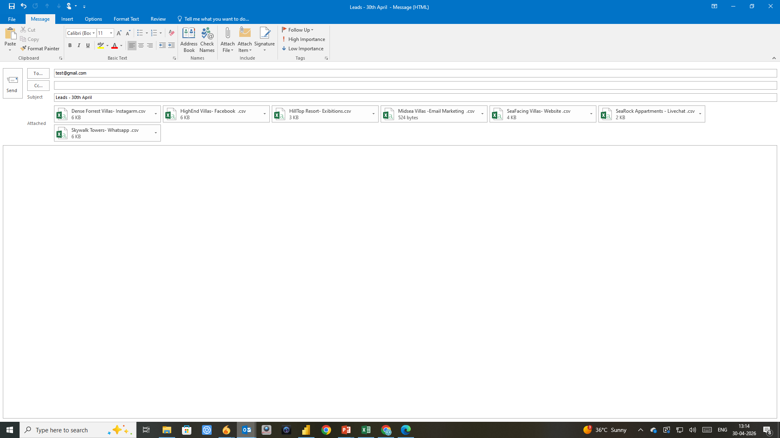
Automation in Action
Real project screenshots showing the flow across desktop tools and automation
EMAIL → PYTHON → POWER AUTOMATE → REPORT
YUKTI-AI BUSINESS AUTOMATION
5

Slide 6
Outlook / Email Attachment Automation
Automatically capture incoming lead files and organize them for processing
Automatic Capture
Identify relevant incoming attachments.
Automatic Organization
Save files into the correct workflow structure.
Ready for Processing
Pass files into cleaning, mapping and master-file automation.
YUKTI-AI BUSINESS AUTOMATION
6

Slide 7
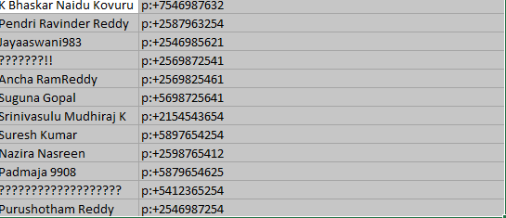
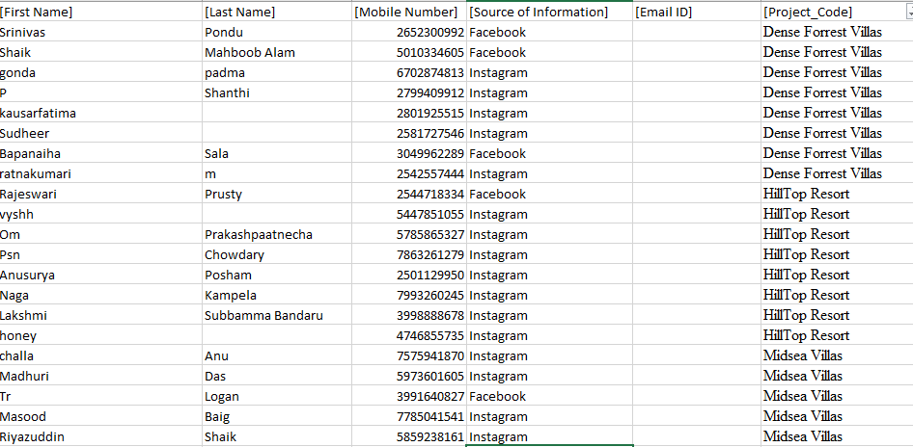
Raw Data → Clean Master File
Transform inconsistent source data into a standardized structure
Normalize
Clean names and mobile numbers.
Map
Standardize project and source values.
Validate
Apply rules and duplicate checkpoints.
YUKTI-AI BUSINESS AUTOMATION
7

Slide 8
Master File & CRM Preparation
Structured output becomes the controlled hand-off to CRM or other applications
Standardized Fields
Name • Mobile • Email • Project • Source
Duplicate Checkpoint
Identify potential duplicates before ingestion.
CRM-Ready Output
Validated data can be pushed into the target application.
YUKTI-AI BUSINESS AUTOMATION
8

Slide 9
Automated Summary & Reporting
Management-ready summaries without manual consolidation
Project-wise Summary
See lead distribution by project.
Source-wise Visibility
Compare acquisition channels.
Scheduled Communication
Send summaries and outputs to the required team.
YUKTI-AI BUSINESS AUTOMATION
9

Slide 10
Python + Power Automate + Power BI
The current workflow combines automation, orchestration and analytics
Python Automation
Capture • Clean • Map • Create outputs
Power Automate
Orchestrate • Trigger • Notify
Power BI
Analyze • Visualize • Monitor
Mobile / API
Access operational information
YUKTI-AI BUSINESS AUTOMATION
10

Slide 11
Eight Automation Modules
Capabilities can work independently or as one end-to-end solution

Slide 12
Eight Automation Modules
Capabilities can work independently or as one end-to-end solution
01 Excel Automation
02 Outlook Automation
03 Google Sheet Automation
04 CRM Automation
Spreadsheet processing.
Email attachment capture.
Spreadsheet sync.
Validate and push CRM data.
05 Hybrid Automation
06 Python Automation
07 Power BI Dashboard
08 Master File → CRM
Combine CSV + Sheets.
Custom rule-based workflows.
Management analytics.
Duplicate checks + upload tracking.
YUKTI-AI BUSINESS AUTOMATION
11

Slide 13
Dashboard & Mobile Layer
Move from desktop processing toward anywhere-access operational visibility
Dashboard
Mobile App
Global SaaS Direction
• Total / today leads
• Project-wise counts
• Source-wise counts
• Trends and summaries
• Management visibility
• Lead visibility
• Automation
• Reports
• Settings
• API-driven data
• Multi-user
• Multi-tenant
• Customer configuration
• Cloud deployment
• Secure integrations
YUKTI-AI BUSINESS AUTOMATION
12

Slide 14
Cloud / SaaS Architecture
Target architecture for a global multi-user platform
Web / Flutter Mobile
Yukti-Ai Backend
Database
Customer CRM / API
HTTPS / API
Automation Engine
Secure Storage
CUSTOMER SYSTEMS CAN REMAIN ON-PREMISE
YUKTI-AI BUSINESS AUTOMATION
13

Slide 15
Enterprise Security Principles
Foundational requirements for a scalable multi-tenant platform
Tenant Isolation
Role-Based Access
Secure Credentials
Separate each customer's data and configuration.
Give users only the permissions they require.
Protect CRM/API credentials.
Audit Logs
HTTPS / TLS
Customer-Controlled Systems
Track automation actions and events.
Protect API and application traffic.
Customer CRM/ERP can remain under customer ownership.
YUKTI-AI BUSINESS AUTOMATION
14

Slide 16
Business Value
The objective is to turn repetitive operational work into a repeatable digital process
Less Manual Work
Better Data Quality
Faster Follow-up
Reduce repetitive downloading, copying and consolidation.
Apply consistent validation and mapping.
Make structured leads available earlier.
Better Visibility
Scalable Operations
Productive Employees
Project/source reporting without manual consolidation.
Handle more workflows without proportional manual effort.
Shift time from data entry to calling and follow-up.
YUKTI-AI BUSINESS AUTOMATION
15

Slide 17
Automate the Work.
Scale the Business.
Yukti-Ai Business Automation
Business Automation • CRM Integration • Data Standardization • Analytics • Mobile
CONTACT
Vipul Shah
LET'S AUTOMATE
9316072612 • yuktiaisales@gmail.com
YUKTI-AI BUSINESS AUTOMATION
16

