Slide 1
Design Pattern: Observer Pattern
Yukun Yu

Slide 2
Structure
Introduction of Design Pattern
Observer Pattern in Behaviour pattern
Implementation background
Structure characteristics: UML
Advantages and disadvantages
repository address: https://github.com/yukun093/observerPattern.git
Example1: General Case
Example2: Selling Tickets
Summary
Reference

Slide 3
Introduction of design pattern
Design pattern, which can be used multiple time, is one experience or summary in the process of software development, in order to reuse codes as well as enhance entensibility and maintainance.
The most significant reason to adopt design pattern in software development is to achieve codes‘ flexibility, portability and entensibility.
Design pattern is refined based on Object-Oriented Programming(OOP), that why it is widely used in several programming language, such as Java, C++, C#.
Two principles, which are Open Closed Principle & Liskov Substitution principle, should be induced notification in the process of design.
Meanwhile, Erich Gamma、Richard Helm、Raplh Johnson and Jonhn Vlissides(GoF) divided design patterns into 23 subclasses.
Notes:
设计模式，即Design Patterns，是指在软件设计中，被反复使用的一种代码设计经验。使用设计模式的目的是为了可重用代码，提高代码的可扩展性和可维护性。
设计模式这个术语是上个世纪90年代由Erich Gamma、Richard Helm、Raplh Johnson和Jonhn Vlissides四个人总结提炼出来的，并且写了一本Design Patterns的书。这四人也被称为四人帮（GoF）。
为什么要使用设计模式？根本原因还是软件开发要实现可维护、可扩展，就必须尽量复用代码，并且降低代码的耦合度。设计模式主要是基于OOP编程提炼的，它基于以下几个原则：
开闭原则
由Bertrand Meyer提出的开闭原则（Open Closed Principle）是指，软件应该对扩展开放，而对修改关闭。这里的意思是在增加新功能的时候，能不改代码就尽量不要改，如果只增加代码就完成了新功能，那是最好的。
里氏替换原则
里氏替换原则是Barbara Liskov提出的，这是一种面向对象的设计原则，即如果我们调用一个父类的方法可以成功，那么替换成子类调用也应该完全可以运行。
设计模式把一些常用的设计思想提炼出一个个模式，然后给每个模式命名，这样在使用的时候更方便交流。GoF把23个常用模式分为创建型模式、结构型模式和行为型模式三类，我们后续会一一讲解。
学习设计模式，关键是学习设计思想，不能简单地生搬硬套，也不能为了使用设计模式而过度设计，要合理平衡设计的复杂度和灵活性，并意识到设计模式也并不是万能的。

Slide 4
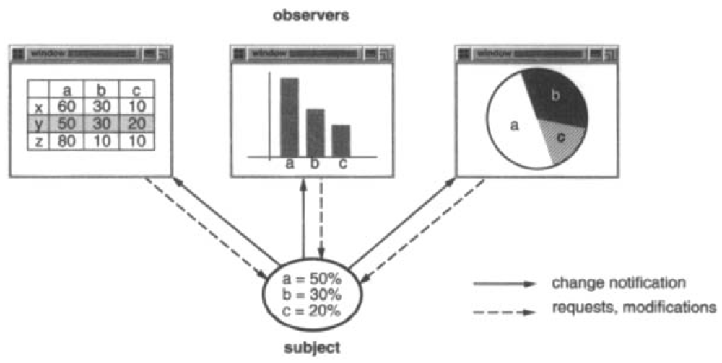
Observer Pattern in Behaviour pattern
Definition: define one-to-many dependency between objects so that when one object changes state, all its dependents are notified and updated automatically.
Section 1.2 page5 ,,“Design Patterns, Elements of Reusable Object-Oriented Software”
Notes:
设计模式，即Design Patterns，是指在软件设计中，被反复使用的一种代码设计经验。使用设计模式的目的是为了可重用代码，提高代码的可扩展性和可维护性。
设计模式这个术语是上个世纪90年代由Erich Gamma、Richard Helm、Raplh Johnson和Jonhn Vlissides四个人总结提炼出来的，并且写了一本Design Patterns的书。这四人也被称为四人帮（GoF）。
为什么要使用设计模式？根本原因还是软件开发要实现可维护、可扩展，就必须尽量复用代码，并且降低代码的耦合度。设计模式主要是基于OOP编程提炼的，它基于以下几个原则：
开闭原则
由Bertrand Meyer提出的开闭原则（Open Closed Principle）是指，软件应该对扩展开放，而对修改关闭。这里的意思是在增加新功能的时候，能不改代码就尽量不要改，如果只增加代码就完成了新功能，那是最好的。
里氏替换原则
里氏替换原则是Barbara Liskov提出的，这是一种面向对象的设计原则，即如果我们调用一个父类的方法可以成功，那么替换成子类调用也应该完全可以运行。
设计模式把一些常用的设计思想提炼出一个个模式，然后给每个模式命名，这样在使用的时候更方便交流。GoF把23个常用模式分为创建型模式、结构型模式和行为型模式三类，我们后续会一一讲解。
学习设计模式，关键是学习设计思想，不能简单地生搬硬套，也不能为了使用设计模式而过度设计，要合理平衡设计的复杂度和灵活性，并意识到设计模式也并不是万能的。

Slide 5
Implementation background
Image an situation, when one part of programe has been modified, it is necessary to update other part at the same time. One method is that calling CPU all the time to check the message from sender.
This method has two shortcomings:
Take over the CPU processing time
Check would be missed if period intervals are too long
Implement Observer Pattern is an solution for the problem

Slide 6
Advantages and disadvantages
AD
-updating the state of observable object, then the state of observer would be automatically updated, they are bundled with each other with an abstract relationship.
DISAD
-if there are many direct or indirect observers with observable object, it would take much time to notice observers.
-if there are cyclic relationship between observers and observable object, it would press burden on system, which might cause in anomaly.
-observers cannot observer how the observable object is updated, but only what is updated.

Slide 7
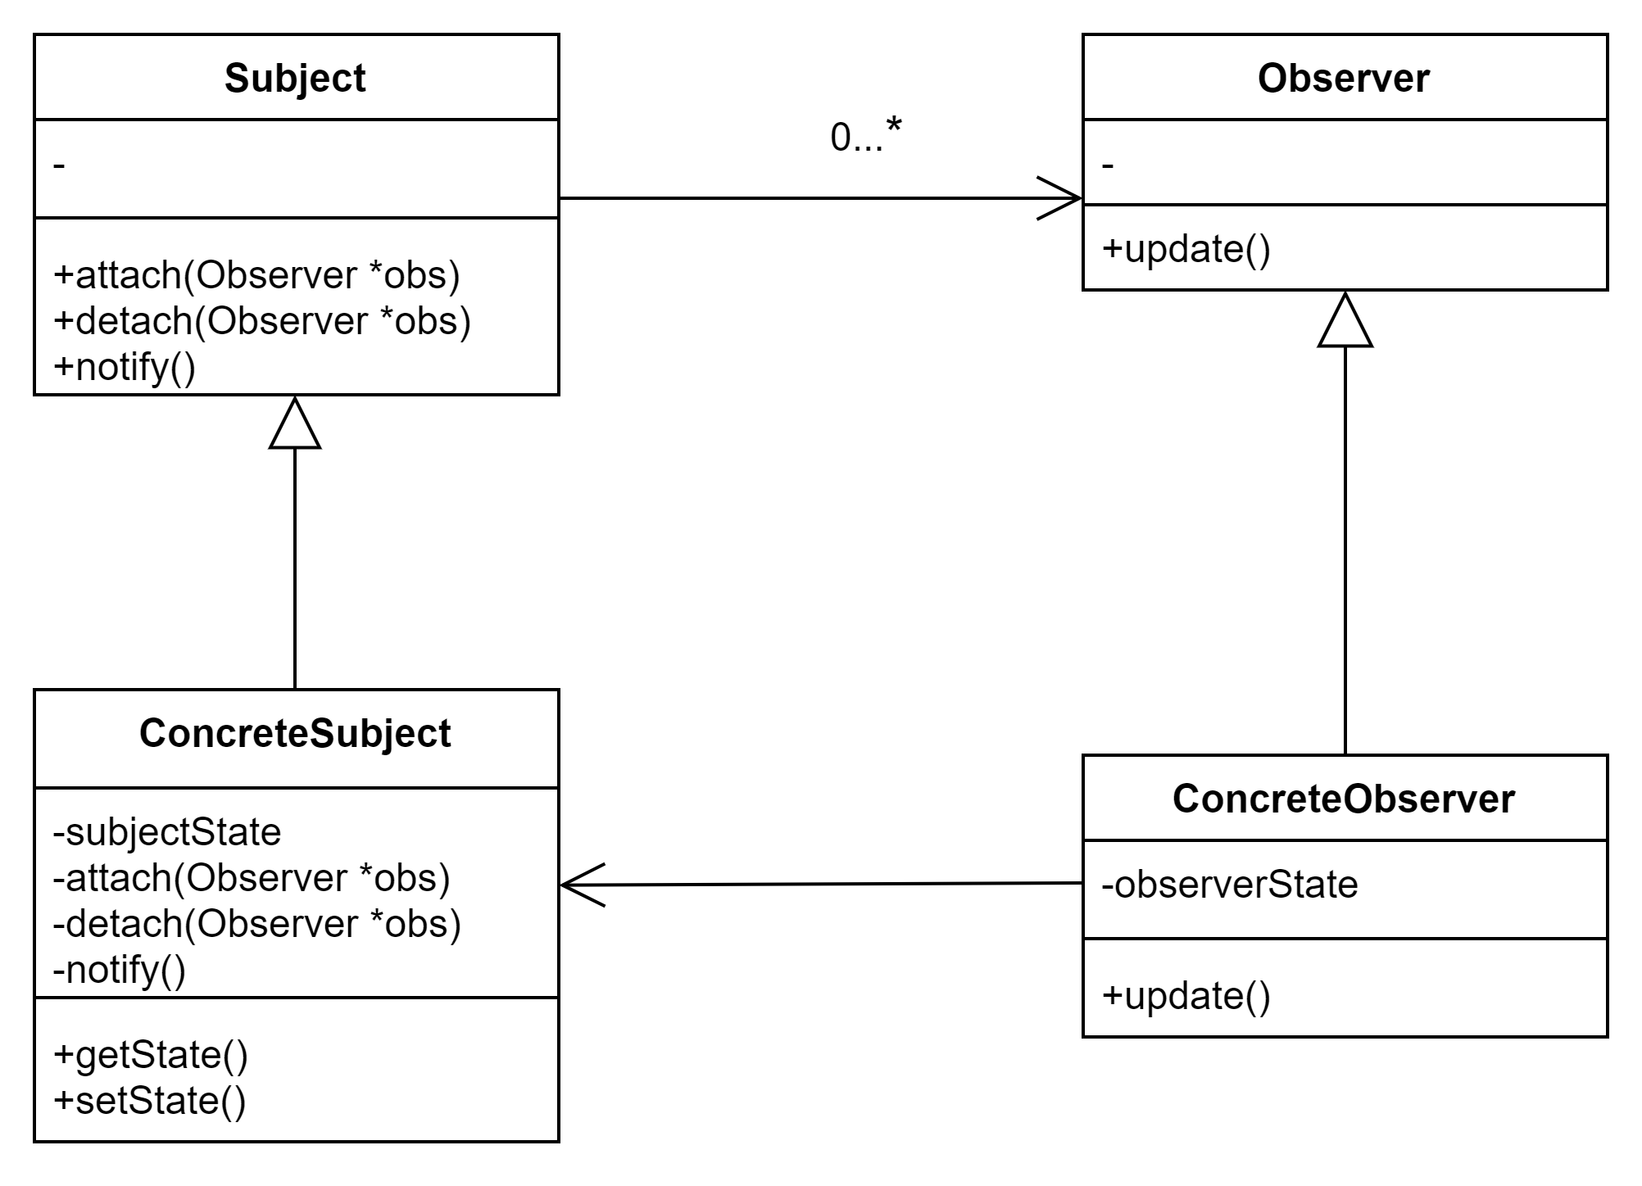
UML on general case
Subject is observable and it has zero to many Observers.
ConcreteObserver has many Concretesubjects, which keep a relationship of one to many.
One ConcreteSubject is one Subject, which keep a relationship of one to one
One ConcreteObserver is one Observer, which keep a relationship of one to one

Slide 8
Code on General Case
- ObserverPattern.cpp
- Subject.h
- ConcreteObserver.h
- ConcreteSubject.h
- Observer.h

Slide 9
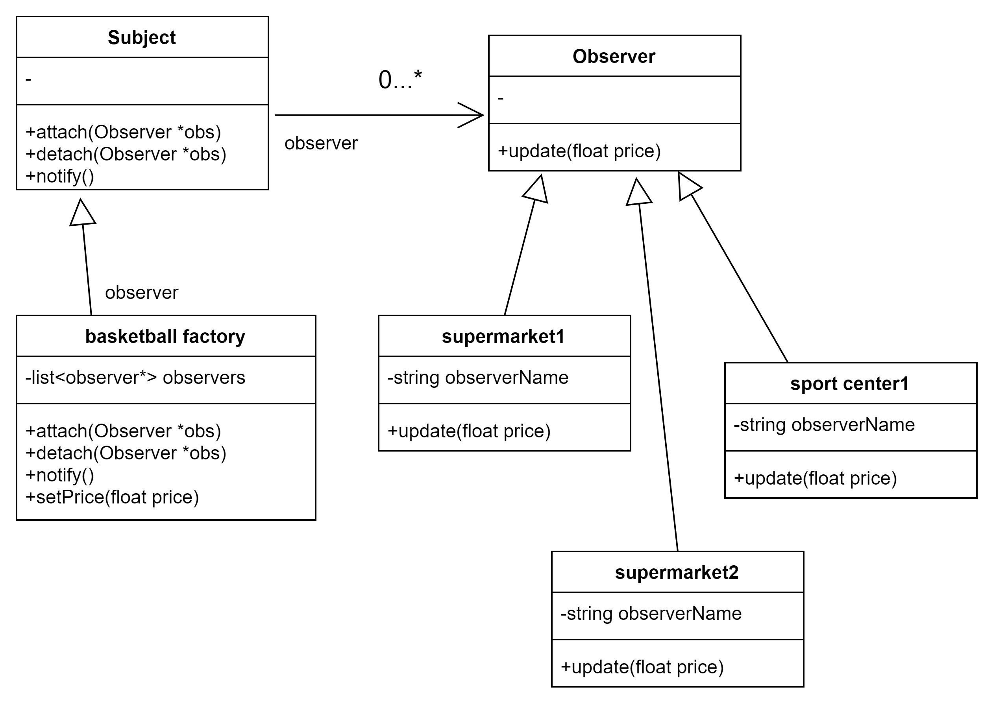
UML on selling basketballs
First, basketball factory set the original price to produce basketball.
Second, when the price is modified from factory, supermarkets and sport center will update price meanwhile.
Observer can own as many as Concrete observers.

Slide 10
Code on Selling tickets
- ObserverPattern.cpp
- Subject.h
- BasketballFacotry.h
- ConcreteStore.h
- Observer.h

Slide 11
Summary

Slide 12
Reference
[1] Gamma, Erich, and Erich. Gamma. Design Patterns : Elements of Reusable Object-Oriented Software. 37th printing. Reading, Mass: Addison-Wesley, 1995. Print.
[2] http://blog.csdn.net/liang19890820

