Slide 1
Design Pattern: Observer Pattern
Yukun Yu

Slide 2
Structure
Introduction of Design Pattern
Observer Pattern in Behaviour pattern
Implementation Background
Structure Characteristics: UML
Advantage and Disadvantage
Example1: General Case
Example2: Selling Tickets
Summary
Reference
repository address: https://github.com/yukun093/observerPattern.git

Slide 3
Structure
Introduction of Design Pattern
Observer Pattern in Behaviour Pattern
Implementation Background
Structure Characteristics: UML
Advantages and Disadvantage
Example1: General Case
Example2: Selling Tickets
Summary
Reference

Slide 4
Introduction of design pattern
Design pattern, which can be used multiple time, is one experience or summary in the process of software development, in order to reuse codes as well as enhance entensibility and maintainance.
The most significant reason to adopt design pattern in software development is to achieve codes’ flexibility, portability and entensibility.
Design pattern is refined based on Object-Oriented Programming(OOP), that‘s why it is widely used in several programming language, such as Java, C++, C#.
Two principles, which are Open Closed Principle & Liskov Substitution principle, should be induced notification in the process of design.
Meanwhile, Erich Gamma、Richard Helm、Raplh Johnson and Jonhn Vlissides(GoF) divided design patterns into 23 subclasses.

Slide 5
Structure
Introduction of Design Pattern
Observer Pattern in Behaviour Pattern
Implementation Background
Structure Characteristics: UML
Advantages and Disadvantage
Example1: General Case
Example2: Selling Tickets
Summary
Reference

Slide 6
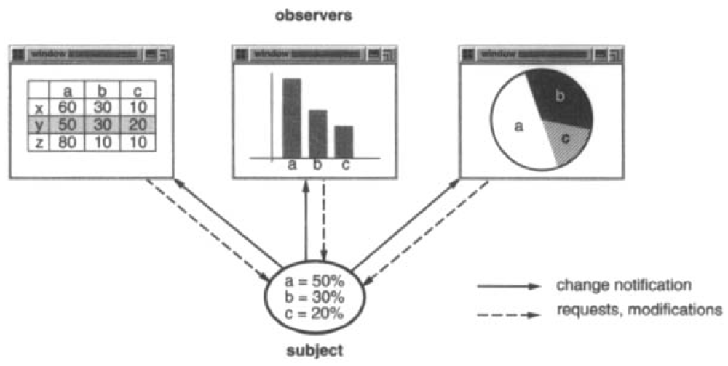
Observer Pattern in Behaviour pattern
Definition: define one-to-many dependency between objects so that when one object changes state, all its dependents are notified and updated automatically.
Section 1.2 page5 “Design Patterns, Elements of Reusable Object-Oriented Software”
Notes:
We generate three graphical methods, and they could be reused independently. They can work together, too. Both a spreadsheet object and bar chart object can depict information in the same application data object using different presentations. The spreadsheet and the bar chart don’t know about each other, thereby we could reuse only the one we need. They behave as they do. Once the user changes the information in the spreadsheet, the bar chart reflects the changes immediately, and vice versa.
This behavior implies that the spreadsheet and bar chart are dependent on the data object and therefore they should be notified of any change in its state. And there is no reason to limit the number of dependent objects to two, three, or four even more. There may be any number of different user interfaces to the same data.

Slide 7
Structure
Introduction of Design Pattern
Observer Pattern in Behaviour Pattern
Implementation Background
Structure Characteristics: UML
Advantages and Disadvantage
Example1: General Case
Example2: Selling Tickets
Summary
Reference

Slide 8
Implementation background
when one part of programe has been modified, it is necessary to update other part at the same time. One method is that calling CPU all the time to check the message from sender.
This method has two shortcomings:
Take over the CPU processing time
Check would be missed if period intervals are too long
Notes:
Implement Observer pattern is an solution for the problem. Imagine an situation,

Slide 9
Structure
Introduction of Design Pattern
Observer Pattern in Behaviour Pattern
Implementation Background
Structure Characteristics: UML
Advantages and Disadvantage
Example1: General Case
Example2: Selling Tickets
Summary
Reference

Slide 10
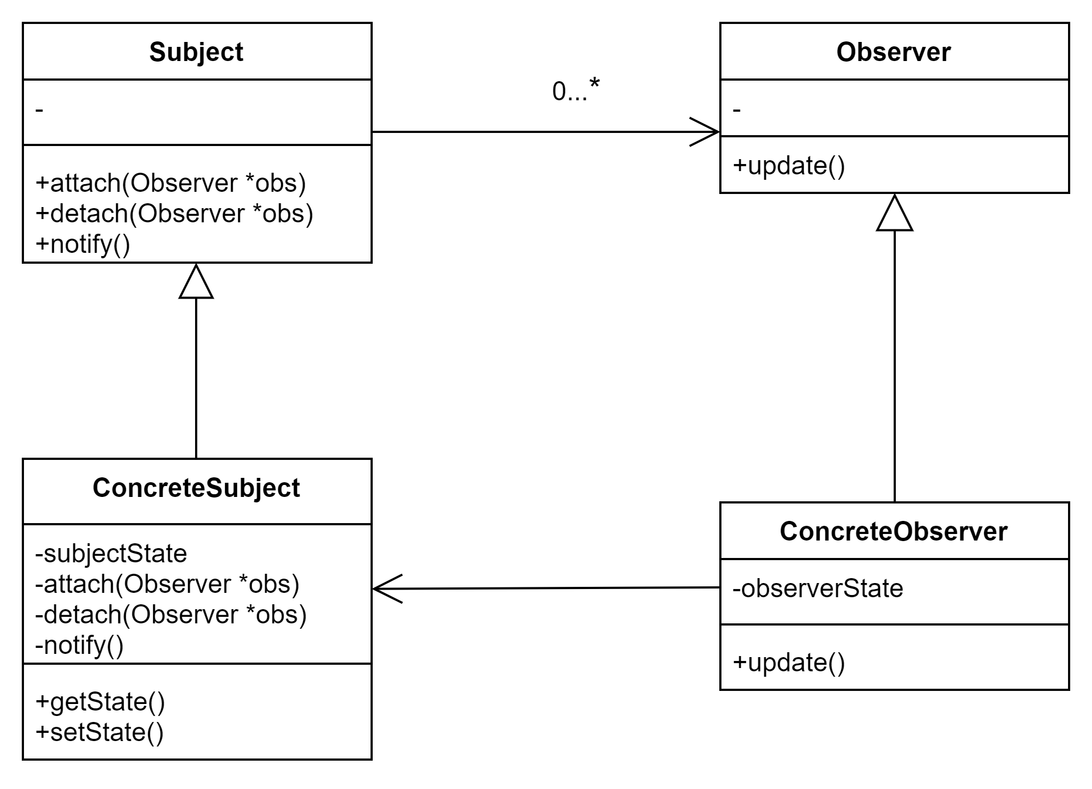
UML(unified modelling language) on general case
Subject is observable and it has zero to many Observers.
ConcreteObserver has many Concretesubjects, which keeps a relationship of one to many.
One ConcreteSubject is one Subject, which keeps a relationship of one to one
One ConcreteObserver is one Observer, which keeps a relationship of one to one

Slide 11
Structure
Introduction of Design Pattern
Observer Pattern in Behaviour pattern
Implementation Background
Structure characteristics: UML
Advantage and Disadvantage
Example1: General Case
Example2: Selling Tickets
Summary
Reference

Slide 12
Advantages and disadvantages
Ad
- when updating the state of observable objects, then the state of observer would be automatically updated, they are bundled with each other with an abstract relationship.
disAd
- if there are many direct or indirect observers with observable objects, it would take much time to notice observers.
- if there are cyclic relationship between observers and observable objects, it would press burden on system, which might cause in anomaly.
- observers cannot know how observable objects are updated, but only what is updated.

Slide 13
Structure
Introduction of Design Pattern
Observer Pattern in Behaviour Pattern
Implementation Background
Structure Characteristics: UML
Advantages and Disadvantage
Example1: General Case
Example2: Selling Tickets
Summary
Reference

Slide 14
Code on General Case
- ObserverPattern.cpp
- Subject.h
- ConcreteObserver.h
- ConcreteSubject.h
- Observer.h

Slide 15
Structure
Introduction of Design Pattern
Observer Pattern in Behaviour pattern
Implementation Background
Structure Characteristics: UML
Advantages and Disadvantage
Example1: General Case
Example2: Selling Basketball
Summary
Reference

Slide 16
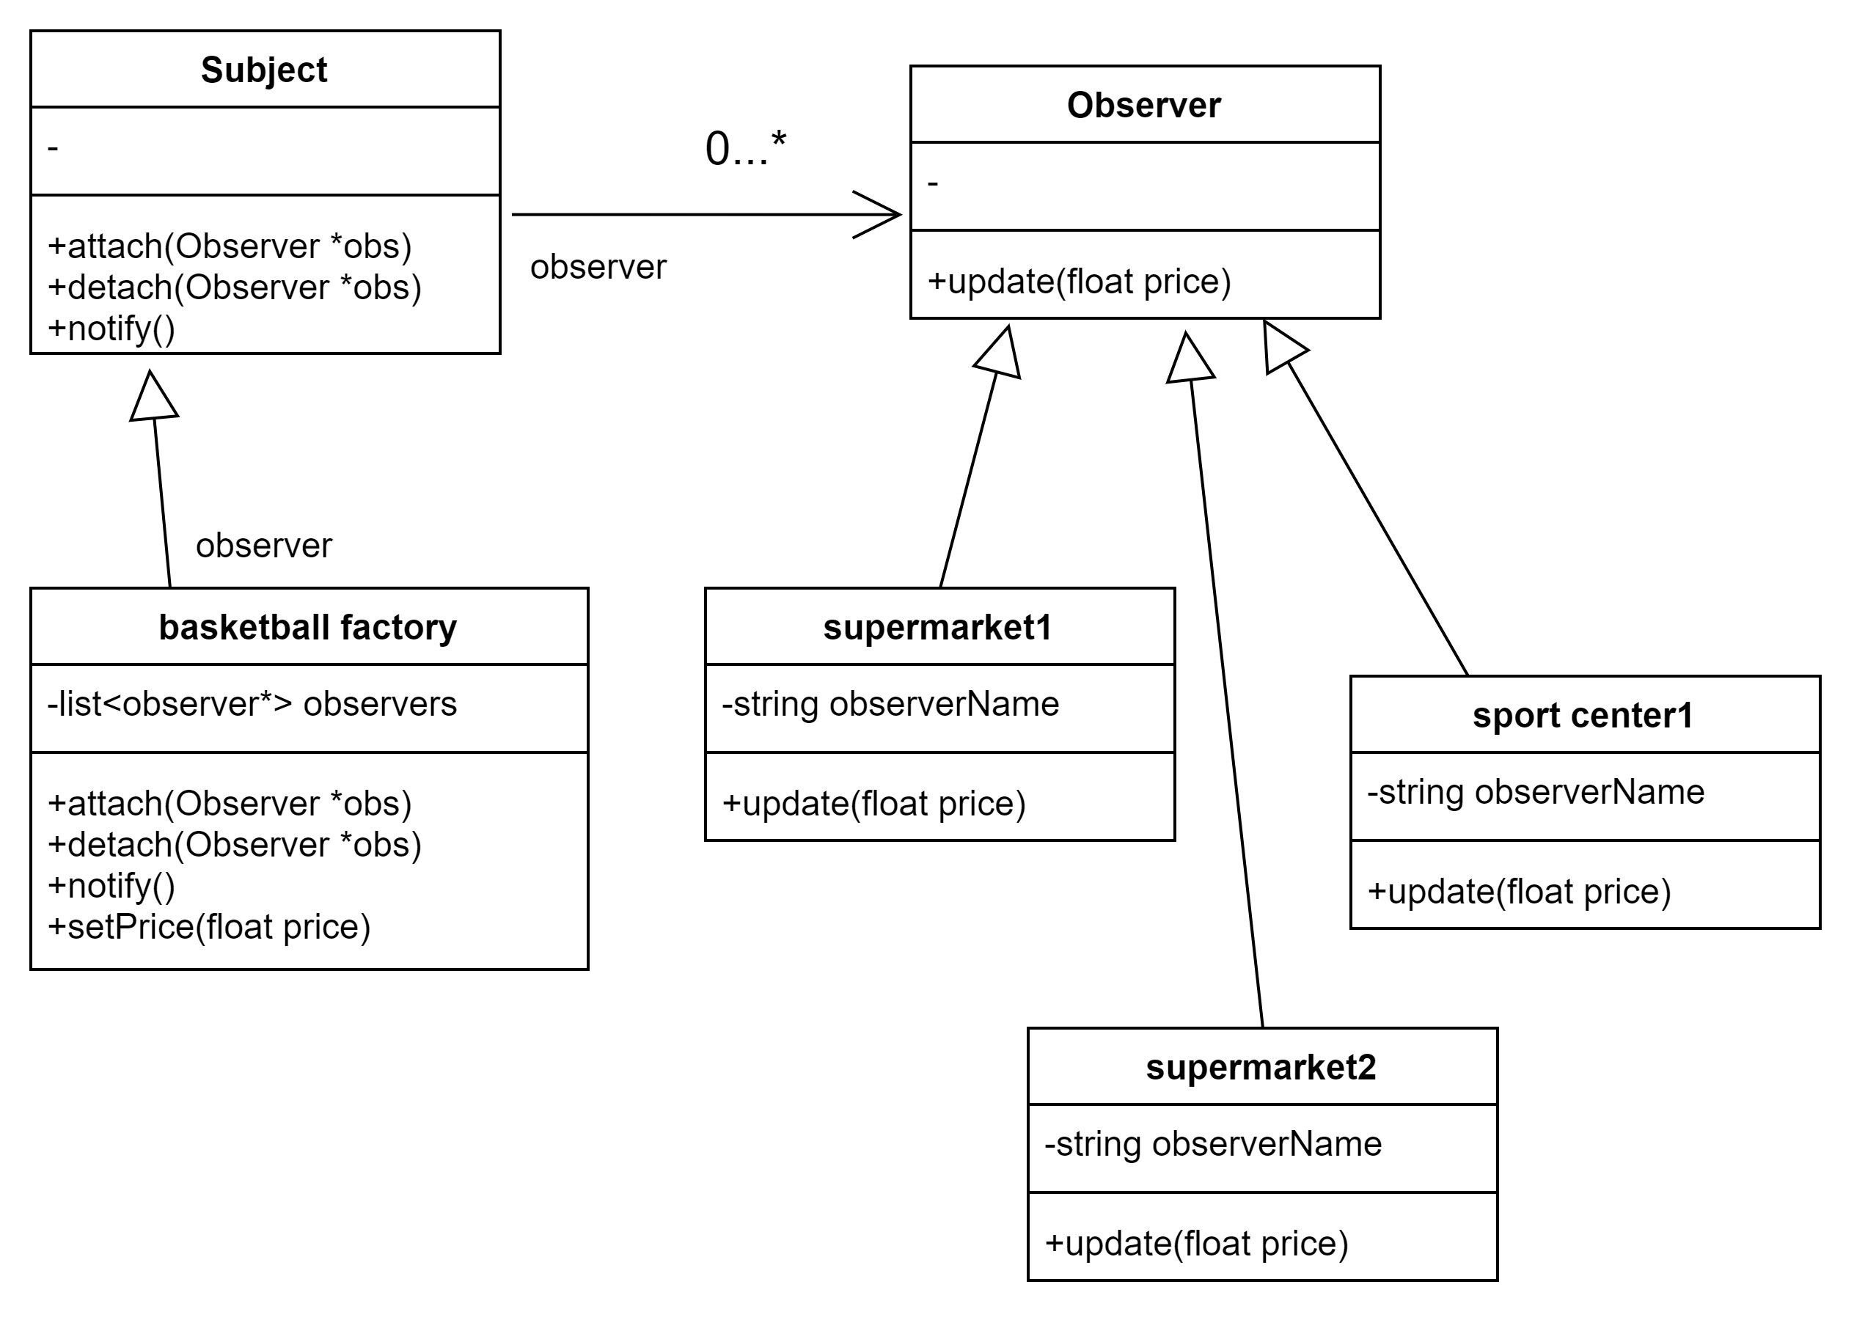
UML on selling basketballs
First, basketball factory sets the original price to produce basketball.
Second, when the price is modified from factory, supermarkets and sport center will update price meanwhile.
Observer can own as many as Concrete observers.
- ObserverPattern.cpp
- Subject.h
- BasketballFacotry.h
- ConcreteStore.h
- Observer.h

Slide 17
Summary
Observer pattern defines one-many dependent relationship between objects, which causes several objects are notified once one object is updated. This pattern is defined as Publisher-Subscriber, Model-View, Source-Listener or Dependents. This is one behavioural pattern.
Observer pattern includes four roles which are subject, concrete subject, observer, concrete observer. Subject is defined as theme as well, which is one observered object. Concrete subject is one subordinate class of Subject. Basically it includes data which should be modified with high frequency. When the state of concrete subject is modified, it would send modifications to several observers. Meanwhile observers would handle corresponding changes, according to modification from concrete subject. On the concrete observers, observers would maintain one reference pointing to concrete subjects. It stores relevant states of concrete observers and these states should be maintained with consistence of concrete Subject.
Notes:
Firstly, they are four patterns which could be defined as observer pattern: Publisher-Subscriber, Model-View, Source-Listener or Dependents
Secondly, objects‘ reletionship

Slide 18
Summary
Obvious advantages of this pattern aim at division between presentation layer as well as data login layer and generate one abstract relationship between observerable object and observers. It supports broadcast. However, it would be limited at small number of observers, since it would spend much time notifying all observers when the number is more than one threshold. Even badly, when there is one cyclic relationship between subjects and observers, the system may break down.
One abstract model includes two aspects. On the one hand, one object is dependent on another object, and modification of one object would cause in modification of one or more objects. On the other hand, the concrete process is not clear, for example, subject don‘t know how many observers‘ state have been modified and subject should notify them to make a change, but don‘t konw which subjects they are.
Notes:
Advantages
Abstract model

Slide 19
Reference
[1] Gamma, Erich, and Erich. Gamma. Design Patterns : Elements of Reusable Object-Oriented Software. 37th printing. Reading, Mass: Addison-Wesley, 1995. Print.
[2] http://blog.csdn.net/liang19890820
[3] https://design-patterns.readthedocs.io/zh_CN/latest/behavioral_patterns/observer.html

