Slide 1
CS410 Project Report
Kevin Yu

Slide 2
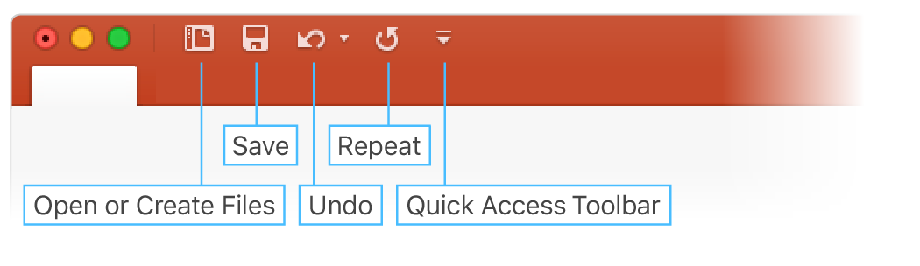
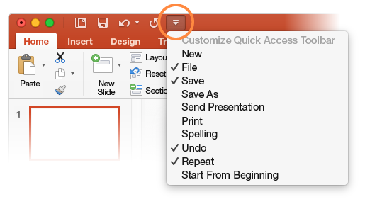
About the Project
The project is to reproducing a paper called.
If the commands currently shown aren’t quite what you need, customize the Quick Access Toolbar.
Try it:
Select Customize Quick Access Toolbar and select command names to add or remove them from the Quick Access Toolbar.

Slide 3
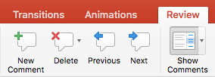
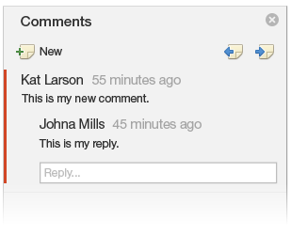

Github Information
Comments are organized as conversations, so you can easily discuss what's on a slide. This is a great way to quickly add your feedback.
Try it:
Select somewhere in this paragraph, and then select the Review tab.
Select New Comment and type something.
Select Reply, and type something.
Hint: If you want a quick way to see comments in presentations, just select Comments in the Status Bar at the bottom of the screen.

Slide 4
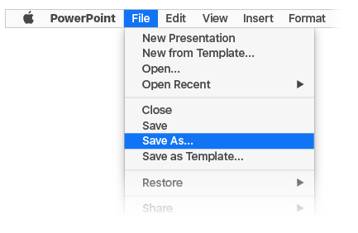
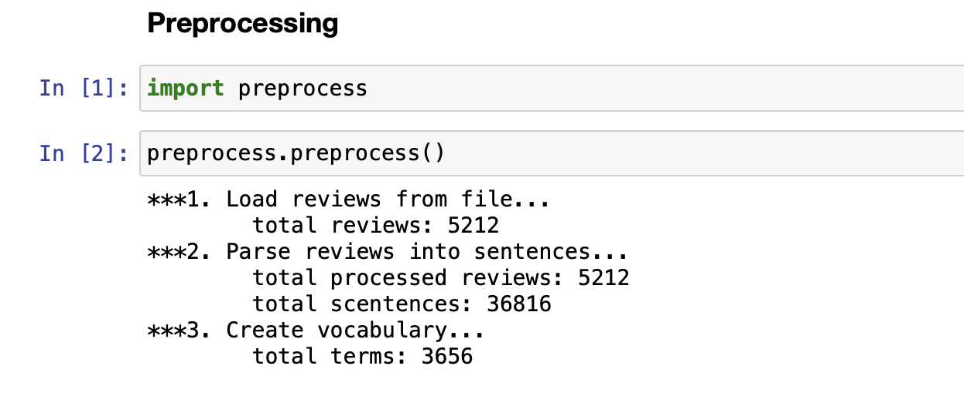
Preprocessing
With your document stored online, your group can work on it together at the same time.
How it works:
Select File > Save As to save your document in an online location, like OneDrive.
Select Share from above the ribbon.
Invite people or send a link so they can edit with you.

Slide 5
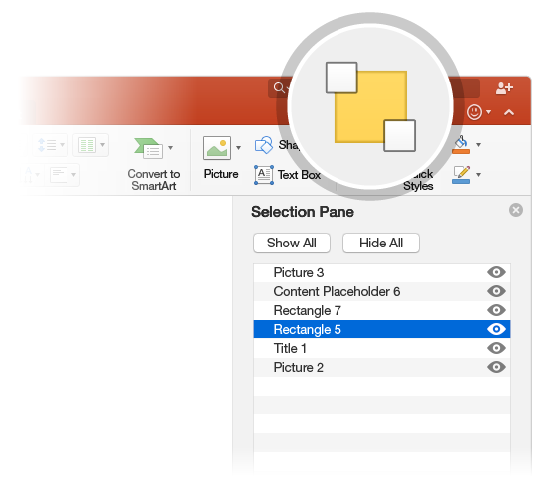

Aspect Segmentation
The Selection Pane is a great tool to organize and manage the objects on a slide, such as images, shapes, and text boxes. The Selection Pane is a subscription-only feature. If you have an Office 365 subscription, you can try it yourself:
Try it:
Go to the Home tab, select Arrange > Selection Pane.
Try renaming an object: Double-click the name “Large grey rectangle” in the Selection Pane and type a new name.
Try changing the order of objects: In the Selection Pane, drag and drop the large grey rectangle so it’s at the top.
To toggle visibility of objects in the Selection Pane, click Show/Hide checkbox.

Slide 6

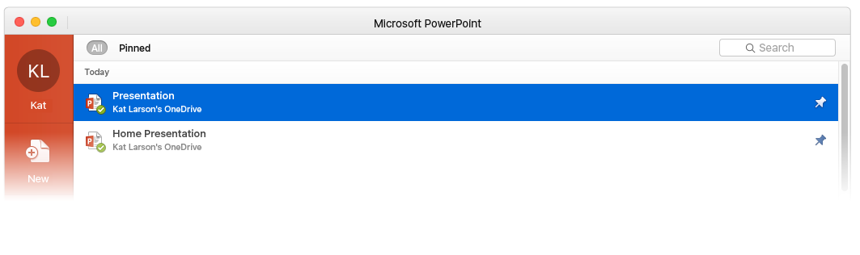

LRR Model Regression
When you sign in to Office 365, your documents go with you wherever you are. Signing in connects Office to you and to the cloud.
Whenever you launch a program, you’ll see the documents you recently opened on any of your devices.
Got a favorite presentation? Pin it to that first screen you see when you launch an Office program. It remains pinned even when you sign in to Office on another computer.
PowerPoint keeps track of where you left off. The next time you open a presentation, PowerPoint invites you to jump directly to where you were last reading or editing.

Slide 7
What to do next?
Finish the Expectation Maximization implementation using gradient descent method.
Use the trained model to decompose reviews to find out laten aspect rating sand weights.
Notes:
In Slide Show mode, select the arrows to visit links.

