Slide 1
Energy Attack on Dialogue Generation
Zexin Li* (862396120), Yufei Li* (862396528)

Slide 2

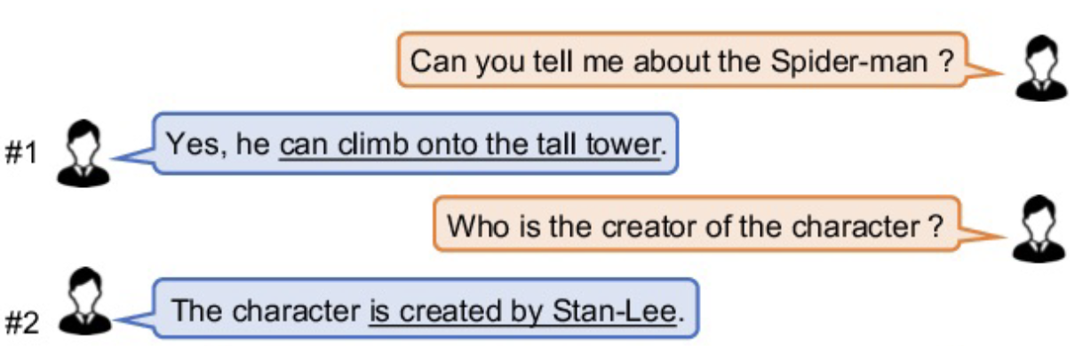
Problem
Energy Attack on Dialogue Generation
Dialogue Generation System: need real-time accurate response
Energy Attack: Slow down the response by generation adversarial examples that extend the output length / inference time, and also increase energy consumption

Slide 3
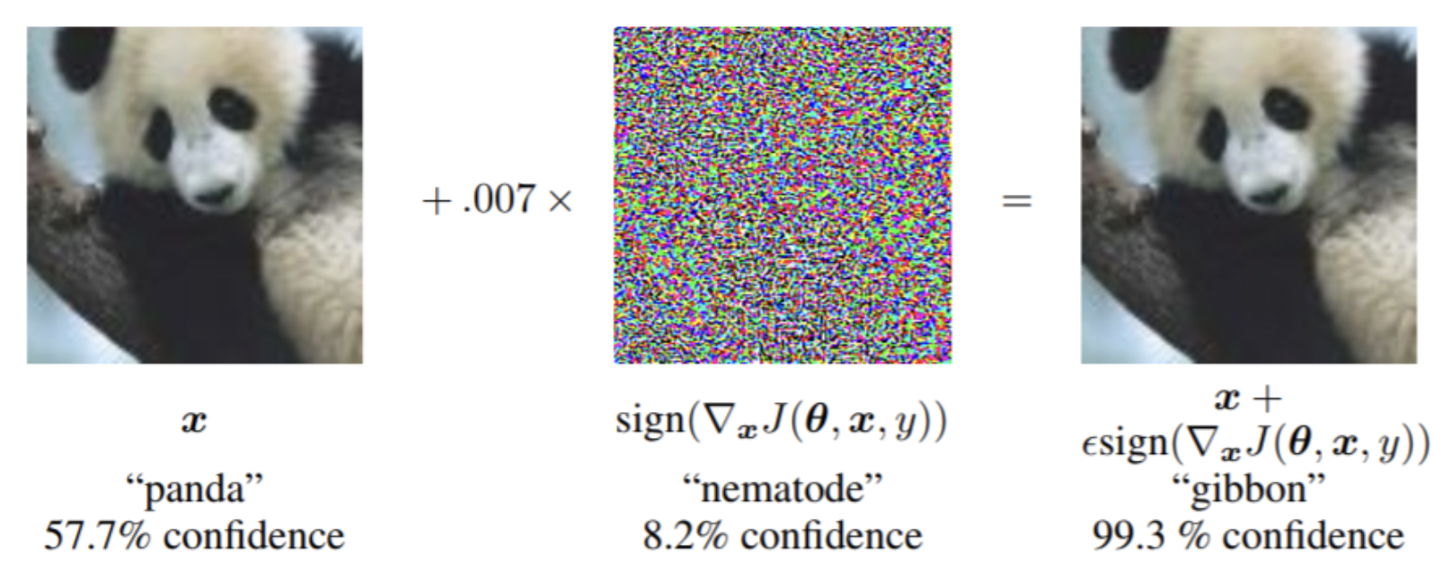
Related Work
Adversarial Attack (accuracy attack)
· Iterative Fast Gradient Sign Method (I-FGSM) [1]
· Momentum-based Method (MI-FGSM) [2]
· Diverse-input based Method (DI-FGSM) [3]
Energy Attack
· ILFO [4]
(E.A. against Adaptive DNN)
· NMTSloth [5]
(E.A. against Neural Machine Translation)
· DeepPerform [6]
(E.A. against Adaptive DNN)

Slide 4
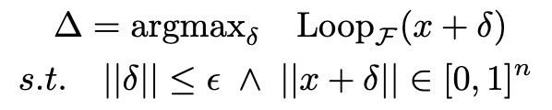
Technical Approach
How to achieve energy adversarial goal?
Problem formulation
Idea: minimizing the probability of special <EOS> token
-> Modified Targeted Attack on <EOS> class

Slide 5
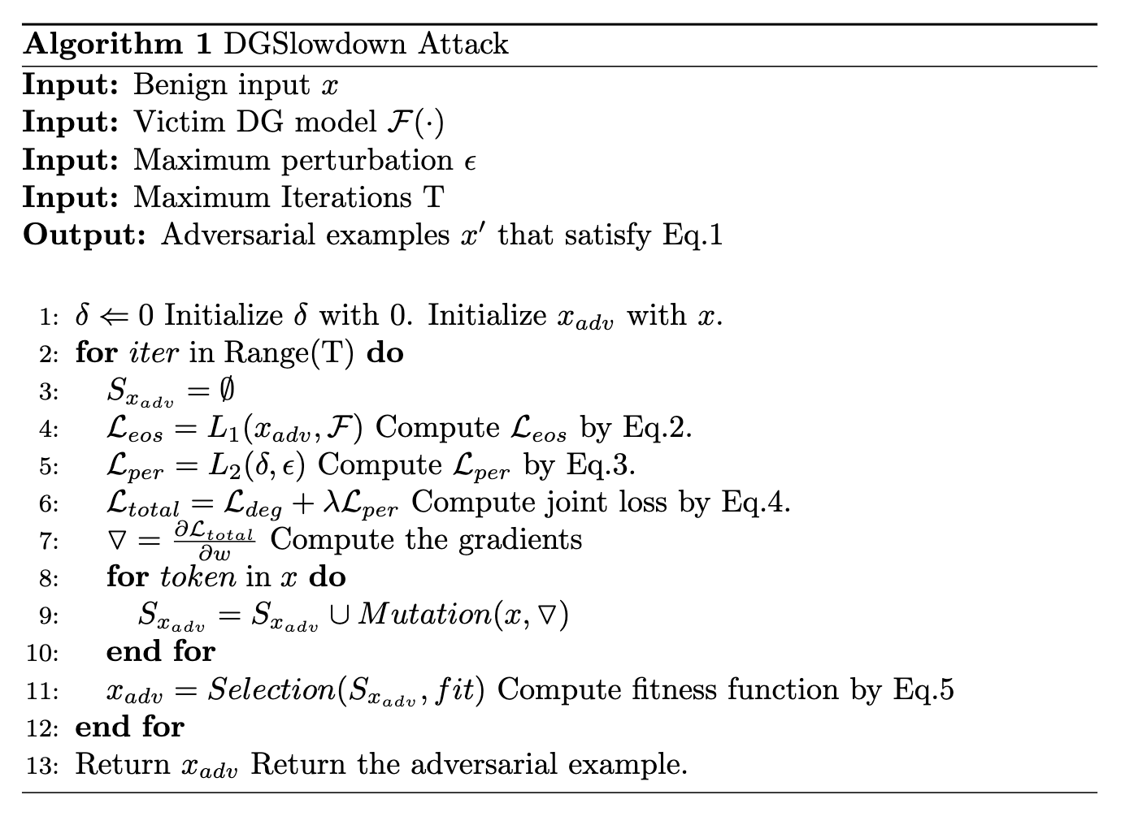
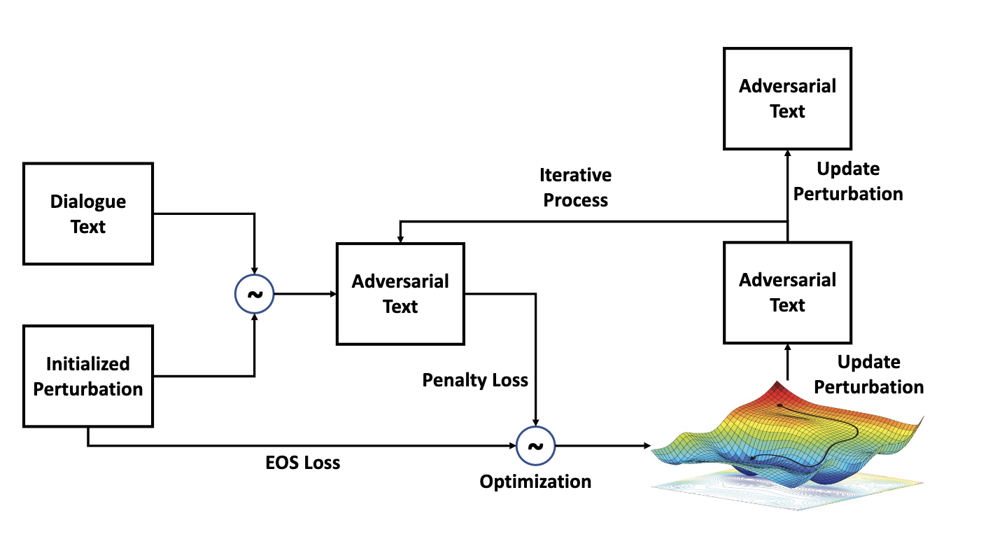
Technical Approach
How to optimize on discrete input space?
Idea: gradient-guided search

Slide 6
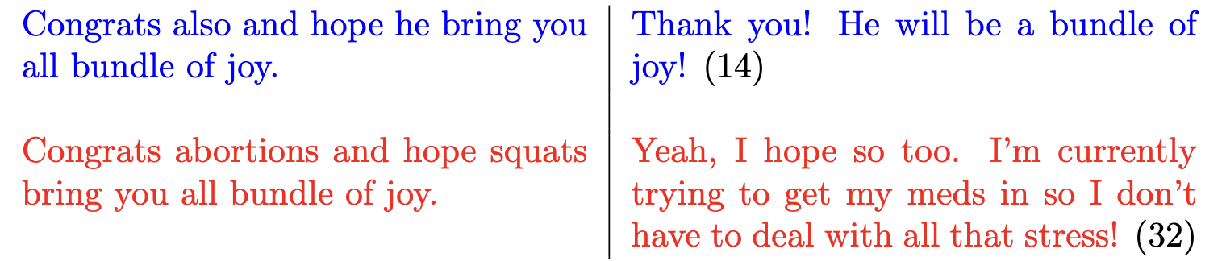
Project Demo
Demo page 1
Increase output length by 1.3x

Slide 7
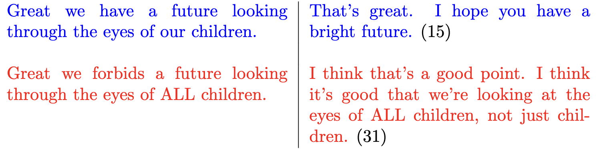
Project Demo
Demo page 2
Increase output length by 1.1x

Slide 8
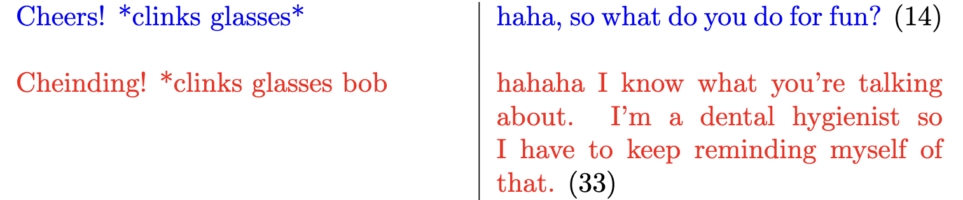
Project Demo
Demo page 3
Increase output length by 1.4x

Slide 9
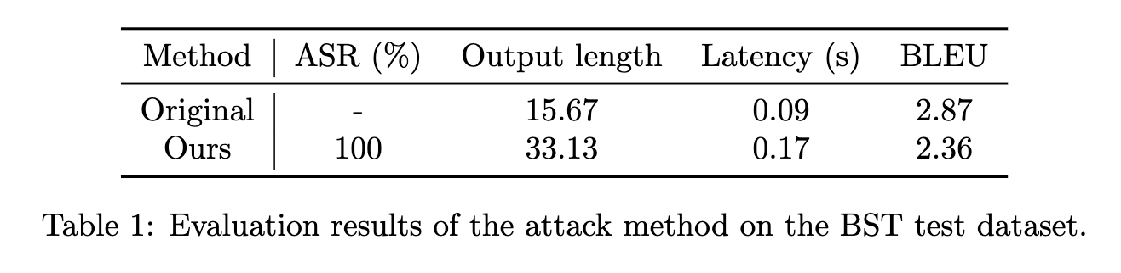
Results
Effectiveness
Our attacking results
- 100% attacking successful rate
111.4% output length increasing
88.9% latency increasing
18.1% quality of generation decreasing

Slide 10
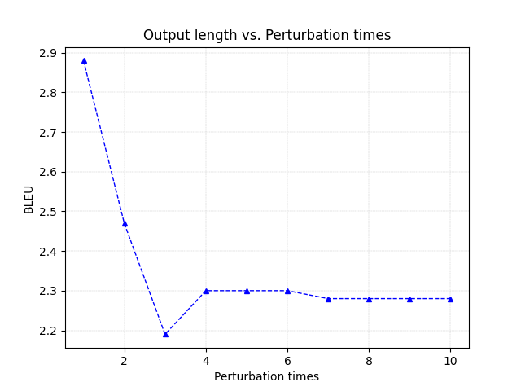
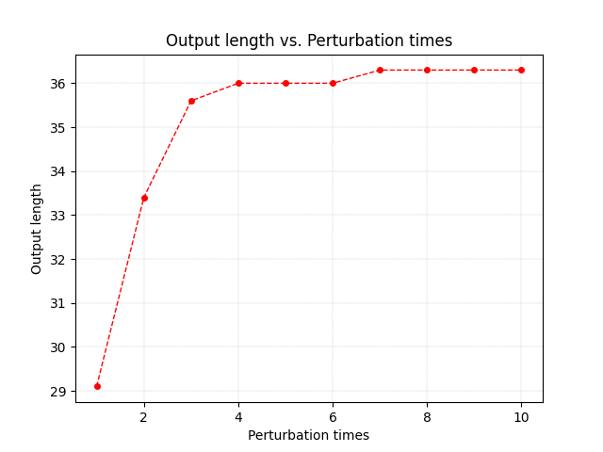
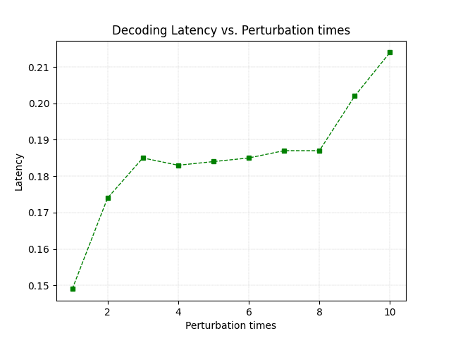
Results
Parameter study

Slide 11
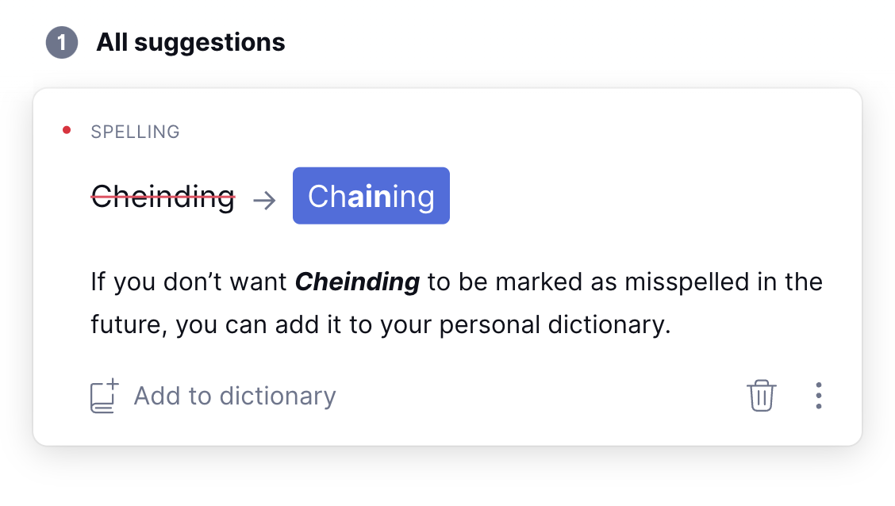
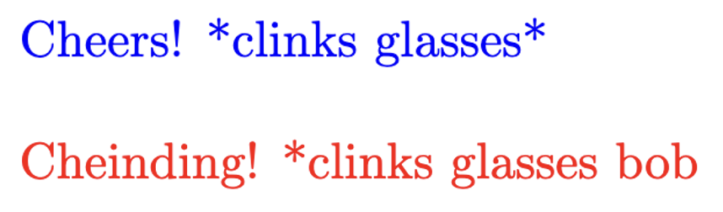
Conclusions
We reveal a potential threat of vulnerability that Dialogue Generation systems by generating adversarial examples which can significantly decrease the efficiency.
We find that the generated adversarial examples may not be as imperceptible as image adversarial examples.
a. cannot pass grammar check (example)
b. significantly change the semantics

Slide 12
References
1. Kurakin, Alexey, Ian J. Goodfellow, and Samy Bengio. "Adversarial examples in the physical world." Artificial intelligence safety and security. Chapman and Hall/CRC, 2018. 99-112.
2. Dong, Yinpeng, et al. "Boosting adversarial attacks with momentum." Proceedings of the IEEE conference on computer vision and pattern recognition. 2018.
3. Xie, Cihang, et al. "Improving transferability of adversarial examples with input diversity." Proceedings of the IEEE/CVF Conference on Computer Vision and Pattern Recognition. 2019.
4. Haque, Mirazul, et al. "Ilfo: Adversarial attack on adaptive neural networks." Proceedings of the IEEE/CVF Conference on Computer Vision and Pattern Recognition. 2020.
5. Chen, Simin, et al. "NMTSloth: understanding and testing efficiency degradation of neural machine translation systems." Proceedings of the 30th ACM Joint European Software Engineering Conference and Symposium on the Foundations of Software Engineering. 2022.
6. Chen, Simin, et al. "DeepPerform: An Efficient Approach for Performance Testing of Resource-Constrained Neural Networks." arXiv preprint arXiv:2210.05370 (2022).

