Slide 1
Flow-Sensitive Type-Based
Heap Cloning
Mohamad Barbar ^{1,2}
Yulei Sui ¹
Shiping Chen ²
¹ University of Technology Sydney
² CSIRO’s Data61

Slide 2
Points-to analysis
Points-to analysis
What does pointer “p” point to?
  pt(p) = { o1, o2, ... }
Why?
  Compiler optimisations
  Bug detection
  Security enforcement
Various sensitivities
  Field
  Flow
  Context
Precision at the expense of speed

Slide 3
Strict aliasing
Pointers to incompatible types cannot alias when dereferenced
A char * can alias any pointer
Enables type-based alias analysis (TBAA)
1 void foo(int *i, long *l, char *c) {
2 ...
3 }
ALIAS(i, l)? No
ALIAS(i, c)? Yes
ALIAS(l, c)? Yes

Slide 4
Motivation
Analysis
cclyzer-ss¹
--
Sparse²
--
--
--
TypeClone
Relations
pt(p) = { o•, oint, ofloat }
pt(q) = { o•, oint, ofloat }
pt(l8-, p) = { o• }
pt(l10-, q) = { o• }
pt(l8, p) = { o•, oint, ofloat }
pt(l9-, p) = { oint }
pt(l10, q) = { o•, oint, ofloat }
pt(l11-, q) = { ofloat }
1 void *xmalloc(size_t n) {
2 void *x = malloc(n); // o•
3 if (!x && n != 0) xalloc_die();
4 return x;
5 }
6
7 int main(void) {
8 int *p = (int *)xmalloc(…);
9 *p = 1;
10 float *q = (float *)xmalloc(…);
11 *q = 0.5;
12 ...
13 }
l12: ALIAS(p, q)?
Yes
Yes
No
1 Balatsouras, George, and Yannis Smaragdakis. "Structure-sensitive points-to analysis for C and C++." International Static Analysis Symposium. Springer, Berlin, Heidelberg, 2016.
2 Hardekopf, Ben, and Calvin Lin. "Flow-sensitive pointer analysis for millions of lines of code." International Symposium on Code Generation and Optimization (CGO 2011). IEEE, 2011.

Slide 5
Subtyping relations
char
1 struct S {
2 int i;
3 void *v;
4 }
5 class C : public S {
6 float f;
7 virtual void foo(void) { }
8 }
9 union U {
10 long l;
11 int i;
12 }
int
long
float
void *
S
U
t′ is a subtype of t if t is reachable from t′:
t ≺ t′
C

Slide 6
Type model
R1 An abstract heap object’s type is undefined until a non-void type is potentially assigned.
R2 Any pointer may point to any object. However, through a pointer of type t *, only objects whose type is t′, such that t ≺ t′, may be read.
R3 For pointer arithmetic q = p + j, q will either point within the object pointed to by p, or at one past the last element of the object if it is an array object.
R4 An object may not access any of its virtual methods until it is passed to the corresponding constructor.
R5 An object’s type can be changed to a type that is not a transitive base (i.e. reuse).

Slide 7
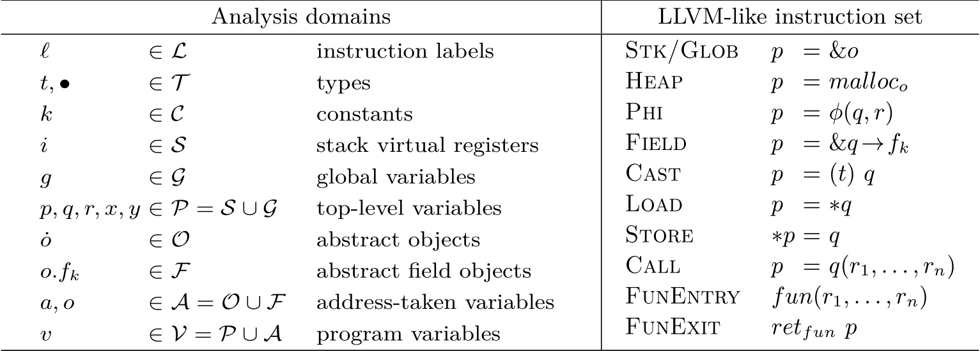
Analysis focus

Slide 8
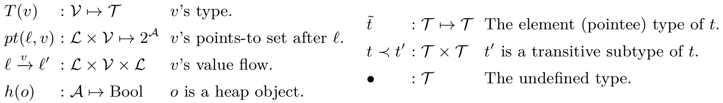
Quick notation

Slide 9
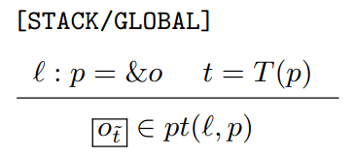
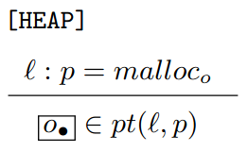
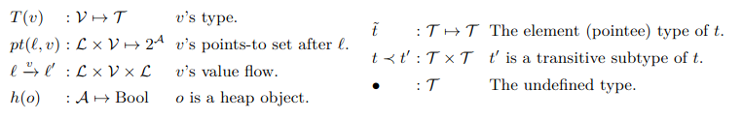
TypeClone: allocation

Slide 10
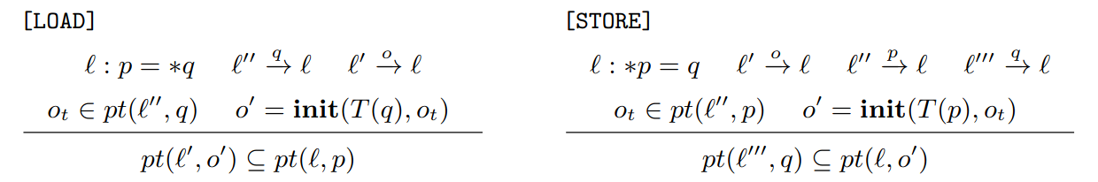
TypeClone: loads and stores

Slide 11
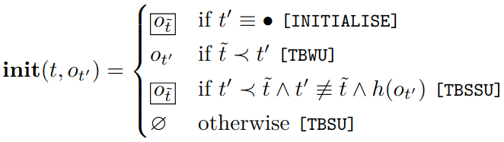
TypeClone: object initialisation

Slide 12
TypeClone: object initialisation
Initialisation
1 S *s = (S *)malloc(…); // o•
2 *s = …;
init(S *, o•) = oS

Slide 13
TypeClone: object initialisation
Type-based weak updates
1 S s; // oS
2 S *p = &s;
3 … = *p;
4 char *q = (char *)&s;
5 … = *q;
init(S *, os) = oS
init(char *, os) = os

Slide 14
TypeClone: object initialisation
Type-based semi-strong updates
1 char *c = malloc(…); // o•
2 *c = …; // ochar
3 S *s = c;
4 *s = …;
init(S *, ochar) = oS

Slide 15
TypeClone: object initialisation
Type-based strong updates
1 S *s = foo(…); // oT, oS
2 … = *s;
init(S *, oT) = ∅
init(S *, oS) = oS

Slide 16
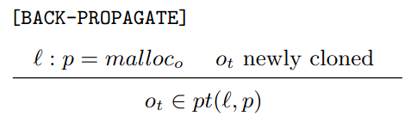
TypeClone: back-propagation
1 int *i = malloc(…); // o•
2 void *v = i;
3 *i = 1; // oint
, oint
pt(l3, i) = { oint }, pt(l3, a) = { o• }
pt(l3, i) = { oint }, pt(l3, a) = { oint, o• }
Unsound!
Sound!

Slide 17
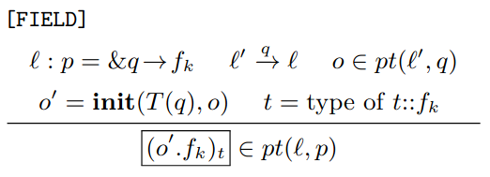
TypeClone: field-sensitivity

Slide 18
Evaluation

Slide 19
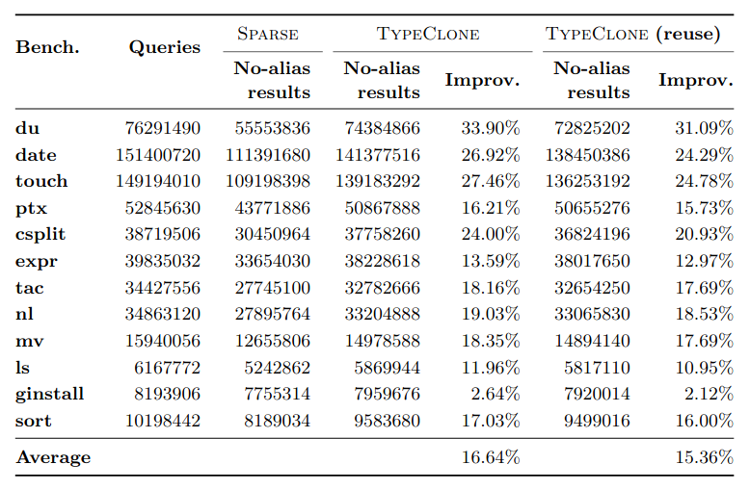
Evaluation: precision

Slide 20
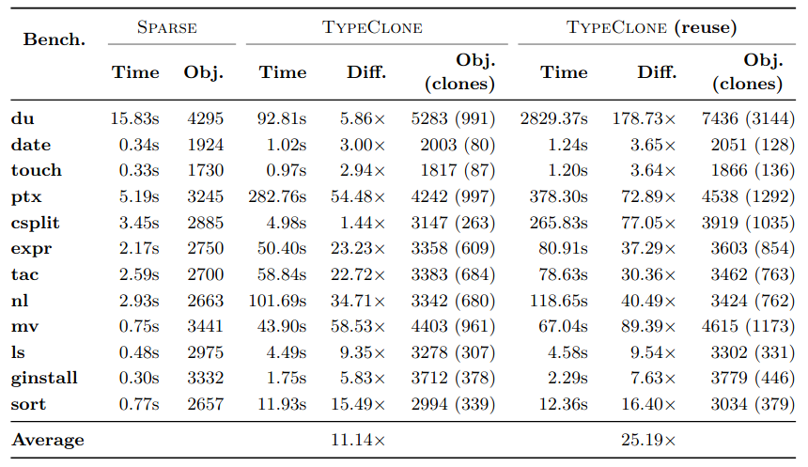
Evaluation: time

Slide 21
Summary
TypeClone: a flow- and field-sensitive, type-based points-to analysis
More precise than Sparse at the expense of speed
  Lighter than context-sensitivity
New strong updates: type-based strong updates
Try it @ https://bit.ly/typeclone

