Slide 1
Type-Based Heap Cloning

Slide 2
Background
Pointer analysis
Flow-sensitivity/insensitivity
Allocation wrappers
Strict aliasing

Slide 3
Pointer Analysis
int i; // o₁
void *v = malloc(...); // o₂
int *p = &i;
int *q = (int *)v;
One abstract object per allocation site
Result
  pt(v) = { o₂ }
  pt(p) = { o₁ }
  pt(q) = { o₂ }
v may-alias q because pt(v) ∩ pt(q) ≠ ∅
p does not-alias q because pt(p) ∩ pt(q) = ∅

Slide 4
Flow Sensitivity
Flow-insensitive
  pt(p, l₁ ) = { o₁ , o₂ }
  pt(p, l₂ ) = { o₁ , o₂ }
  ∀x. ∀y. pt(p, l_{x} ) ≡ pt(p, l_{y} )
Flow-sensitive
  pt(p, l₁ ) = { o₁ }
  pt(p, l₂ ) = { o₂ }
int i; // o₁
void *v = malloc(...); // o₂
int *p = &i; // l₁
p = (int *)v; // l₂

Slide 5
Allocation Wrappers
void *xmalloc(size_t s) {
void *x = malloc(s); // o
assert(v && “Failed!”);
return x;
}
int *i = xmalloc(...);
float *f = xmalloc(...);
long *l = xmalloc(...);
pt(i) = { o }
pt(f) = { o }
pt(l) = { o }
Separate allocations but they all alias!

Slide 6
Strict Aliasing (C/C++)
int *i = ...;
*i;
float *f = ...;
*f;
A pointer may only dereference objects with a compatible type
  (undefined behaviour otherwise)
  ∴ two pointers of incompatible ∴ types do not alias

Slide 7
Strict aliasing can be used to differentiate objects which originate from the same allocation site

Slide 8
Motivation
void *xmalloc(size_t s) {
void *x = malloc(s); // o
assert(v && “Failed!”);
return x;
}
int *i = xmalloc(...); // l₁
*i = 1; // l₂
float *f = xmalloc(...); // l₃
*f = 2.0; // l₄
pt(i, l₁ ) = { o } pt(i, l₂- ) = { o_{int} }
pt(f, l₃ ) = { o } pt(f, l₄- ) = { o_{float} }
At l₂, we know the object pointed to by i is an int
At l₄, we know the object pointed to by f is a float
∴ o refers to at least two ∴ objects – an int object ∴ and a float object

Slide 9
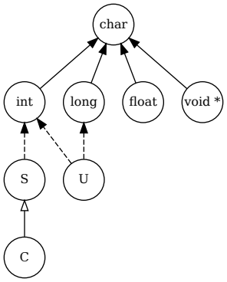
Type Compatibility
struct S {
int i;
void *v;
};
class C : public S {
float f;
virtual void foo(void) { }
};
union U {
long l;
int i;
};

Slide 10
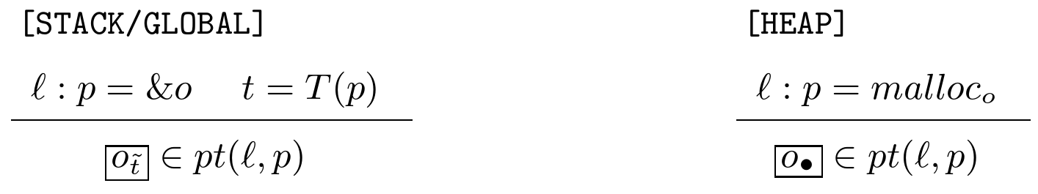
Allocation
int i;
int *p = &i; // l
int *p = malloc(...); // l
pt(p, l) = { o_{int} }
pt(p, l) = { o• }

Slide 11
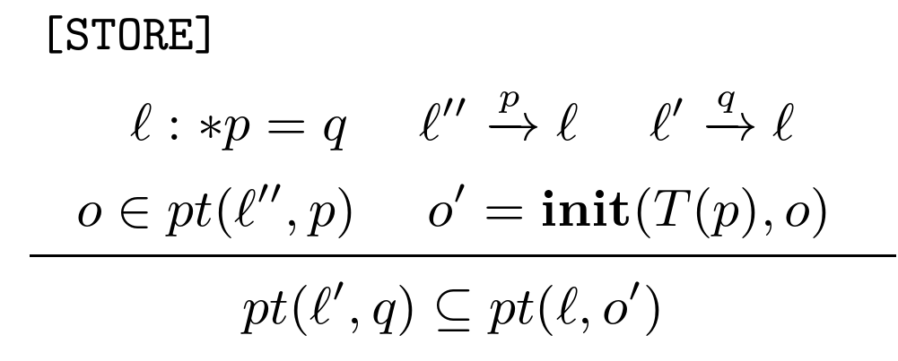
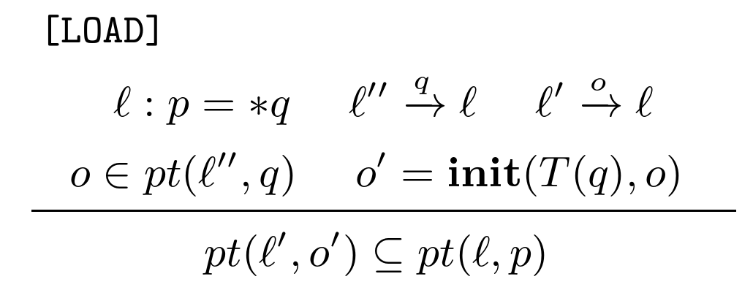
Memory Access

Slide 12
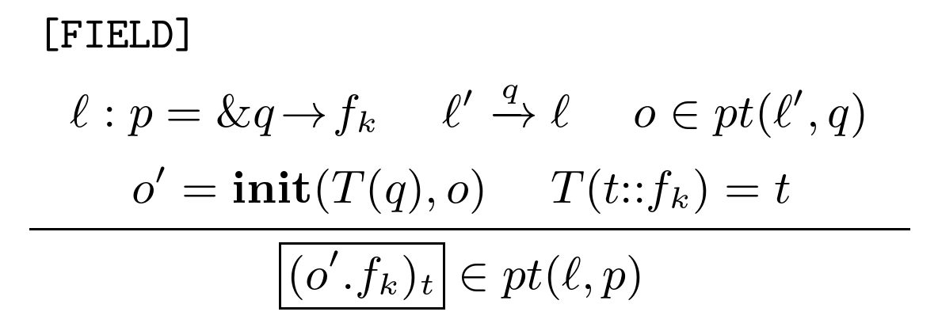
Field Accesses

Slide 13
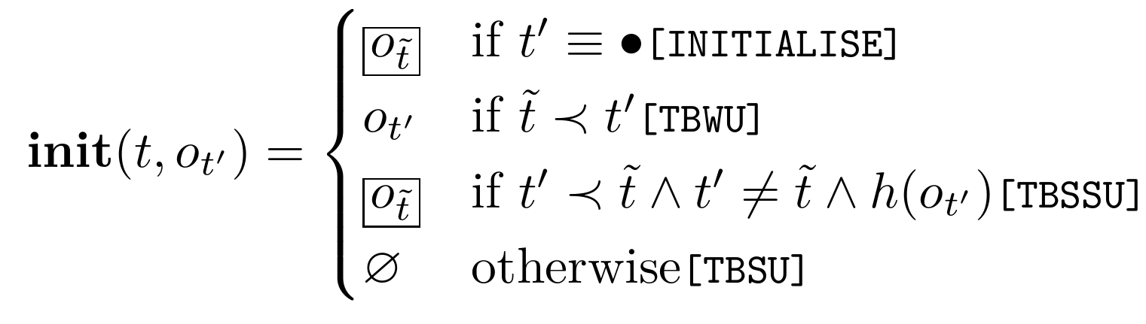
init Function
char *c = ...;
*c; // pt(c) = { o_{int} }
t : accessing pointer type
t’ : type of the accessed
t̃ : base type of t
≺ : sub-typing relation
t : char *
t’ : int char ≺ int
t̃ : char

Slide 14
init Function
Given an untyped object, we return an object typed with the expected type
int *i = ...;
*i; // pt(i) = { o• } → { o_{int} }

Slide 15
init Function
If the object’s type is compatible with the expected type, we just reuse the object
Type-Based Weak Update
char *c = ...;
*c; // pt(c) = { o_{int} } → { o_{int} }

Slide 16
init Function
If the expected type is a sub-type of the object’s type (downcast), return a new object with the expected type
Type-Based Semi-Strong Update
Derived *d = ...;
*d; // pt(d) = { o_{Base} } → { o_{Derived} }

Slide 17
init Function
If the expected type is incompatible with the object’s type, return nothing (i.e. filter it)
Type-Based Strong Update
int *i = ...;
*i; // pt(i) = { o_{float}, o_{int} } → { o_{int} }

Slide 18
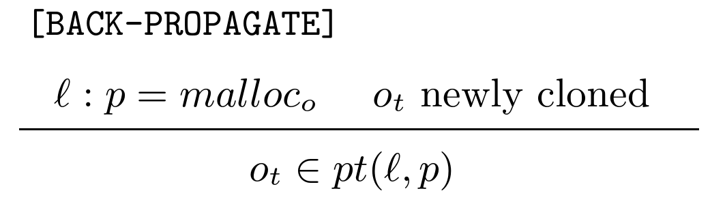
Aliases Before Cloning
void *xmalloc(size_t s) {
void *x = malloc(s); // o
assert(v && “Failed!”);
return x;
}
void *v = xmalloc(...); // l₁
int *i = (int *)v; // l₂
*i = 1; // l₃
pt(v, l₁-) = { o• }
pt(i, l₂ ) = { o• }
pt(i, l₃-) = { o_{int} }
BUT v and i should alias at l₃ onwards
  ∴ back-propagate

Slide 19
Aliases Before Cloning
void *xmalloc(size_t s) {
void *x = malloc(s); // o
assert(v && “Failed!”);
return x;
}
void *v = xmalloc(...); // l₁
int *i = (int *)v; // l₂
*i = 1; // l₃
pt(v, l₁-) = { o• , o_{int} }
pt(i, l₂ ) = { o• , o_{int} }
pt(i, l₃-) = { o_{int} }
Sound again!

Slide 20
Conclusion

