Slide 1
In-depth analysis of
Anubis Banking Trojan
Background: Anubis attack pictures (payload)
Aims and problems
What is payload (define)?
Methodologies: break down into parts
Steps correspond to figures
Try to be well-organised

Slide 2
Motivation

Slide 3
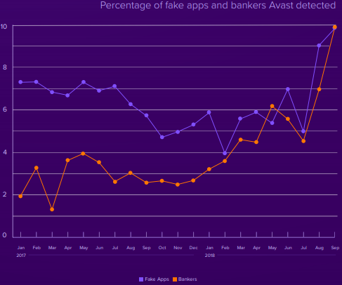
Why Banking Trojans
“we believe that cybercriminals are finding bankers to be a more reliable way to make money than cryptomining. ”
------ Avast
https://press.avast.com/hubfs/media-materials/kits/2019-Predictions-Report/Avast%202019%20Threat%20Landscape%20Report.pdf?hsLang=en

Slide 4
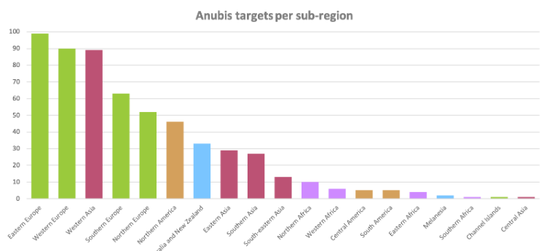
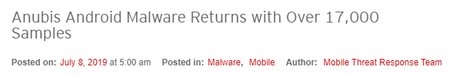
Why Anubis
https://www.threatfabric.com/blogs/anubis_2_malware_and_afterlife.html
https://blog.trendmicro.com/trendlabs-security-intelligence/anubis-android-malware-returns-with-over-17000-samples/

Slide 5
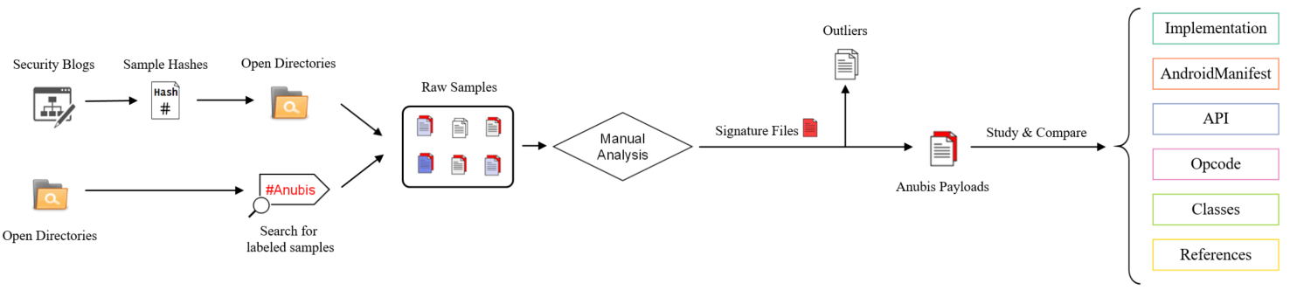
Workflow

Slide 6
Existing work
(under construction)
--- Should be in forms

Slide 7
Background

Slide 8
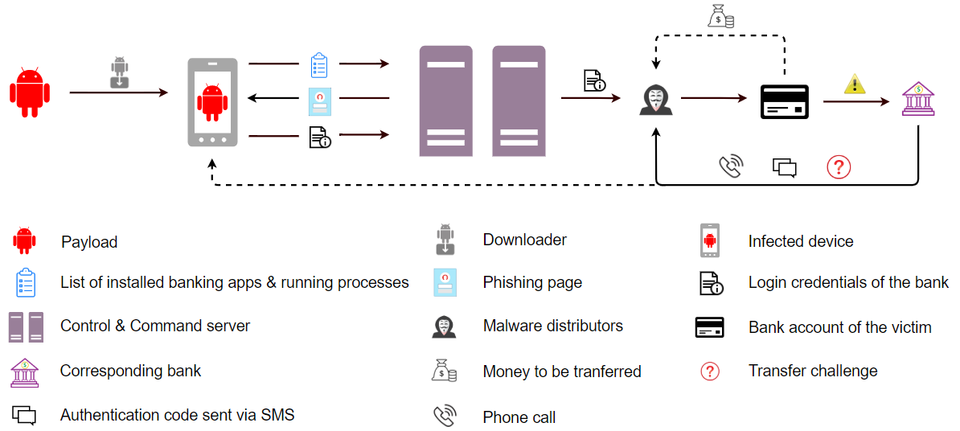
Anubis Attack Mechanism
* Steps correspond to figures

Slide 9
Dataset

Slide 10
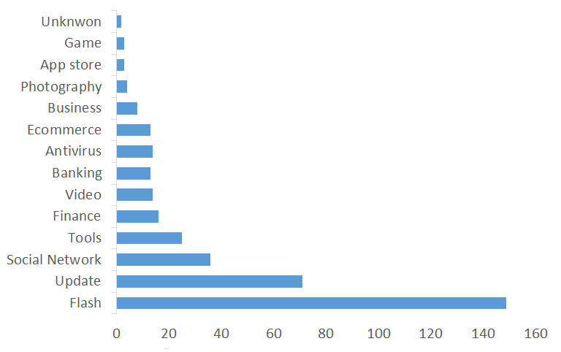
Data taxonomy based on App type

Slide 11
Results and analysis

Slide 12
Implementation Details
Downloader
AndroidManifest.xml
①
②
android.permission.BIND_DEVICE_ADMIN
&
android.intent.action.PACKAGE_ADDED
android.permission.REQUEST_INSTALL_PACKAGES &
com.google.android.finsky.permission.BIND_GET_INSTALL_REFERRER_SERVICE (get referrer URL)
&
Receiver for com.android.vending.INSTALL_REFERRER
-uses permission: android.permission.INSTALL_PACKAGES
Receivers

Slide 13
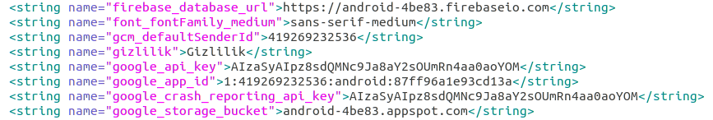
Implementation Details
Downloader
Code Details
A
res.values.strings.xml

Slide 14
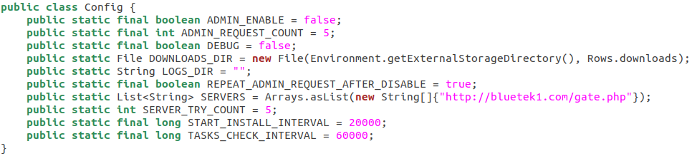
Implementation Details
Downloader
Code Details
B

Slide 15
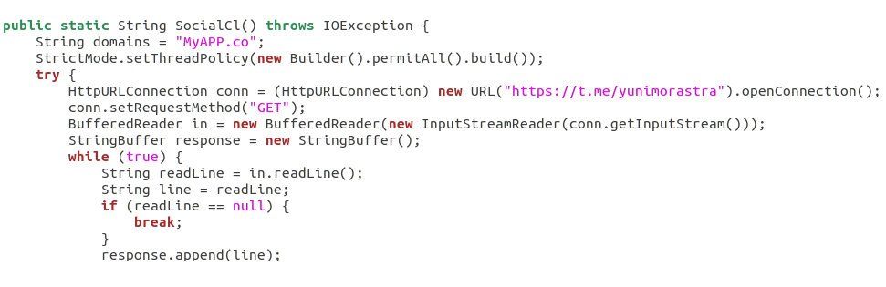
Implementation Details
Downloader
Code Details
C

Slide 16
Implementation Details
Dropper
Real Payload to be dropped
Directory names | Files names
image | images
templates | main.tpl
assets | extand.bak
layout | about.xml
 | files
Others are all junk classes (codes) !

Slide 17
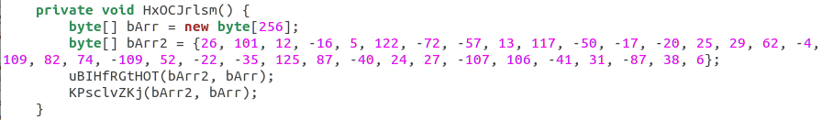
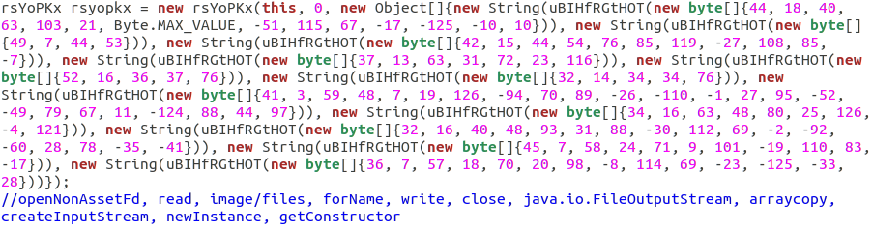
Implementation Details
Dropper
Code details
RC4 key to decrypt payload and literals
Classes’ and methods’ names in bytes

Slide 18
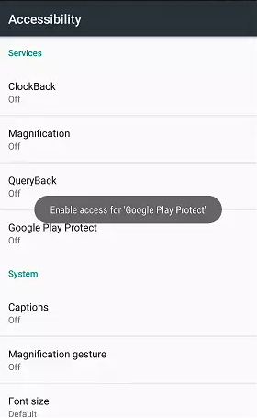
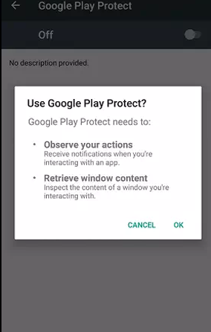
Implementation Details
Payload
Functionalities
Request privilege escalation for Accessibility

Slide 19
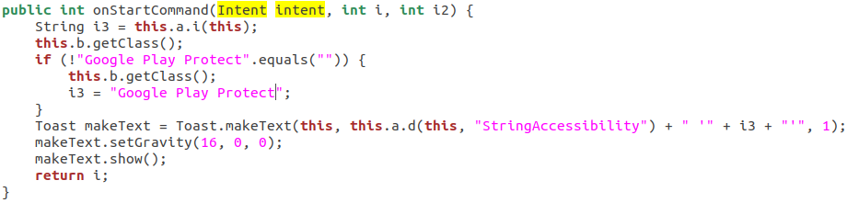
Implementation Details
Payload
Functionalities
Using self-made toast

Slide 20
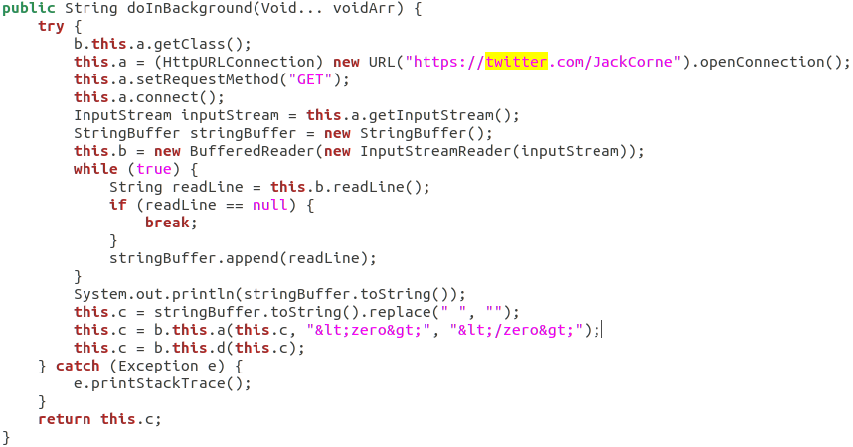
Implementation Details
Payload
Functionalities
Real C&C address fetching through intermediate social server (twitter)

Slide 21
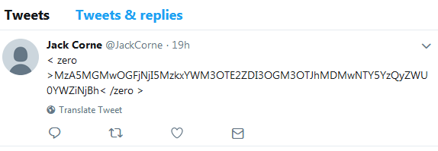
Implementation Details
Payload
Functionalities
Real C&C address fetching through intermediate social server (twitter)

Slide 22
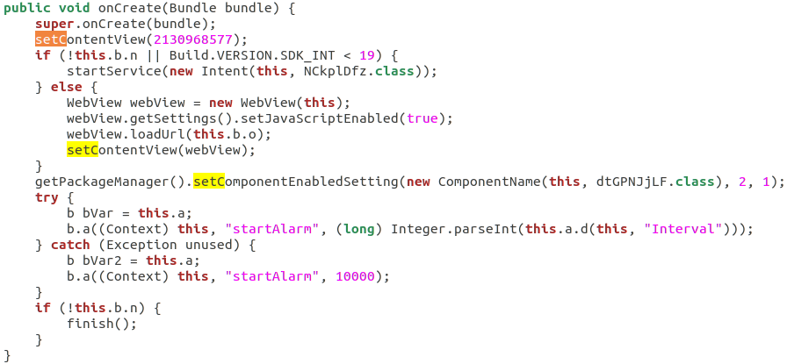
Implementation Details
Payload
Functionalities
Self-hiding (icon hidden)
2: COMPONENT_ENABLED_STATE_DISABLED
1: DONT_KILL_APP

Slide 23
Implementation Details
Payload
Functionalities via
RAT(Remote Access Tool)
Send_GO_SMS | Send certain SMS to certain telephone number
nymBePsG0 | Steal contacts info
GetSWSGO | Steal local SMS
getapps | Acquire installed App list
getpermissions | Acquire granted permissions
startaccessibility | Request accessibility privilege
startpermission | Request specified permissions
=ALERT| | Popup specified alert window
=PUSH| | Push specified notifications
startAutoPush | Push notifications automatically based on country
RequestPermissionGPS | Request GPS-related permissions
|ussd= | Call forward

Slide 24
Functionalities via
RAT(Remote Access Tool)
|recordsound= | Record sound
|replaceurl= | Replace C&C server
|startapplication= | Start specified application
getkeylogger | Steal key log
stopsound | Stop recording
startsound | Start recording
startscreenVNC | Start VNC (remote control)
deletefilefolder: | Delete certain file
downloadfile: | Download certain file
opendir: | Acquire file path
startforward= | Start to forward calls to certain number and set device to silent mode
stopforward | Stop forwarding calls to certain number and set device to silent mode

Slide 25
Functionalities via
RAT(Remote Access Tool)
|openbrowser= | Open browser
|openactivity= | Invoke the activity to open certain webpage
|cryptokey= | Crypt files(/mnt, /mount, /sdcard, /storage)
|decryptokey= | Decrypt files(/mnt, /mount, /sdcard, /storage)
getip | Get the device’s IP address

Slide 26
Comparisons
RQ1: Does different Anubis payload have similar/different AndroidManifest.xml ?
Percentage of samples | Similarity scores
2.7% | 100
87.1% | >=90
7.6% | >=80
1.9% | >=70
0.7% | others

Slide 27
Comparisons
RQ2: Does different Anubis payloads have similar or different API methods/classes?
API methods
Percentage of samples | Similarity scores
1.8% | 100
73.6% | >=90
14.7% | >=80
6.8% | >=70
3.1% | others

Slide 28
Comparisons
RQ2: Does different Anubis payloads have similar or different API methods/classes?
API classess
Percentage of samples | Similarity scores
15.7% | 100
81.2% | >=90
2.5% | >=80
0.6% | others

Slide 29
Comparisons
RQ3: Does different Anubis payloads have similar or different opcodes?
Op-codes in length (Longest shared string)
Percentage of samples | Similarity scores
0.3% | 100
1.5% | >=90
4.6% | >=80
13.9% | >=70
15.2% | >=60
26.9% | >=50
37.6% | others

Slide 30
Comparisons
RQ3: Does different Anubis payloads have similar or different opcodes?
Op-codes in length (3-gram)
Percentage of samples | Similarity scores
3.6% | 100
6.5% | >=90
4.6% | >=80
17.3% | >=70
32.5% | >=60
21.4% | >=50
14.1% | others

Slide 31
Comparisons
RQ4: Does different Anubis payloads have similar or different numbers of classes?
Percentage of samples | Similarity scores
16.2% | 100
43.6% | >=90
31.7% | >=80
5.3% | >=70
3.2% | others

Slide 32
Comparisons
RQ5: Does different Anubis payloads have similar or different reference maps?
AndroidManifest.xml:
a. Declared and existing classes
b. Declared but not existing classes
c. Not declared but existing classes
Code Segments:
Import maps
“startactivity” and “startservice” invocation maps
Percentage of samples | Overall similarity scores
0.6% | 100
13.6% | >=90
17.2% | >=80
15.6% | >=70
16.4% | >=60
10.5% | >=50
26.1% | others

Slide 33
Q & A

