Slide 1


ECE 411 MP4 Final Presentation
This Isn’t CS 411
Mitchell Bifeld
Neha Agarwal
Yu Li

Slide 2

Baseline
In order, 5-stage pipeline
2-way SA cache w/ 8 sets for Data Cache & Instruction Cache
Static not-taken branch prediction
ELECTRICAL & COMPUTER ENGINEERING
GRAINGER ENGINEERING

Slide 3

Advanced Features
ELECTRICAL & COMPUTER ENGINEERING
GRAINGER ENGINEERING

Slide 4
Advanced Features Overview
Cache Optimizations
Parameterized Cache
4/8-way Cache
L2 Cache
OBL Prefetching
Victim Cache
Branch Prediction
Local Branch Predictor
Global Branch Predictor
Tournament Branch Predictor
BTB
Software Branch Prediction
ELECTRICAL & COMPUTER ENGINEERING
GRAINGER ENGINEERING
Notes:
45 seconds slides 1-4

Slide 5
Cache Optimization
ELECTRICAL & COMPUTER ENGINEERING
GRAINGER ENGINEERING

Slide 6
Parameterized Cache
Parameterized Sets and Ways
Sets
Changed tag and index selection bits
Ways
Pseudo LRU
Generate block to create tag array, data array, etc.
ELECTRICAL & COMPUTER ENGINEERING
GRAINGER ENGINEERING

Slide 7
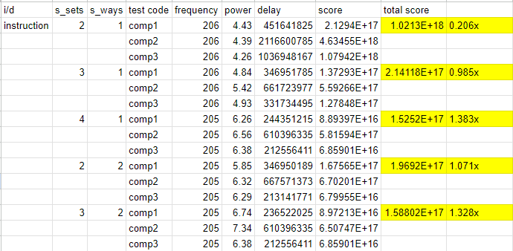
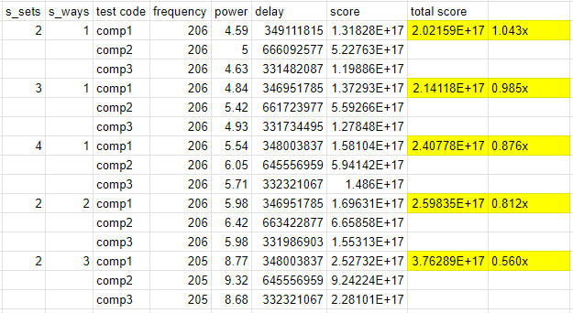
Parameterized Cache
Results: Best performance with 2-way cache with 16 sets on ICache and 4 sets on DCache
Instruction Cache
Data Cache
ELECTRICAL & COMPUTER ENGINEERING
GRAINGER ENGINEERING

Slide 8
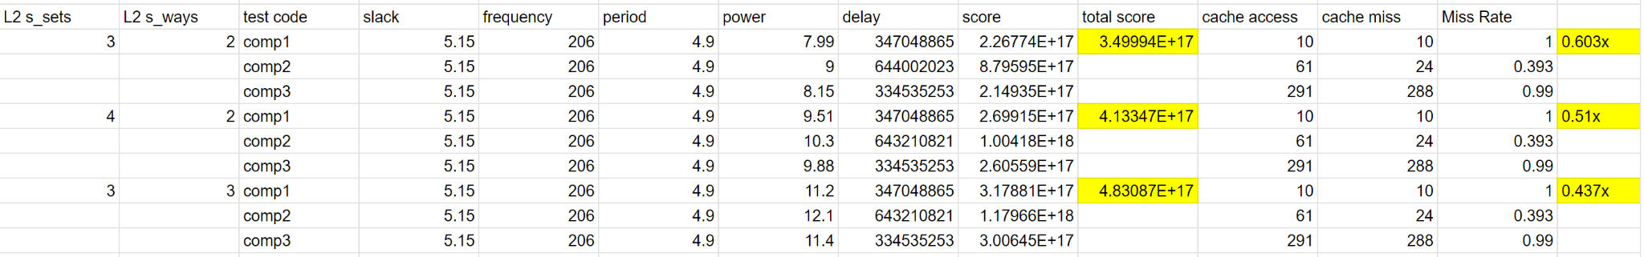
L2 Cache
Applied to data cache
L1: 2-way SA w/ 8 sets
L2
write_en = 32’d0
No read before write
Results: Worse performance due to high power requirement
ELECTRICAL & COMPUTER ENGINEERING
GRAINGER ENGINEERING

Slide 9
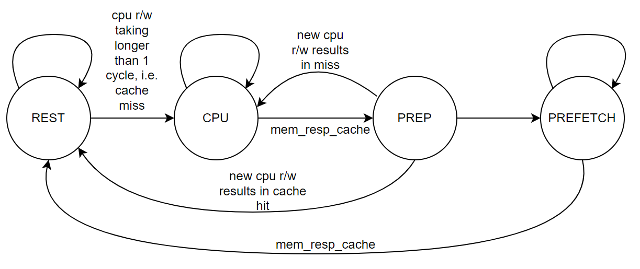
OBL Prefetching
Applied to data cache
Initiates prefetch only when
Last CPU access resulted in miss
CPU is not attempting read/write
Results: Performs slightly worse overall, results vary by testcode
Simplified state diagram for prefetching
ELECTRICAL & COMPUTER ENGINEERING
GRAINGER ENGINEERING

Slide 10
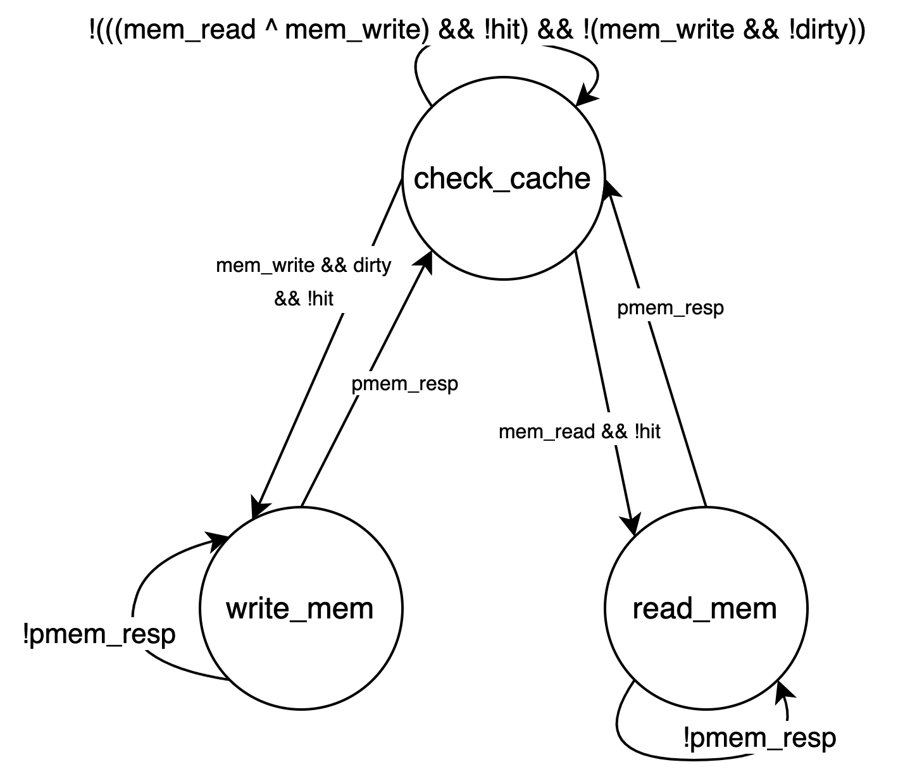
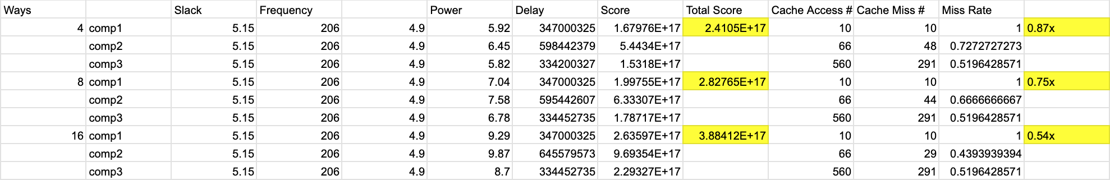
Victim Cache
4, 8, and 16-Way FA Victim Cache
Placed between L1 and Physical Memory within the Data Cache
Utilized Parameterized Cache for faster development
Had to adjust L1 Cache to write back clean evictions
Results: Worse Performance Due To High Miss Rate
ELECTRICAL & COMPUTER ENGINEERING
GRAINGER ENGINEERING

Slide 11
Branch Prediction
ELECTRICAL & COMPUTER ENGINEERING
GRAINGER ENGINEERING
Notes:
2.5 minutes for branch prediction

Slide 12
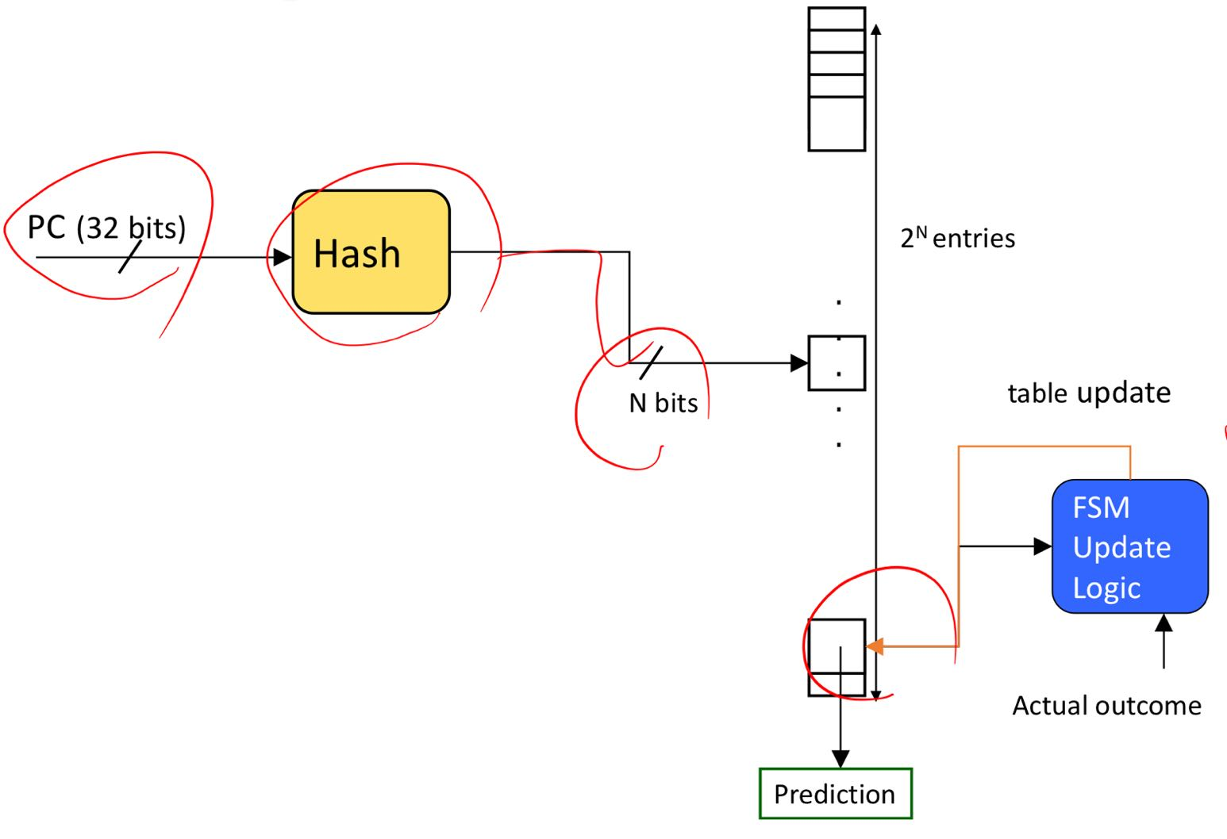
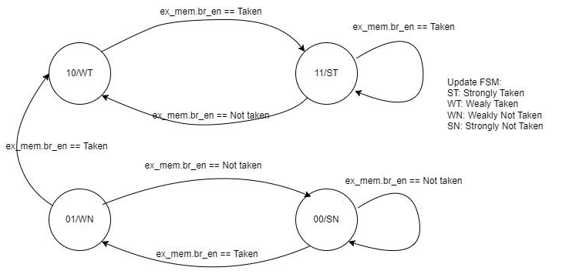
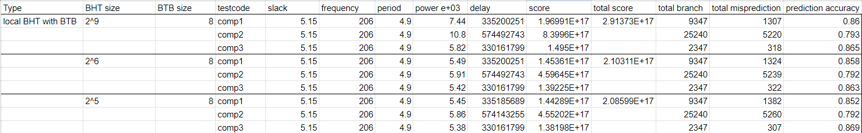
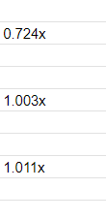
Local Branch Predictor 1
2-bit predictor table & update FSM
- Use PC [idx_bits+1:2] to directly index the predictor table.
- Get the 2-bit predictor, determine the predicted direction.
Update logic:
- Input: branch enable signal from ex_mem stage.
- Output: updated 2-bit predictor.
Result: The 2^5 choice has better performance than the baseline.
ELECTRICAL & COMPUTER ENGINEERING
GRAINGER ENGINEERING

Slide 13
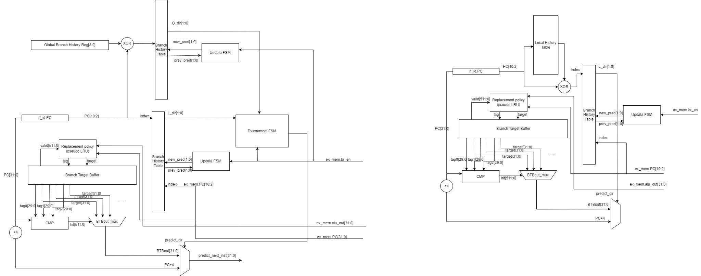
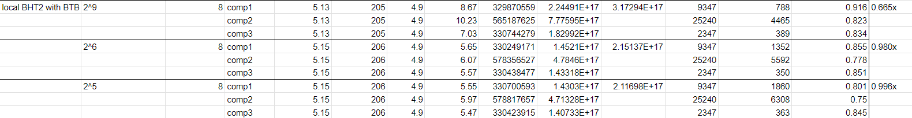
Local Branch Predictor 2
2-bits predictor table & Local history table & Update FSM
- Maintain a local history table which each entry corresponds to a separate conditional jump, and each entry contains the history of branches at this branch PC.
The prediction accuracy and latency for the 2^9 case is the best, but the power increases the score.
The 2^5 case has the best performance, but it doesn’t outperform the baseline.
ELECTRICAL & COMPUTER ENGINEERING
GRAINGER ENGINEERING

Slide 14
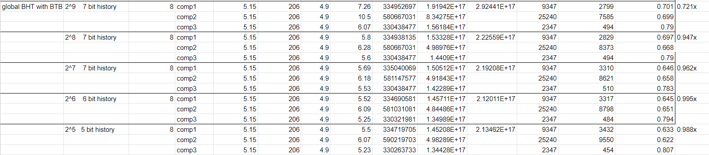
Global Branch Predictor
Shared Global History Register & 2-bit predictor table & Update FSM
- In addition to the local branch predictor 1, the global branch predictor keeps track of last n branches (n=7).
- The branch history is stored in a 7-bits shift register.
- PC[idx_bits+1:2] XOR zero-extended global history register.
Results: Worse performance due to the power increase. Accuracy is low because all the global branches pollute the prediction register.
ELECTRICAL & COMPUTER ENGINEERING
GRAINGER ENGINEERING

Slide 15
Tournament Branch Predictor
Combination of local branch predictor 1 and global branch predictor
Combine 2^5 local predictor and 2^6 global
predictor.
lc_pred gl_pred testcode score total score
Result: Worse performance due to the power
increase.
ELECTRICAL & COMPUTER ENGINEERING
GRAINGER ENGINEERING

Slide 16
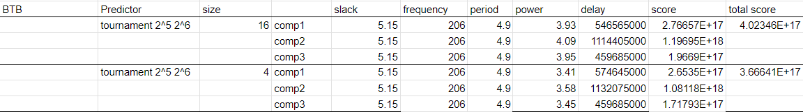
BTB
Fully-associative BTB with pseudoLRU
- Most efficient at 8 entries.
- Recursive pseudoLRU.
ELECTRICAL & COMPUTER ENGINEERING
GRAINGER ENGINEERING

Slide 17
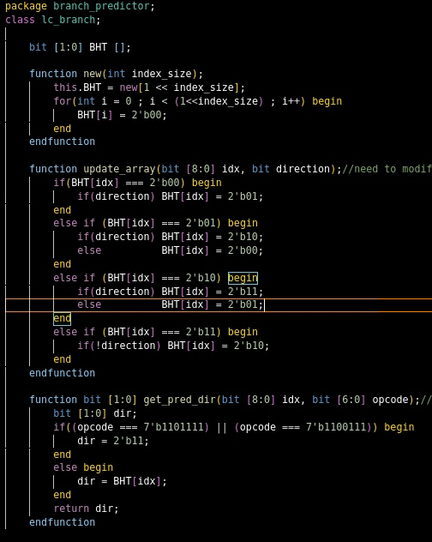
Software Branch Prediction Model
Debugging method for branch predictor
- Using software model to compute the expectation, compare the expectation with the actual prediction.
- Example code for local branch predictor software model (right)
ELECTRICAL & COMPUTER ENGINEERING
GRAINGER ENGINEERING

Slide 18
Final Results
ELECTRICAL & COMPUTER ENGINEERING
GRAINGER ENGINEERING
Notes:
1.5 minutes slides 18-21

Slide 19
Final Results
Advanced Features Included In Final Design
Instruction Cache - 16-Set 2-Way L1
Data Cache - 4-Set 2-Way L1
Local Branch Prediction - 32 Entries
Final Frequency: 333 MHz
ELECTRICAL & COMPUTER ENGINEERING
GRAINGER ENGINEERING
Notes:
When ran at same frequency, it’s a 1.5x speedup

Slide 20
What We Would Do Differently
Test codes are small, so most cache optimizations did little
There are lots of function calls in the test code, so having RAS should improve the performance
ELECTRICAL & COMPUTER ENGINEERING
GRAINGER ENGINEERING
Notes:
RAS = Return Address Stack

Slide 21
Q & A
ELECTRICAL & COMPUTER ENGINEERING
GRAINGER ENGINEERING

