Slide 1
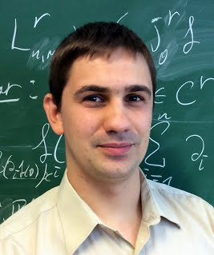
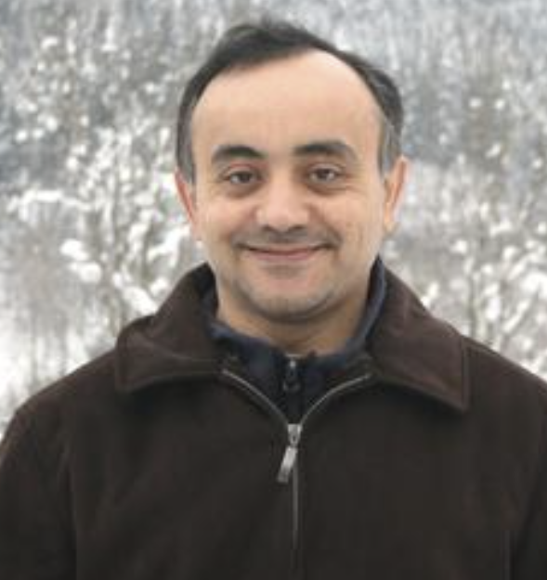

Two tubes model of miscible displacement: travelling waves and normal hyperbolicity
Yulia Petrova
IMPA
yulia-petrova@github.io
Sergey Tikhomirov
University of Duisburg-Essen
Germany
13th Americas Conference on Diff. Equations and Nonlinear Analysis and ICMC Summer Meeting on Differential Equations - 2023 Chapter
Yalchin Efendiev
Texas A&M
USA

Slide 2
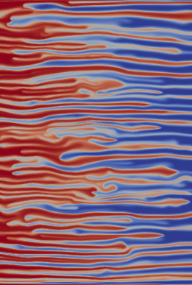
Outline
General phenomenon
  Viscous fingers
  Gravitational fingers
Motivation of the statement of the problem
  Why we believe that our setting is important
  Introduce the “toy model”
Theorem and Conjectures

Slide 3

Homsy, G.M., 1987. Viscous fingering in porous media.
Annual review of fluid mechanics, 19(1), pp.271-311.

Slide 4
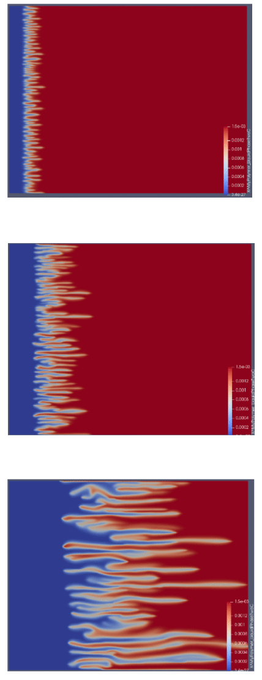
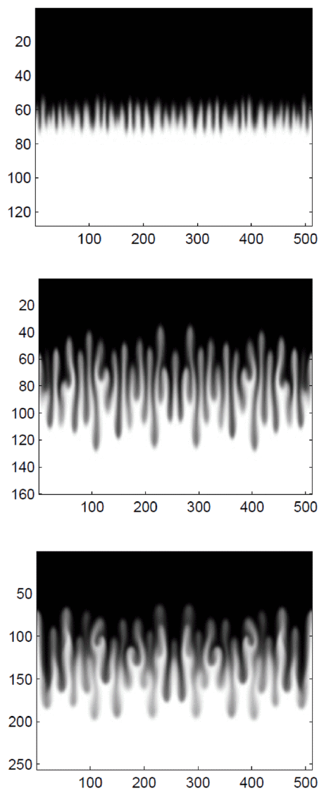
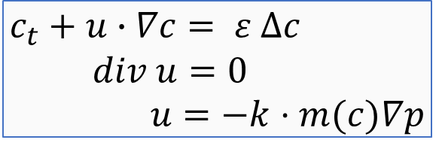
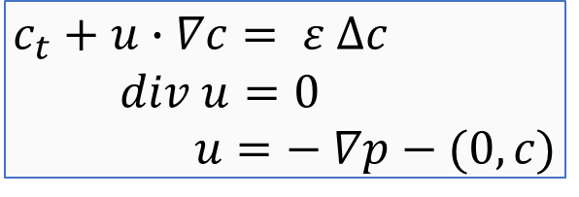


Two settings (Peaceman model)
Viscosity-driven fingers
Gravity-driven fingers
$$c_{t}+u∙∇c= ε ∆c \\ div u=0 \\ u=−k⋅m(c)∇p$$
$$c_{t}+u∙∇c= ε ∆c \\ div u=0 \\ u=− ∇p−(0, c)$$
$c$ – concentrations of viscous spices
(transport equation) $c∈\left[0, 1\right]$
$u$ – velocity of fluid
(incompressibility condition)
$p$ – pressure
velocity is defined by Darcy law
and mobility of liquid $m\left(c\right);$
$m(c)$ – decreasing function, e.g.
$m\left(c\right)=e^{−ac}$
$c$ – concentrations of heavy spices
(transport equation) $c∈\left[−1, 1\right]$
$u$ – velocity of fluid
(incompressibility condition)
$p$ – pressure.
velocity is defined by Darcy law and gravitation
We did a lot of numerical simulations. Motivation of statement of the problem.
We have some theorems for “toy model”

Slide 5
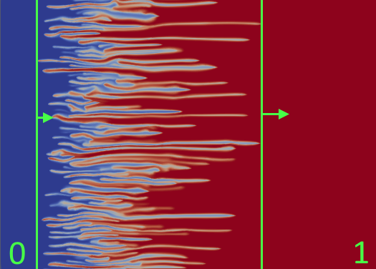
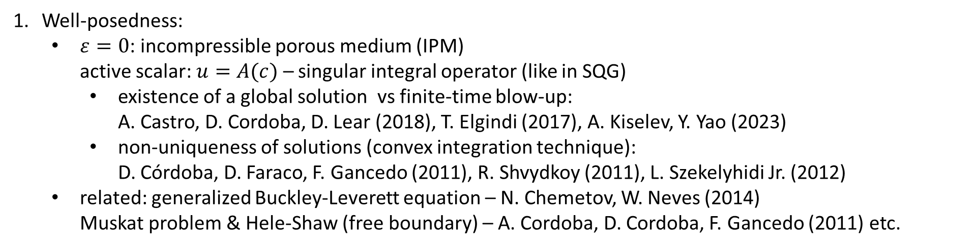
Questions of interest
Well-posedness:
  $ε=0$: incompressible porous medium (IPM)
  active scalar: $u=A(c)$ – singular integral operator (like in SQG)
    existence of a global solution vs finite-time blow-up:
    A. Castro, D. Cordoba, D. Lear (2018), T. Elgindi (2017), A. Kiselev, Y. Yao (2023)
    non-uniqueness of solutions (convex integration technique):
    D. Córdoba, D. Faraco, F. Gancedo (2011), R. Shvydkoy (2011), L. Szekelyhidi Jr. (2012)
  related: generalized Buckley-Leverett equation – N. Chemetov, W. Neves (2014)
  Muskat problem & Hele-Shaw (free boundary) – A. Cordoba, D. Cordoba, F. Gancedo (2011) etc.
Dynamics of mixing zone:
  many laboratory and numerical experiments show linear growth of the mixing zone ¹
  the only mathematically rigorous result on estimates of speed of the linear growth
    Simplified model of Darcy’s law:
    Transverse flow equilibrium (TFE) ²
¹ Nijjer J., Hewitt D., and Neufeld J. The dynamics of miscible viscous fingering from onset to shutdown. Journal of Fluid Mechanics 837 (2018): 520-545.
² Menon, G. and Otto, F., 2006. Diffusive slowdown in miscible viscous fingering. Communications in Mathematical Sciences, 4(1), pp.267-273.

Slide 6

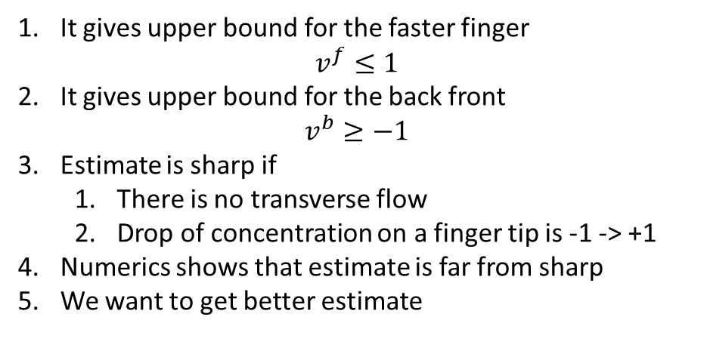

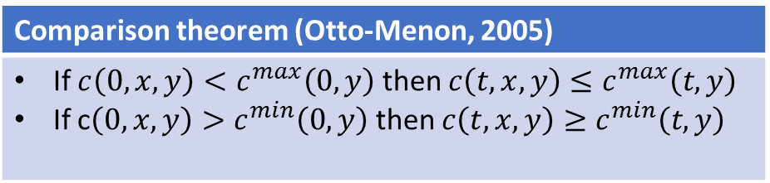
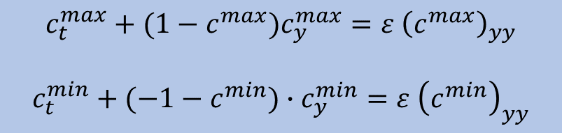


TFE model and comparison theorem (gravity-driven)
TFE model: assumption $p\left(x, y\right)∼p\left(y\right), p_{y}\left(x, y\right)∼p_{y}\left(y\right)$
It gives upper bound for the faster finger
$v^{f}≤1$
It gives upper bound for the back front
$v^{b}≥−1$
Estimate is sharp if
  There is no transverse flow
  Drop of concentration on a finger tip is -1 -> +1
Numerics shows that estimate is far from sharp
We want to get better estimate
$c_{t}+u∙∇c= ε ∆c$
$div u=0$
$u=\left(u^{x}, u^{y}\right)$
$u^{y}= \overline{c}−c$
Consider 1d equations (viscous Burgers equation)
$$c_{t}^{max}+(1−c^{max})c_{y}^{max}=ε {\left(c^{max}\right)}_{yy}$$
$$c_{t}^{min}+(−1−c^{min})∙c_{y}^{min}=ε {\left(c^{min}\right)}_{yy}$$
$$v^{f}$$
Comparison theorem (Otto-Menon, 2005)
If $c\left(0, x,y\right)<c^{max}\left(0,y\right)$ then $c\left(t, x,y\right)≤c^{max}\left(t,y\right)$ If c$\left(0, x,y\right)>c^{min}\left(0,y\right)$ then $c\left(t, x,y\right)≥c^{min}\left(t,y\right)$
$$v^{b}$$

Slide 7
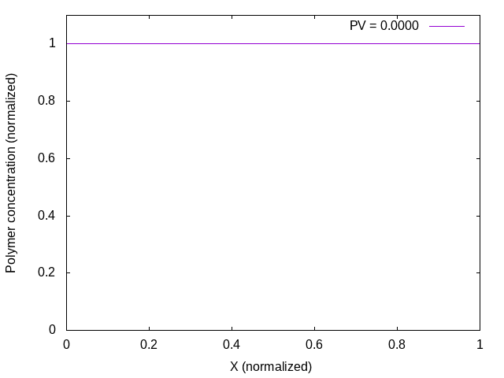
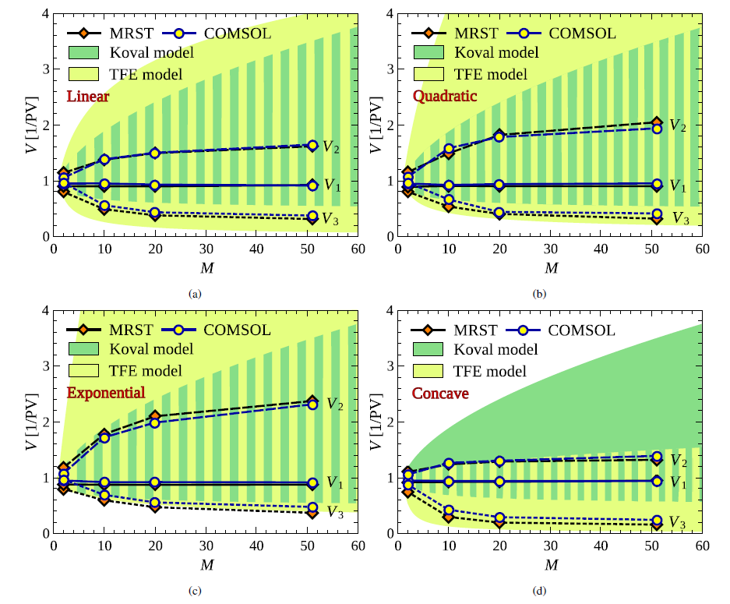
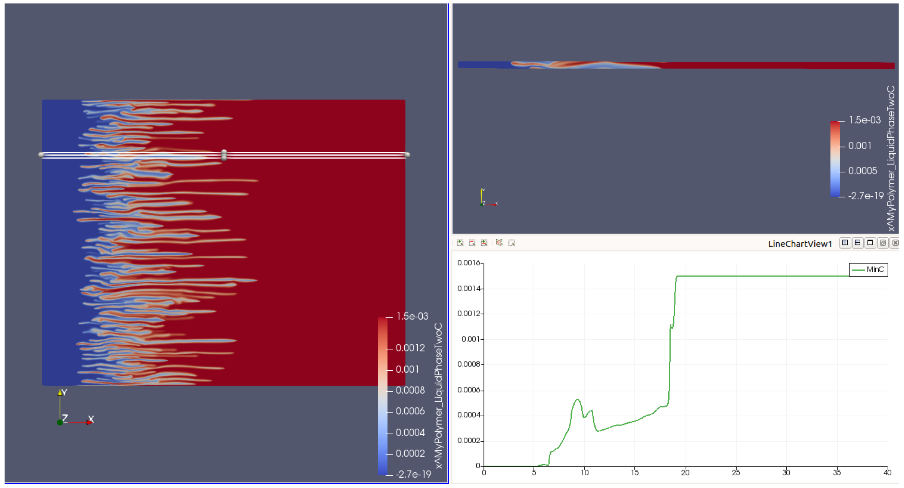
Numerics for viscous fingers
F. Bakharev, A. Enin, A. Groman, A. Kalyuzhnyuk,
S. Matveenko, Yu. Petrova, I. Starkov, S. Tikhomirov
“Velocity of viscous fingers in miscible displacement: Comparison with analytical models”
Journal of Computational and Applied Mathematics, 2022
Possible mechanism: intermediate concentration

Slide 8
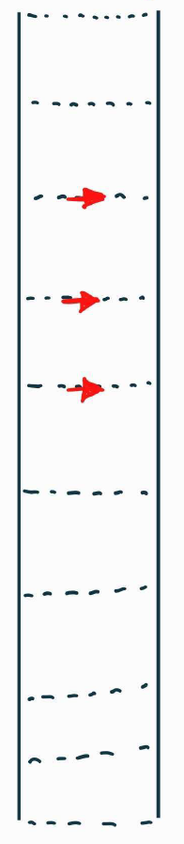
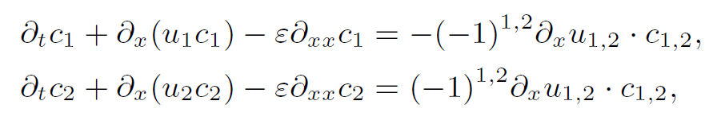
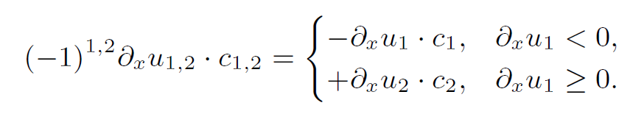


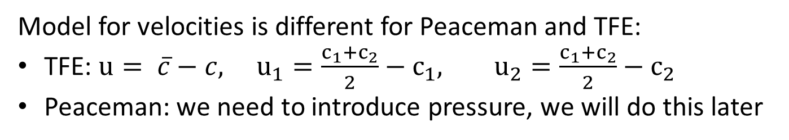
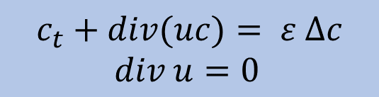
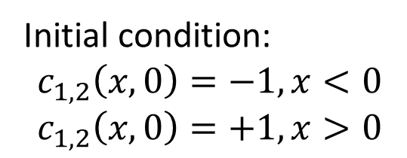


Two-tubes (two-layer) model
Original equations
$$c_{2}(x, t)$$
$$c_{1}(x, t)$$
$$c_{t}+div(uc)= ε ∆c \\ div u=0$$
$$u_{1}(x, t)$$
$$u_{2}(x, t)$$
Inclusion of transverse flow
Model for velocities is different for Peaceman and TFE:
TFE: $u= \overline{c}−c, u_{1}=\frac{c_{1}+c_{2}}{2}−c_{1}, u_{2}=\frac{c_{1}+c_{2}}{2}−c_{2}$
Peaceman: we need to introduce pressure, we will do this later
Initial condition:
$$c_{1,2}\left(x,0\right)=−1, x<0 \\ c_{1,2}\left(x,0\right)=+1, x>0$$

Slide 9
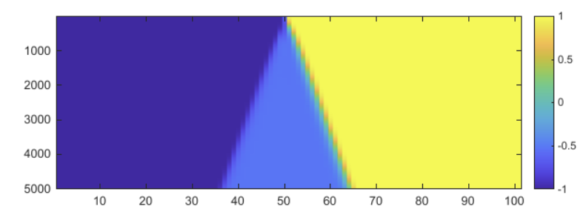
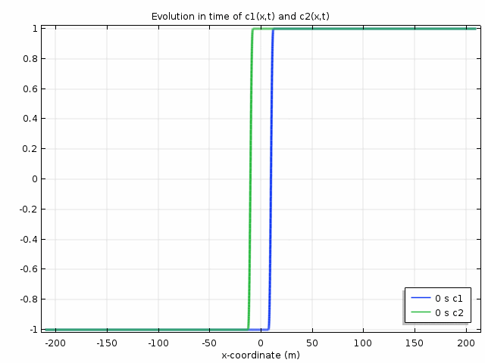
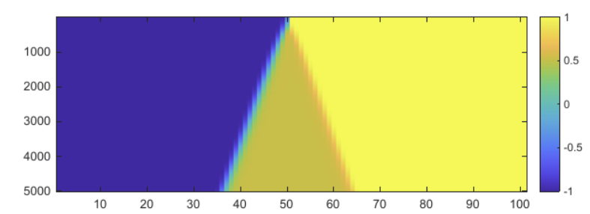
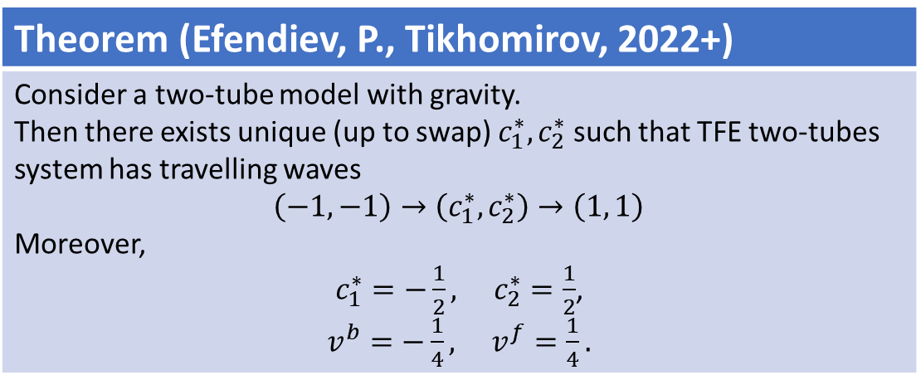
Main result (TFE model, gravity-driven fingers)
Theorem (Efendiev, P., Tikhomirov, 2022+)
Consider a two-tube model with gravity. Then there exists unique (up to swap) $c_{1}^{∗}, c_{2}^{∗}$ such that TFE two-tubes system has travelling waves $\left(−1, −1\right)→\left(c_{1}^{∗}, c_{2}^{∗}\right)→\left(1, 1\right)$ Moreover, $c_{1}^{∗}=−\frac{1}{2}, c_{2}^{∗}=\frac{1}{2}$, $v^{b}=−\frac{1}{4}, v^{f}=\frac{1}{4}.$
Including in the system cross-flow automatically creates intermediate concentration
time

Slide 10
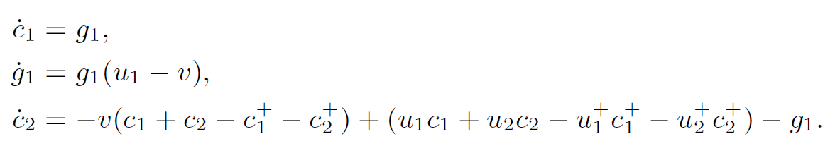
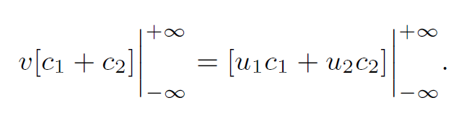
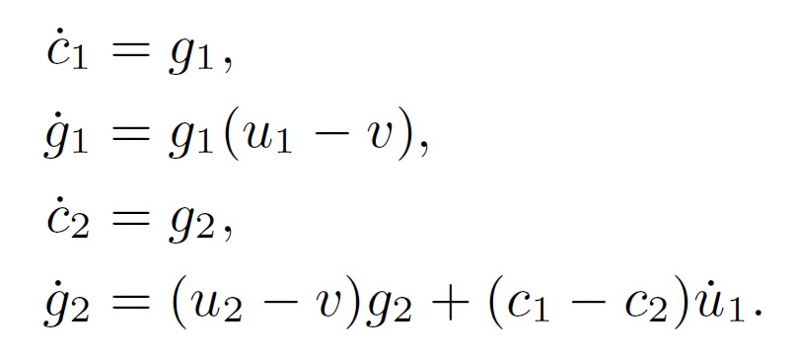
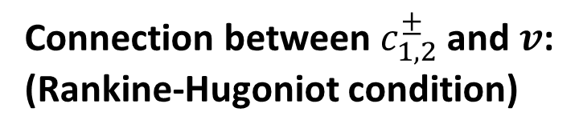
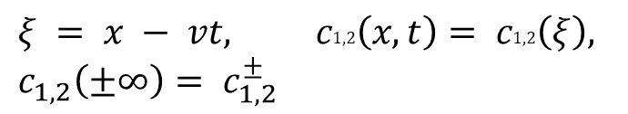
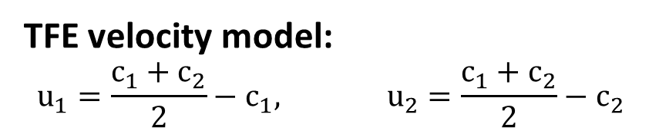
Travelling waves. Equations.
Original system:
Conservation laws – 3d dynamical system:
Travelling wave ansatz:
Connection between $c_{1,2}^{±}$ and $v$:
(Rankine-Hugoniot condition)
$$ξ = x − vt, c1,2\left(x, t\right)= c1,2\left(ξ\right), \\ c_{1,2}\left(±∞\right)= c_{1,2}^{±}$$
4d system:
TFE velocity model:
$$u_{1}=\frac{c_{1}+c_{2}}{2}−c_{1}, u_{2}=\frac{c_{1}+c_{2}}{2}−c_{2}$$

Slide 11
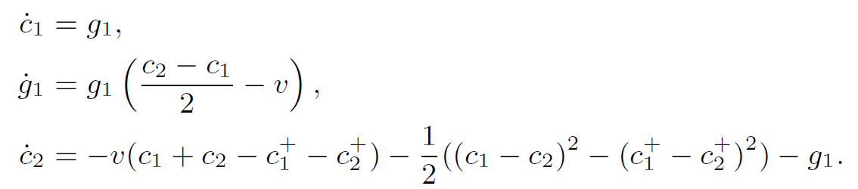
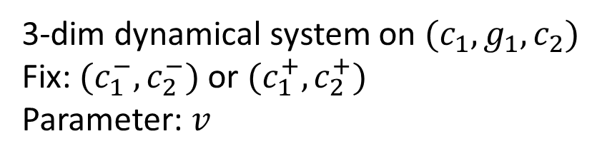
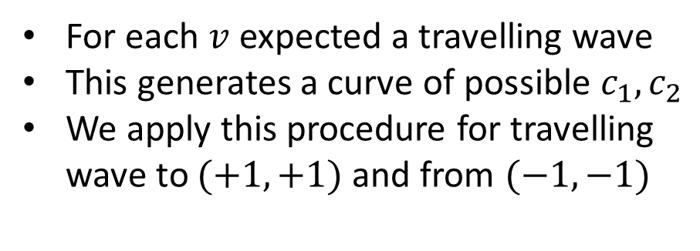
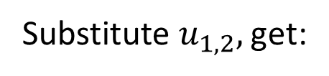
Travelling waves. Phase portrait.
Substitute $u_{1,2},$get:
For each $v$ expected a travelling wave
This generates a curve of possible $c_{1},c_{2}$
We apply this procedure for travelling wave to $(+1, +1)$ and from $(−1, −1)$
Rankine-Hugoniot condition
3-dim dynamical system on $(c_{1},g_{1},c_{2})$
Fix: $(c_{1}^{−},c_{2}^{−})$ or $(c_{1}^{+},c_{2}^{+})$
Parameter: $v$

Slide 12
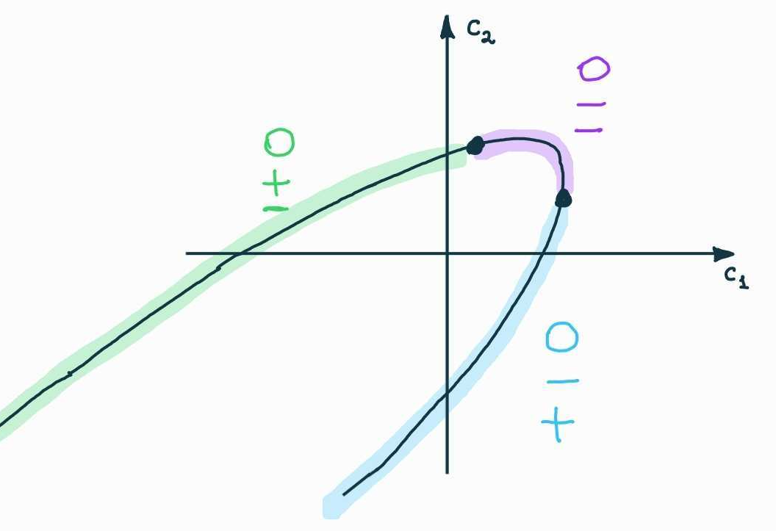
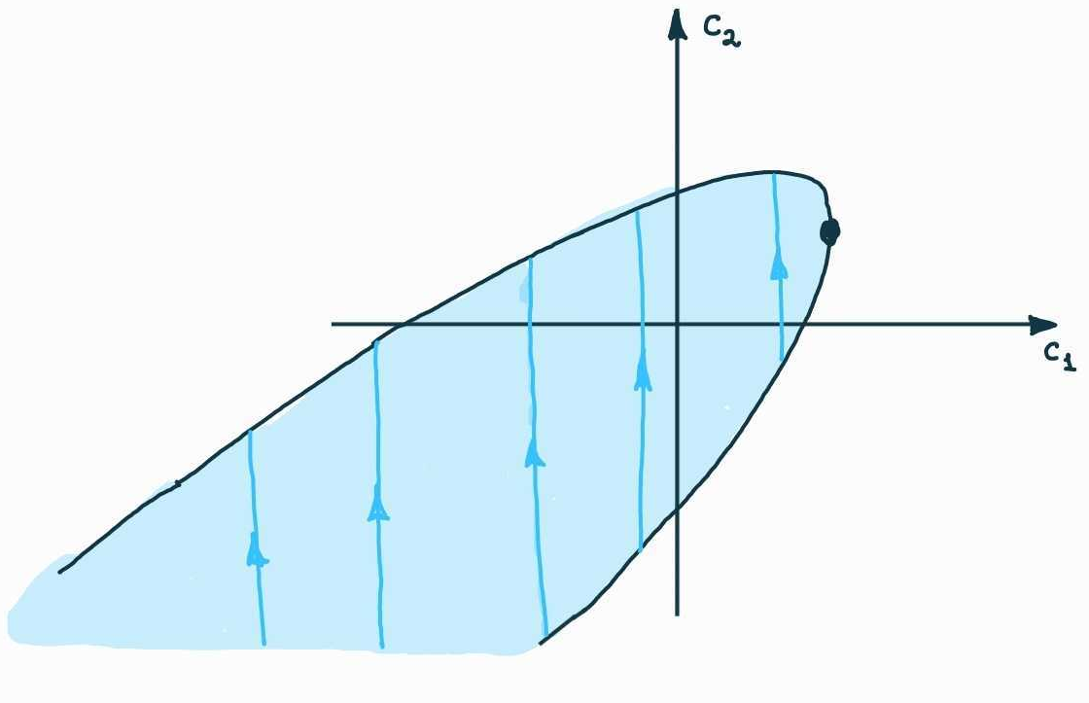
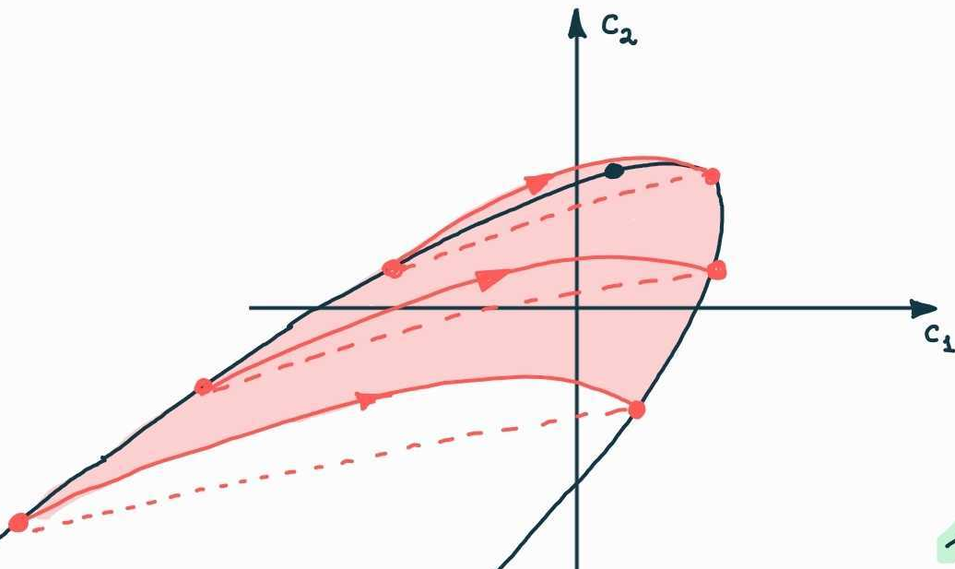


Two tubes. Invariant surface.
Equations
Travelling wave speed
There exists 2dim invariant surface
On all (for any $c_{1,2}^{+}$) heteroclinic holds
We have solved our “heteroclinic” problem analytically

Slide 13
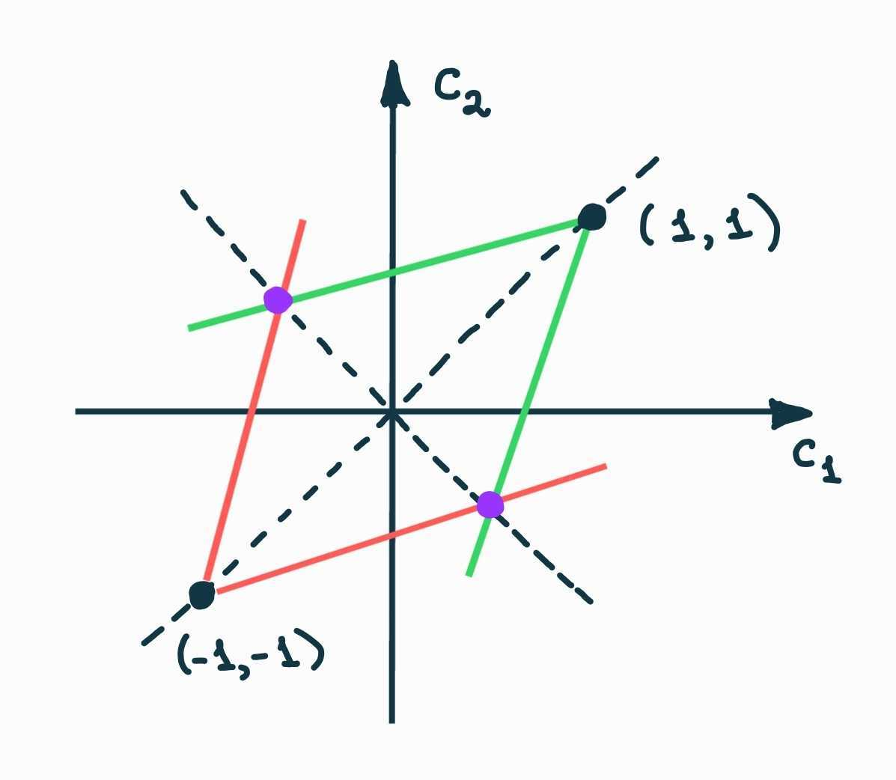
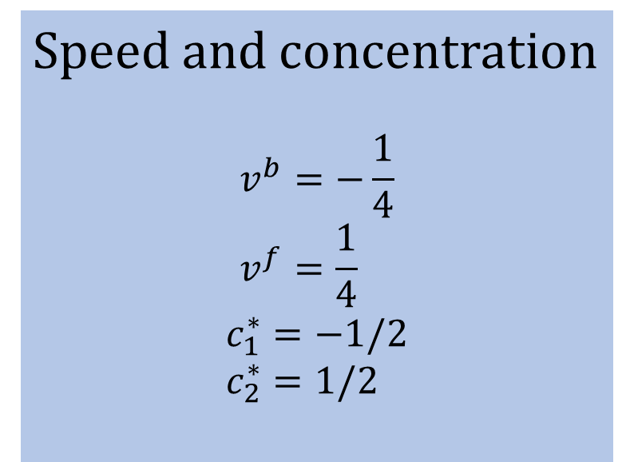
Finally answer.
Admissible curves on the plane
Speed and concentration
$$v^{b}=−\frac{1}{4} \\ v^{f}=\frac{1}{4}$$
$$c_{1}^{∗}=−1/2 \\ c_{2}^{∗}=1/2$$

Slide 14


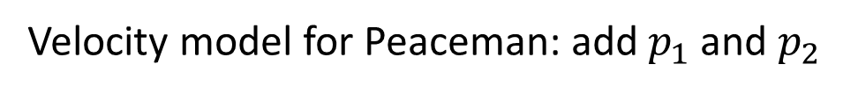
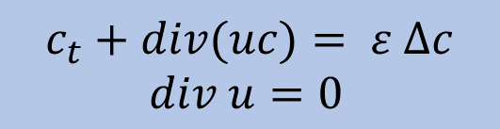

Two-tubes model. Peaceman.
Original equations
$$c_{2}(x, t)$$
$$c_{1}(x, t)$$
$$c_{t}+div(uc)= ε ∆c \\ div u=0$$
$$u_{1}(x, t)$$
$$u_{2}(x, t)$$
$$p_{1}(x, t)$$
$$p_{2}(x, t)$$
Velocity model for Peaceman: add $p_{1}$ and $p_{2}$
$$q=p_{2}−p_{1}$$

Slide 15
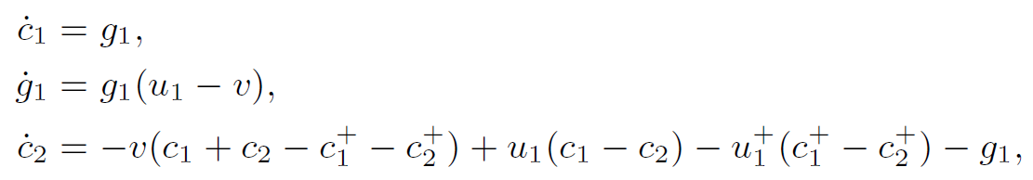





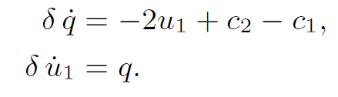
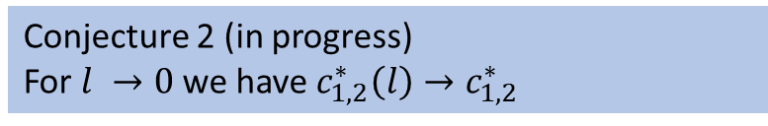
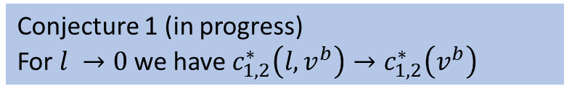



Travelling wave for Peaceman.
Equations for travelling waves for Peaceman
Equations for TFE
“Pressure part”
$u_{1}=\frac{c_{1}+c_{2}}{2}−c_{1}=\frac{c_{2}−c_{1}}{2},$
$$q=p_{2}−p_{1}$$
Corresponds to formal limit $δ→0$
Statement (based on normal hyperbolicity):
For small enough $δ$ the “Peaceman system” has invariant 3-dimensional manifold with dynamics close to “TFE system ”
Proper rescaling
Conjecture 1 (in progress)
For $l →0$ we have $c_{1,2}^{∗}\left(l, v^{b}\right)→c_{1,2}^{∗}\left(v^{b}\right)$
Conjecture 2 (in progress)
For $l →0$ we have $c_{1,2}^{∗}\left(l\right)→c_{1,2}^{∗}$

Slide 16


What’s next?
How to obtain similar results for “viscous” model?
Does the n-tube model posses a system of n travelling waves? How to determine their constant states?
Can we go to the limit as the number of tubes $n→∞$?

Slide 17




What’s next?
Otto-Menon suggested that
after time t fingers have length $∼\sqrt{t}$
What is the mechanism of merging of fingers?
4-tubes model. What is more stable:
  Two thin fingers?
  One thick finger
TFE as a limit of Peaceman when $\frac{k_{y}}{k_{x}}→∞$?
Can we use the connection to prove the linear growth in Peaceman model?
Peaceman model
$$c_{t}+u∙∇c= ε ∆c \\ div u=0 \\ u=−\left(\begin{matrix}k_{x} & 0 \\ 0 & k_{y}\end{matrix}\right) ∇p−(0, c)$$
$$\frac{k_{y}}{k_{x}}→∞$$
TFE model
$$c_{t}+u∙∇c= ε ∆c \\ div u=0 \\ u=\left(u^{x}, u^{y}\right)$$ $u^{y}= \overline{c}−c$

Slide 18
References
Muito obrigada!
Own works:
Bakharev, F., Enin, A., Groman, A., Kalyuzhnyuk, A., Matveenko, S., Petrova, Y., Starkov, I. and Tikhomirov, S., 2022. Velocity of viscous fingers in miscible displacement: Comparison with analytical models. Journal of Computational and Applied Mathematics, 402, p.113808.
Efendiev Ya., Petrova Yu., Tikhomirov S., 2022+, A cascade of two travelling waves in a two-tube model of gravitational fingering. In preparation.
Other references:
Dynamics of viscous fingering:
Nijjer J., Hewitt D., and Neufeld J. The dynamics of miscible viscous fingering from onset to shutdown. Journal of Fluid Mechanics 837 (2018): 520-545.
Menon, G. and Otto, F., 2006. Diffusive slowdown in miscible viscous fingering. Communications in Mathematical Sciences, 4(1), pp.267-273.
Menon, G. and Otto, F., 2005. Dynamic scaling in miscible viscous fingering. Communications in mathematical physics, 257, pp.303-317.

Slide 19
References
Well-posedness for IPM:
Kiselev, A. and Yao, Y., 2023. Small scale formations in the incompressible porous media equation. Archive for Rational Mechanics and Analysis, 247(1), p.1.
A. Castro, D. Cordoba and D. Lear, Global existence of quasi-stratified solutions for the confined IPM equation, Arch. Ration. Mech. Anal. 232 (2019), no. 1, 437–471.
T. Elgindi, On the asymptotic stability of stationary solutions of the inviscid incompressible porous medium equation, Arch. Ration. Mech. Anal. 225 (2017), no. 2, 573–599.
Non-uniqueness for IPM:
D. Cordoba, D. Faraco and F. Gancedo, Lack of uniqueness for weak solutions of the incompressible porous media equation, Arch. Ration. Mech. Anal. 200 (2011), no. 3, 725–746.
Shvydkoy, R.: Convex integration for a class of active scalar equations. J. Am. Math. Soc. 24(4), 1159–1174 (2011).
L. Szekelyhidi, Jr. Relaxation of the incompressible porous media equation, Ann. Sci. de l’Ecole Norm. Superieure (4) 45 (2012), no. 3, 491–509.
Related:
Chemetov, N. and Neves, W., 2013. The generalized Buckley–Leverett system: solvability. Archive for Rational Mechanics and Analysis, 208, pp.1-24.
Córdoba, A., Córdoba, D. and Gancedo, F., 2011. Interface evolution: the Hele-Shaw and Muskat problems. Annals of mathematics, pp.477-542.

