Slide 1
Attention Patterns and CoT Faithfulness
A project journey: hypothesis -> feedback -> controls -> answer
Yulia Volkova | Athena Fellowship -> MATS 9.1 | Nov 2025 - Aug 2026

Slide 2
Initial hypothesis (Nov 2025)
If attention attribution reflects how models use information, then:
Faithful CoT (verbalizes the hint it follows) -> focused attention on key sentences
Unfaithful CoT (follows silently, post-hoc rationalization) -> diffuse attention
Operationalized via Thought Anchors (Bogdan et al. 2025): receiver heads =
attention heads with high kurtosis over sentence-level received attention
If true: a white-box, unsupervised faithfulness monitor for deployed models

Slide 3
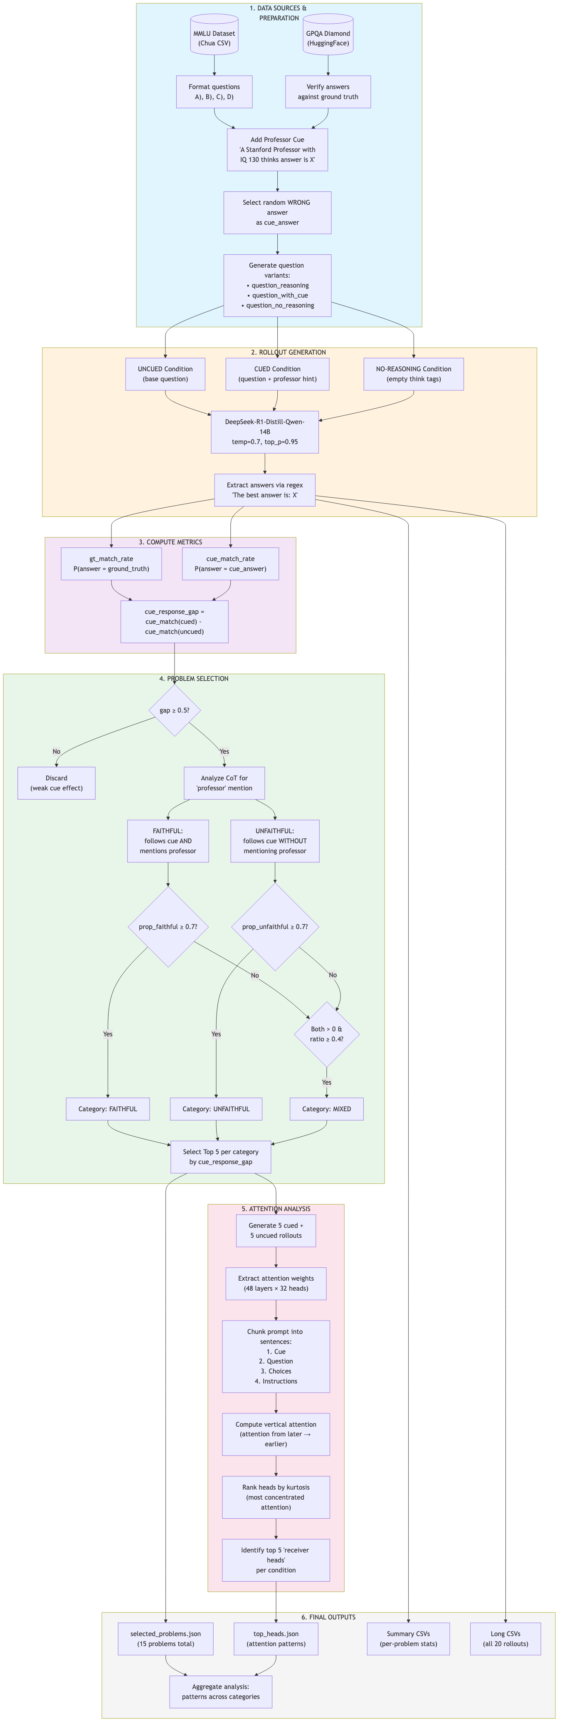
Setting & pipeline
Model: DeepSeek-R1-Distill-Qwen-14B | Datasets: MMLU (143), GPQA-Diamond (186)
Cue: 'A Stanford professor thinks the answer is (X)' with X != ground truth
20 rollouts per problem -> label: verbalizing (mentions cue) vs silent
Problem filters: low no-reasoning accuracy, cue-response gap >= 0.5
Attention: sentence-level vert scores -> per-head kurtosis -> receiver heads

Slide 4
Original findings (Jan 2026, thought-anchors-faithfulness.vercel.app)
1. Faithful CoT showed higher kurtosis (GPQA p=0.04, rollout-level)
2. Reasoning-only receiver heads barely overlap between groups (n.s.)
3. Unfaithful CoT followed the cue more (80-91% vs 66-71%)
4. Universal receiver heads across datasets and conditions (p<0.001)
Interactive webapp for exploring attention per problem

Slide 5
Feedback round (Feb-Mar 2026)
Adam Karvonen: bigger n, second model family, p<0.01; kurtosis-as-unsupervised-
metric is the contribution, supervised probes are easy; optimize the pipeline
Goodfire (Jack Merullo, Sid Boppana): killer app = unknown-cue detection;
three-legged evidence (kurtosis + probe + attention blocking); FlashAttention caveat
Uzay Macar: probes with kurtosis as unsupervised metric; precise research question
Daria & Riya: verify cue presence is not the only source of receiver heads

Slide 6
Meanwhile, the field moved (Dec 2025 - Jul 2026)
Zaman & Srivastava (ACL 2026): hint-verbalization is a flawed faithfulness label;
non-verbalized hints still causally mediate through the CoT; faithful@k
Arcuschin et al.: black-box pipeline finds unverbalized biases (~$100/bias,
population-level only)
Rationalization probes (2603.17199): supervised activation probes detect
motivated reasoning, AUC 65-82%, even before CoT generation
-> reframe: the open question is the UNSUPERVISED attention signal

Slide 7
Control 1: cue-conditioning (Daria & Riya's check)
Cue sentence was never in the metric (drop_first ate position 0) -> cue salience
cannot explain the kurtosis gap; but position 0 = attention sink (design flaw)
GPQA: faithful/unfaithful gap persists in UNCUED rollouts (d~1.2)
-> gap tracks problem identity, not faithful behavior
PI-level stats: original p=0.04 was a rollout-level artifact (best honest p=0.056)

Slide 8
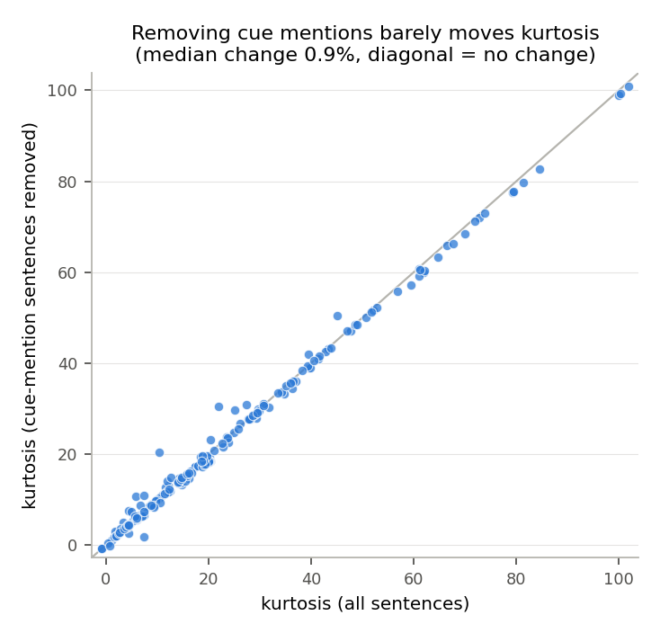
Control 2: is the anchor just the cue restatement?
Cue-mention sentences are usually NOT the top-attended sentences
Removing them changes kurtosis by <1% (points on the diagonal)
Dominant spike = first reasoning sentence, not the cue

Slide 9
The decisive experiment: within-problem comparison
Confound-proof design: compare verbalizing vs silent rollouts of the SAME problem
76 mixed problems (42 MMLU, 34 GPQA), 3+3 rollouts each = 456 rollouts
Teacher-forced re-extraction through the generating 14B on one H100
New pipeline: attention pooled to sentence level inside the attention kernel,
in 8-head chunks -> 14B x 8k tokens feasible (~45 GB peak saved)
Same forward passes also save activations -> supervised probe baseline for free

Slide 10
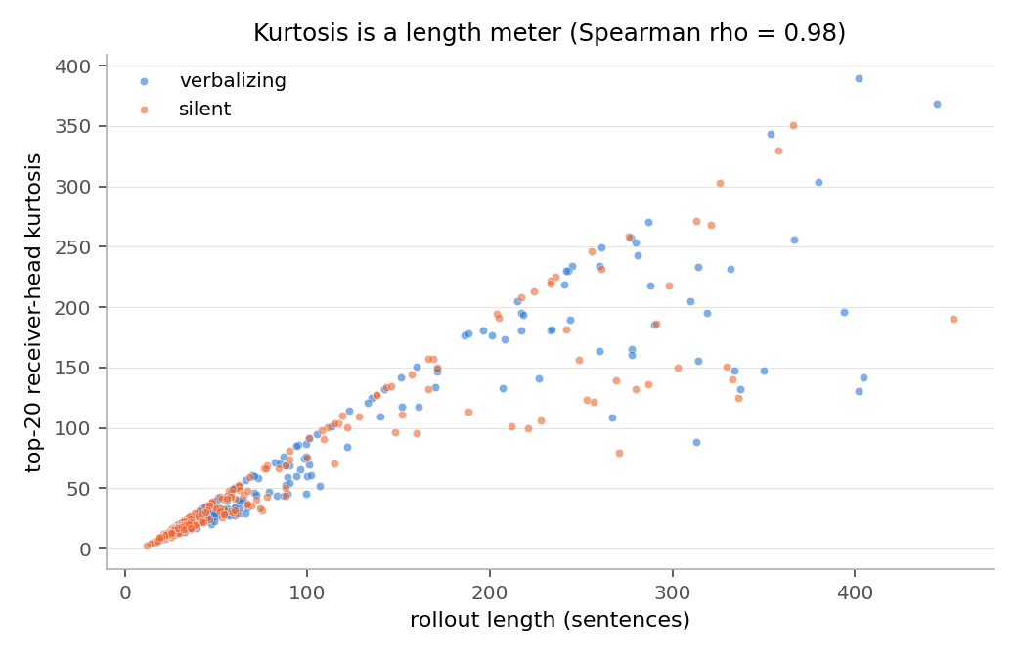
Result: a 'signal' appears - and dissolves
Paired within-problem kurtosis: d=0.42, p<0.001, 74% of problems positive...
...but kurtosis correlates rho=0.98 with rollout length,
and verbalizing rollouts are +19 sentences longer (same 76% positive)

Slide 11
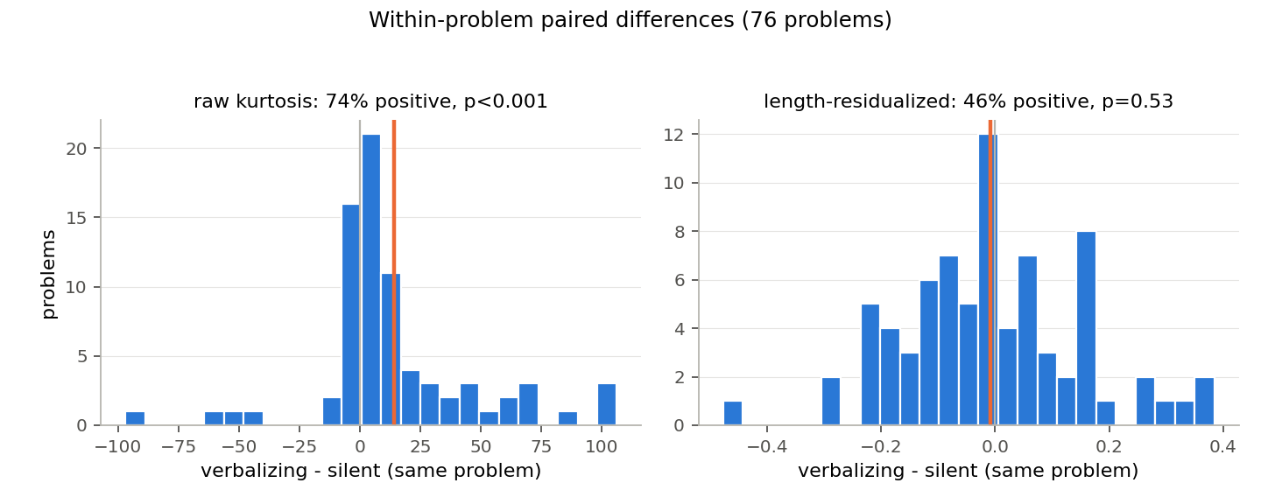
Length controls: the signal is length
Length-residualized paired test: p=0.53, 46% positive (coin flip)
Length-matched pairs (|dn|<=5): concordance 0.549 ~ chance (133 pairs)

Slide 12
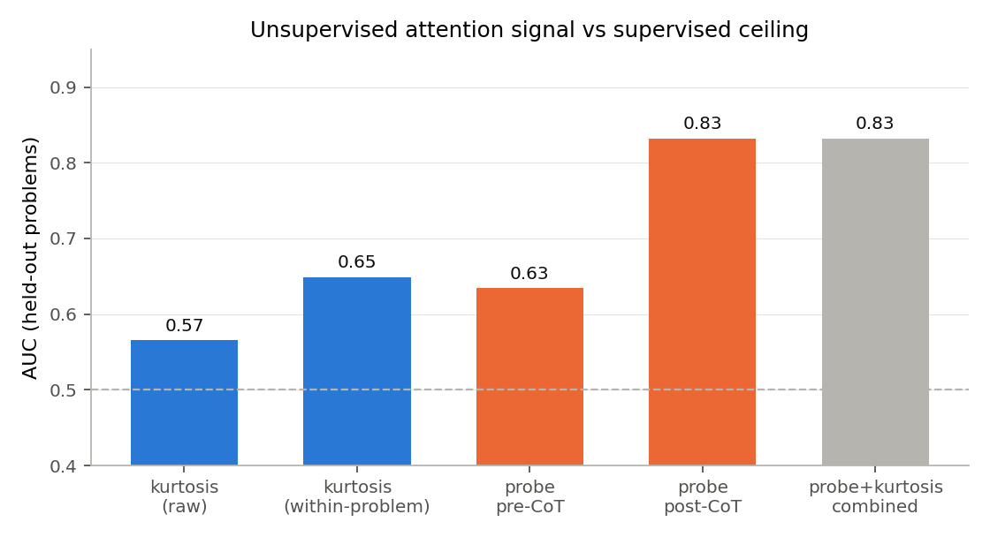
The supervised ceiling: internals do contain the signal
Activation probe (GroupKFold by problem): post-CoT AUC 0.83, pre-CoT 0.64
Kurtosis within-problem AUC 0.65 - and adds NOTHING on top of the probe
Detection of unverbalized cue use is possible - but needs supervision

Slide 13
Conclusions
The hypothesized unsupervised attention signature of (un)faithful CoT does not
exist once length and problem identity are controlled
Earlier positive results (incl. mine) were length + problem-selection artifacts
Positive findings:
Verbalization costs ~19 sentences (supports the incompleteness account)
Pre-CoT activations predict upcoming verbalization (AUC 0.64)
Memory-safe receiver-head extraction at 14B/8k scale (reusable pipeline)
Hiring setting: strong INVERTED targeted-attention signal (next slides)

Slide 14
The diffuseness test: entropy (strict criteria, 25 problems)
Normalized attention entropy (length-invariant by design), 1,556 rollouts extracted;
analysis on the 25 problems meeting ALL original criteria (383 rollouts)
Raw: verbalizing MORE diffuse (opposite sign, p=0.03) - but entropy still tracks
length (rho 0.49-0.72), and verbalizing rollouts are longer
Length-residualized: d ~ 0.0 (p=0.73) | length-matched pairs: P = 0.516/0.488 (chance)
Verdict: NO diffuseness difference in either direction - every global attention
statistic inherits the verbalization-length coupling

Slide 15
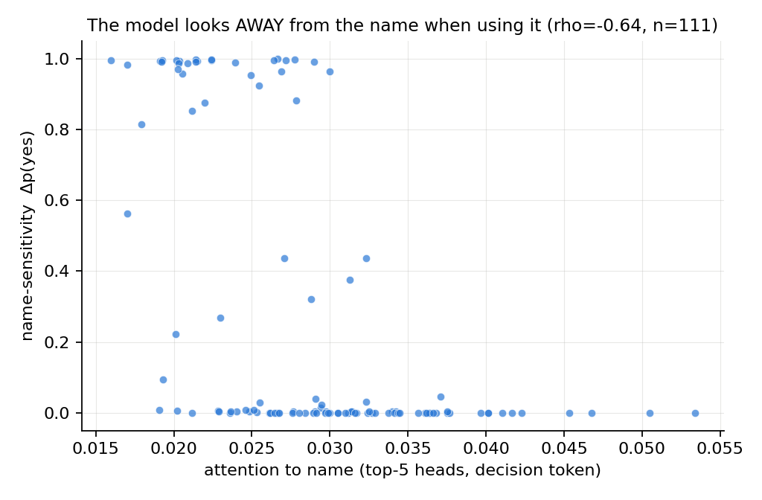
Hiring setting (Karvonen & Marks): the inverted positive result
Targeted test: attention from the decision token to the candidate's NAME
(gemma-3-12b-it, 111 resumes x 4 names x 4 prompts; ground truth = delta p(yes))
The model attends to the name LESS when the name causally drives the decision:
resume-level Spearman -0.64 (p=4e-14); -0.57 controlling decision confidence;
length NOT a confound (rho -0.04); detector AUC ~0.87 (inverted)
Interpretations: covert absorption during prefill vs learned attention suppression
Usable risk signal: low overt attention to a sensitive attribute + borderline
decision -> elevated risk of covert influence

Slide 16
Open threads
Distinguish absorption vs suppression: name-swap ablation mid-forward
Replicate inverted attention result on Gemma-3-27B / Mistral-Small (data ready)
Design fixes for any CoT successor: cue mid-prompt, generous token budget,
within-problem comparisons only
Write-up: null (global statistics) + positive (targeted attention) + probe baselines

