Slide 1
Intro to Wynton
Yulia Gutierrez

Slide 2
Wynton is UCSF’s high-performance computer cluster
Most universities have HPC clusters to run computationally expensive programs or complex tasks
Basically a bunch of powerful computers connected by fast network
UCSF’s HPC cluster is a co-op program
Available to all UCSF researchers
Priority given to research groups that contribute to additional compute capacity

Slide 3
Why would you need a computing cluster?
Notes:
What might you imagine? What have you done before?

Slide 4
Why would you need a computing cluster?
Running MD simulations
Training ML models
Analyzing big datasets
Batch jobs
Eg, designing lots of proteins! Backbone generation, sequence design, structure prediction

Slide 5
CPU vs GPU
Two classes of computational resources: GPU and CPU
Graphics Processing Unit (GPU)
Linear algebra operations that are graphics, image processing, matrix multiplication
Good for parallel processing
Often used for training ML models
In high demand so try not to request unless you need it
Central Processing Unit (CPU)
Used for pretty everything else
Good for serial processing

Slide 6
Cluster specifications
Feature | Login Nodes | Transfer Nodes | Development Nodes | Compute Nodes
Hostname | log[1-2].wynton.ucsf.edu, plog1.wynton.ucsf.edu | dt[1-2].wynton.ucsf.edu, pdt[1-2].wynton.ucsf.edu | dev[1-3], gpudev1, pdev1, pgpudev1 | …
Accessible via SSH from outside of cluster | ✓ (2FA if outside of UCSF) | ✓ (2FA if outside of UCSF) | no | no
Accessible via SSH from within cluster | ✓ | ✓ | ✓ | no
Outbound access | Within UCSF only: SSH and SFTP | HTTP/HTTPS, FTP/FTPS, SSH, SFTP, Globus | Via proxy: HTTP/HTTPS, GIT+SSH(*) | no
Network speed | 10 Gbps | 10 Gbps | 10 Gbps | 1,10,40 Gbps
Core software | Minimal | Minimal | Same as compute nodes + compilers and source-code packages | Rocky 8 packages
modules (software stacks) | no | no | ✓ | ✓
Global file system | ✓ | ✓ | ✓ | ✓
Job submission | ✓ | no | ✓ | ✓
CPU quota per user(**) | 100% (“1 core”) | 200% (“2 cores”) | not limited | not limited
Memory limit per user(**) | 32 GiB | 96 GiB | 48 GiB | per job request
Purpose | Submit and query jobs. SSH to development nodes. File management. | Fast in- & outbound file transfers. File management. | Compile and install software. Prototype and test job scripts. Submit and query jobs. Version control (clone, pull, push). File management. | Running short and long-running job scripts.
https://wynton.ucsf.edu/hpc/about/specs.html

Slide 7
Login nodes are for logging into Wynton
& light job submission!

Slide 8

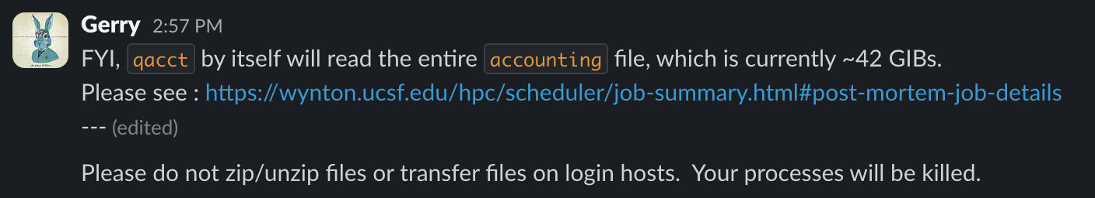
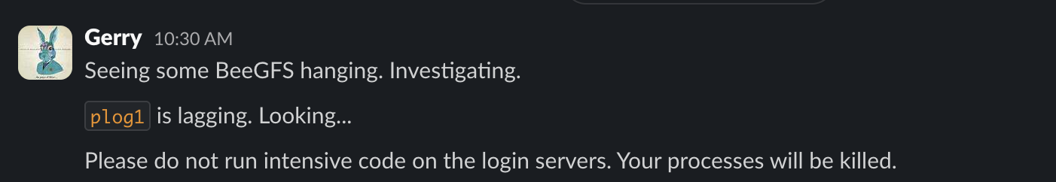
Login nodes are for logging into Wynton
& light job submission!
Don’t make Wynton admins mad! ☺

Slide 9
plog1 is the login node for protected users
Users working with P3 sensitive data have Wynton Protected Account (had to register)
All Protected Health Information (PHI) data is not on Wynton
Probably won’t need this during your rotation ☺
If you do, you should receive lab specific onboarding instructions
More information on data classification: https://it.ucsf.edu/standard-guideline/ucsf-policy-650-16-addendum-f-ucsf-data-classification-standard

Slide 10
Transfer nodes are for transferring data
Used for transferring files to and from Wynton
To and from your local device
Backup to cloud storage
Be careful storing data on Wynton! (don’t!)
Globus for moving/syncing/sharing large amounts of data in the background
Transfer between Wynton and UCSF Box using UCSF Wynton HPC Box Globus Connector
Would recommend backing data up to Box often!

Slide 11
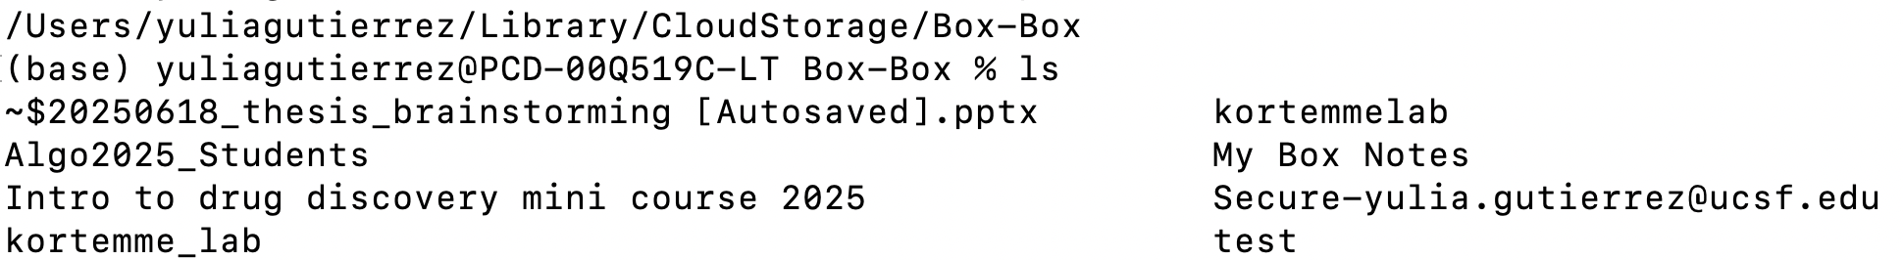
Box is UCSF’s cloud storage system
Unlimited cloud storage!!
Install Box Drive to your local machine to access cloud data from your computer
Also access at ucsf.box.com!

Slide 12
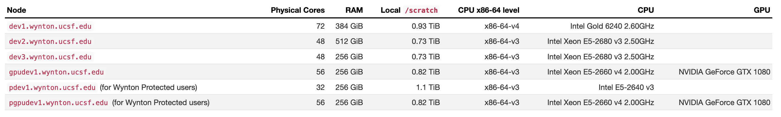
Development nodes are for ‘prototyping’
Development that you can’t submit through the job scheduler (basically interactive node)
Install and compile new software, prototype
Same configuration and software as compute nodes, but more limitations on resource usage
Protected nodes, GPU nodes

Slide 13
Wynton uses a job scheduler to assign tasks to compute nodes
Job schedulers control allocation and execution of jobs
Prevents overloading
‘Fair-share’ score enforce fairness
UCSF uses SGE job scheduler
SLURM?
Compute nodes are only accessible through job submission
Many pre-installed softwares
CPU and GPU resources available
Notes:
Son of Grid Engine
File Editing
emacs, nano, vim
File Transferring
ftp, lftp, scp, sftp, rsync curl, wget rclone dos2unix
File Compression and Archiving
7z, bzip2, gzip, lz4, zip, xz ar, cpio, tar
Communication
ssh, telnet
Version Control
git, svn
Text, Documents, and Reports
hunspell pandoc LaTeX, PDF and Postscript tools
Programming Languages, Compilers, and Tools
make, cmake gcc / g++ (C, C++, and Fortran) java, javac lua node, npm perl python rustc (Rust)
System Utilities
top screen, tmux
Linux Containers
apptainer (formerly singularity)

Slide 14
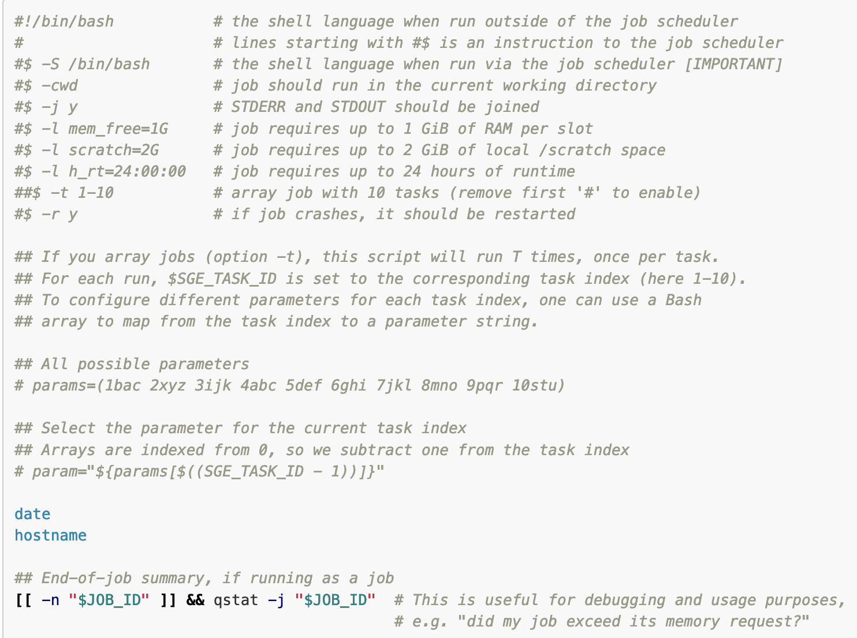
What does asking for resources look like?
Where should the job run?
How much memory do you need?
How much intermediate storage do you need?
How long will your job need to run?
+ other more advanced specifications

Slide 15
Don’t make 10 million directories
You’ll break Wynton
Wynton goes down a lot
Wynton is laggy

Slide 16






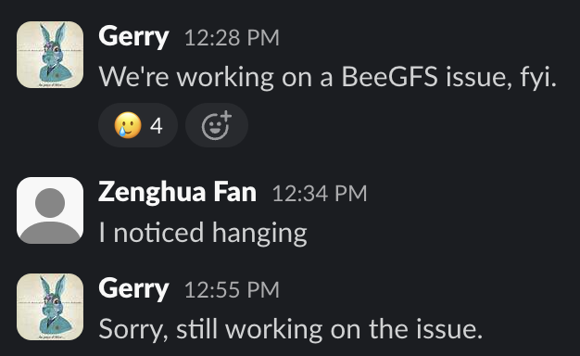



Don’t make 10 million directories
You’ll break Wynton
Wynton goes down a lot
Wynton is laggy

Slide 17
Data storage on Wynton
Use scratch space for temporary storage of many intermediate files
Unlimited?
Cleared by Wynton admins so don’t store anything precious!
Use home/group for temporary storage
Don’t store anything permanently on Wynton! Back up your data on Box or lab-specific location

Slide 18
Other notes + conclusions
Conda, python, matlab, R – all ready to go on Wynton
Generate private-public key pair to login without a password
Great for heavy usage
Don’t store data on Wynton
Use what you need + follow good practices (https://wynton.ucsf.edu/hpc/get-started/good-practices.html)
Join Wynton slack for support (or email admins)
Questions?

Slide 19

Exercise!
Login into Wynton and submit basic job
https://tinyurl.com/wynton25
Can also generate private-public key pair

