Slide 1

CS61B: 2018
If forecast > 18 feet, go! http://goo.gl/GzNrrv
Using and Defining Classes
Compilation
Defining and Instantiating Classes
A Closer Look at Static
public static void main(String[] args)
Using Libraries (e.g. StdDraw, In)
Best place to watch waves: http://goo.gl/tlDSVq

Slide 2
Compilation
THERE IS A LIVE PIAZZA THREAD IF YOU HAVE ANY QUESTIONS MID-LECTURE. Someone will answer probably.

Slide 3
Compilation
The standard tools for executing Java programs use a two step process:
This is not the only way to run Java code.
Compiler
Interpreter
stuff
happens
Hello.java
javac
Hello.class
java
Why make a class file at all?
.class file has been type checked. Distributed code is safer.
.class files are ‘simpler’ for machine to execute. Distributed code is faster.
Minor benefit: Protects your intellectual property. No need to give out source.
You can learn more about all this in 61C and particularly 164.
Note: .class files are easily reversible into similar looking Java files.

Slide 4
Defining and Instantiating Classes

Slide 5
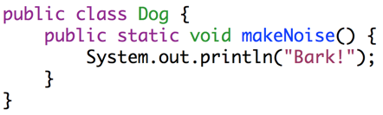
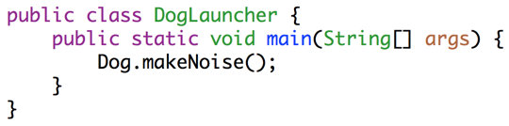
Dog
As we saw last time:
Every method (a.k.a. function) is associated with some class.
To run a class, we must define a main method.
Not all classes have a main method!
public class Dog {
public static void makeNoise() {
System.out.println("Bark!");
}
}
Can’t be run directly, since there is no main method.
public class DogLauncher {
public static void main(String[] args) {
Dog.makeNoise();
}
}
Calls a method from another class. Can think of this as a class that tests out the Dog class.

Slide 6
A not so good Approach
We could create a separate class for every single dog out there, but this is going to get redundant in a hurry.
public class MayaTheDog {
public static void makeNoise() {
System.out.println("arooooooooooooooo!");
}
}
public class YapsterTheDog {
public static void makeNoise() {
System.out.println("awawawwwawwa awawaw");
}
}

Slide 7
Object Instantiation
Classes can contain not just functions (a.k.a. methods), but also data.
For example, we might add a size variable to each Dog.
Classes can be instantiated as objects.
We’ll create a single Dog class, and then create instances of this Dog.
The class provides a blueprint that all Dog objects will follow.
Side note: For E7/MATLAB folks, if you’ve ever gotten an axis using gca(), this is similar. Each axis has the same properties, e.g. they all have xTicks, etc.
These instances are also called ‘objects’

Slide 8
Defining a Typical Class (Terminology)
public class Dog {
public int weightInPounds;
public Dog(int startingWeight) {
weightInPounds = startingWeight;
}
public void makeNoise() {
if (weightInPounds < 10) {
System.out.println("yipyipyip!");
} else if (weightInPounds < 30) {
System.out.println("bark. bark.");
} else {
System.out.println("woof!");
}
}
}
Instance variable. Can have as many of these as you want.
Constructor (similar to a method, but not a method). Determines how to instantiate the class.
Non-static method, a.k.a. Instance Method. Idea: If the method is going to be invoked by an instance of the class (as in the next slide), then it should be non-static.
Roughly speaking: If the method needs to use “my instance variables”, the method must be non-static.

Slide 9
Instantiating a Class and Terminology
public class DogLauncher {
public static void main(String[] args) {
Dog smallDog;
new Dog(20);
smallDog = new Dog(5);
Dog hugeDog = new Dog(150);
smallDog.makeNoise();
hugeDog.makeNoise();
}
}
Declaration of a Dog variable.
Instantiation of the Dog class as a Dog Object.
Instantiation and Assignment.
Declaration, Instantiation and Assignment.
Invocation of the 150 lb Dog’s makeNoise method.
The dot notation means that we want to use a method or variable belonging to hugeDog, or more succinctly, a member of hugeDog.

Slide 10
Arrays of Objects (assuming you’ve done HW0!)
To create an array of objects:
First use the new keyword to create the array.
Then use new again for each object that you want to put in the array.
Example:
After code runs:
Dog[] dogs = new Dog[2];
dogs[0] = new Dog(8);
dogs[1] = new Dog(20);
dogs[0].makeNoise();
Creates an array of Dogs of size 2.
Yipping occurs.
dogs =
Dog of size 8 | Dog of size 20
0
1

Slide 11
Static vs. Instance Members

Slide 12
Static vs. Non-static
Key differences between static and non-static (a.k.a. instance) methods:
Static methods are invoked using the class name, e.g. Dog.makeNoise();
Instance methods are invoked using an instance name, e.g. maya.makeNoise();
Static methods can’t access “my” instance variables, because there is no “me”.
Non-static
Static
public void makeNoise() {
if (weightInPounds < 10) {
System.out.println("yipyipyip!");
} else if (weightInPounds < 30) {
System.out.println("bark. bark.");
} else { System.out.println("woof!"); }
}
public static void makeNoise() {
System.out.println("Bark!");
}
This method cannot access weightInPounds!
maya = new Dog(100);
maya.makeNoise();
Invocation:
Dog.makeNoise();
Invocation:

Slide 13
Why Static Methods?
Some classes are never instantiated. For example, Math.
x = Math.round(5.6);
Sometimes, classes may have a mix of static and non-static methods, e.g.
Much nicer than:
Math m = new Math();
x = m.round(x);
public static Dog maxDog(Dog d1, Dog d2) {
if (d1.weightInPounds > d2.weightInPounds) {
return d1;
}
return d2;
}

Slide 14
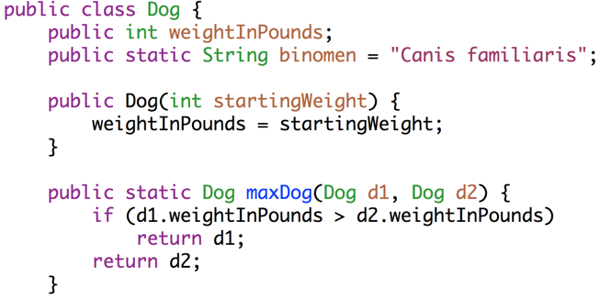
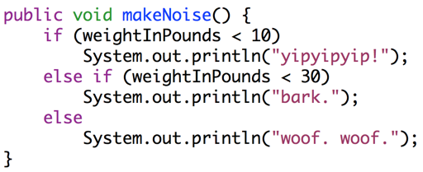
Static vs. Non-static
A class may have a mix of static and non-static members.
A variable or method defined in a class is also called a member of that class.
Static members are accessed using class name, e.g. Dog.binomen.
Non-static members cannot be invoked using class name: Dog.makeNoise()
Static methods must access instance variables via a specific instance, e.g. d1.

Slide 15
Question: Will this program compile? If so, what will it print?
public class DogLoop {
public static void main(String[] args) {
Dog smallDog = new Dog(5);
Dog mediumDog = new Dog(25);
Dog hugeDog = new Dog(150);
Dog[] manyDogs = new Dog[4];
manyDogs[0] = smallDog;
manyDogs[1] = hugeDog;
manyDogs[2] = new Dog(130);
int i = 0;
while (i < manyDogs.length) {
Dog.maxDog(manyDogs[i], mediumDog).makeNoise();
i = i + 1;
}
}
}
< 10:
yip
< 30: bark
>=30:
woof
Notes:
26 minutes not including questions or announcements

Slide 16
public static void main(String[] args)

Slide 17
One Special Role for Strings: Command Line Arguments
public class ArgsDemo {
/** Prints out the 0th command line argument. */
public static void main(String[] args) {
System.out.println(args[0]);
}
}
jug ~/Dropbox/61b/lec/usingDefiningClasses
$ java ArgsDemo hello some args
hello

Slide 18
One Special Role for Strings: Command Line Arguments
public class ArgsSum {
/** Prints out the sum of arguments, assuming they are
* integers.
*/
public static void main(String[] args) {
int index = 0;
int sum = 0;
while (index < args.length) {
sum = sum + Integer.parseInt(args[index]);
index = index + 1;
}
System.out.println(sum);
}
}
How’d we know to do this? We Googled “convert string integer java”.
$ java ArgsSum 1 2 3 4
10

Slide 19
Using Libraries
(e.g. StdDraw, In)

Slide 20
Java Libraries
There are tons of Java libraries out there.
In 61B, we will provide all needed libraries. These include (but are not limited to):
The built-in Java libraries (e.g. Math, String, Integer, List, Map)
The Princeton standard library (e.g. StdDraw, StdAudio, In)
As a programmer, you’ll want to leverage existing libraries whenever possible.
Saves you the trouble of writing code.
Existing widely used libraries are (probably) will probably be less buggy.
… but you’ll have to spend some time getting acquainted with the library.

Slide 21
Java Libraries
As a programmer, you’ll want to leverage existing libraries whenever possible.
Best ways to learn how to use an unfamiliar library:
Find a tutorial (on the web, youtube, etc.) for the library.
Read the documentation for the library (Java docs often very good).
Look at example code snippets that use the library.
In 61B, please don’t use new libraries downloaded from the web (won’t work with our grader). Use the provided libraries only.
Won’t really come up until we get to project 2.

Slide 22
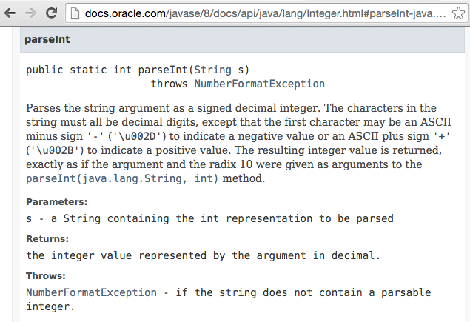
Library Documentation Example

Slide 23

The Princeton Standard Library
We’ll be using a great library courtesy of my old colleagues at Princeton, mostly Kevin Wayne: http://introcs.cs.princeton.edu/java/stdlib/
Makes various things much easier:
Getting user input.
Reading from files.
Making sounds.
Drawing to the screen.
Getting random numbers.
Make sure to see the example code for project 0!

