Slide 1

Can GPS Devices Replace Proximity Loggers for Detecting Mating Behavior?
Correlation analysis between GPS data and proximity logger data

Slide 2
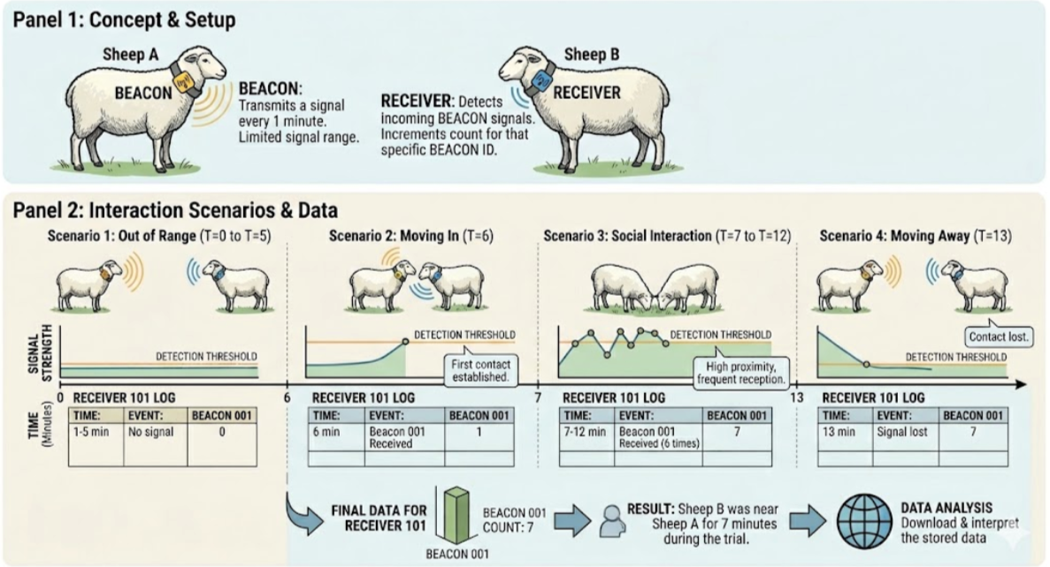

Slide 3
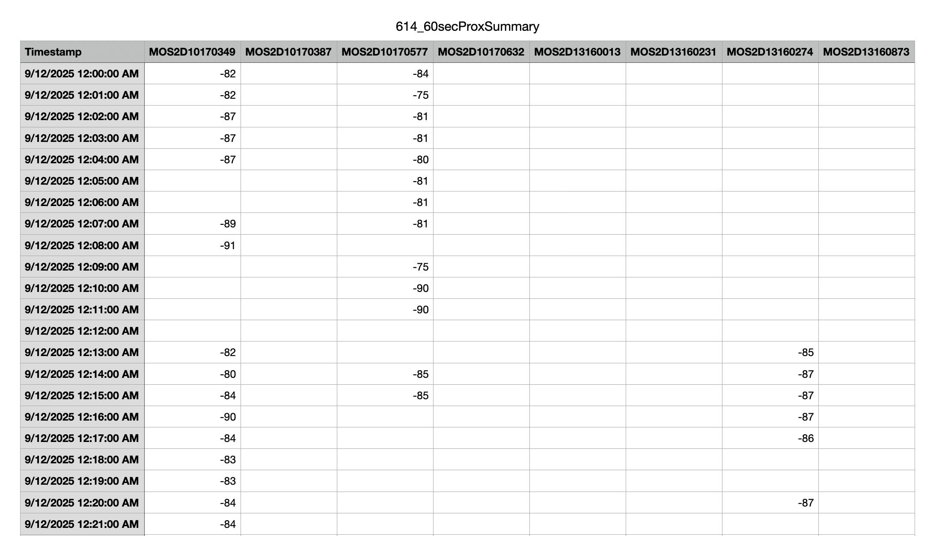
Raw Data of Proximity Logger

Slide 4
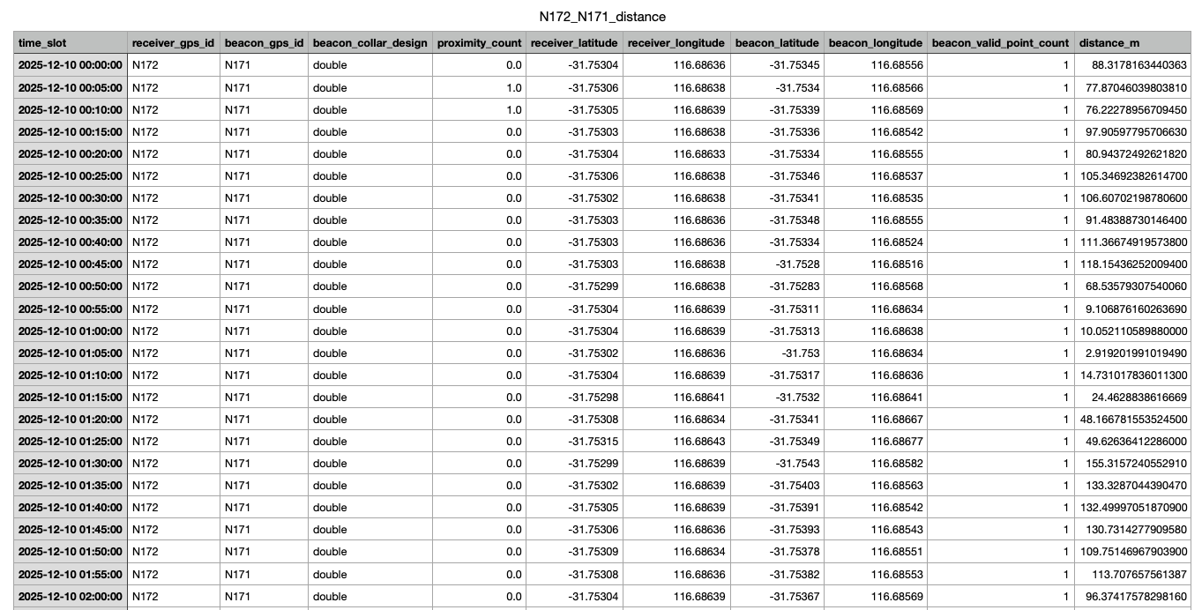

Slide 5
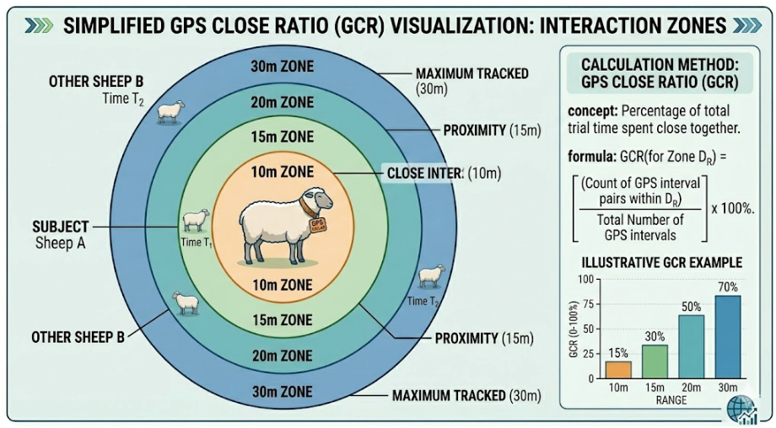

Slide 6
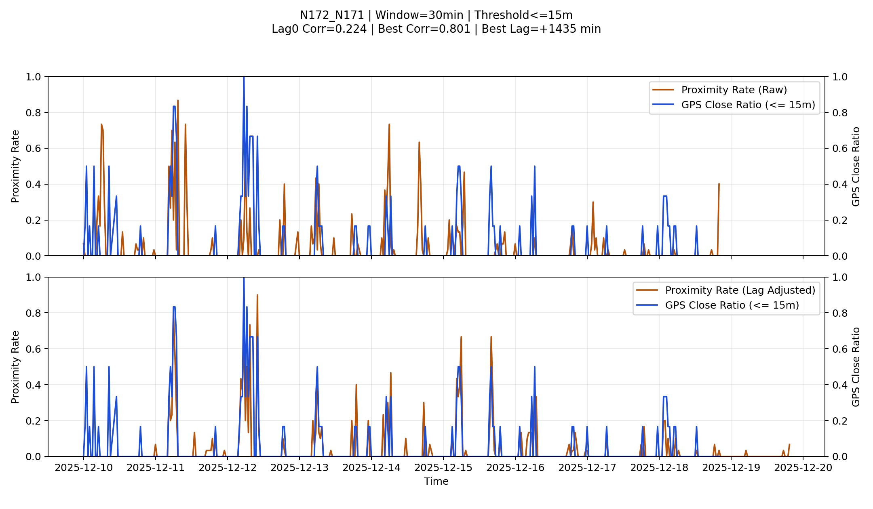
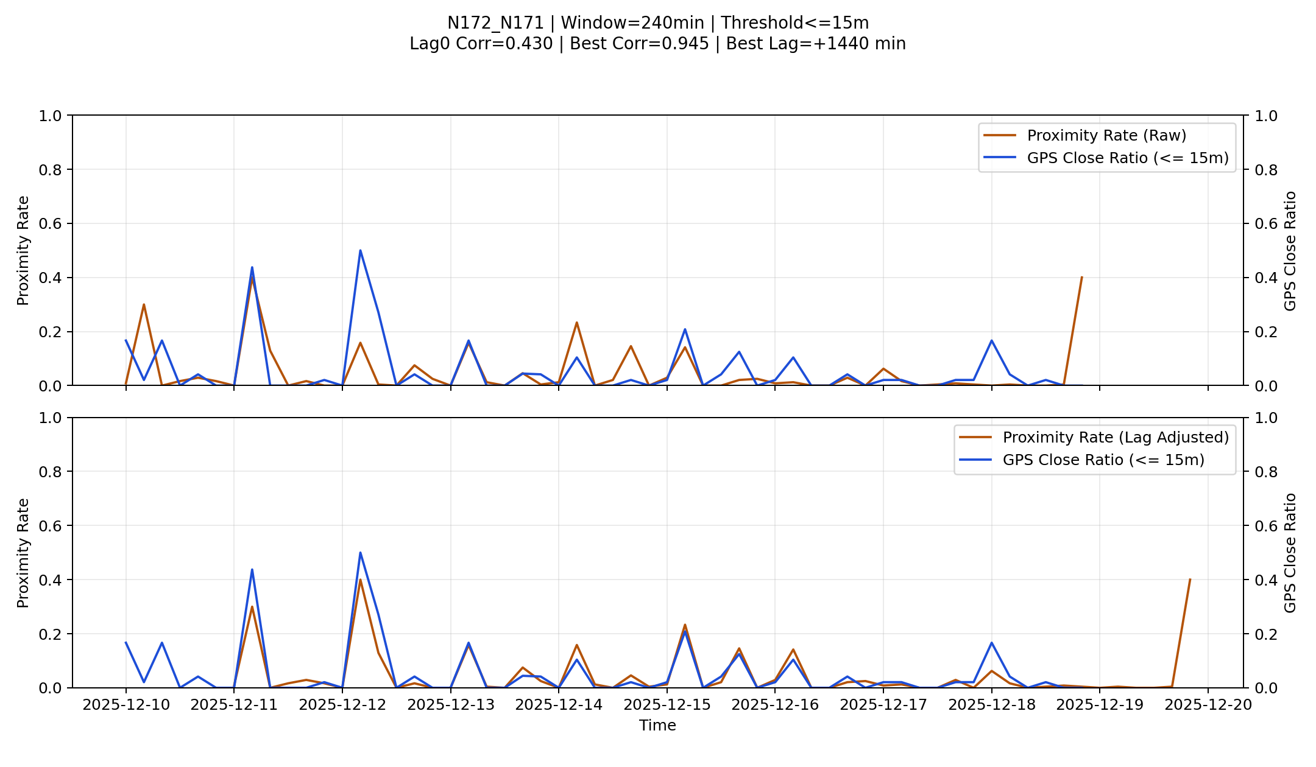
Important hyperparameters
Aggregation Window
30min, 60min, …, 240min
GPS close range:
10m, 15m, 20m, …, 50m
Selected
Win: 240min
Range: 15m ( GPS error: ~10m)

Slide 7
Time Series Visualization: N172_N171

Slide 8
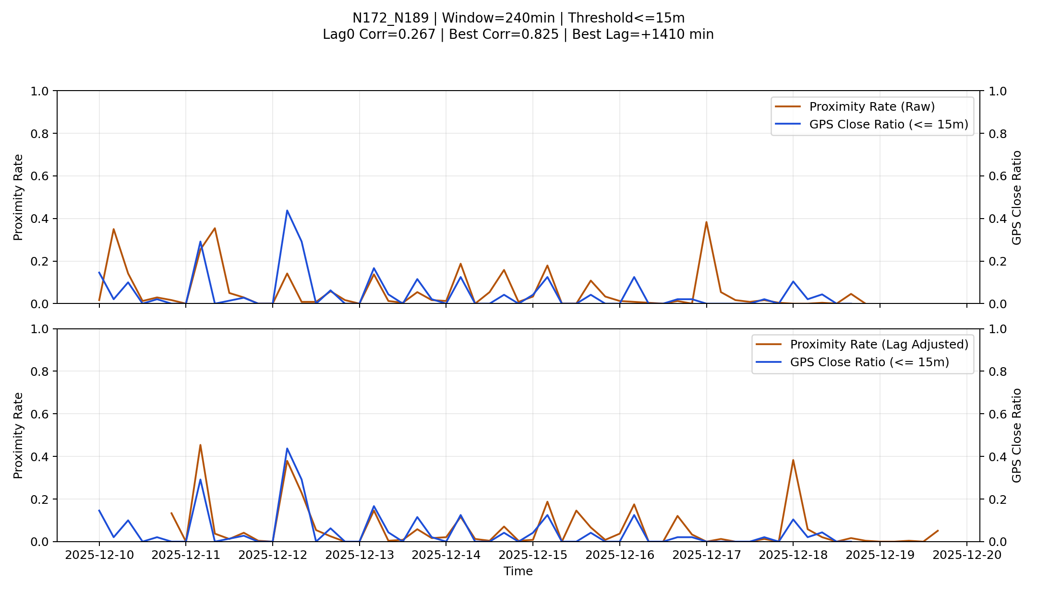
Time Series Visualization: N172_N189

Slide 9
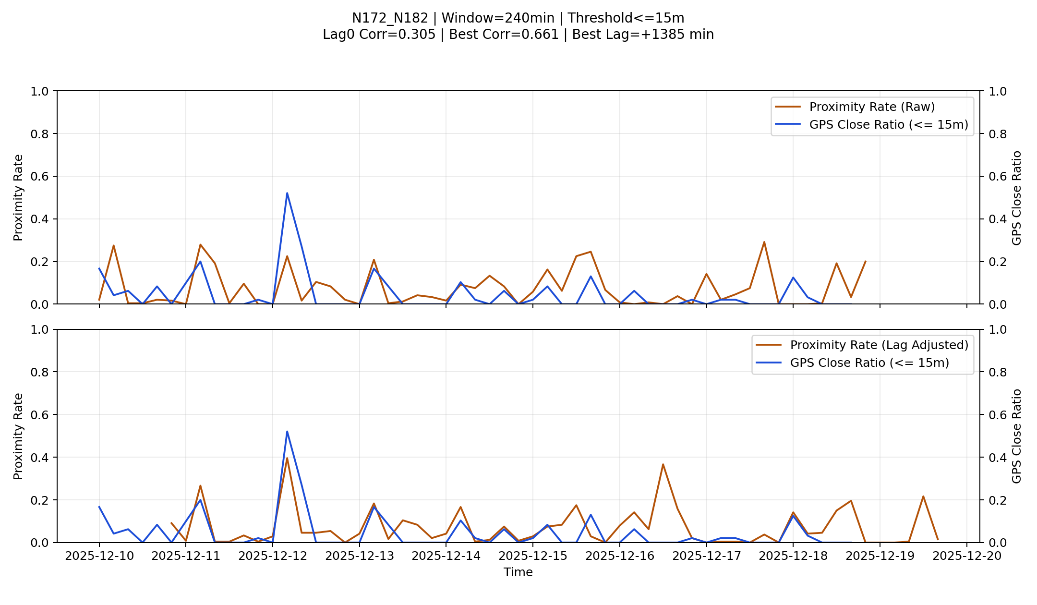
Time Series Visualization: N172_N182

Slide 10
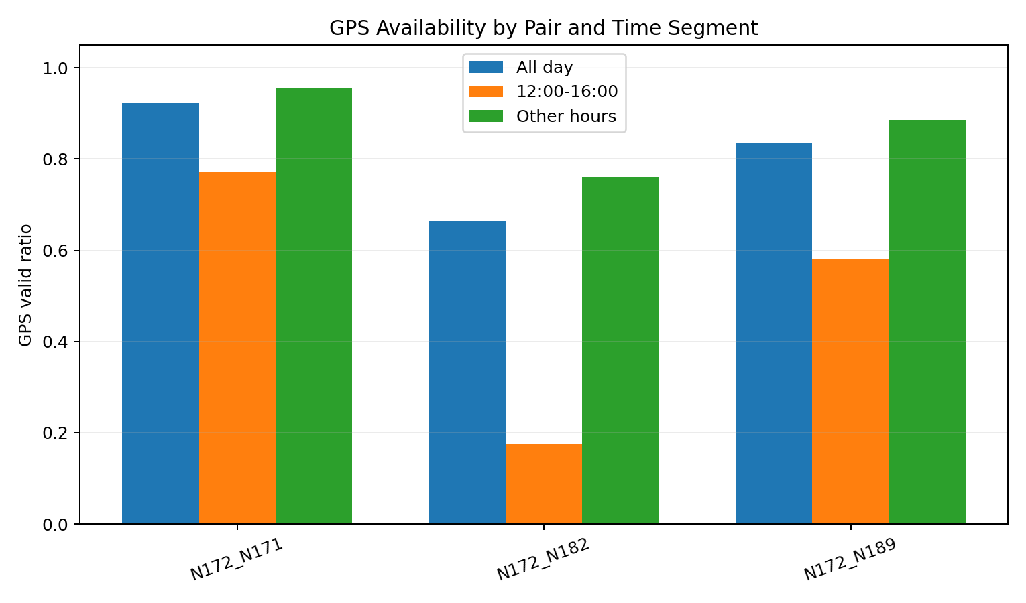
GPS Availability by Pair and Time Segment

Slide 11
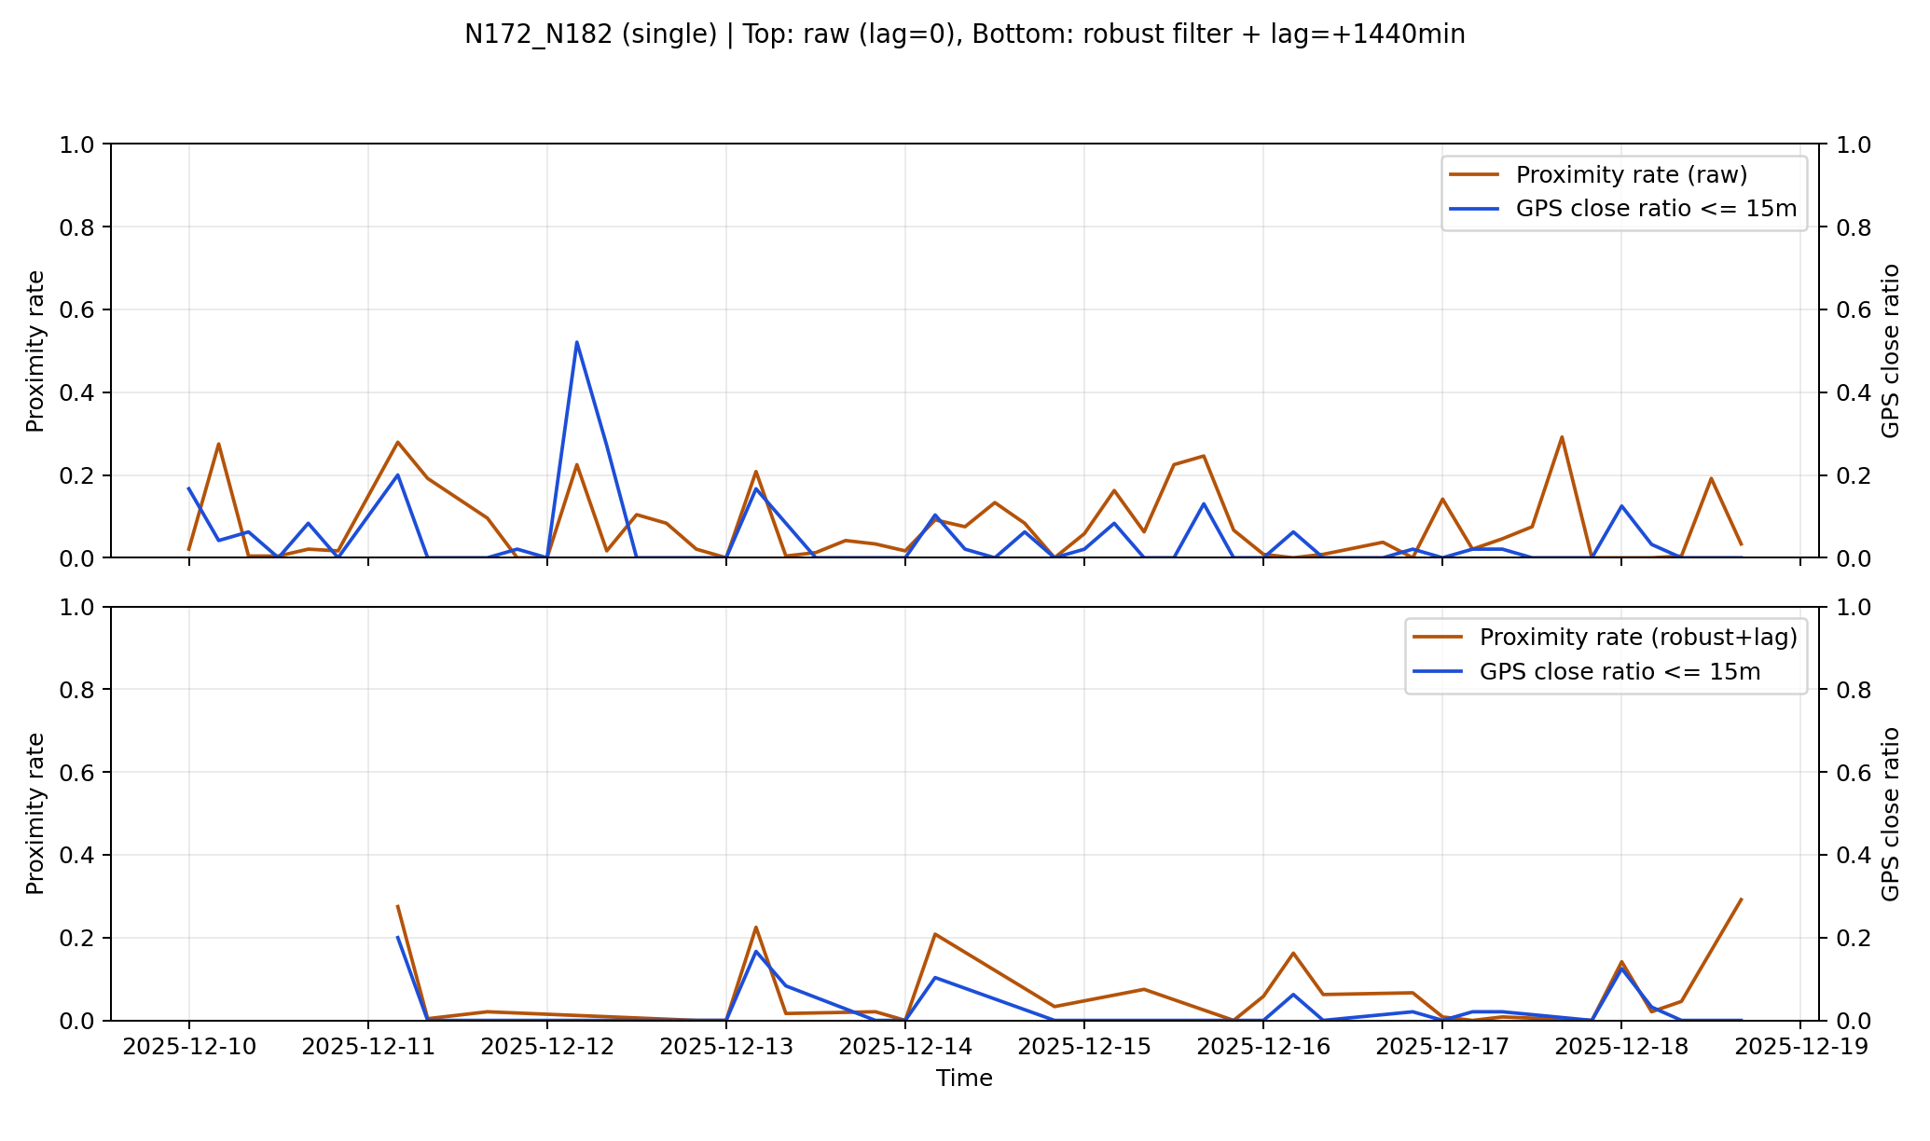
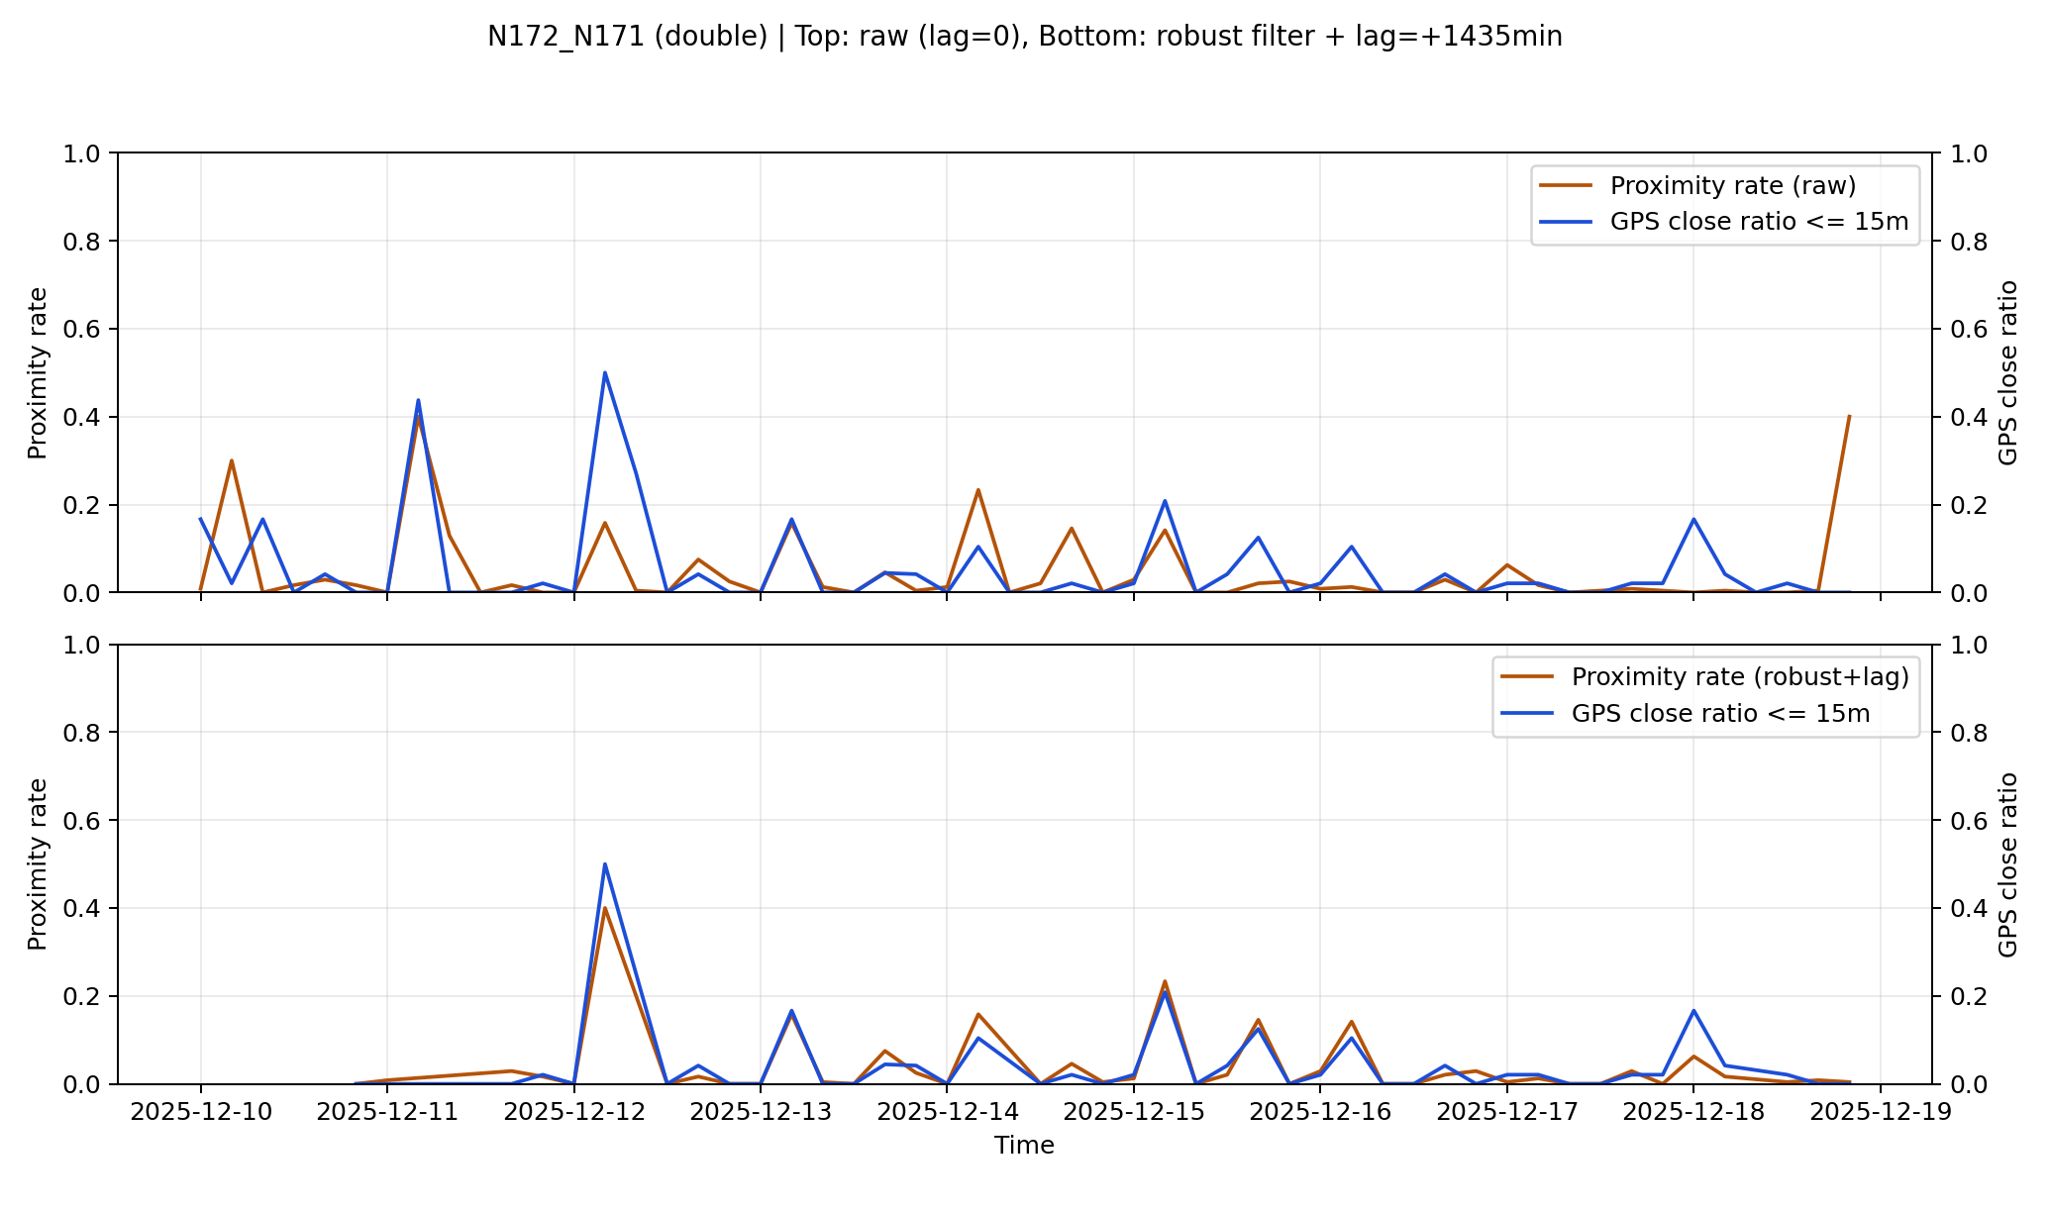
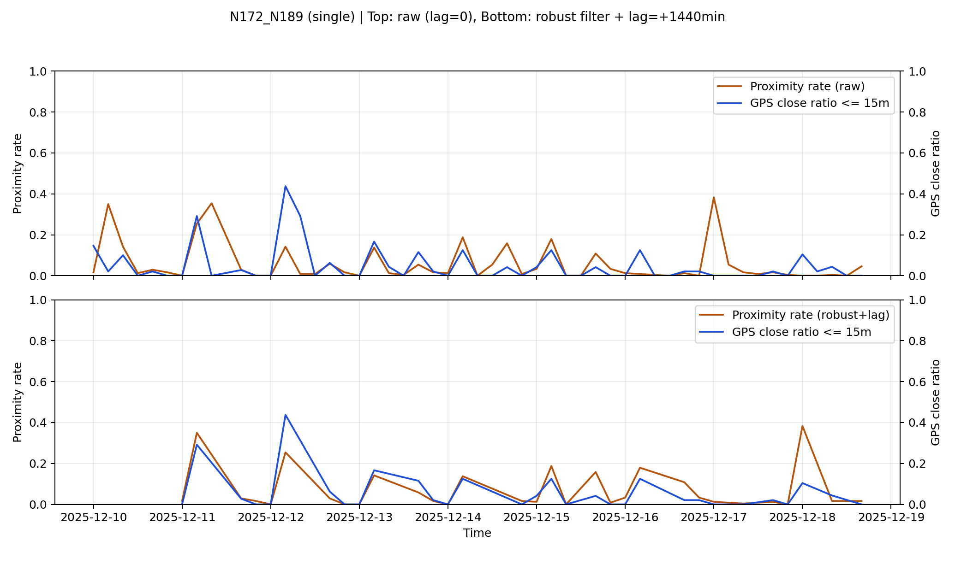
Remove Abnormal GPS Pairs

Slide 12
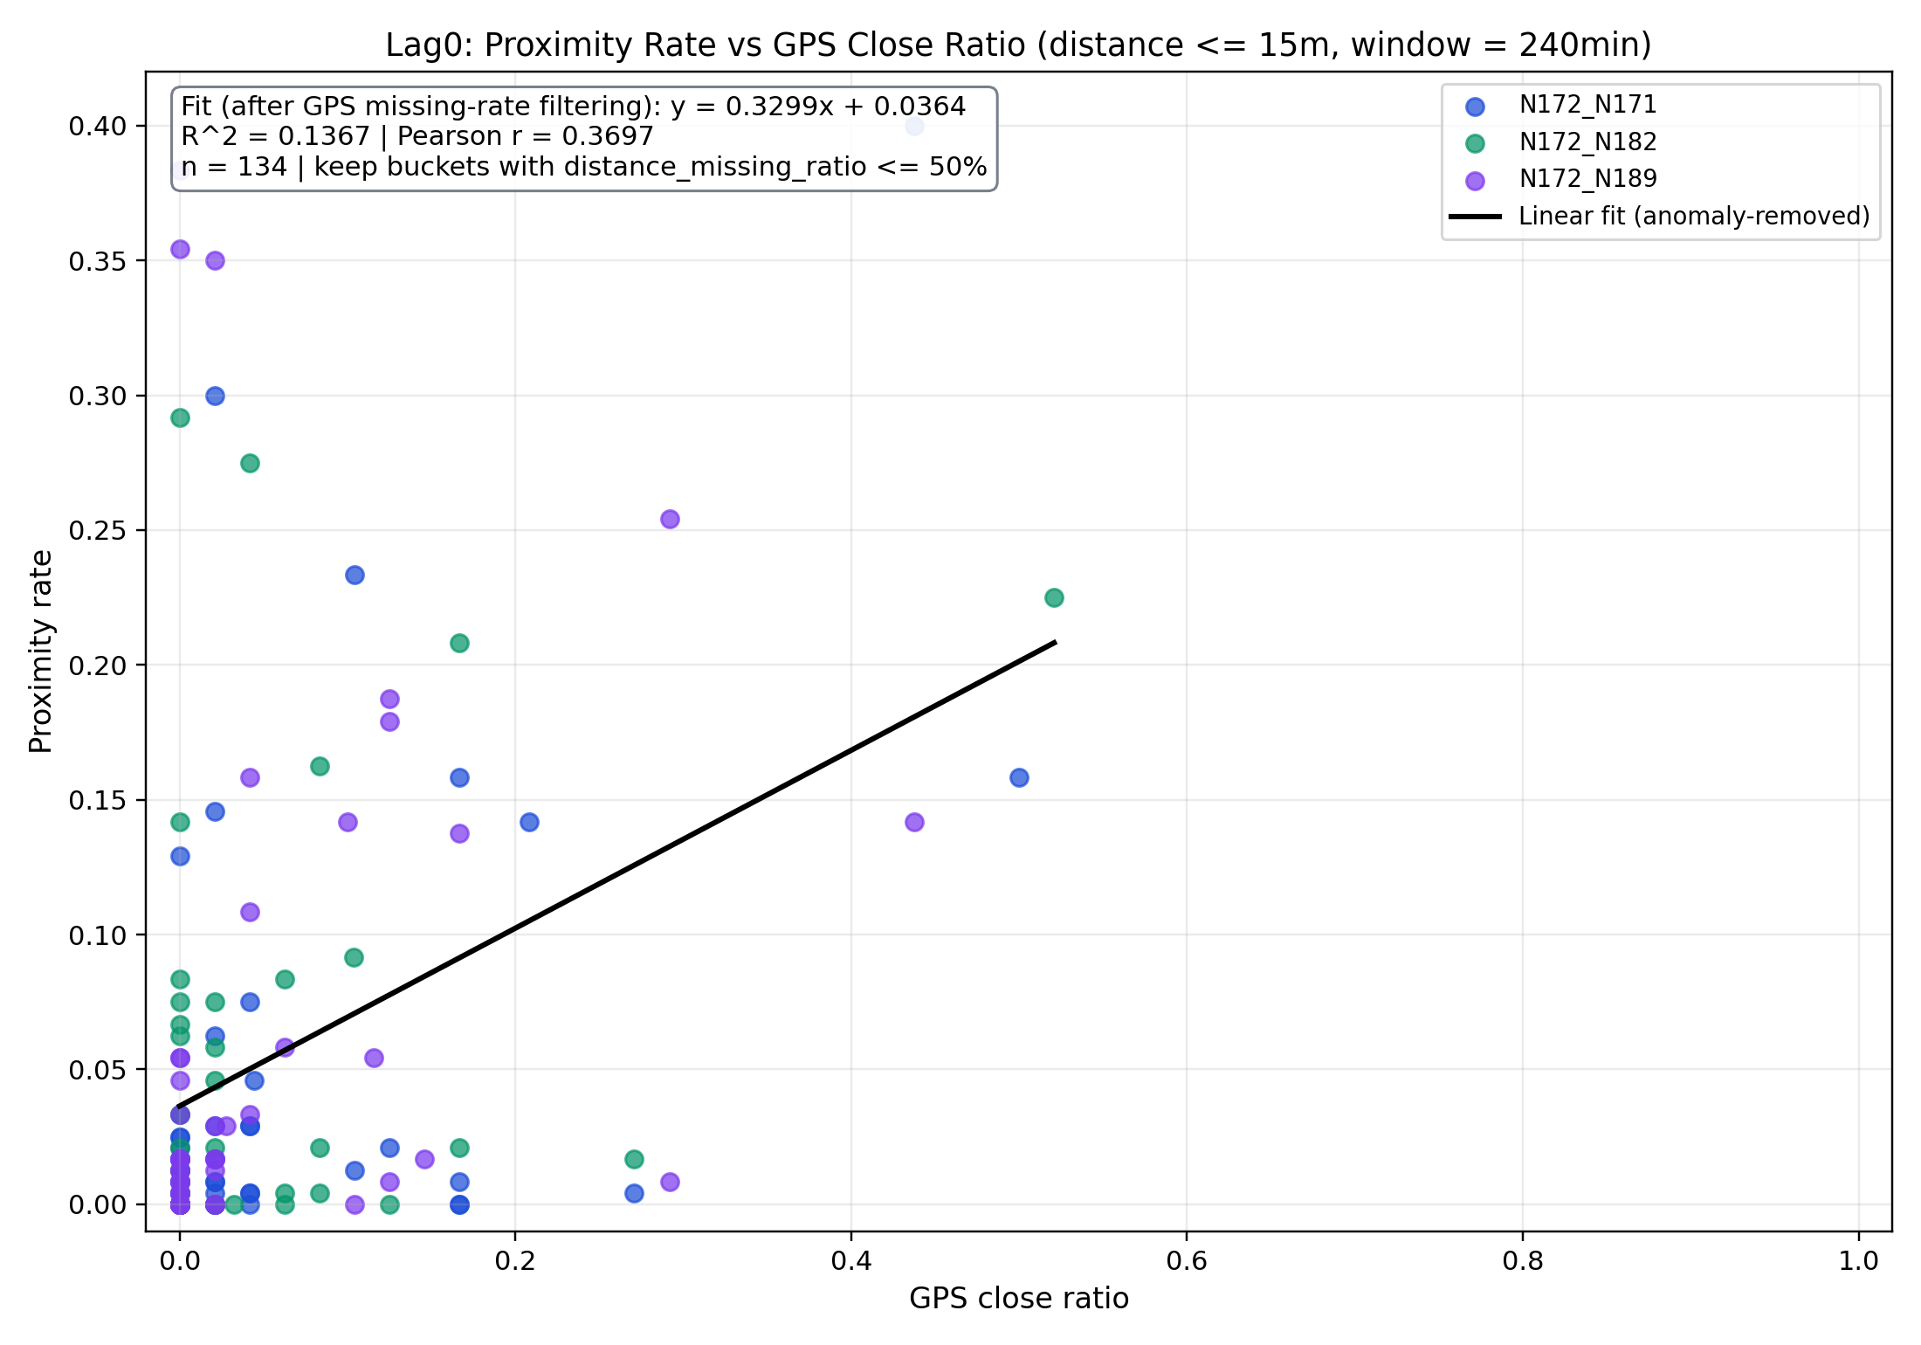
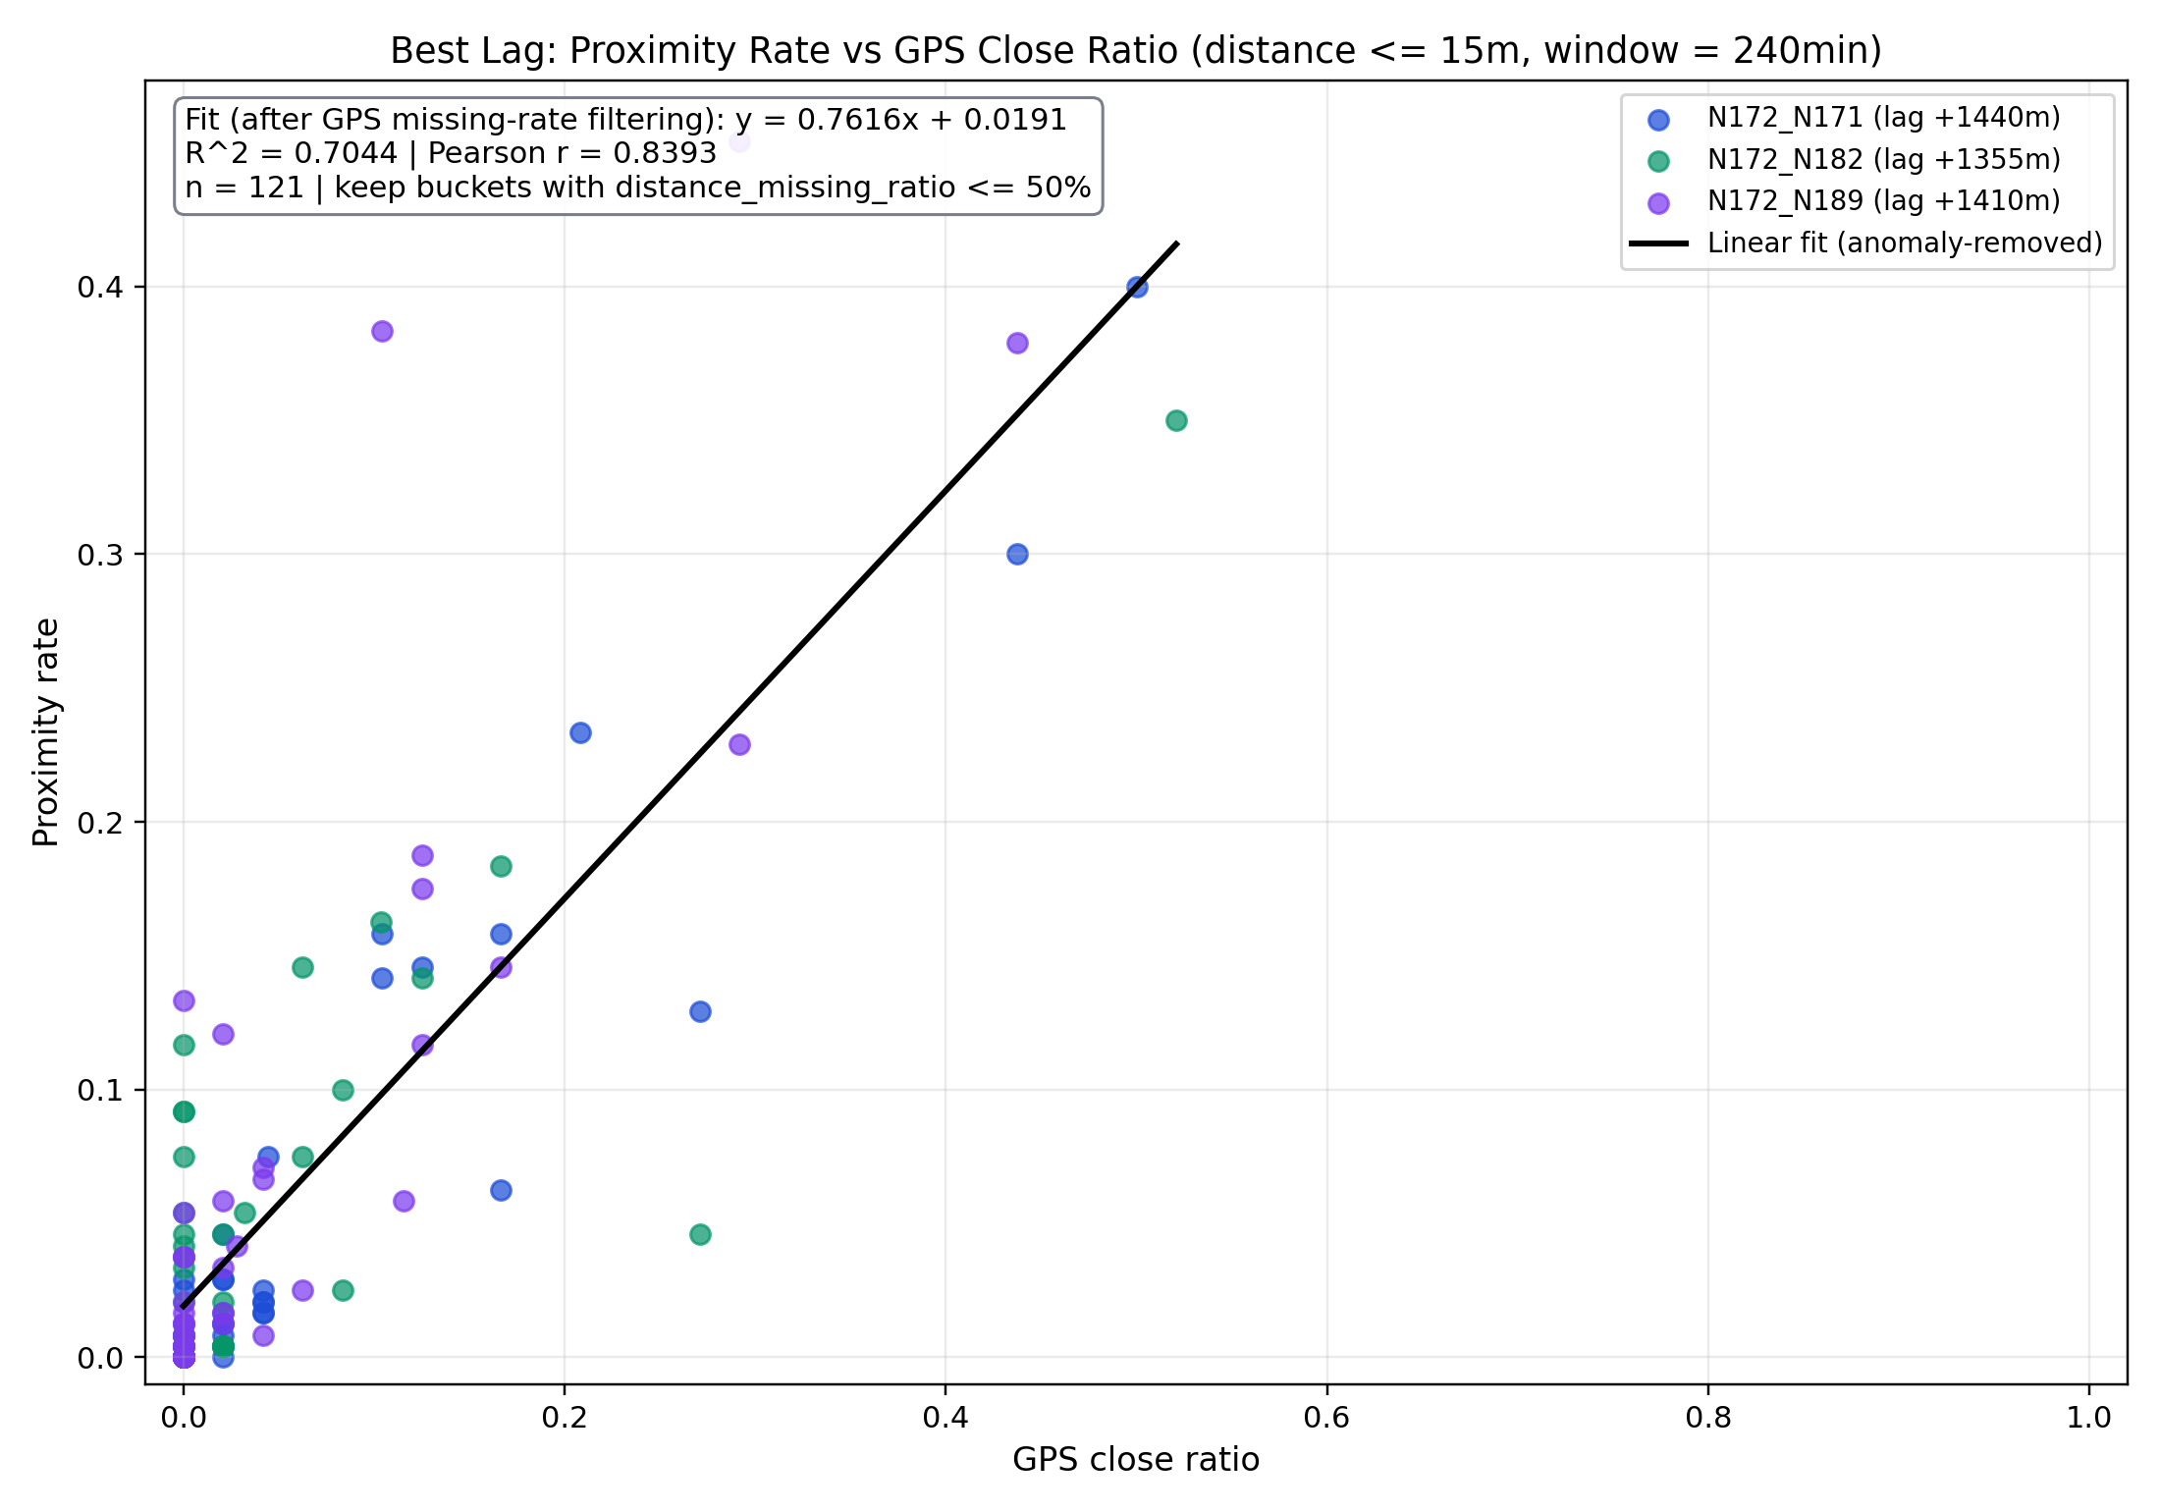
Correlation Analysis Plot

Slide 13

Summary
Possibility to replace proximity logger?
Yes, with the following condition
High quality GPS data (low accuracy error)
Low missing rate (collar on the side)
Advantages
One device for multiply purposes
Long-time monitoring (at least 50 days)
Not only when, but also where

Slide 14
