Slide 1
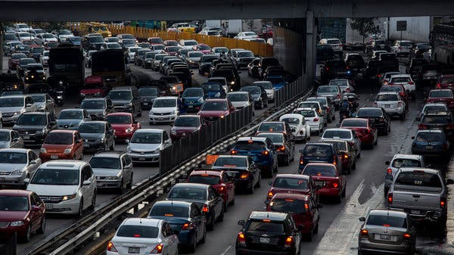
Project 1
Car incidents in Mexico City

Slide 2
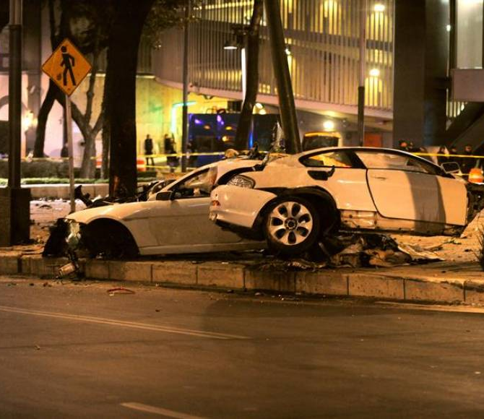
HYPOTHESIS
More car average incidents are registered during festive days than during non - festive days in Mexico City

Slide 3
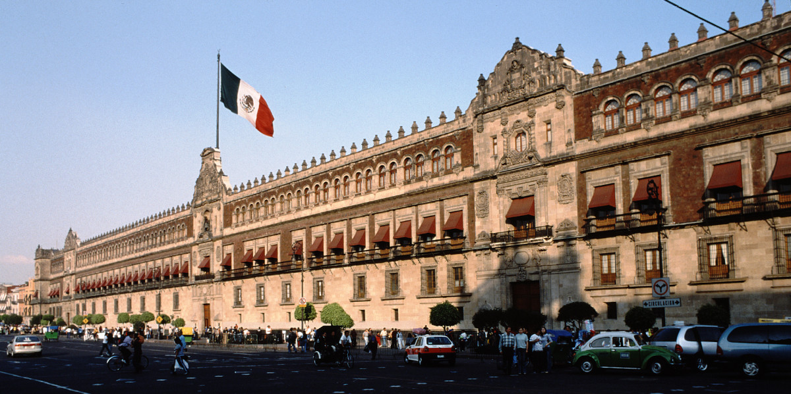
SOURCE
Database of Car Incidents in Mexico city registered via C-5 since 2014 is saved in https://datos.cdmx.gob.mx/api/records/1.0/download/?dataset=incidentes-viales-c5&format=json
According to web documentation, database contain all car incidents received from “Centro de Comando, Control, Cómputo, Comunicaciones y Contacto Ciudadano de la Ciudad de México “ .
Dates, Location - Lat and Long, Emergency types, Weekdays, Area between other information is recorded in Database
Holidays period considered:
Christmas and New Year holidays
Saint week holidays
Labor day
Summer vacation
Independence day

Slide 4
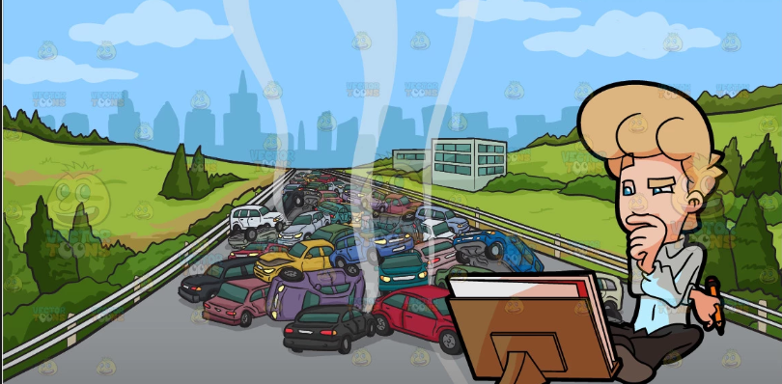
QUESTIONS - MOTIVATION
Which day of the week recorded the highest number of car incidents in Mexico City??
Is it the same day, the highest number of incidents, for festive period and non - festive ones??
Is it safer to drive in Mexico City on festive than on non-festive days??
Where the greatest number of incidents are located?, , Which one "Alcaldia"?
Is it the same "Alcaldia", where the greatest number of incidents are located for festive and non - festive period?

Slide 5

DATA EXPLORATION - CLEANING PROCESS
According to the web explanation, codigo_cierre = “A = “Afirmativo”: si se registra un incidente y personal de atención a emergencias confirma la emergencia en el lugar de los hechos” , means car incidents really happened, then filtering ["codigo_cierre"] = “A”
Creating columns fields to be filled
Discarding blank rows ( in any column)
Fix the wrong values recorded in "dia_semana" column

Slide 6
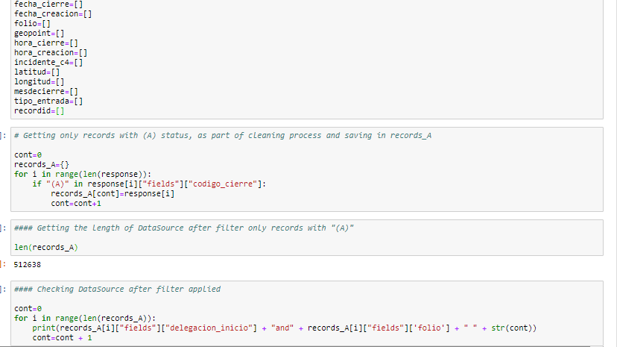
ANALYSIS PROCESS
In Jupyter Notebook is explained the whole process to get final results

Slide 7
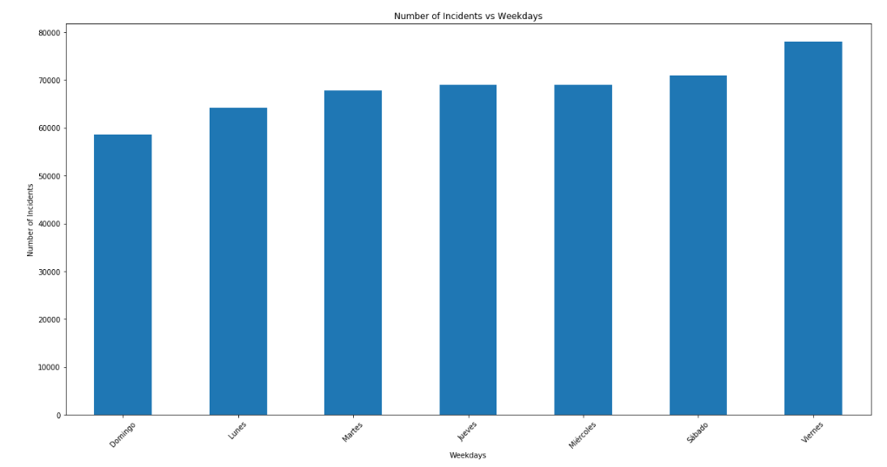
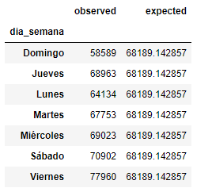
Results
Number of Incidents vs Weekdays
The highest number of incidents in Mexico City is registered on Friday and the less one is on Sunday.

Slide 8
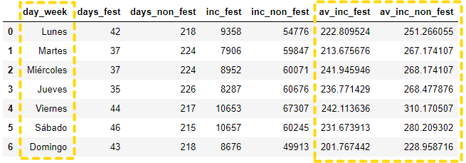
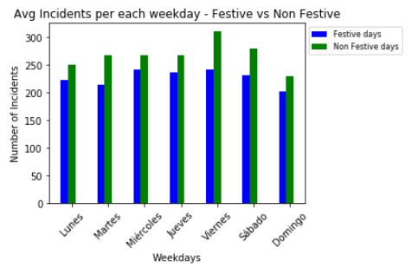
Incidents (Average) - Festive vs Non Festive
Similar trending is observed regarding average of incidents between Festive vs Non Festive days; in both periods, the highest value is register on Friday.

Slide 9
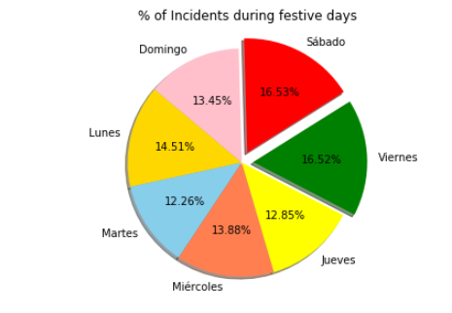
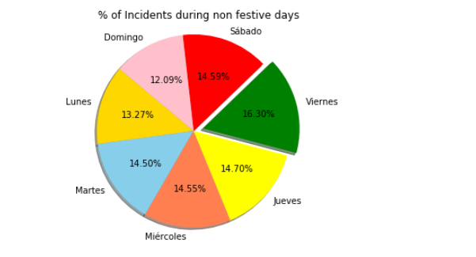
% Incidents (Total) - Festive vs Non Festive
Similar trending is observed regarding average of incidents between Festive vs Non Festive days; in both periods, the highest value is register on Friday.
Festive days
Non - Festive days

Slide 10
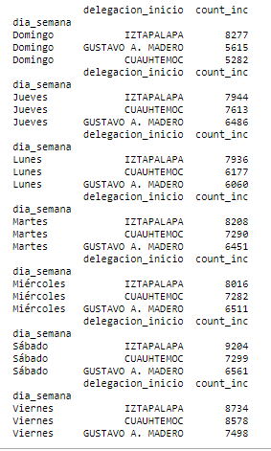
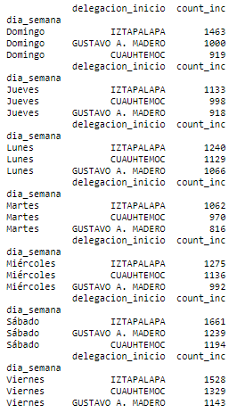
Area (Total) - Festive vs Non Festive
Iztapalapa is the “Alcaldia” with the highest number of car incidents in festive and non – festive days.
Festive days
Non - Festive days

Slide 11

CONCLUSIONS
Holidays or not holidays period , the highest car incidents in CDMX is registered on Friday.
In festive period, Saturdays register high car incidents in CDMX as well.
TOP 3 of the “Alcaldias” that register major incidents are the Iztapalapa, Gustavo A. Madero, Cuahtemoc both on holidays and on non-holiday days.
A little suggestion, if it is Friday ( or Saturday in festive days), avoid to drive on the three “alcaldias” or good luck.

