Slide 1

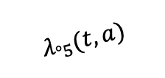





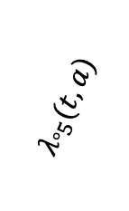
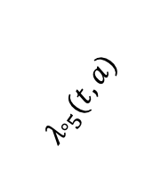

1. Stable (Tx 1)
$$λ_{°5}(t, a)$$
$$λ_{12}(t, a)$$
5. MDS/AML
$$λ_{°5}(t, a)$$
2. Stable (Tx 2)
$$λ_{°5}(t, a)$$
$$λ_{57}(t)$$
$$λ_{23}(t, a)$$
7. Death (MDS/AML)
3. Stable (Tx 3)
$$λ_{°5}(t, a)$$
$$λ_{34}(t, a)$$
4. Salvage treatment
$$λ_{°8}(t)$$
$$λ_{46}(t)$$
8. Death (Other)
6. Death (Progression)

Slide 2

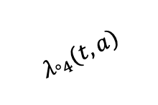




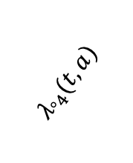

NEC Model Life States and Allowable Transitions
1. Stable (2nd line)
$$λ_{°4}(t, a)$$
4. MDS/AML
$$λ_{12}(t, a)$$
$$λ_{°4}(t, a)$$
2. Stable (3rd line)
OLD
$$λ_{°4}(t, a)$$
$$λ_{46}(t)$$
$$λ_{23}(t, a)$$
6. Death (MDS/AML)
3. Salvage treatment
$$λ_{35}(t)$$
$$λ_{°7}(t)$$
5. Death (Progression)
7. Death (Other)

