Slide 1
Climbing AI Coach
Concept Video
Owen Kang, Jiemi Niu, Yulin Yu

Slide 2
Name: 3B (Bouldering Beta Buddy)
How did we land on the name?
We wanted a name the signals climbing beta, video-based learning, community comparison, and personal coaching.
Bouldering - We especially narrowed down to bouldering, which requires the most technique, balance, and brain.
Beta - The specific, actionable information, advice, or moves required to complete a climbing route.
Buddy - Getting help from our friend AI

Slide 3
One-liner Value Proposition
Providing a community where users can find useful videos and suggestions from others and get personalized suggestions from AI trained with data provided by users

Slide 4
Problem / Solution overview

Slide 5
primary user: Alex & Jackson (Climber training in busy gyms.)
What’s the Problem?
Climbers get stuck and want better beta + technique feedback but mid-climb feedback breaks focus/flow, and existing solutions either require gym-installed cameras or have unreliable personal filming issues
What’s the Solution?
A video-based AI coach that works in any gym, lets you record easily, then delivers fast post-climb insights + compare-your-beta vs community patterns, while learning your personal style over time.

Slide 6
Market Research

Slide 7
SPOT
Gym-installed cameras
provide real-time user behavior analysis and track the frequency (probability) of reaching each hold,
What works for out problem?
What doesn’t work?
Real-time behavior analysis; route difficulty and hold success rates.
Lets users compare performance patterns.
Not installed in every climbing gym, so it's only applicable at specific climbing gyms.
Implication for our concept
We keep the community-level analytics idea, but avoid infrastructure lock-in by using personal recording and shared route database.

Slide 8
Belay AI
personal camera body tracking
What works for out problem?
What doesn’t work?
Provides detailed information about my climb.
Because it's a personal camera, other people might walk in front of it or obstacles might block the view, causing me to miss some of the moves.
Implication for our concept
We design for gym reality, quick setup, stable angle guidance, and multi-attempt aggregation.

Slide 9
climbing.ai
When a climber uploads their video, AI analyzes their height, physical characteristics, and gender, and then visualize.
What works for out problem?
What doesn’t work?
Provides visualized answers, incorporates my physical characteristics.
Because it uses a personal camera, other people passing by or obstacles may cause the system to miss movements.
Implication for our concept
We combine body-aware visualization with community beta comparison.

Slide 10
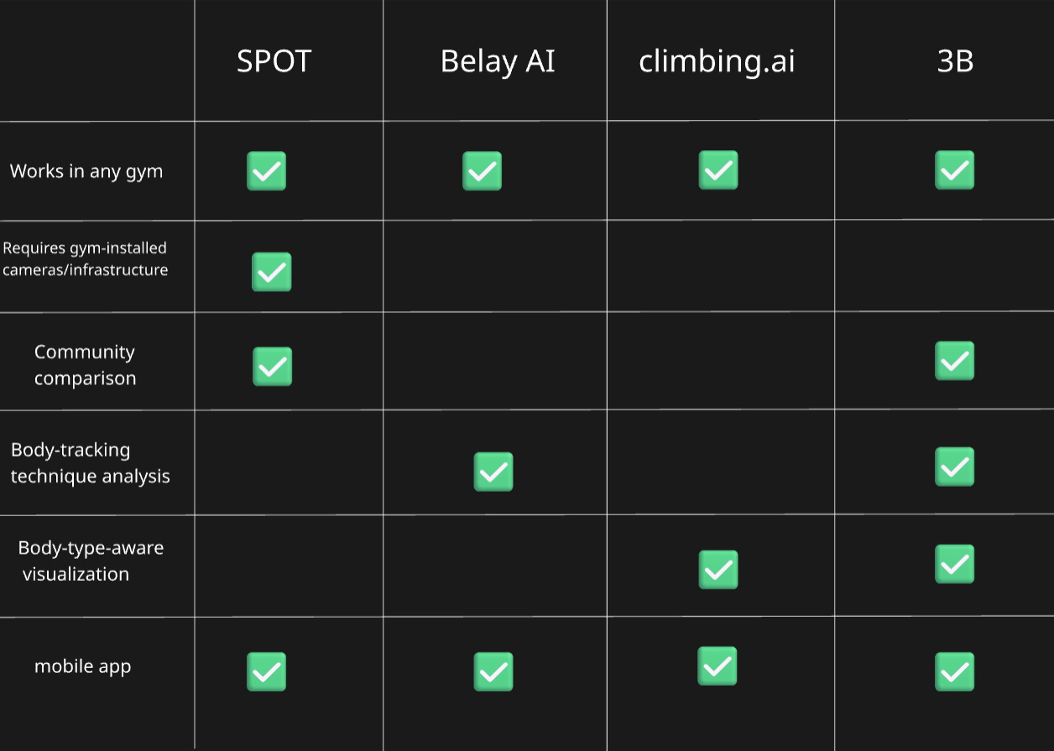

Slide 11
Task

Slide 12
Simple-1
The user see how others climb on that route.
Why?
Even a shy climber can easily look at how others behave on the route when taking rests

Slide 13
Simple-2
The user finds video to see the beta from that route.
Why?
There are so many resources online and on the local forum, including videos for different routes

Slide 14
Moderate-1
The user learn from some general suggestions for that route/similar ones
Why?
Taking effort to decide which suggestion make sense for him, and apply these suggestions in next try

Slide 15
Moderate-2
Uploads his video and gets feedback from AI
Why?
Posting videos takes effort, some users may not want to upload their own videos

Slide 16
Complex
Getting more personalized suggestions overtime
Why?
General suggestions are enough for those "not-powered customers", they don't have enough motivation for doing that; keeping posting videos(for AI to learn about the customer) is hard as well

Slide 17
Storyboarding

Slide 18
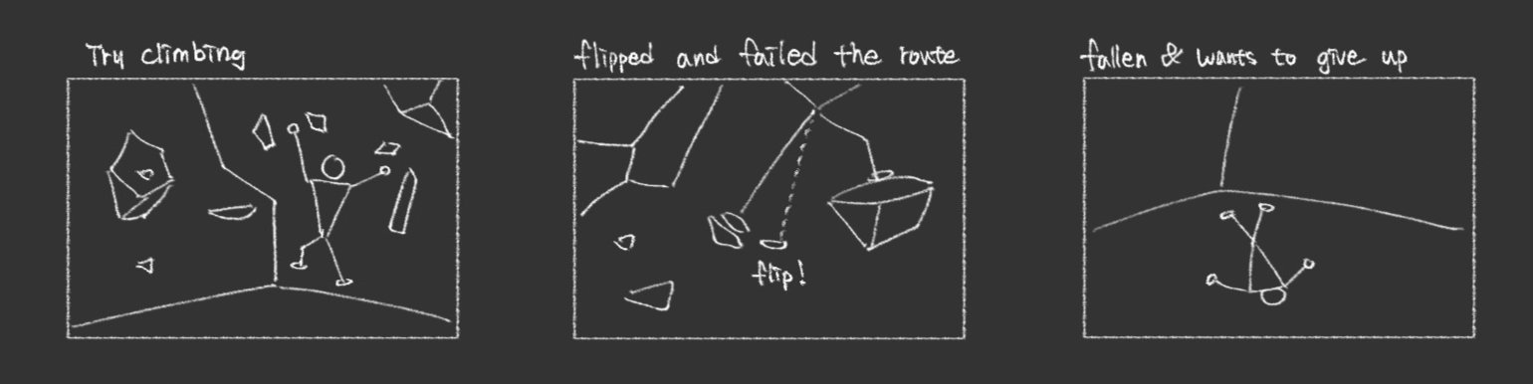
[Mood Change]
passionate → discouraged
[Setting Change]
hard-working → giving up

Slide 19
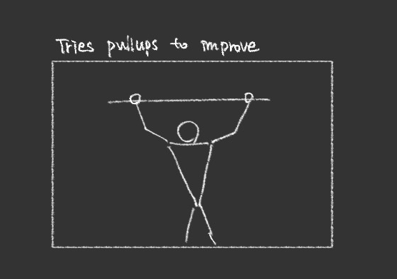
[Mood Change]
discouraged → hopeful
[Setting Change]
giving up → improvement
0:15

Slide 20
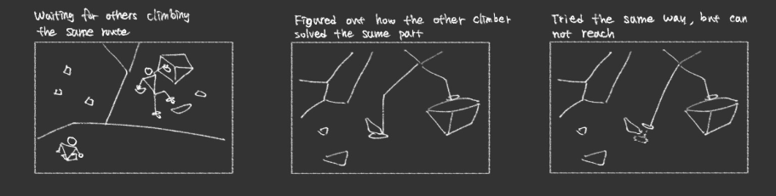
[Task 1]
the user see how others climb on that route.
[Mood change]
hopeful → frustrated
0:29

Slide 21
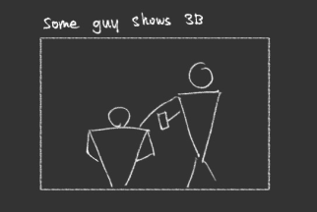
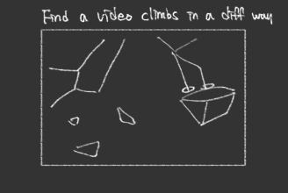
[Task 2]
the user learn from some general suggestions for that route/similar ones
[Mood change]
frustrated → curious
0:37

Slide 22
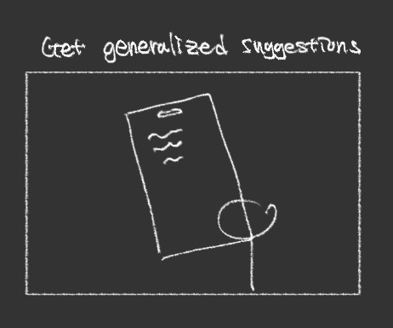
[Task 3]
the user learn from some general suggestions for that route/similar ones
[Mood change]
curious → relieved
0:53

Slide 23
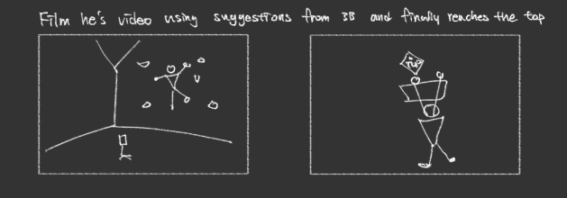
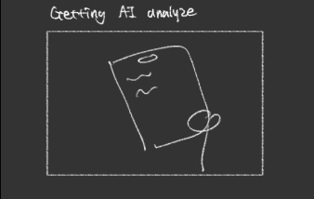
[Task 4]
uploads his video and gets feedback from AI
[Mood change]
relieved → motivated
1:12

Slide 24
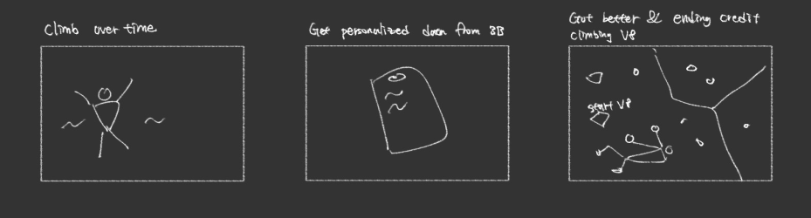
[Task 5]
getting more personalized suggestions overtime
[Mood change]
motivated → confident
1:25

Slide 25
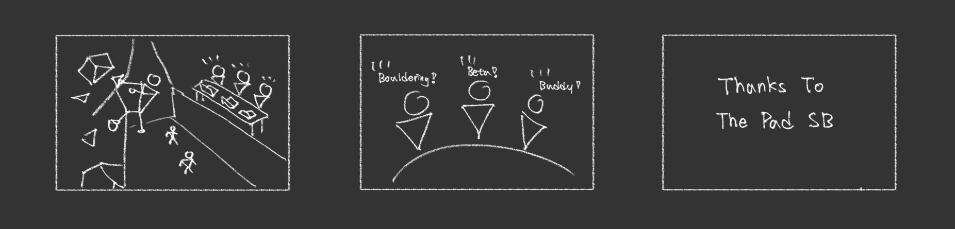
[Resolution]
Successfully climbed a difficult route

Slide 26
Concept Video

Slide 27
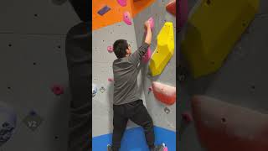

Slide 28
THANK YOU

