Slide 1
On successive point-of-interest recommendation
汇报人：黎腾

Slide 2
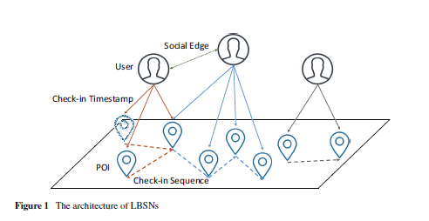
Location-based social networks（LBSNs）
LBSN is a combination of
users, check-in timestamps and point-of-interests (POIs).

Slide 3
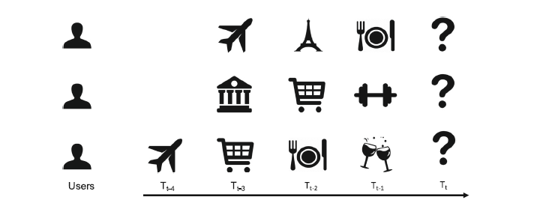
successive （英 [səkˈsesɪv]）
a user’s intention for visiting one POI may be also influenced by
the prior POI(s) that the user just visited

Slide 4
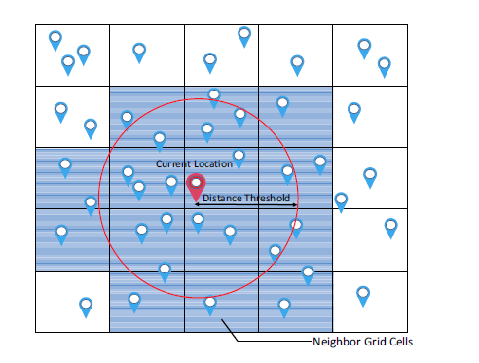
influence of the regions

Slide 5
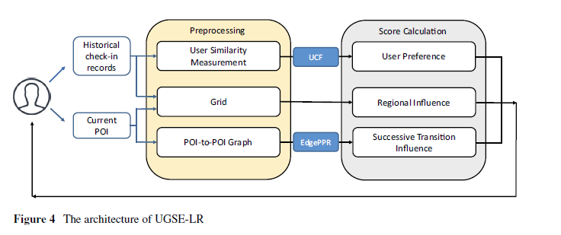
Architecture

Slide 6


User preference

Slide 7



Regional influence

Slide 8



Regional influence

Slide 9




Successive transition influence

Slide 10
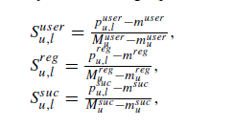


final

Slide 11
谢谢您的观看
by liter

