Slide 1
Modern C++

Slide 2
Outline
C++ is not
C with class
OO
Template
C++11/14
Tools
Reference

Slide 3
C++ is not
C with class
1

Slide 4
Why
Change from C to C++?

Slide 5
C++ is a federation of languages
Notes:
视C++为一个语言联邦，它包含了多种编程范式，而OO只是其中一种。

Slide 6
OO
2

Slide 7
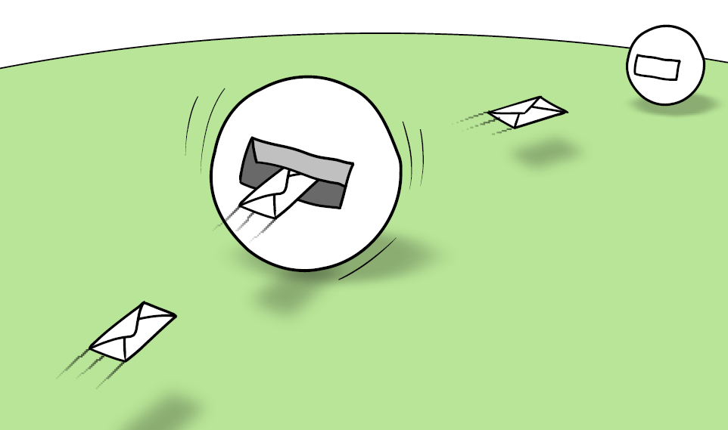
Objects and Classes
An object is a computational process that receives messages from other objects and reacts by
by sending messages to other objects and perhaps returning a value or exception to the original
sender.
An object:
• encapsulates some internal state
• has a method for handling each type of message that it understands
Every object is an instance of a class. The class defines the object's interface and implementation.
When design OO systems it is more useful to think in terms of relationships
between objects than in terms of relationships between classes.

Slide 8
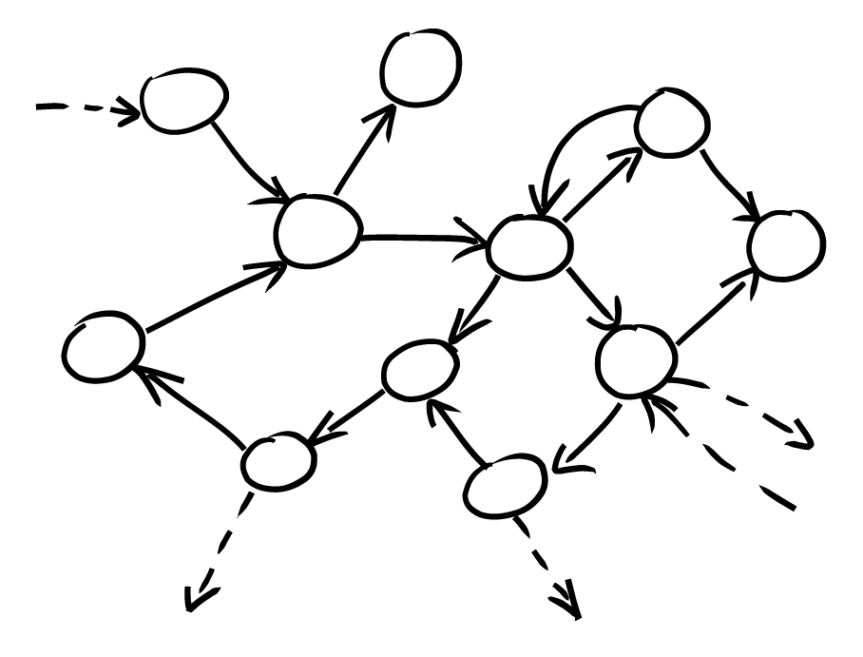
OO is about communication
An object-oriented system is a web of collaborating objects.
The behavior of the system is an emergent property of the composition of the objects: the
choice of objects and how they are connected. You can think of the composition of objects as a
declarative definition of the system's behavior. You can easily change the system behavior by
changing the way objects are plugged together.
At least, you should be able to...
Notes:
Roles, Responsibilities and Collaborators

Slide 9
composition
Vs
inherent
IS-A
HAS-A

Slide 10
3
Template

Slide 11
template <class T> T max(const T&a, const T&b) { return (a >b) ? a : b; }
Different from OO

Slide 12
C++11/14
Notes:
See markdown version for C++ 11 introduction

Slide 13
See Code

Slide 14
Using STL
Using STL
Using STL

Slide 15
C++ Editor/IDE
VIM
Sublime Text
Eclipse
CLion

Slide 16
Reference: 1. C++ Common Knowledge 2. Effective Series: Effective C++, Effective Modern C++ 3. Exceptional C++

Slide 17
Xia Wood wood.xia@nokia.com
Contract

