Slide 1
Object-oriented programming
By Julia Tsurkan

Slide 2
Procedural programming
Object-oriented programming

Slide 3
Object-oriented programming
C#
C++
Java
JavaScript
Delphi
PHP
Perl
Python
Ruby
SmallTalk
Objective-C
Object Pascal
ActionScript 3

Slide 4
Object model
“Everything in JavaScript is an object”
Objects include arrays, functions, built-in objects and user defined objects too. But interestingly primitives sometimes behave like objects too!

Slide 5
Object model
An Object is a collection of properties. The properties are also known as key-value pairs.
In JavaScript, an object can be created in two ways:
Object literal
2) Object constructor
const <object-name> = { key1: value1, key2: value2,... keyN: valueN};
const <object-name> = new Object();

Slide 6
Adding properties to an object
An object can only contain a single key with one value. We can’t have a single key having two different values.
Using the dot-notation, you can’t use property names that are numbers, or string that contain spaces, or special character, or dynamic properties.
If you don’t want to be limited by the above caveats, you may consider using bracket notation.
obj.address = 'Earth';
const propName = 'address';
obj[propName] = 'Earth'
obj.5 = 'five';
obj.first name = 'alex' obj.first-name = 'alex'
obj[5] = 'five';
obj['first name'] = 'alex';
obj['first-name'] = 'alex';

Slide 7
Objects and Properties
Reading/Retrieving
Like addition, we can use the dot-notation or bracket notation get the value of a property. If the property exists, we get its value. If the property does not exist, we get undefined.
Updation
It’s just like addition. You can use dot-notation or bracket-notation.
Deletion
Deletion is performed using thedelete operator. Again, we can use both the notations.
obj.address // => 'Earth'
obj['firstName'] // => 'Alex'
obj['middleName'] // => undefined
obj.firstName = 'Timothy'
obj['firstName'] = 'Timothy'
delete obj.firstName; // => true
delete obj['firstName']; // => true

Slide 8
Comparison
There are no good in-built of ways of comparing two objects. When you use the == or === operators, they only compare the references of the objects. References can be understood as “memory addresses” of the objects. Only primitives types are compared by values.
Now, two objects can have the same key-values pairs but they can’t occupy the same location in memory or reference. The object is only equal to itself as the example shows us —
const obj1 = {
name: 'Alex',
}
const obj2 = {
name: 'Alex',
}
obj1 === obj2 // => false
obj1 === obj1 // => true

Slide 9
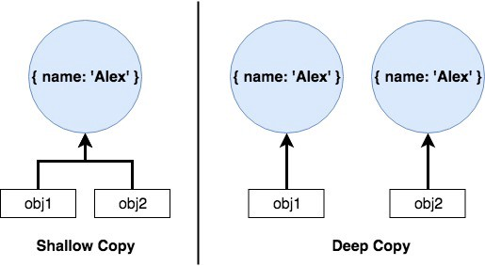
Copying
const obj1 = {
name: 'Alex',
}
const obj2 = obj1;
const obj2 = {
…obj1
}
const obj2 = JSON.parse(JSON.stringify(obj1));
const obj2 = Object.assign({}, obj1);

Slide 10
OOP
Class-based (Java)
class
instance
Prototype-based (JavaScript)
objects

Slide 11
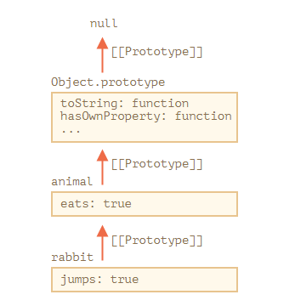
Inheritance with the prototype chain
JavaScript objects have a link to a prototype object. When trying to access a property of an object, the property will not only be sought on the object but on the prototype of the object, the prototype of the prototype, and so on until either a property with a matching name is found or the end of the prototype chain is reached.
JavaScript does not have "methods" in the form that class-based languages define them. In JavaScript, any function can be added to an object in the form of a property. An inherited function acts just as any other property

Slide 12
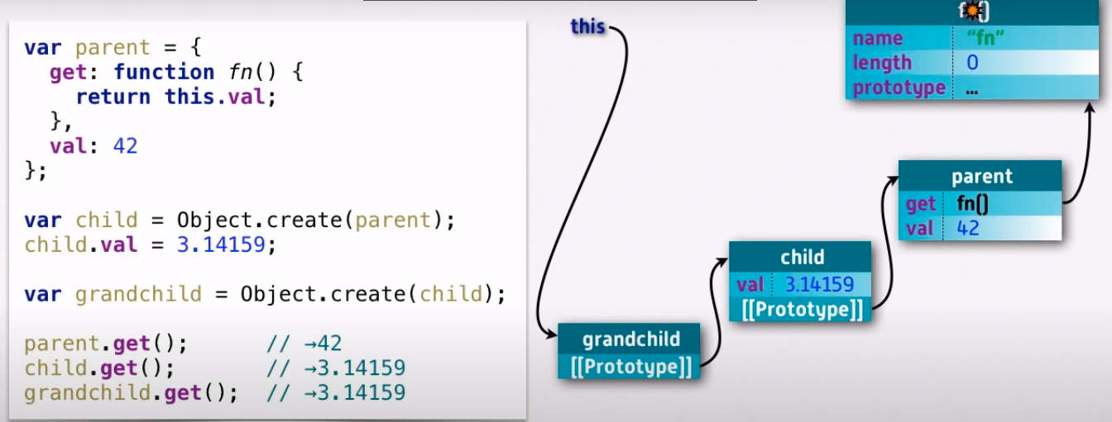
Prototype chain

Slide 13
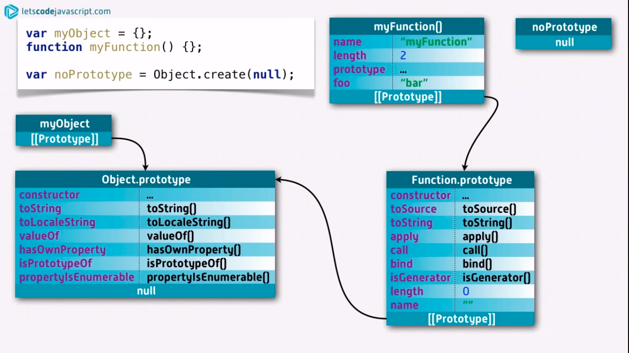
Prototype chain

Slide 14
Different ways to create objects and the resulting prototype chain
1) Objects created with syntax constructs
2) With a constructor
const o = {a: 1};
// o ---> Object.prototype ---> null
const b = ['yo', 'whadup', '?'];
// b ---> Array.prototype ---> Object.prototype ---> null
function f() { return 2; }
// f ---> Function.prototype ---> Object.prototype ---> null
function Graph() {
this.vertices = [];
this.edges = [];
}
Graph.prototype = {
addVertex: function(v) {
this.vertices.push(v);
}
};
const g = new Graph();

Slide 15
Different ways to create objects and the resulting prototype chain
3) With Object.create()
4) With the class keyword
const a = {a: 1};
// a ---> Object.prototype ---> null
const b = Object.create(a);
// b ---> a ---> Object.prototype ---> null
const c = Object.create(b);
// c ---> b ---> a ---> Object.prototype ---> null
const d = Object.create(null);
// d ---> null
class Polygon {
constructor(height, width) {
this.height = height;
this.width = width;
}
}
class Square extends Polygon {
constructor(height, width) {
super(height, width);
}
}
const square = new Square(2, 4);

Slide 16
Constructors
Sometimes we need to create more than one single object. It is not a good idea to use the literal way for this. It will be better create a scenario for objects reproducing.
Constructor is a function that implements this scenario in JavaScript.
Constructor consists of declaration attributes and methods that should be added into each new object with presented structure.

Slide 17
Constructors: example
        function Cat (name) {
        this.name = name;
        this.run = function () {
        console.log(this.name + " run!");
        };
        return this;
        }
        const murzyk = new Cat("Murzyk");

Slide 18
This keyword
1) Alone, this refers to the global object.
2) In a function, this refers to the global object.
3) In a function, in strict mode, this is undefined.
const x = this;
//[object Window]
"use strict";
function myFunction() {
return this;
}
//undefined
function myFunction() {
return this;
}
//[object Window]

Slide 19
This keyword
In an event, this refers to the element that received the event.
5) In a Arrow function represents the object that defined the arrow function.
const objReg = {
hello: function() {
return this;
}
};
const objArrow = {
hello: () => this
};
objReg.hello(); //objReg objArrow.hello(); //[object Window]
const person = {
firstName: "John",
lastName : "Doe",
fullName : function() {
return this.firstName + " " + this.lastName;
}
};
//John Doe

Slide 20
This keyword
6) In a function, this refers to the global object.
7) Methods like call(), and apply() can refer this to any object.
const person1 = {
fullName: function() {
return this.firstName + " " + this.lastName;
}
}
const person2 = {
firstName:"John",
lastName: "Doe",
}
const x = person1.fullName.call(person2);
//John Doe
<button onclick="this.style.display='none'">Click to Remove Me!</button>

Slide 21
Object methods
Object.assign()
Object.create()
Object.defineProperties()
Object.entries()
Object.getOwnPropertyDescriptors()
Object.is()
Object.keys()
Object.seal()
Object.values()
Object.setPrototypeOf()

Slide 22
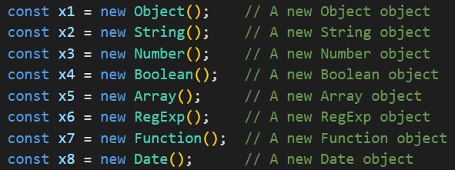
Built-in JS objects

Slide 23
Is a string an object?
Now, sometimes primitive values also act like objects.
This can be best explained with string value type in JavaScript.
When we access the length property of stringVariable, it is converted into an Object and the length property is accessed. Once the property is accessed, it returns to being a primitive value string.
And that is why almost everything in JavaScript is object.
const stringVariable ='KSN';
stringVariable.length;
stringVariable.substring(0,2);

Slide 24
What about arrays?
Arrays are objects too. The only difference is that the keys are predetermined to be whole numbers (+0 ≤ i < 2³²–1). They are 0, 1, 2, 3… etc. by default. Also, while creating an array, the keys are automatically set.
Arrays have length property denoting the number of items in the array that is managed by JavaScript. From the example, we can see that Object.entries return the key-value pairs of the arr object.
const arr = ['Alex', 'Earth'];
typeof arr; // => object
Object.entries(arr);
// [ [ '0', 'Alex' ], [ '1', 'Earth' ] ]

Slide 25
And functions?
They are objects too. Specifically, they are objects with internal (not accessible to us) [[Call]] method. Let’s see —
function func1() {
return 'Alex';
}
typeof func1; // => 'function‘
func1.name; // => 'func1‘
func1.address = 'Earth'; // Setting our own property
func1.address; // => 'Earth'
func1['address']; // => 'Earth'
All functions have certain properties on them by default. name is one of them which stores the name of the function. In this case, name gives us func1 which was the original name of the declared function.

Slide 26


