Slide 1
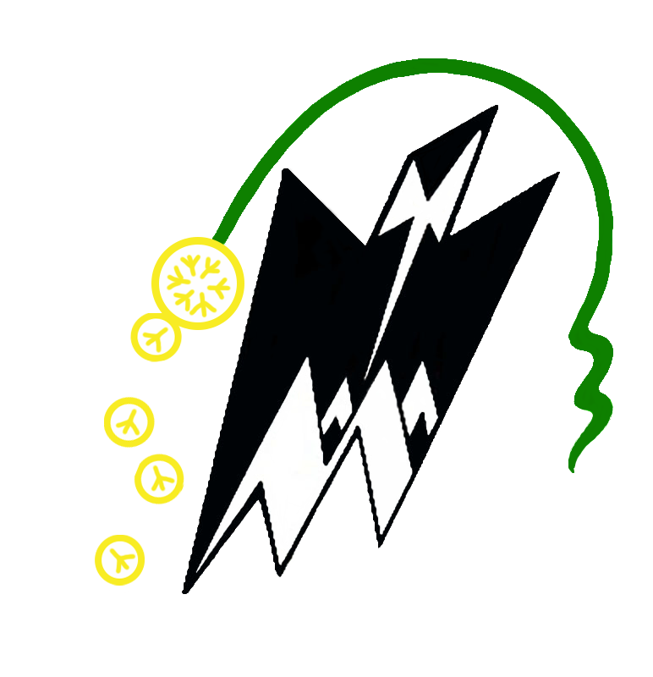


AgentFlowShield : Defending LLM Agents Against Metadata Side Channels.
Authors : Redha Boukhari, Yulliwas Ameur, Mehammed Daoui.
Affiliations : LARI Laboratory (Mouloud Mammeri University of Tizi Ouzou), CEDRIC (Cnam Paris), Efrei Research Lab.

Slide 2
The Evolution Towards LLM Agents
  From simple completion to autonomous agents.
  LLM Agents orchestrate multi-step, complex tasks.
  Typical execution phases:
    Planning / Reasoning
    Document retrieval (RAG / Vector stores)
    External APIs and Tool invocation
    Persistent memory Read/Write
Notes:
The evolution towards llm agents
Modern LLM deployments are no longer just stateless text generators.
They expose an 'Agent'. This agent operates as a control loop
For atypical execution phase
it planning and resonning for a specific tasks ,
retrieves documents via RAG,
calls external APIs tools,
and accesses memory—all driven by a single user request.
From a network perspective, this multi-phase execution creates a highly structured event that looks very different from a simple prompt-response interaction.

Slide 3
The Threat Model
  Encryption is not enough: It protects the payload content, but not the traffic shape.
  Observable metadata includes:
    Packet sizes and directions
    Inter-arrival times (IAT) and burst boundaries
    Total flow duration
  The Consequence: A passive on-path observer can deduce which tools were invoked, whether memory was accessed, and coarse properties of the underlying task.
Notes:
The core issue is that standard transport-layer encryption, like TLS, protects the content of the messages, but it does not hide the 'shape' of the traffic.
Any on-path observer can see
packet sizes, pauses, burst boundaries, and overall duration.
In the context of a tool-augmented agent, this metadata is highly expressive. A pause followed by a specific data burst often indicates an external tool call, allowing an attacker to fingerprint the agent's internal state.

Slide 4
Our Core Idea - Phase-Aware Shaping
Generic defenses (VPNs, Tor): Application-agnostic, incur high bandwidth overhead.
Our Solution: AgentFlowShield - Phase-Aware Shaping .
The Principle: The agent orchestrator has privileged knowledge of its internal execution phase (e.g., planning, tool, generation).
We exploit this knowledge to shape egress traffic before it enters the TLS tunnel.
Notes:
To defend against this, one might think of using generic network-level defenses .
However, these are Application-agnostic entirely blind to what the application is actually doing , and time consuming.
Our solution ….
The principal . The central idea behind our paper is this: the agent's orchestrator has privileged knowledge of its internal execution phase (e.g., planning, tool, generation). It knows exactly which phase it is in at any given moment.
AgentFlowShield uses this internal, phase-specific signal—which is unavailable to standard network proxies—to apply targeted traffic shaping right at the source, before encryption.

Slide 5
Architecture and Defense Mechanisms
5 Key Mechanisms managed by a risk-aware controller:
  Bucket Padding: Rounds packet sizes up to phase-specific boundaries (e.g., 512, 1024 bytes).
  Aggregation (Release Windows): Buffers frames (e.g., 50-200ms) to collapse phase transitions.
  Jitter: Injects random temporal noise to disrupt timing analysis.
  Tool Normalization: Forces all tool invocations to share an identical size signature.
  Memory Envelopes: Standardizes RAG access to hide cache hit/miss distinctions.
Notes:
AgentFlowShield intercepts frames at the client-facing egress and applies five coordinated mechanisms.
First, 'Bucket Padding' alters packet sizes to standard boundaries, destroying exact volume information.
Next, we use aggregation windows to batch frames, which blurs the exact moment the agent transitions between phases.
We also add timing jitter.
Most importantly, we introduce tool normalization and memory envelopes. This means a complex web search and a simple database query will produce the exact same network size signature.

Slide 6
Testbed and Experimental Methodology
Testbed: Controlled cloud deployment (loopback) with synthetic WAN noise (jitter, Pareto) and background multiplexing (10-50%).
Dataset: 6,300 labeled network traces.
Workloads: 42 agent templates across 7 workflow families (Chatbot, RAG, Tool, Memory, Code, Composite, Multi-agent).
Adversaries: Evaluated against Classical ML (Random Forest, LightGBM) and Deep Learning models (CNN, Bi-LSTM, Transformers).
Notes:
To ensure our evaluation was realistic, we injected synthetic WAN noise and background traffic.
To evaluate our system, we generated a dataset of 6,300 traces across 42 different agent templates, covering 7 distinct use cases like RAG or Multi-agent workflows.
We then tested our defense against a wide array of adversaries, from classical statistical classifiers like Random Forest to complex sequence-based Deep Learning models.

Slide 7
Evaluation Scenarios and Protocols
Attack Goals (6 Tasks): Ranging from workflow type prediction (A1) and tool-use detection (A2), to exact template fingerprinting (A6).
Evaluation Protocol:
  Standard Split (70/10/20): Training and testing on the same set of templates.
  Template-Disjoint Split: Testing on unseen templates to separate true structural generalization from simple memorization.
Notes:
The adversary's goal was evaluated across 6 tasks, from simply detecting if a tool was used, to pinpointing the exact template.
For our methodology 'Template-Disjoint Split'. Instead of just standard testing, we withheld certain templates from the training phase entirely. This allowed us to determine if the AI attacker was actually learning the general structure of the agent's workflow, or if it was just memorizing specific templates.

Slide 8
Effectiveness Against Policy-Aware Attackers
The Ultimate Test: The adversary knows the exact defense policy.
Results on Workflow Classification (A1):
  Random Padding (D1): Bypassed easily (99.5% AUPRC).
  AgentFlowShield Lite (D8): Reduced to 84.5%.
  AgentFlowShield Full (D9): Drops drastically to 44.2%.
Our solution forces the attacker to change strategies.
Notes:
Let's look at the results.
When facing a 'policy-aware' attacker—one who knows exactly how our defense works—generic random padding fails completely, allowing the attacker to maintain a 99.5% success rate in predicting the workflow.
However, under the full AgentFlowShield configuration, we break this attack, dropping their success rate to 44.2%. Tying the defense to the application's internal semantic phases proves to be highly effective against calibrated adversaries.

Slide 9
The Fundamental Trade-off
A transparent result: Residual leakage remains in standard splits (97-100% on A1-A4).
The Fixed-Envelope Trade-off:
  Suppresses fine-grained leakage (The "What"): Attackers can no longer distinguish which tool was used (AUPRC drops from 0.512 to 0.490 on unseen templates).
  Increases binary detectability (The "Whether"): The artificial envelope makes the action more visible (Memory access AUPRC rises from 0.246 to 0.585 on unseen templates).
Notes:
We are completely transparent about a fundamental limitation of our approach. Our defense does not eliminate all leakage in a standard split scenario.
In fact, we identified a critical trade-off inherent to fixed-envelope defenses. By forcing all tools to share the same network signature, we successfully prevent the attacker from knowing which specific tool was used.
However, this artificial regularity paradoxically makes it easier to detect the fact that a tool was used at all. We trade fine-grained detail leakage for increased binary detectability.

Slide 10
Privacy-Utility Trade-off (Overhead)
Measured Overhead on a composite workflow:
  Bandwidth Amplification: + 31%.
  Latency: + 24%.
AgentFlowShield preserves low engineering overhead while offering strong policy-aware resistance.
Notes:
In terms of usability, this trade-off is highly cost-effective.
Because AgentFlowShield uses targeted, phase-aware shaping, it only incurs a 31% bandwidth increase and a 24% latency overhead.
This makes it a highly practical solution for protecting agents handling sensitive data in real-world deployments.

Slide 11
Conclusion and Future Work
Conclusion:
  Metadata side channels expose the internal execution structure of LLM agents.
  Phase-aware shaping outperforms generic network defenses against calibrated attackers.
  Fixed-envelope defenses present a fundamental trade-off: hiding what happens makes whether it happens more obvious.
Future Work:
  Production validation with HTTP/2 multiplexing and TLS.
  Impact of CDN edge caching.
  Exploring adaptive/dynamic envelopes.
Notes:
To conclude, our work demonstrates that network metadata is a severe threat to LLM agent privacy.
AgentFlowShield shows that coupling egress defenses with the agent's internal state is a highly effective strategy, outperforming generic network proxies.
Moving forward, we plan to validate this architecture in full production environments involving HTTP/2 proxies and CDNs,
and we aim to explore dynamic envelopes to overcome the detectability trade-off we discovered.
Thank you for your time, and I am happy to take any questions.

Slide 12
Thank You For Your Attention
Notes:
Thank you for your time, and I am happy to take any questions.

