Slide 1
AudioSearch
Steven Kester
Ian Leow

Slide 2
Audio Matching Algorithms
Magnitude Spectrum
Energy
Zero Crossing
MFCC

Slide 3
Distance Measures
Cosine
Euclidean
City Block

Slide 4
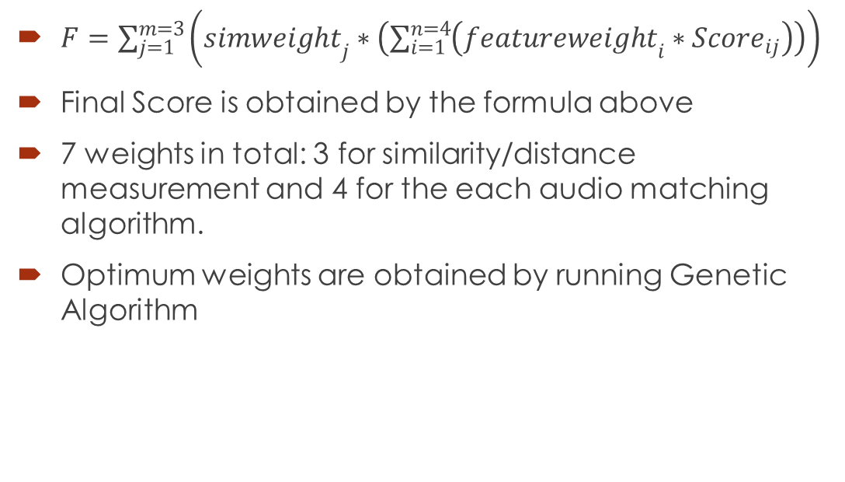
Weights and Genetic Algorithm
$F=\sum_{j=1}^{m=3}{\left({simweight}_{j}∗\left(\sum_{i=1}^{n=4}{\left({featureweight}_{i}∗{Score}_{ij}\right)}\right)\right)}$
Final Score is obtained by the formula above
7 weights in total: 3 for similarity/distance measurement and 4 for the each audio matching algorithm.
Optimum weights are obtained by running Genetic Algorithm

Slide 5
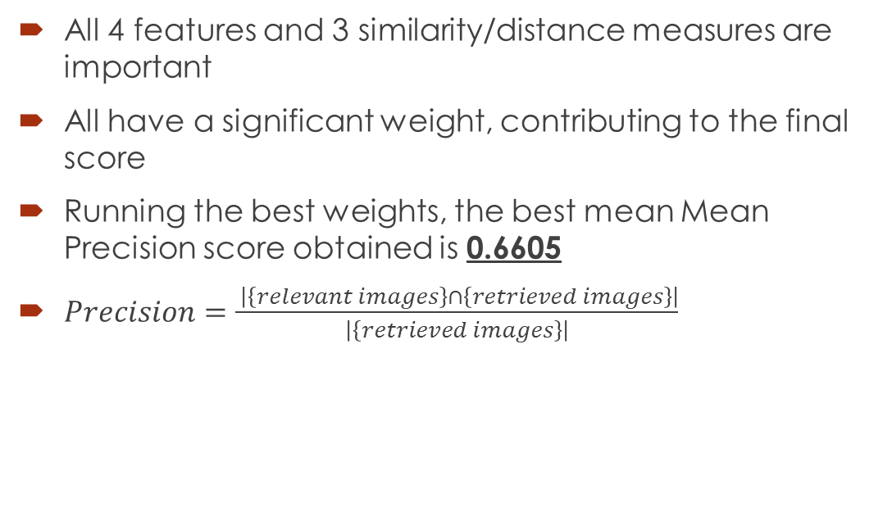
Conclusion
All 4 features and 3 similarity/distance measures are important
All have a significant weight, contributing to the final score
Running the best weights, the best mean Mean Precision score obtained is 0.6605
$Precision=\frac{ \left|\left\{relevant images\right\}∩\left\{retrieved images\right\}\right|}{\left|\left\{retrieved images\right\}\right|}$

Slide 6
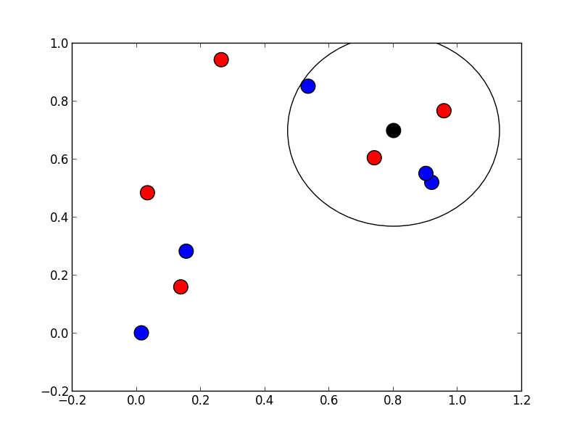
Relevance Feedback
Simple relevance feedback was implemented
Adding or subtracting a significant percentage (50%) of similarity score
Moving all audio clips similar to the chosen audio clip, closer or further from the query audio clip

