Slide 1
ImageSearch
Steven Kester
Ian Leow

Slide 2
Image Matching Algorithms
Color Histogram
Visual Concept Recognition
Visual Keyword
Text Description

Slide 3
Color Histogram
Uses the Color Histogram Java API provided
Convert RGB to YCrCb
Score obtained from computing distance between two histograms

Slide 4
Visual Concept Recognition
Using the 1000-class tool
Run the executable with the image path as argument
Produces a text file with 1000 floating point numbers
Obtain a score/probability for each class
Direct Comparison between query image and database image 1000-class decision score
Made a mapping from 1000-class to 25 classes
The score from the 1000-class contributes towards the 25 classes

Slide 5
Visual Keyword (SIFT)
Using the SIFT tool
Convert the jpeg image into pgm format (8-bit grayscale) using Java Advance Imaging (JAI) image io library
Extract Keyword from pgm image
Match two sets of keywords
Score is obtained by the number of keyword matches.

Slide 6
Text Description
Parses the text descriptions
Store as a list of words
The score is the number of matching words between two image descriptions

Slide 7
Final Score
Final Score is obtained by summing each feature mentioned
Each feature is multiplied by certain weight
Optimum weight obtained by running Genetic Algorithm

Slide 8

Conclusion
Color Histogram and SIFT are the least useful in classifying images
Visual Concept Recognition is the strongest feature
Text Description is the second strongest feature
Running the best weights, the best mean F1-Score obtained is 0.24602
$Precision=\frac{ \left|\left\{relevant images\right\}∩\left\{retrieved images\right\}\right|}{\left|\left\{retrieved images\right\}\right|}$
$Recall=\frac{ \left|\left\{relevant images\right\}∩\left\{retrieved images\right\}\right|}{\left|\left\{relevant images\right\}\right|}$
$F1Score=\frac{ 2∗Precision∗Recall}{(Precision+Recall)}$

Slide 9
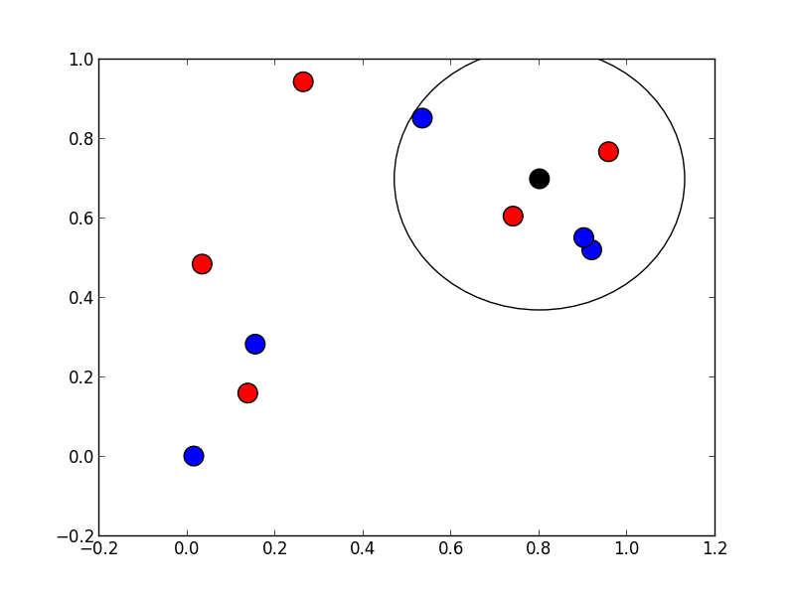
Relevance Feedback
Simple relevance feedback was implemented
Adding or subtracting a small percentage of the 1000-class score
Moving the chosen image closer or further from the query image

