Slide 1
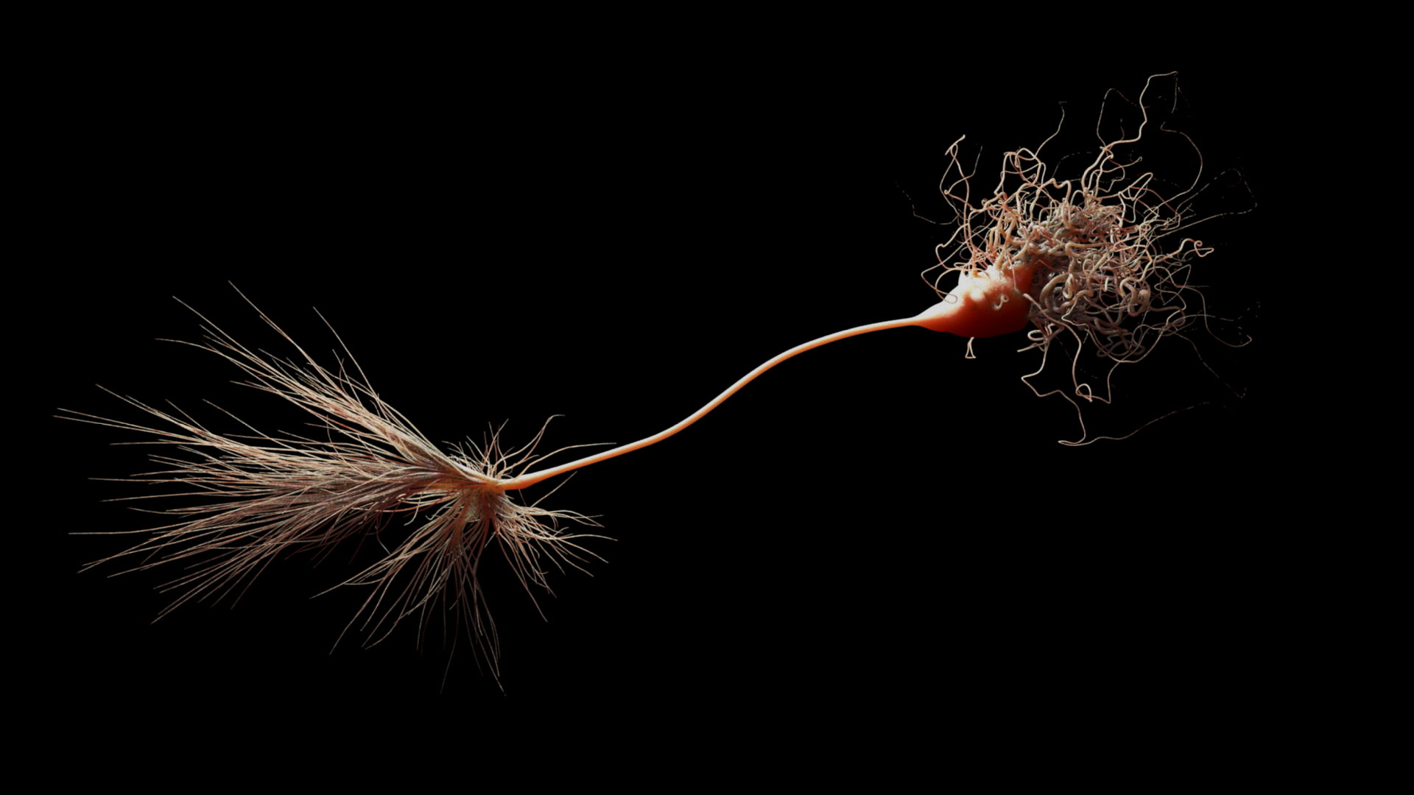
Nov 12, 2021
Metastable spiking networks
in the replica-mean-field limit
Luyan Yu
Department of Physics,
University of Texas at Austin
Supervisor: Dr. Thibaud Taillefumier
Department of Mathematics & Department of Neuroscience,
The University of Texas at Austin

Slide 2
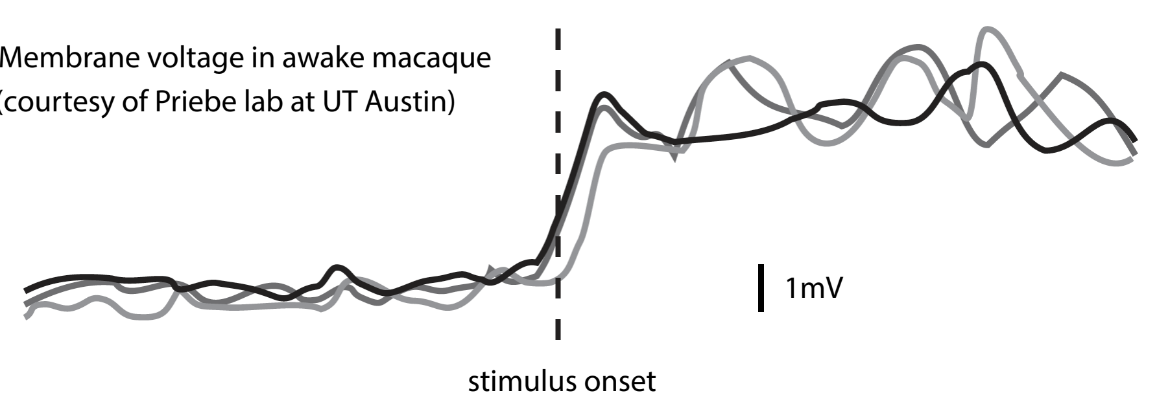
Introduction
Neural variability plays an important role in neural activities.
Traditional thermodynamic-mean-field(TMF) limit erases neural variability.
Need a model that preserves neural variability, finite-sizeness and can take both excitation and inhibition neurons.
Low drive
small mean and variance
High drive
large mean and variance
(Experimental data from Priebe lab at UT Austin)
Variance
Drive

Slide 3






Simplification: Network Level
Finite-size network
$$1$$
$$3$$
$$2$$

Slide 4














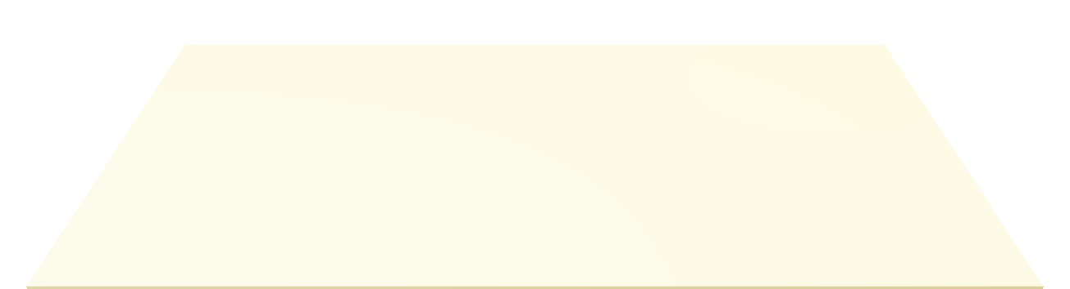


Simplification: Network Level
Replica-mean-field (RMF) limit network
Spike!
$$1$$
$$3$$
Replica 1
$$2$$
$$1′$$
Receive!
$$3′$$
Replica 2
$$2′$$
$$1′′$$
Receive!
$$3′′$$
Replica 3
$$2′′$$

Slide 5
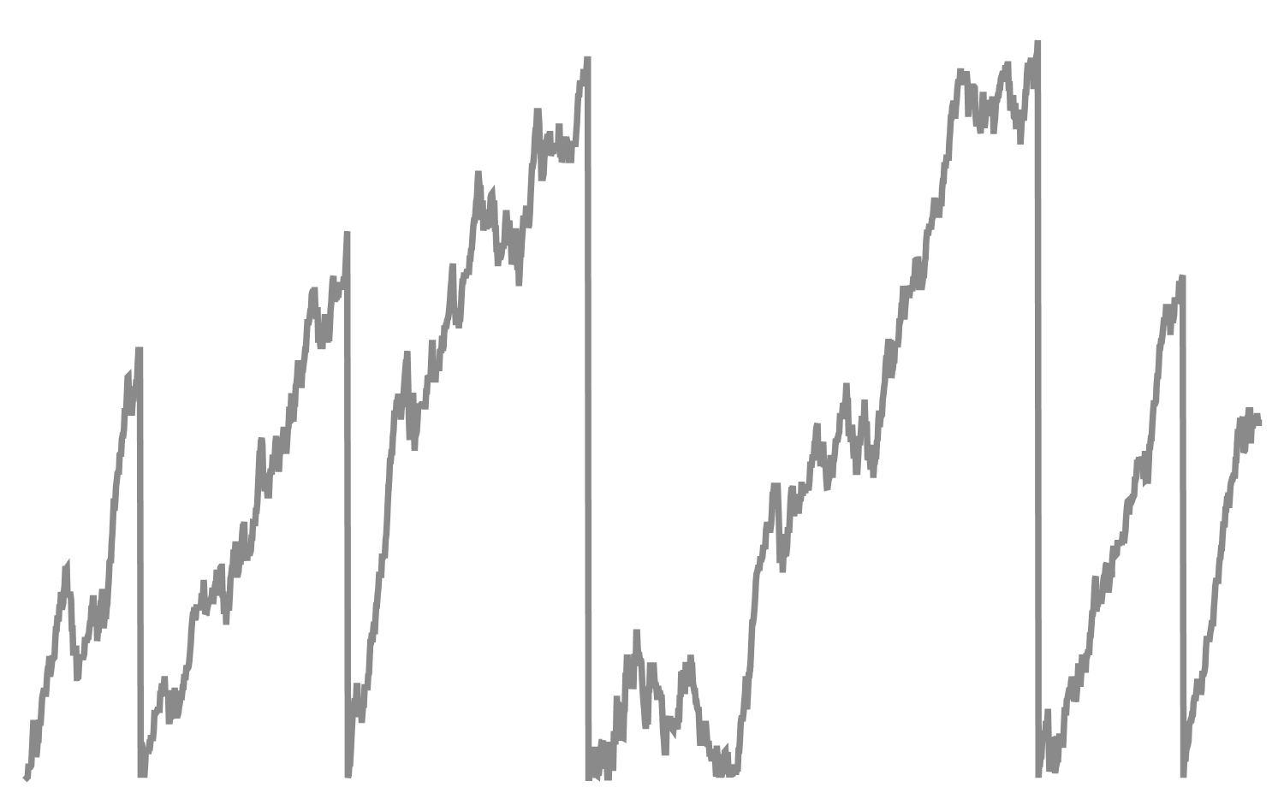





Simplification: Neuron Level
Stochastic Intensity Formulation
Stochastic
Intensity
Neuron
$$i$$
$$λ_{i}(t)$$
$$t$$
Point process
$$t$$
$$N_{i}$$

Slide 6













Modeling: Exponential Firing Neuron
Internal variable $x_{i}\left(t\right)$
$$1$$
$$μ_{13}>0$$
receive spike
$$x_{i}\left(t\right)→x_{i}\left(t\right)+μ_{ji}$$
$$μ_{21}=0$$
$$3$$
spike and reset
$$x_{i}\left(t\right)→0$$
$$μ_{32}<0$$
relax to zero $\frac{ dx_{i}}{dt}=−\frac{x_{i}\left(t\right)}{τ}$
$$2$$
(Signs of $μ$ indicate excitation/inhibition)
Stochastic intensity
$$λ_{i}\left(t\right)=he^{ax_{i}\left(t\right)}$$

Slide 7







Modeling: Writing Down Equations
$$1$$
$$μ_{13}>0$$
$$μ_{21}=0$$
$$3$$
$$μ_{32}<0$$
$$2$$
Rate-conservation principle
$$e^{ux_{i}\left(t\right)}−e^{ux_{i}\left(0\right)}=\sum_{j≠i}{\left(e^{uμ_{ji}}−1\right)\int_{0}^{t}{e^{ux_{i}\left(s^{−}\right)}N_{j}\left(ds\right)}}+\int_{0}^{t}{\left(1−e^{ux_{i}\left(s^{−}\right)}\right)N_{i}(ds)}−\frac{u}{τ_{i}}\int_{0}^{t}{x_{i}\left(s\right)e^{ux_{i}\left(s\right)}ⅆs}$$
receive spike
spike and reset
relax to zero

Slide 8



Modeling: Writing Down Equations
$$1$$
$$μ_{13}>0$$
$$μ_{21}=0$$
$$3$$
$$μ_{32}<0$$
$$2$$
Equation for moment generating function (MGF)
$$L_{i}\left(u\right)=𝔼[e^{ux_{i}}]$$
$$\frac{u}{τ}L_{i}^{′}\left(u\right)−V_{i}\left(u\right)L_{i}\left(u\right)−\left(β_{i}+hL_{i}\left(u+a\right)\right)=0$$
Need to solve a delay differential equation (DDE) self-consistently (NEW!)

Slide 9
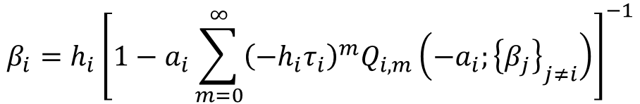
Modeling: Solving Equations
$$1$$
$$μ_{13}>0$$
$$μ_{21}=0$$
$$3$$
$$μ_{32}<0$$
$$2$$
RMF Equations for Mean Firing Rates
$$β_{i}=h_{i}{\left[1−a_{i}\sum_{m=0}^{∞}{{\left(−h_{i}τ_{i}\right)}^{m}Q_{i,m}\left(−a_{i};{\left\{β_{j}\right\}}_{j≠i}\right)}\right]}^{−1}$$
Divergent series, summed using Padé approximation.

Slide 10
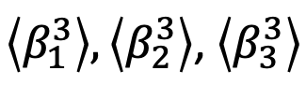
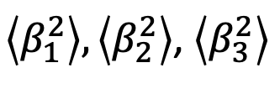

Modeling: Solving Equations
$$1$$
$$μ_{13}>0$$
$$β_{1},β_{2},β_{3}$$
$\left\langle β_{1}^{2}\right\rangle ,\left\langle β_{2}^{2}\right\rangle$, $\left\langle β_{3}^{2}\right\rangle$
$$μ_{21}=0$$
$$3$$
RMF Equations
$\left\langle β_{1}^{3}\right\rangle ,\left\langle β_{2}^{3}\right\rangle$, $\left\langle β_{3}^{3}\right\rangle$
$$μ_{32}<0$$
$$2$$

Slide 11
Results: Computational Time
Computational efficient compared to simulation

Slide 12
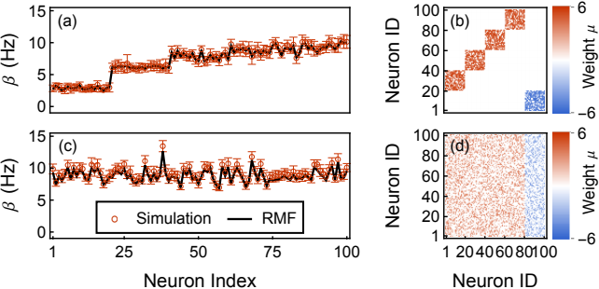
Results: Compute Network Activities
The simulated rates and the RMF calculation agree with each other.

Slide 13
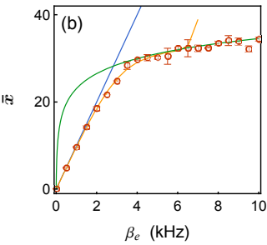
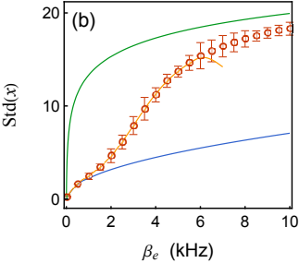
Results: Moment Analysis
Capable of recovering both the mean and standard deviation.
Mean
Standard Deviation
Red dots are simulated values.
RMF calculation (yellow lines) agrees well with the simulation when convergent.
The green/blue lines are TMF limit approximation, they only asymptotically describe the correct behavior.

Slide 14
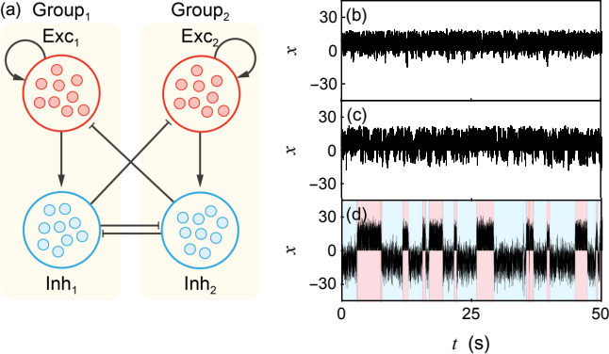
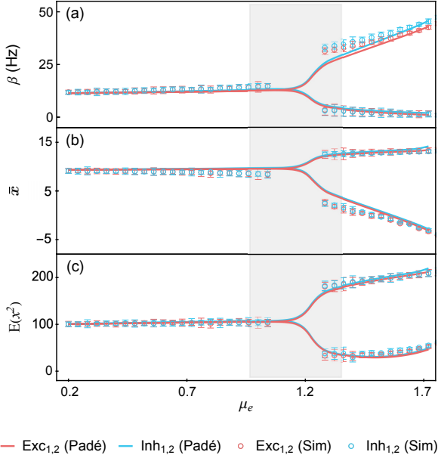
Results: Bistable Network Analysis
Up
Down
Monostable
Bistable

Slide 15
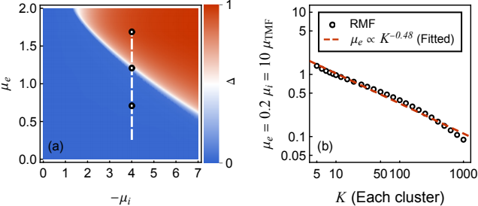

Results: Phase transition
$$μ_{critical}∼\frac{1}{\sqrt{K}}$$
… indicating phase transition driven by the variability

Slide 16
Outlooks: Predicting the Transition Rate
Arrhenius Law?

Slide 17
Thank You!
Q & A
Yu, L., & Taillefumier, T. (2021).
Metastable spiking networks in the replica-mean-field limit.
arXiv preprint arXiv:2105.01223.

