Slide 1
A Comprehensive Review of High-Performance Photoacoustic Microscopy Systems
Park E, Kim D, Ha M, Kim D, Kim C
Photoacoustics 44 (2025) 100739
Notes:
Hello everyone. Today I will discuss a review by Park and colleagues, published in Photoacoustics in 2025. It brings together different approaches to improving photoacoustic microscopy, or PAM.
I chose this paper to understand how the parts of a PAM system work together. My focus is on what each design improves, what it costs, and what evidence supports that improvement. I will use parallel UV imaging and extended optical focus as two examples related to our project.

Slide 2
Six dimensions of PAM performance
SNR
  Signal detectability
Speed
  Acquisition rate
Resolution
  Spatial detail
Depth
  Depth of focus
Functionality
  Biological information
Practicality
  Cost and usability
AI methods across the six dimensions
.
Notes:
This is not a single-system paper. The authors organize recent PAM work around six performance dimensions: SNR, speed, resolution, depth, functionality, and practicality.
The first four describe image quality: can we detect the signal, how fast, how fine, and over what depth range. The last two describe what biological information we get, and how easy the system is to use.
In every section, the authors also discuss AI methods, and show how AI can help each of these six dimensions.
My plan today: first, a quick reminder of how PAM forms a signal. Then I'll go through the six dimensions. Then I'll show the trade-offs between them, and end with a few questions for discussion.
Q: Why does a ring in the back focal plane give a long beam?
The lens performs roughly a Fourier transform between the back focal plane and the focus. A thin ring means all the light arrives at nearly the same angle, and that interference pattern stays narrow over a long distance. That's the Bessel beam.
Q: What's the cost of a Bessel beam?
Much of the energy goes into the sidelobes, not the central core. In PAM, the signal is proportional to fluence, so the sidelobes can excite absorbers outside the focus and cause artifacts.
Q: How does depth of focus depend on NA?
Roughly as lambda over NA squared. So if I halve the spot size, the depth of focus drops to about a quarter.
Q: Is depth of focus the same as imaging depth?
No. Depth of focus is how long the beam stays sharp. Imaging depth is limited by scattering and attenuation in tissue. A longer focus doesn't make light penetrate deeper.
Q: Are these six dimensions independent?
No, they're coupled. For example, higher NA improves resolution but shortens the depth of focus. I'll show this on the trade-offs slide.
Q: Why did the authors choose these six?
I think the first four cover image quality, and the last two cover what the image tells us and whether it's usable in practice. The review doesn't justify the choice in detail, so I'm not sure there's a strict reason.

Slide 3
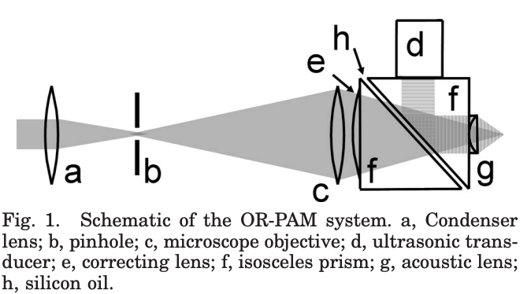
PAM signal formation
Generation
Optical absorption produces transient heating and thermoelastic expansion.
Detection
The transducer converts acoustic pressure into an electrical signal.
Image formation
Time-resolved signals are acquired at successive scanning positions.
p0​=Γμa​F
Notes:
Let me start with how one laser pulse becomes one pixel, because every technique in this review changes some part of this chain.
First, generation. A short laser pulse is absorbed by molecules in the sample: hemoglobin in blood, or DNA and RNA in the UV. The absorbed energy causes a very small, very fast temperature rise. The tissue expands, and this launches a pressure wave, an ultrasound wave.
The initial pressure, p-zero, is the product of three terms: the Grüneisen parameter, which is how efficiently heat turns into pressure; the absorption coefficient, which is where the contrast comes from; and the local light fluence.
Second, detection. The transducer converts the pressure wave into a voltage. The sound travels only one way, from the absorber to the transducer, so arrival time maps directly to depth: depth equals the speed of sound times time, about 1.5 millimeters per microsecond.
Third, image formation. Each pulse gives one time trace, an A-line. We scan point by point and stack the A-lines into B-scans and a 3D volume.
This schematic is a classic optical-resolution PAM. The light is focused through the objective and the prism, and the acoustic wave is reflected by a thin oil layer inside the prism toward the transducer. So light and sound share the same axis. This idea comes back in the SNR section.
One last point: in OR-PAM, lateral resolution is set by the optical focus, and axial resolution is set by the acoustic bandwidth. Light decides how fine we see sideways; sound decides how fine we see in depth.
5. 这张图：Wang 组 2008 年的 OR-PAM
出处：Maslov, Zhang, Hu & Wang, Optics Letters 2008，《Optical-resolution photoacoustic microscopy for in vivo imaging of single capillaries》。这是最早的 OR-PAM 系统之一，第一次在活体上看到了单根毛细血管。slide 上最好在图下标出这个出处。
光路（从左到右）：
a 聚光透镜 + b 针孔（pinhole）：组成空间滤波器，把激光光束"整干净"，得到一个干净的点光源。
c 显微物镜：把光聚焦到样品上，决定横向分辨率。
e 校正透镜：补偿光穿过棱镜时引入的像差。
f 棱镜组：两块棱镜，斜面对斜面贴在一起，中间夹一层薄薄的 h 硅油。
为什么中间要夹一层油？这是整个设计的巧妙之处：
对光来说：硅油的折射率和玻璃很接近，光几乎不反射，直接穿过去。油层对光是一扇"窗"。
对声来说：硅油的声阻抗和玻璃差得很远，声波斜着打到油层时几乎全部被反射。油层对声是一面"镜子"。
声路（从右往左回来）：
样品发出的声波先经过 g 声透镜。它磨成凹面，让换能器的声学焦点和光学焦点对在同一个点上。
声波进入棱镜，打到斜的油层上被反射向上，到达顶部的 d 超声换能器。
"Light and sound share the same axis"（共轴）的意思：光的焦点和声的焦点在同一条线上，最好就是同一个点（共焦）。
为什么重要：换能器在它的声学焦点处最灵敏。光激发的位置如果偏离这个区域，信号就会变弱。这个棱镜设计让光能直接通过，换能器又不挡光，两者还对得很准。它就是综述 Slide 5 里的 OUC（opto-ultrasound combiner）。
扫描方式：整个探头（或样品）用机械平台逐点移动，所以很慢。后来的快速扫描器（Slide 6）就是为了解决这个问题。
性能：我记得的数字是横向约 5 µm、轴向约 15 µm、成像深度约 0.7 mm，换能器中心频率约 75 MHz。要讲这些数字，请先对照原文确认。
Q: Why is it 1.5 millimeters per microsecond?
The speed of sound in water and soft tissue is about 1500 meters per second, which is 1.5 millimeters per microsecond.
Q: Why don't you divide by two, like in ultrasound imaging?
In ultrasound, the wave goes to the target and back, so it's a round trip. In photoacoustics, the sound is generated at the absorber and travels only one way, to the transducer.
Q: What's the Grüneisen parameter physically?
It describes how efficiently absorbed heat becomes pressure. It depends on thermal expansion, the speed of sound, and heat capacity, and it increases with temperature.
Q: What's the difference between OR-PAM and AR-PAM?
In OR-PAM, lateral resolution comes from the optical focus, so it's very fine but limited to about 1 millimeter, because light scatters. In AR-PAM, the light is diffuse and lateral resolution comes from the acoustic focus, so it goes deeper but with coarser resolution.
Q: Why does the oil layer reflect sound but not light?
Its refractive index is close to glass, so light passes through. But its acoustic impedance is very different from glass, so at that oblique angle the sound is almost fully reflected.
Q: Why is axial resolution worse than lateral in OR-PAM?
Lateral resolution is set by the optical focus, which can be a few micrometers. Axial resolution depends on the transducer bandwidth. Even at 50 megahertz of bandwidth, that's about 26 micrometers.
Q: What limits OR-PAM depth to about 1 millimeter?
Optical scattering. Beyond roughly one millimeter, too few photons are unscattered to form a tight focus.
Q: Why does the laser need to be pulsed?
The pulse has to be short, on the order of nanoseconds, so the pressure builds up before heat and stress spread out. This is called stress confinement.
Q: Does our digitizer sampling rate set the axial resolution?
Not directly. Axial resolution mainly comes from the transducer bandwidth. But the sampling rate must be high enough to capture that bandwidth. At 100 MS/s, each sample is 15 micrometers in depth, so that's worth checking.

Slide 4
Six performance dimensions of PAM
Feature | Goal | Example approaches
SNR | Weak-signal detection | Optical–acoustic alignment
Speed | Faster acquisition | Fast scanning; parallel excitation
Resolution | Finer spatial detail | Nonlinear methods; localization
Depth | Extended depth of focus | Beam shaping
Functionality | More biological information | Multiwavelength and multimodal imaging
Practicality | Lower cost and easier use | Low-cost light sources; compact probes
AI methods are discussed across all six dimensions.
Notes:
Here are the six dimensions again, with the main approaches for each.
For SNR, the main topic is how the optical and acoustic paths are aligned. For speed: faster scanners, and parallel excitation, meaning several foci per laser pulse. For resolution: nonlinear methods and localization, which go beyond the normal diffraction limit. For depth, the review focuses on extending the depth of focus with beam shaping. Functionality means using several wavelengths, or combining PAM with other modalities. Practicality means cheaper light sources and compact probes.
These dimensions are not independent, and I'll come back to the trade-offs at the end. For each one, I'll follow the same order: why it matters, what methods the review covers, one example, and what it costs.
5. 可能被问的问题
Q: Why these six dimensions?
The first four describe image quality: whether we can detect the signal, how fast, how fine, and over what depth. The last two describe what information we get and whether the system is usable. The review doesn't strictly justify the choice, but it covers the main directions in the field.
Q: Are they independent?
No, they're coupled. For example, higher NA improves resolution but shortens the depth of focus, and averaging improves SNR but costs time. I'll show this on the trade-offs slide.
Q: What do you mean by parallel excitation?
Creating several foci with one laser pulse, for example with a diffraction grating. Each pulse then samples several points, so we're less limited by the laser repetition rate.
Q: Why does the depth row say "depth of focus" and not imaging depth?
Because the review's depth section mainly covers extending the depth of focus with beam shaping. That keeps the image sharp over a larger z range, but penetration in tissue is still limited by scattering.
Q: Which dimension matters most for our work?
For slide-free histology, the authors say speed and resolution come first. Depth of focus also matters, because fresh tissue surfaces aren't flat.
Q: Why is AI not a seventh dimension?
Because it's a tool rather than a performance goal. The review applies it within each dimension, for example denoising for SNR and virtual staining for practicality.
Q: Where does PUV-PAM fit in this table?
Mainly in speed, through parallel excitation with eight foci. It also relates to SNR, because two transducers are needed to detect and separate the signals across the scan.
维度
改信号链的哪一环
SNR
声波能收到多少（探测）
Speed
每秒能采多少个点（扫描 + 激光）
Resolution
光斑有多细（激发）
Depth
光斑在 z 方向能保持多长（激发）
Functionality
用什么波长、看什么分子（μₐ）
Practicality
用多贵、多大的器件来实现整条链
Resolution：Finer spatial detail → Nonlinear methods; localization
是什么：能分辨多近的两个点。
先要知道的上限：常规 OR-PAM 的横向分辨率受衍射限制：
横向分辨率 ≈ 0.51 λ / NA
提高分辨率最直接的办法是加大 NA，但 NA 有上限，而且会让焦深变短。所以综述介绍了两类超越衍射极限的方法：
Nonlinear methods（非线性）：让信号随光强的平方或更高次方变化。光斑中心最亮，被放大得最多，等效光斑就变窄。例如光漂白法（PI-PAM），约 90 nm。
Localization（定位）：每次只有少数孤立的吸收体发出信号时，可以精确找出每个点的中心，再把很多帧叠起来。例如血管里流动的红细胞，思路和荧光显微镜里的 STORM/PALM 一样。
Q: What is NA?
Numerical aperture is n times sine theta, where theta is the half-angle of the light cone at the focus. It tells us how wide an angle the objective focuses light from.
Q: Why does higher NA give better resolution?
Light arrives from a wider range of angles, so it interferes constructively only in a smaller region. The spot size is about 0.51 lambda over NA.
Q: Why not just use the highest NA?
Because the depth of focus drops with NA squared. The working distance and field of view also get smaller. For uneven fresh tissue, a very short focus would leave parts of the image blurred.
Q: What NA does PUV-PAM use?
About 0.15, and the measured lateral resolution is 1.3 micrometers.
Q: What's acoustic NA?
The same idea for sound: how wide an angle the transducer receives from. Larger acoustic NA collects more signal and gives a tighter acoustic focus.

Slide 5

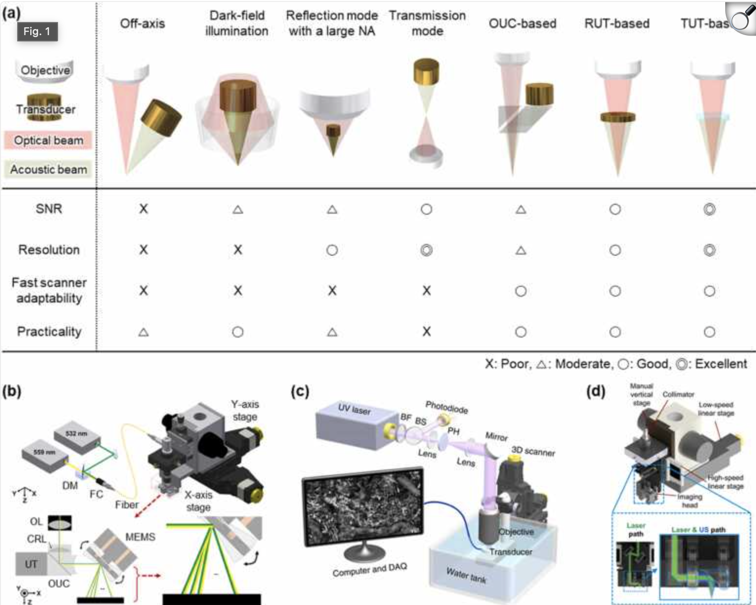
SNR: Optical–Acoustic Alignment
Overlap between optical excitation and acoustic sensitivity supports efficient signal detection.
Key Requirement: The detection geometry must match the optical focus and scanning strategy.
OUC Opto-Acoustic Combiner
Combines optical and acoustic paths
• Key factor: Acoustic loss at interfaces
RUT Ring Ultrasound Transducer
Light passes through a central aperture
• Key factor: Aperture size and receive sensitivity
TUT Transparent Ultrasound Transducer
Light passes through the transducer
• Key factor: Optical transmission and acoustic performance
Notes:
Once the pressure wave is generated, the question is how much of it we can actually detect. The key idea is overlap: the region excited by the light should match the region where the transducer is most sensitive.
In panel a, pink is the optical beam and gray-green is the acoustic sensitivity of the transducer. Off-axis is the simplest: the transducer sits at an angle, so it is not aligned with the light, and sensitivity is low. Dark-field uses ring-shaped illumination with the transducer in the center. It is coaxial with good SNR, but the light cannot be focused tightly. Transmission mode gives excellent resolution, but the sound must pass through the sample, so it only works for thin samples.
The last three layouts try to keep both a tight optical focus and coaxial detection, and that also makes them compatible with fast scanners.
The OUC, or opto-ultrasound combiner, is a prism pair with a thin liquid layer. Light passes straight through, while sound is reflected to the side, toward the transducer. The cost is acoustic loss at the interfaces.
The ring-shaped transducer, or RUT, has a hole in the center for the light. It is simpler, but removing the center reduces receive sensitivity. Still, in one comparison study, the RUT gave 7 to 15 dB higher SNR than an OUC. Panel c is a reflection-mode UV-PAM for bone specimens using a ring transducer. This is Rui's earlier work.
The transparent transducer, or TUT, lets light pass through the detector itself. A 2024 version reached more than 80 percent optical transparency.
So these are design choices for different samples, not a strict ranking. The detection geometry has to match the optical focus and the scanning strategy.
Q: What do the pink and gray-green cones mean?
Pink is the optical beam focused by the objective. Gray-green is the acoustic sensitivity of the transducer, meaning where it can detect sound from. We want their tips to meet at the same point.
Q: Why do the first four layouts score poorly on fast scanning?
In those layouts, light and sound are separate. A scanning mirror moves only the light, so the focus leaves the transducer's sensitive region. In OUC, RUT, and TUT, the two paths are combined, so they can be scanned together.
Q: Why is dark-field good for SNR but poor for resolution?
The light is a ring, so it covers a large area and isn't focused into a small spot. The transducer in the center is coaxial and collects well, but lateral resolution comes from the acoustic focus, which is coarse.
Q: Why does transmission mode have the best resolution?
Because the objective and the transducer don't compete for space, so we can use a high-NA objective. The limitation is that sound has to pass through the sample, so it only works for thin samples.
Q: What limits the OUC's optical NA?
The prism sits between the objective and the sample, so the working distance is long and the light cone can't be very wide. That reduces the NA.
Q: Why did Rui's bone system use a ring transducer?
It's reflection mode, which is needed for thick fresh tissue. The ring transducer keeps light and sound coaxial without a prism, so it has less acoustic loss than an OUC.
（如果被追问更深的设计原因："I'd like to hear more about that choice." 请他来讲。）
Q: What's the photodiode for in panel c?
A small part of the beam is split off to a photodiode to monitor each laser pulse, for timing or to normalize pulse energy.
（这和你台架上用 photodiode 验证激光出光是同一个用途，被问到时可以顺带提一句。）
Q: Why is a transparent transducer hard to make?
Both the piezoelectric material and the electrodes must be optically transparent, while still converting sound efficiently. It's harder in the UV, because many materials absorb UV.
Q: Is the rating table quantitative?
No. The symbols are the authors' qualitative judgment. The only quantitative comparison mentioned is the OUC versus RUT study, and those numbers are from specific tests.

Slide 6
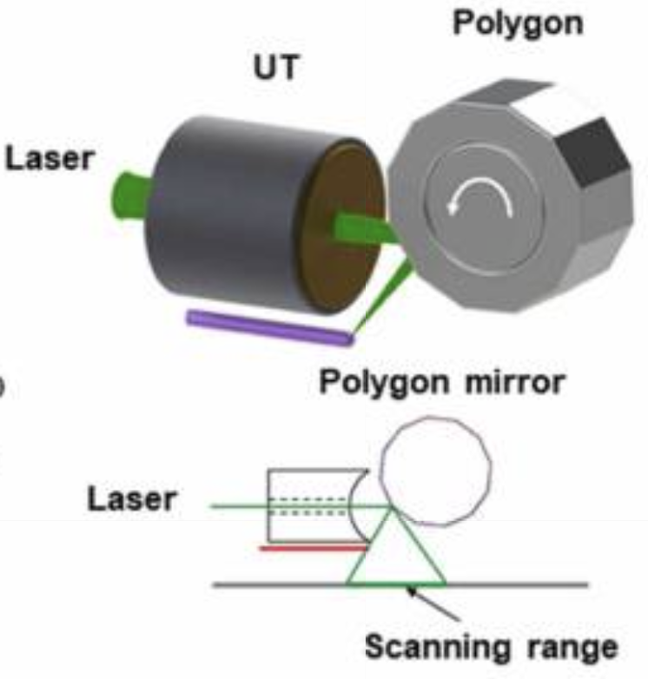
Speed: scanning
Scanner | How it scans | Main constraint
Voice coil | Linear translation | Moving mass and travel range
MEMS | Tilting micromirror | Mirror aperture and scan angle
Galvo | Motor-driven mirror | Scan speed and field of view
Polygon | Rotating faceted mirror | Scan timing and calibration
Compare speed at matched field of view, sampling, and image quality.
Notes:
[~2 min]
Now speed. Conventional PAM moves the sample with a motorized stage, point by point, which is slow. The review describes four faster scanners.
A voice coil moves the scan head in a straight line. It is limited by the moving mass and the travel range. A MEMS mirror is a tiny tilting mirror. It is small and can work in water, but its aperture and scan angle are small. A galvo is a motor-driven mirror. It is stable and flexible, and it is the fast-axis scanner in PUV-PAM, which I'll show next. A polygon mirror has many facets and rotates continuously, so it is the fastest, but its timing needs careful calibration. The picture shows a polygon scanner.
One practical issue: when a scanner works in water, water damping slows it down. One solution is to scan only the light in air, and use a cylindrically focused transducer that covers the whole scan line.
My main takeaway here: when we compare speed, we should compare at the same field of view, the same sampling step, and similar image quality. A B-scan rate in hertz alone doesn't tell us which system finishes the same task faster.

Slide 7
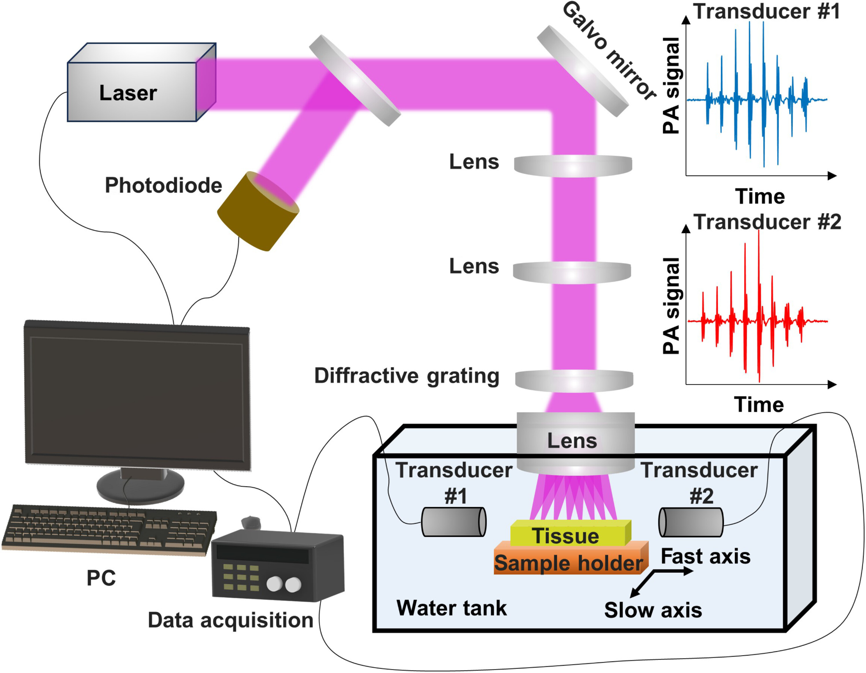
Speed: parallel acquisition
One laser pulse illuminates multiple lateral positions.
Arrival-time differences separate signals from the eight foci.
Diffractive grating、Eight foci、Two transducers、Separated signals
Notes:
[~2 min]
Faster scanners help, but with a single focus we still get at most one A-line per laser pulse. So the laser repetition rate becomes the upper limit, especially for UV lasers.
Parallel acquisition changes this. This is PUV-PAM, parallel UV photoacoustic microscopy. A diffractive grating splits one UV beam into eight foci. The galvo scans all eight foci together along the fast axis, and a motorized stage moves the sample along the slow axis.
The key question is: if one pulse excites eight points at the same time, why don't the signals mix? Two transducers receive the signals. Because the foci are at different distances from each transducer, their signals arrive at different times, so they can be separated in time.
为什么需要并行：单焦点时，每个激光脉冲最多换一个像素。所以扫描器再快，每秒像素数也不会超过 PRF。UV 激光的 PRF 不高（PUV-PAM 用的是 50 kHz），这就是瓶颈。综述原话："This approach effectively addresses the limitations imposed by low laser repetition rates."
衍射光栅：表面有周期性细纹的光学元件，能把一束光分成几束角度略有不同的光。每束光被物镜聚焦后，落在样品上的不同位置，于是一个脉冲同时产生 8 个焦点。
Time-of-flight（飞行时间）：声波从焦点传到换能器所用的时间 = 距离 ÷ 声速。距离不同，到达时间就不同。
F-theta 物镜：一种特殊物镜，焦点位置和入射角度成正比（位置 = f × θ）。所以角度等间隔，焦点在样品上也等间隔；galvo 转动的角度也能线性地变成焦点的位移。
Q: How are the eight signals separated?
By time of flight. Adjacent foci are 375 micrometers apart along the transducer axis, which gives 250 nanoseconds. Each signal lasts about 30 nanoseconds, given the 32-megahertz bandwidth, so they don't overlap.
Q: Why two transducers and not one?
The paper places them face to face along the line of foci. My understanding is that this keeps the sensitivity more even across all eight foci, since the far ones would otherwise be weaker. I'd like to hear more about that design choice.
（这里用提问的方式把话题交给 Rui，他是设计者。）
Q: Why 375 micrometers spacing?
It's a trade-off. Wider spacing gives more time separation between signals, but the galvo has to scan farther and the foci need to stay within the transducers' sensitive range, which is about 3 millimeters. Eight times 375 is exactly 3 millimeters.
Q: Where does 400,000 pixels per second come from?
50,000 pulses per second times eight foci. At 1-micrometer steps, that's 0.4 square millimeters per second, so an 8-by-3-millimeter field takes 60 seconds, which matches the paper.
Q: What's the bottleneck now: the motor or the laser?
The laser. By my estimate the slow axis only moves about 0.13 millimeters per second, while the motor can go up to 10. So the PRF is still the limit.
Q: What's the cost of more foci?
Energy per focus goes down, since it's shared. The paper needs less than 10 nanojoules per focus, so eight foci need about 100 nanojoules from the laser, including grating loss. More foci would also shrink the time separation or require a wider transducer range.
Q: What's the photodiode for?
A beam splitter sends a small part of each pulse to a photodiode, which gives the true pulse timing to the acquisition system.
（和你台架上用 photodiode 确认激光出光是同一个用途。）
Q: Does our 100 MS/s digitizer matter here?
For separating foci, 250 nanoseconds is still 25 samples, so that's fine. But the transducer band goes up to about 50 megahertz, so Nyquist needs just over 100 MS/s. We're right at the edge, which could limit axial detail. I'd like your view on whether that matters for reproduction.
3. 图怎么看（光路和声路）
光路：
Laser 发出 266 nm 脉冲。
第一块斜镜是分束器：一小部分光分给 photodiode，用来记录每个脉冲的真实时刻（给采集卡做时间参考）。大部分光继续往前。
Galvo mirror 把光转向下，同时负责快轴扫描。
两个 Lens：一对中继透镜，把光束传递并调整到合适大小，送进后面的光学元件。（具体作用我是按常见设计推断的，原文没在这张图上说明。）
Diffractive grating：把一束光分成 8 束，相邻夹角 0.37°。
最下面的 Lens 就是 F-theta 物镜：把 8 束光聚焦成 8 个点，打在 Tissue 上（图中的粉色扇形）。
声路：
8 个焦点处的组织吸收 UV，各自产生声波。
水槽里左右两边是 Transducer #1 和 #2，面对面放置，声轴沿着 8 个焦点排成的那条线。
8 个焦点离换能器的距离各不相同，声波到达的时间也就不同。
右上两条波形：
每条波形里能看到 8 个分开的信号包，就是 8 个焦点的信号在时间上排开了。
两个换能器各自记录一条。一个在左、一个在右，所以同一个焦点在两条波形里出现的先后顺序是反的，幅度也不同：离得近的通常更强。
扫描方向：图上标了 Fast axis（galvo）和 Slow axis（样品台）。
4. 核心计算与论证（我的推算，都和原文数字对得上）
① 250 ns 是怎么来的
相邻焦点距离差 375 µm ÷ 声速 1.5 mm/µs = 0.25 µs = 250 ns
和原文一致。
② 为什么 250 ns 足够把信号分开
一个点吸收体的信号持续时间大约是 1/带宽：
带宽 = 34.1 MHz × 95.2% ≈ 32.5 MHz → 信号宽度 ≈ 1 / 32.5 MHz ≈ 31 ns
31 ns 远小于 250 ns，所以相邻焦点的信号不会重叠。
前提是组织在深度方向的吸收也集中在很薄的一层。UV 在组织里穿透很浅，这个前提基本成立，但我没有在原文里核实。
③ 轴向分辨率为什么 > 30 µm
0.88 × c / Δf = 0.88 × 1.5 mm/µs ÷ 32.5 MHz ≈ 41 µm
和原文 "> 30 µm，受换能器带宽限制" 一致。
④ 400,000 pixels/s
50,000 脉冲/s × 8 焦点 = 400,000 pixels/s
每个脉冲产生 8 个像素，没有平均。
⑤ 0.4 mm²/s 和 60 秒
步长 1 µm → 每个像素 1 µm² → 400,000 µm²/s = 0.4 mm²/s
8 mm × 3 mm = 24 mm² → 24 ÷ 0.4 = 60 s ✓
1 cm² = 100 mm² → 250 s ≈ 4.2 min ✓
⑥ 为什么视场宽度正好是 3 mm（一个漂亮的设计）
8 个焦点 × 375 µm = 3 mm
每个焦点只需要被 galvo 扫过 375 µm，8 段拼起来就是 3 mm 宽。这和换能器"3 mm 范围内灵敏度 > 50%"也对得上。galvo 只需小幅摆动，这是这套设计聪明的地方。
⑦ 慢轴速度（验证整条链是否自洽）
每条线：375 µm ÷ 1 µm = 375 个脉冲 → 50,000 ÷ 375 ≈ 133 条线/秒
慢轴每条线前进 1 µm → 133 µm/s
8 mm ÷ 133 µm/s ≈ 60 s ✓
电机最快能到 10 mm/s，这里只用了约 0.13 mm/s。所以瓶颈是激光 PRF，不是电机。
⑧ 如果只用单焦点
24 mm² = 2.4 × 10⁷ 个像素 ÷ 50,000 = 480 s = 8 分钟（对比 60 秒）
⑨ 每个脉冲需要多少能量
每个焦点 < 10 nJ × 8 = 80 nJ；光栅效率 80% → 激光端约 100 nJ/脉冲
100 nJ × 50 kHz ≈ 5 mW 平均功率
（忽略了其他光学损耗，只是量级估计。）
⑩ 焦点和光栅角度自洽吗
等效焦距 ≈ 375 µm ÷ tan(0.37°) ≈ 0.375 mm ÷ 0.00646 ≈ 58 mm
F-theta 物镜的焦距在几十毫米量级是合理的。（这是我反推的，原文没直接给。）
5. 和你们系统的联系（被问到时用）
采样率：你们现在 100 MS/s，论文 500 MS/s。
250 ns 在 100 MS/s 下 = 25 个采样点 → 分开 8 个焦点在时间上没问题
换能器 −6 dB 频带 ≈ 34.1 ± 16.2 MHz ≈ 17.9–50.3 MHz
Nyquist 要求采样率 > 2 × 50.3 ≈ 100.6 MS/s
所以 100 MS/s 刚好卡在边缘，高频部分可能记录不全，影响轴向细节。
这是我的推算，要请 Rui 判断是否算复现差距。

Slide 8
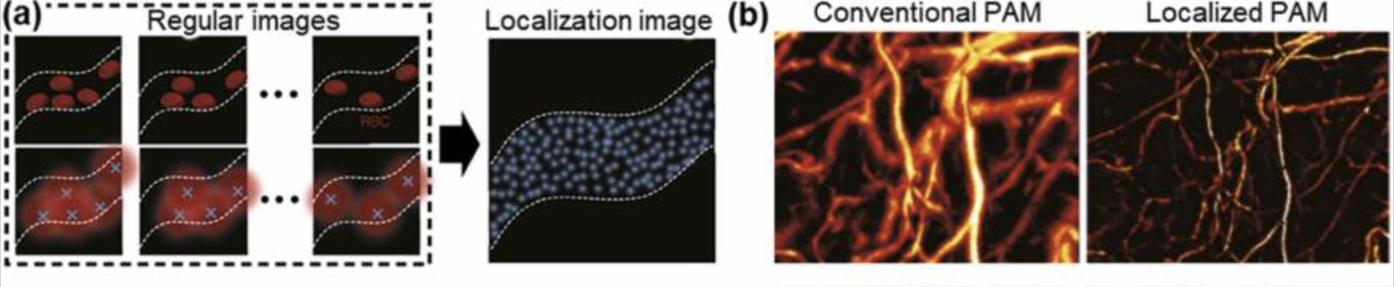
Resolution: resolving finer structures
Conventional OR-PAM lateral resolution depends on optical focusing.
Nonlinear methods and localization provide additional routes to finer detail.
RBC localization combines detections from multiple frames.
Notes:
[~2 min]
Next, resolution. In conventional OR-PAM, lateral resolution depends on how tightly we focus the light, and it is limited by diffraction, roughly 0.5 lambda over NA.
The review describes two ways to go beyond this. The first is nonlinear methods. For example, in photobleaching PAM, the first pulse bleaches molecules most strongly at the center of the focus, where the light is strongest. By comparing two pulses, the signal difference comes mainly from the center, so the effective spot becomes smaller, about 90 nanometers.
The second is localization, similar to PALM or STORM in fluorescence microscopy. This slide shows RBC localization. Red blood cells flowing in a vessel act as isolated, randomly appearing absorbers. In each frame, we find the center of each cell, and then combine many frames into one localization image. In panel b, the localized image shows much sharper microvessels than the conventional one. Interestingly, this used a very low NA, about 0.04, and still reached 400 to 700 nanometers.
Both methods need extra conditions: multiple pulses, higher energy, or sparse, moving absorbers. So they are not free improvements.

Slide 9
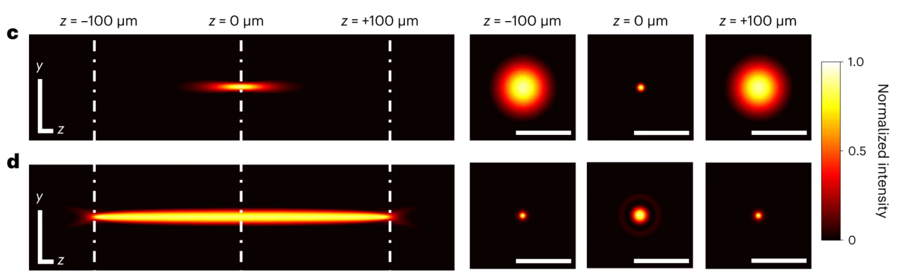
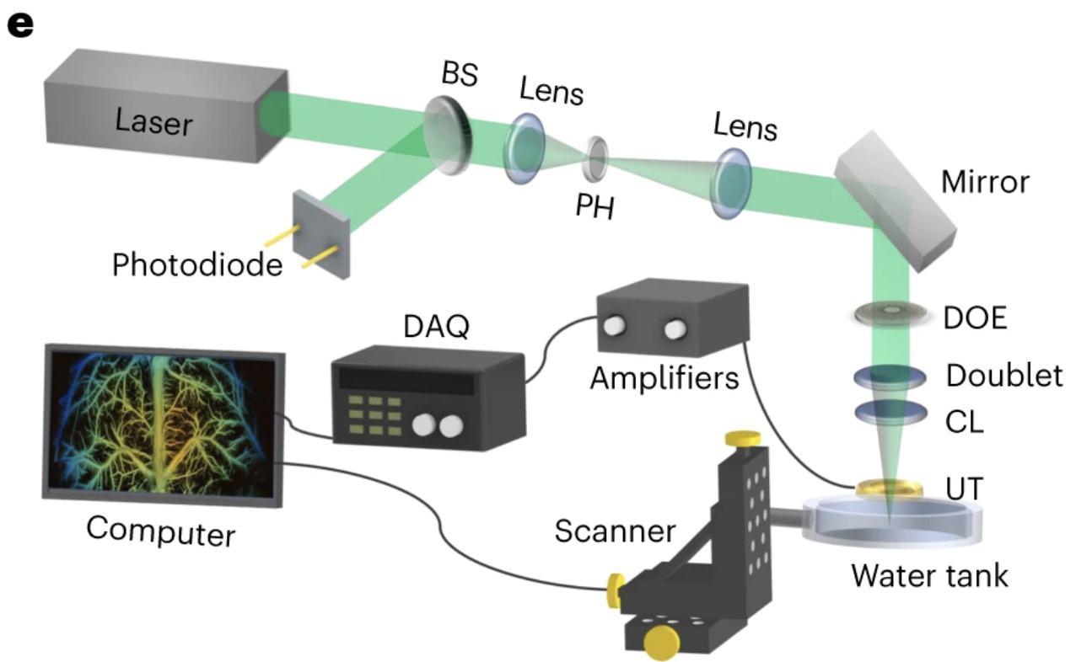
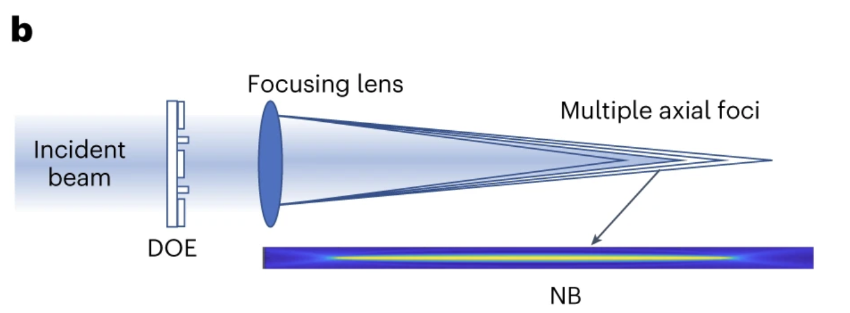
Depth: extended depth of focus
A focused Gaussian beam maintains fine resolution over a limited axial range.
A diffractive optical element creates an extended needle-shaped beam.
UV example: approximately 200 μm DOF with 1.2 μm lateral resolution.
Notes:
[~2 min]
For depth, the review focuses on depth of focus: how long the focus stays sharp along z. For a Gaussian beam, the depth of focus scales with lambda over NA squared. So if we double the NA to get finer resolution, the depth of focus drops to about one quarter. That's a problem for fresh tissue, because its surface is not flat.
Panel c is a normal Gaussian focus: it is sharp only near z equals zero. Panel d is a needle-shaped beam. A diffractive optical element, designed computationally, places several foci along the axis, so the beam stays narrow over a much longer range, with small sidelobes. In the UV, the depth of focus went from about 30 to about 200 micrometers, with 1.2-micrometer lateral resolution.
The review also covers Bessel beams, Airy beams, structured illumination, and metalenses. A Bessel beam also gives a long focus, but it loses energy to sidelobes, which can cause artifacts.
One thing I want to separate: a longer depth of focus keeps the image sharp over a larger z range. It does not, by itself, make light penetrate deeper into scattering tissue.

Slide 10
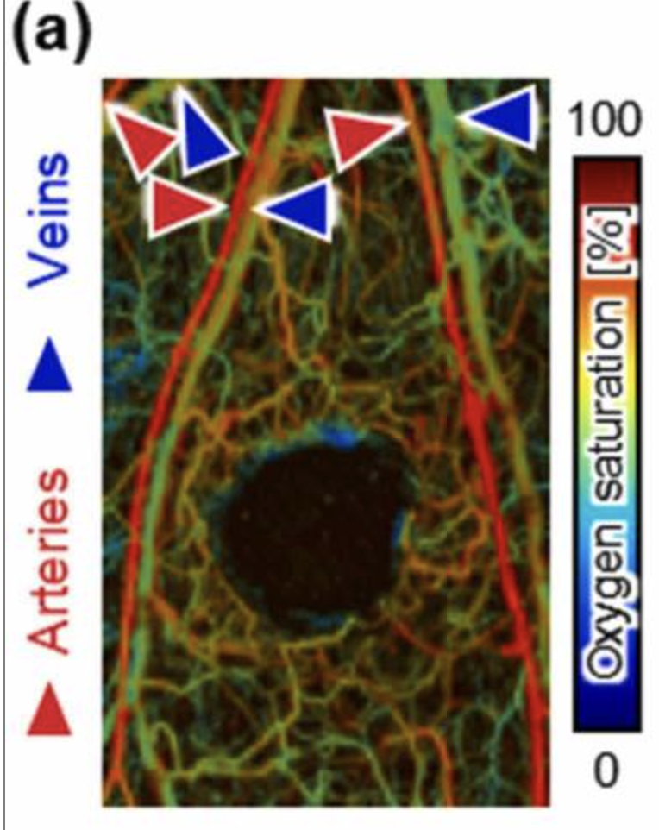
Functionality: from structure to physiology
Oxy- and deoxyhemoglobin absorb light differently.
Multiwavelength measurements can estimate oxygen saturation, sO₂.
Quantitative accuracy depends on local light fluence.
Other directions include molecular contrast and multimodal imaging.
Notes:
[~2 min]
Beyond structure, PAM can measure physiology. Because the contrast comes from absorption, changing the wavelength changes what we see: UV for DNA and RNA, visible light for hemoglobin, and infrared for lipids.
The classic example is oxygen saturation. Oxygenated and deoxygenated hemoglobin absorb light differently. So with at least two wavelengths and a spectral model, we can estimate sO2. In this image, arteries, marked in red, and veins, marked in blue, are clearly separated.
But for accurate numbers, we need to know the local fluence at each wavelength, because tissue attenuates different wavelengths differently. Otherwise, a difference in light delivery can look like a difference in oxygenation.
Other directions include blood flow, metabolism, and multimodal systems that combine PAM with OCT, fluorescence, or ultrasound.

Slide 11
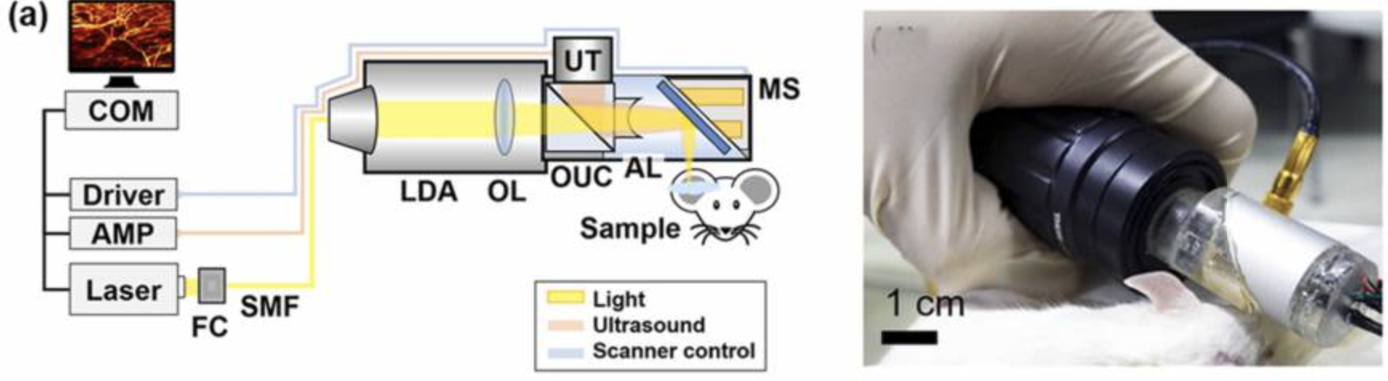
Practicality: cost and usability
Laser diodes can reduce light-source cost.
Handheld probes improve access to different imaging sites.
Practical use also depends on coupling, stability, and workflow.
Notes:
[~1.5 min]
For clinical use, PAM also needs to be cheaper, smaller, and easier to use.
The laser is usually the most expensive part, so several groups use laser diodes, like the system on the left. They are cheap, but their pulse energy is low. Early systems needed 128 to 500 averages, which slows imaging down. That's the SNR-speed trade-off again. Later designs improved the optics and removed the need for averaging.
For size, MEMS and galvo scanners made handheld probes possible, like the one on the right. They can image sites that a tabletop system can't reach, such as the lips. There are even head-mounted systems under 2 grams for freely moving mice.
But practical use also depends on acoustic coupling, stability, and workflow, not only on hardware specs.

Slide 12
Performance trade-offs
Design choice | Benefit | Cost or constraint
Higher optical NA | Finer lateral resolution | Shorter Gaussian-beam DOF
Smaller scan steps | Denser spatial sampling | More acquisition points
More signal averaging | Improved SNR for random noise | Longer acquisition time
the imaging task determines which trade-offs are acceptable.
Notes:
[~1.5 min]
In the discussion, the authors point out that these dimensions are coupled. Three examples.
A higher NA gives finer resolution, but a shorter depth of focus.
Smaller scan steps give denser sampling, but more points take more time.
More averaging improves SNR for random noise, by the square root of the number of averages, but it costs acquisition time.
So there is no single best system. The imaging task decides which trade-offs are acceptable. The authors give an example: for intraoperative histopathology, speed and resolution come first. For neurovascular imaging, SNR and depth are more critical.
Looking forward, they highlight transparent transducers, high-repetition-rate lasers with stable power, beam shaping, and all-optical detection.

Slide 13
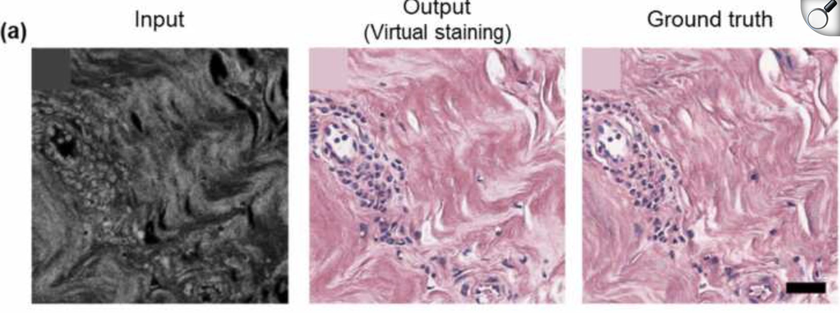
AI: reconstruction and interpretation
PA input → Virtual staining → Histology reference
nuclear counts, boundaries, and missed structures.
AI supports image reconstruction and interpretation.
Virtual staining predicts an H&E-like appearance from PA images.
Validation should measure task-relevant accuracy on independent samples.
Notes:
[~1.5 min]
AI appears in every section of the review. It plays two roles: reconstruction, such as denoising, filling in undersampled data, and extending depth of focus; and interpretation.
The clearest interpretation example, and the most relevant for histology, is virtual staining. A GAN takes a grayscale UV-PA image as input and outputs an H&E-like image, shown here next to the real H&E reference. Another study combined PA and H&E features for cancer classification, and reported 98 percent accuracy on its own dataset.
My view: these images look convincing, but for diagnosis, what matters is whether the diagnostic information is preserved. Are nuclear counts and boundaries correct? Does the network miss real structures, or create fake ones? Does it still work on independent samples, or tissue types it was not trained on? So I think validation should use task-relevant metrics, not only visual similarity.

Slide 14
Proposed check: signal uniformity across the scan field.
Control illumination, sample properties, and acquisition settings.
Distinguish optical, acoustic, and timing effects.
Notes:
[~1.5 min]
To wrap up: this review gave me a map of PAM: six dimensions, and the trade-offs between them.
For our own system, one check I'd like to do is signal uniformity across the scan field. The optical focus moves with the scanner, but the transducer's sensitive region may not move with it, so the signal could drop toward the edges. To test this, I'd keep the illumination, sample, and acquisition settings fixed, image a uniform absorber such as black tape, and try to separate optical, acoustic, and timing effects.
I have two questions for discussion.
First, in PUV-PAM, did the signal amplitude differ between foci, or between the center and the edge of the galvo scan? If so, was it corrected by calibration on a uniform sample, or by normalization in processing?
Second, for our current setup, before scanning, I plan to confirm a real PA signal with three checks: a repeatable bipolar signal on black tape; a signal peak when I adjust X, Y, and Z; and an arrival-time shift of delta-z over c when I move the sample by a known distance. Does this order make sense, or is there a quicker first check you would recommend?
Thank you. I'm happy to take questions.

