Slide 1
Parallel UV-PAM
System reproduction — progress, blocker, and verification plan
Yumeng Chen
Cao Lab · Department of Biomedical Engineering, CWRU
1:1 with Rui Cao · August 31, 2026
Today I need two decisions from you: (1) which verification path to run, (2) what counts as “reproduced.”
Notes:
开场（30 秒内讲完）：
上周之后我把三个轴都试了，X/Y/Z 都能动，驱动器灯都是绿的，没有报错。
但你上次说的 sequence step / step size 我还没验出来 —— 现在扫描的时候声音很大，我怀疑这跟脉冲怎么发出去有关，所以今天主要想跟你确认两件事：一是用哪个方案去验 step size，二是这三四周做到什么程度算复现完成。

Slide 2
STATUS AT A GLANCE
Motors move. Nothing is calibrated yet.
3 / 3
0
1 kHz
AXES RESPOND
VERIFIED STEP SIZE
CURRENT STEP RATE
X, Y, Z all move under LabVIEW
Move X / Y / Z
µm per commanded pulse
not yet measured on any axis
audible growl during scanning
— flagged as a precision risk
What this means
TODAY'S ASK
Motion is not calibration.
Pick verification Path A or Path B
Confirm what “reproduced” means
Answer 6 open settings questions
A green driver LED and an audible stage only prove the motor received something — not that it took every step it was told to take.
Until µm-per-pulse is measured, every position readout in LabVIEW is an assumption.
The noise is the symptom worth chasing: whatever makes a stepper growl at 1 kHz is usually the same thing that makes it lose steps.
Notes:
这一页就是全场的 TL;DR，讲 60–90 秒。
三个数字：三个轴都能动 / 步长一个都没验 / 现在 1 kHz 有噪声。
重点是中间那句话：能动 ≠ 准。绿灯只说明驱动器没报错，不说明它没丢步。
右边黑框是今天要你拍板的三件事，先摆出来，后面每一页都对应其中一件。

Slide 3
REFERENCE SYSTEM
What “reproduced” looks like, in numbers
Cao et al., “Optical-resolution parallel ultraviolet photoacoustic microscopy for slide-free histology,” Sci. Adv. 10, eado0518 (2024)
Excitation
266 nm, 50 kHz repetition rate
A NUMBER THAT AFFECTS US TODAY
Parallel foci
8 foci, 375 µm spacing (diffractive beam splitter)
5 mm/s
Lateral resolution
1.3 µm
is all we get at 1 kHz × 5 µm — half the reference slow-axis speed. If 10 mm/s is the target, the pulse rate has to go up, which makes pulse timing quality matter even more.
Scanning step size
1 µm
Fast axis
2D galvo (GVS412) — scans all 8 foci together
Slow axis
step motor (PLS-85), up to 10 mm/s
Detection
2 × focused single-element transducers, 34.1 MHz
Two candidate finish lines
Minimum: 3 axes calibrated + galvo scanning + a triggered PA signal
Full: a 2D MAP image of a phantom or tissue at comparable resolution
Digitizer
AlazarTech ATS9350, 500 MS/s
Control
NI PCIe-6323 + custom LabVIEW
Throughput
0.4 mm²/s = 400k pixels/s = 4.2 min per cm²
Notes:
这页的用意：把"复现完成"从一句话变成一张数字表，这样验收标准就没有歧义。
论文我从 NSF public access 上拿到了全文（science.org 有付费墙，但 par.nsf.gov 有作者接受稿）。
顺带解决了上下文里一个待确认项：数字化仪论文里是 ATS9350，500 MS/s —— 要问 Rui 我们这台是不是同一型号。
右上角那个 5 mm/s 是我自己算的：1 kHz × 5 µm。如果目标是论文的 10 mm/s，脉冲率必须提高，那脉冲的时序质量就更关键了 —— 这句话是给第 7、8 页铺垫的。
右下角两个终点线，直接问他要哪个。

Slide 4
OUR SYSTEM · CONTROL
The one chain under test today
LabVIEW
NI PCIe-6323
BNC-2110
MOONS’ SR2 × 3
X / Y / Z stages
Move X / Y / Z
kx, ky, kz
digital out
(+ 4 counters, unused)
P0.0 – P0.7
PFI 0 / PFI 12 free
STEP± · DIR± · EN±
current + microstep tables
step motors
A± / B± phases
STEP / DIR pulses
Where the uncertainty sits
Not in scope today
We command a number of pulses in LabVIEW — but we have never measured what actually leaves P0.x, or what the SR2 does with it.
The SR2 microstep table sets how many pulses make one full step, so it sets µm-per-pulse. We have not confirmed its current setting.
STEP± / DIR± are differential inputs driven from single-ended 5 V TTL — worth re-checking the common ground and any series resistor.
kx = 0.25, ky = 0.9, kz = 0.25 in the VI: unknown whether the step box is raw pulses or already scaled by k.
Galvo — ScannerMAX Mach-DSP (S/N PS502441)
266 nm laser + photodiode trigger
AlazarTech digitizer → PA signal capture
C-Scan / Volumetric Scan controls — untouched
Notes:
讲信号链的时候手指着走一遍就行，重点停在 SR2 那个紫色框。
左下角四条是我认为不确定性集中的地方，其中第二条（microstep table 决定 µm/pulse）是最关键的 —— 因为它意味着：不先定 microstep，step size 根本没法定。这两件事必须一起定。
第四条 kx/ky/kz 是老问题了，今天顺便问掉。
右边列出今天不碰的东西，是为了让他知道我没有到处乱试。

Slide 5
OUR SYSTEM · OPTICS
Beam path, and what each element is for
1
266 nm UV laser
excitation source
Why so many lenses
2
Beam splitter → photodiode
per-pulse timing + energy, for sync and PA normalization
spot size ∝ λf / D
Each lens does a different job — collimate, expand, relay, fill the aperture. A wider beam into the focusing lens gives a smaller spot, so beam expansion is what buys lateral resolution.
3
Galvo mirror
angular scan — the fast axis
4
Lens L1 + L2
relay / telescope; sets beam diameter (100 mm + 250 mm → M = 2.5)
5
Lens L3
converts galvo angle into displacement at the sample
OPEN QUESTION
6
Diffractive grating
splits into multiple orders — this is where “parallel” comes from
Which physical lens is the 100 mm and which is the 250 mm? I want to walk the bench with the paper schematic and label each mount before the galvo work starts.
7
Lens L4 / objective
final focus onto tissue; fills the aperture
8
Tissue → 2 transducers
PA wave detection
Notes:
这页快速过，30–45 秒。目的是让他知道我理解了每一片镜子在干什么，不是在"重复聚焦"。
第 6 步（grating）标成橙色，因为那是 parallel 的来源，是这套系统区别于普通 UV-PAM 的地方。
右下角是我第一个要问的问题：100 mm 和 250 mm 到底是哪两片。我想在动 galvo 之前把每个镜架贴上标签。

Slide 6
SINCE OUR LAST MEETING
Done, in progress, not started
Done
5
In progress
2
Not started
4
Learned optical alignment (8/25)
Rewired the motor lines as you asked
Single-axis motion test on X, Y and Z — all three respond
Confirmed all three SR2 drivers report no fault (green LED)
Identified step-size verification as the real gap
Motor-line correction with Maira — scheduled 9/2 afternoon
Reading the reference paper’s methods section for target specs
Step-size / pulse-sequence verification — blocked, see next slide
Galvo (ScannerMAX) testing
AlazarTech acquisition chain
Transducer alignment
Panel values used for the motion test (unchanged from what I found): X 8000 / IN / kx 0.25 · Y 200 / RIGHT / ky 0.9 · Z 320 / UP / kz 0.25
Notes:
老实汇报，不夸大。三个轴都动了是好消息，但我要主动说"这不等于做完了"。
"Not started" 那一栏第一条要点出来：它不是我没做，是卡住了，下一页展开。
底下那行是说：我用的是面板上原来的参数，没有乱改 —— 这一点他会关心。

Slide 7
RESULT · MOTION TEST
All three axes move — and all three are loud
Axis
Commanded
Moves?
Driver LED
µm per pulse
Noise
X
8000 · IN · kx 0.25
Yes
Green — no fault
not measured
loud
Y
200 · RIGHT · ky 0.9
Yes
Green — no fault
not measured
loud
Z
320 · UP · kz 0.25
Yes
Green — no fault
not measured
loud
What we can claim
What we cannot claim
Wiring, enable and power are correct on all three drivers.
DIR polarity is set such that each axis moves; direction sign not yet logged systematically.
That N commanded pulses produce N motor steps.
That the stage travelled the distance LabVIEW reports — Position X/Y/Z is open-loop.
Your note from last week
“The noise during scanning is too loud — the positioning will not be accurate. Check the step size (~5 µm), the driver settings, and whether the default configuration needs to change.”
Notes:
表格从左往右念一遍，重点落在最后两列 —— 红色斜体的"not measured"和"loud"。
左右两个框是我刻意分开的：能声称的 vs 不能声称的。这是为了避免"能动了"被误读成"做完了"。
特别提一句：Position X/Y/Z 是开环显示，它显示的是软件累加的命令值，不是实际位置，所以它永远"正确"，也永远不能用来验证。
最后黑框是复述你上周的原话，确认我理解对了 —— 如果我转述得不准，这里就纠正我。

Slide 8
THE BLOCKER
Three things could make it growl — all three break µm/pulse
H1
Microstep setting too coarse
If the SR2 microstep table is at or near full step, a 1 kHz pulse rate lands in the range where steppers are loudest and most resonance-prone. Finer microstepping smooths torque and quiets the motor — but it also changes µm per pulse, so this setting and the step-size calibration have to be decided together.
H2
Pulse train is not hardware-timed
If STEP is generated by writing to P0.x in a software loop, the interval between pulses inherits operating-system jitter — milliseconds, irregularly. A stepper fed an uneven train growls, and near its torque limit it drops steps. The PCIe-6323 has four counter/timers that can emit an exact finite pulse train instead.
H3
Drive current or input wiring
Current set too high adds noise and heat; too low loses steps under load. Separately, STEP± and DIR± are differential opto-isolated inputs being driven from single-ended 5 V TTL — worth confirming the common ground and whether a series resistor is required.
None of these is visible from the LabVIEW front panel, and none of them trips the driver’s fault LED. That is why the next slide is about measuring, not about trying settings.
Notes:
这页是全场最技术的一页，讲 2–3 分钟，讲慢一点。
H1：SR2 板上有 microstep table，如果现在是整步或者很粗的细分，1 kHz 正好落在步进电机最吵、最容易共振的区间。细分调高会安静，但 µm/pulse 也跟着变 —— 所以细分和步长标定必须一起定，不能先定一个。
H2：这是我最怀疑的一条。如果 LabVIEW 是用软件循环去翻转 P0.x，脉冲间隔就带着操作系统的抖动，毫秒级而且不规则。电机吃到不均匀的脉冲串就会 growl，接近力矩极限时就丢步。PCIe-6323 有四个 counter，可以硬件产生精确的有限脉冲串 —— 这是正确做法。
H3：电流和接线，比较基础但要排除。
最后那句是这页的落点：这三个在前面板上都看不见，驱动器也不会报错 —— 所以必须去测，不能靠试参数。

Slide 9
DECISION 1
Two ways to verify — which do you want first?
PATH A
PATH B
Measure it on the bench
Instrument the VI
~1 day · no code · equipment already on the table
~2–3 days · LabVIEW work · permanent readback
Rigol DS1000Z scope on STEP at the SR2 terminal, DIR on ch2: count edges for a commanded N, check period uniformity, amplitude and rise time.
Rigol DG852 Pro in N-cycle burst: send exactly N clean TTL pulses straight into STEP, bypassing LabVIEW → measure travel → ground-truth µm per pulse.
Sweep 200 Hz → 5 kHz to find the quiet band and the resonance.
Loop STEP back into a PCIe-6323 counter input (PFI 0 or PFI 12, both free) and display actual edge count next to commanded N.
Move STEP generation from a software-timed digital write to a hardware-timed counter pulse-train output.
Log commanded vs. counted per move, so every future scan self-checks.
Answers: is the problem LabVIEW, or the drive and mechanics?
Fixes the root cause if H2 is right, and never has to be redone.
My suggestion: run Path A first — it uses hardware already on the table and gives a number by Wednesday. Then do Path B only if A shows jitter or a count mismatch.
Notes:
这是今天第一个要他拍板的决定。
Path A 的关键设计：用 DG852 Pro 的 N-cycle burst 直接给 SR2 发"正好 N 个"干净脉冲，把 LabVIEW 整个从回路里拿掉。这样如果函数发生器发 N 个走得准、LabVIEW 发 N 个走不准，问题就锁定在软件端；反之就在驱动器或机械端。这是一个干净的二分。
Path B 是长期正确的做法，但要写 LabVIEW，慢。
我建议先 A 后 B，理由是 A 用的东西都在台子上，周三就能有数字。但让他决定。
如果他说两个一起做，我就说人手上 A 我一个人能做，B 需要他确认 VI 的结构。

Slide 10
DECISION 2
Three to four weeks to a first image
Does this match the pace you have in mind?
1
Week 1
2
Week 2
3
Week 3
4
Week 4
Sep 1 – 5
Sep 8 – 12
Sep 15 – 19
Sep 22 – 26
Motor calibration
Fast axis
Detection chain
First image
Run the chosen verification path
Settle SR2 microstep + current
Motor lines with Maira (9/2)
Galvo via ScannerMAX Mach-DSP
Laser + photodiode trigger
Galvo–motor handoff timing
AlazarTech capture in LabVIEW
Transducer alignment + coupling
Amplifier / gain settings
2D raster over a test target
MAP reconstruction
Measure achieved resolution
EXIT CRITERION
EXIT CRITERION
EXIT CRITERION
EXIT CRITERION
µm per pulse known and repeatable on X, Y, Z
Galvo sweeps a repeatable line, synced to the laser
A real PA signal from a phantom, on screen
One 2D MAP image, with a resolution number attached
Each week is gated by its exit criterion — I would rather stop and ask than carry an unverified assumption into the next stage.
Notes:
第二个要拍板的东西。四周，每周一个出口标准。
我故意把"出口标准"写出来，而不是只写"做什么"—— 因为上周的教训就是"电机能动"这种描述太模糊，说不清算不算做完。
要问他：这个节奏对不对？有没有哪一周他觉得不现实？特别是第三周的 Alazar，我完全没碰过，可能需要他或者组里其他人带一下。
另外第四周的"first image"是我理解的最低版本 —— 一张 phantom 的 2D MAP，不是组织切片。如果他要的是组织，时间要往后推。

Slide 11
DECISION 3
Six settings questions I cannot answer from the bench
1
Acceptance criteria
2
The 5 µm
Is “reproduced” three axes + galvo moving, or an image comparable to the paper? The two differ by weeks.
Is that per commanded pulse, or per motor full step? And what should the SR2 microstep table be set to?
3
Pulse generation
4
Step box vs. k
In the current VI, is STEP a software-timed digital write on P0.x, or a hardware counter output?
Is the Move X/Y/Z number raw pulses, or already scaled by kx / ky / kz?
5
Slow-axis speed
6
Digitizer
The paper runs 10 mm/s. At 1 kHz × 5 µm we get 5 mm/s. Do we need to raise the pulse rate?
The paper uses an AlazarTech ATS9350 at 500 MS/s — is ours the same card?
Notes:
六个问题，前三个（橙色）是今天必须要到答案的，后三个（紫色）能问到最好。
第 1 个最重要 —— 验收标准。这个不问清楚，后面三周都可能白做。
第 2 个：5 µm 到底是每个命令脉冲还是每个整步，差一个细分倍数。
第 3 个：直接决定我要不要做 Path B。
第 5 个如果他说要 10 mm/s，那 Week 1 的工作量要加，因为脉冲率翻倍会把 H2 的问题放大。
第 6 个顺便把上下文里那个待确认项收掉。

Slide 12
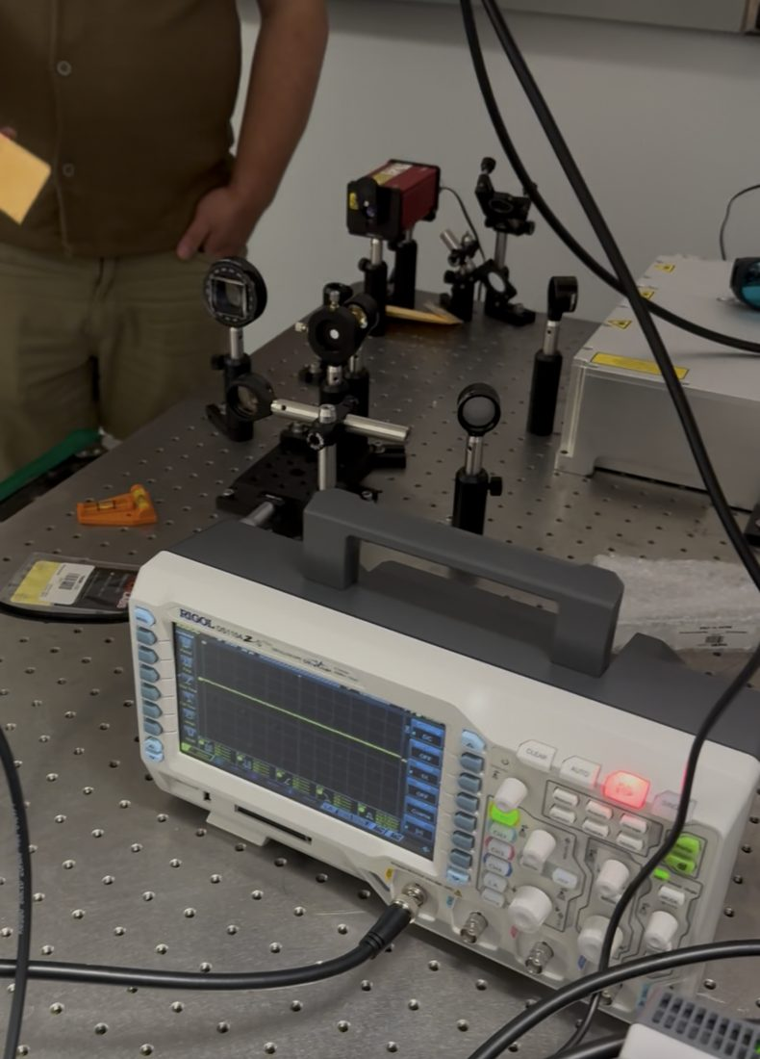
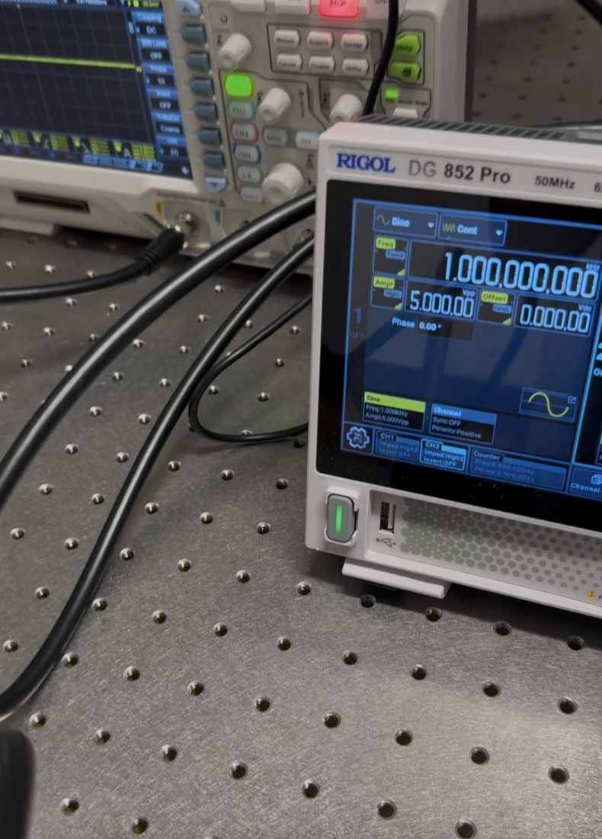
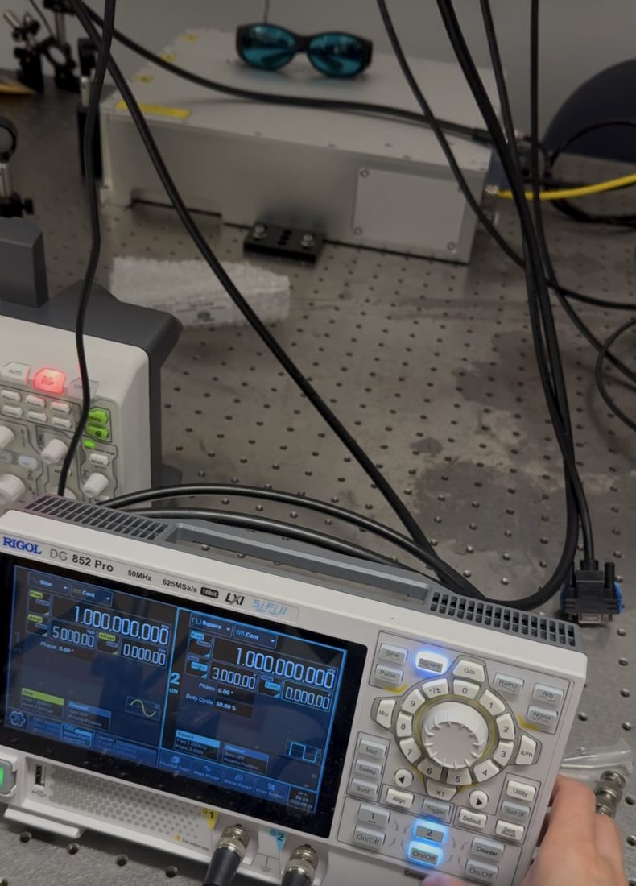
APPENDIX
Equipment available for Path A
Optical table
Scope + generator, wired
Rigol DG852 Pro
266 nm source, mounts, and the Rigol scope already in position
Rigol DS1000Z-series scope (4-ch) beside the DG852 Pro — model to be confirmed on the bench
50 MHz · 625 MS/s · 16-bit · 2-ch, with N-cycle burst and a built-in counter
The DG852 Pro’s N-cycle burst mode is what makes Path A clean: it can emit exactly N pulses at a set frequency, so LabVIEW can be taken out of the loop entirely and the drive tested on its own.
Notes:
附录，只在他问"用什么测"的时候翻。
重点是 DG852 Pro 的 N-cycle burst：它能发"正好 N 个"脉冲，这正是把 LabVIEW 从回路里拿掉所需要的。
示波器型号我按机身认成 DS1000Z 系列，明天到实验室对一下具体型号再改。

Slide 13
APPENDIX
Panel state, safety protocol, references
LabVIEW front panel — as found
Safety protocol I am following
Move X
8000 · IN · kx = 0.25
Hand near Stop / e-stop before the first Move — never on the stage or lead screw
Violent shaking, odd noise, limit crash or a red driver LED → stop, do not click again
One axis at a time, small step counts first
Photograph any cable before unplugging it
266 nm is invisible — goggles per lab protocol
Move Y
200 · RIGHT · ky = 0.9
Move Z
320 · UP · kz = 0.25
dX / dY / dZ
2000 / 1 / 4 — not used
Enable X / Y / Z
not used
C-Scan, Volumetric
not touched
References
R. Cao et al., “Optical-resolution parallel ultraviolet photoacoustic microscopy for slide-free histology,” Science Advances 10, eado0518 (2024). DOI 10.1126/sciadv.ado0518 — full text via NSF Public Access (par.nsf.gov/servlets/purl/10594287)
L. V. Wang, “Multiscale photoacoustic microscopy and computed tomography,” Nature Photonics 3, 503–509 (2009). DOI 10.1038/nphoton.2009.157
MOONS’ SR2 step motor drive — current table, microstep table and LED fault codes printed on the drive body
Prepared 8/30 · open questions carried into the shared context document after the meeting
Notes:
附录第二页，备查。
左边是我看到的前面板原始状态 —— 我一个数都没改，这点如果他问起可以指这里。
右边安全流程，是上次说好的那套。
参考文献：Sci Adv 那篇正文我从 NSF public access 拿到了全文，所以第 3 页那些参数都是论文里的原话，不是我猜的。

