Slide 1
Final Project Proposal
Web Advanced: Javascript
Yumeng Wang 2015

Slide 2
Finding the Mouse
Find the Mouse is a simple web game, in which the player has to find the “invisible” mouse cursor with the clues inside of the small units/cells that cover the entire screen. On each unit there will be a letter, such as “A”, “B”, “C”… Because the mouse is invisible, the user has to open the clue by type the corresponding letter to open the clue inside of the unit. There four types of clues: up, down, left and right. The user will try to find which unit contains the mouse by these clues.

Slide 3
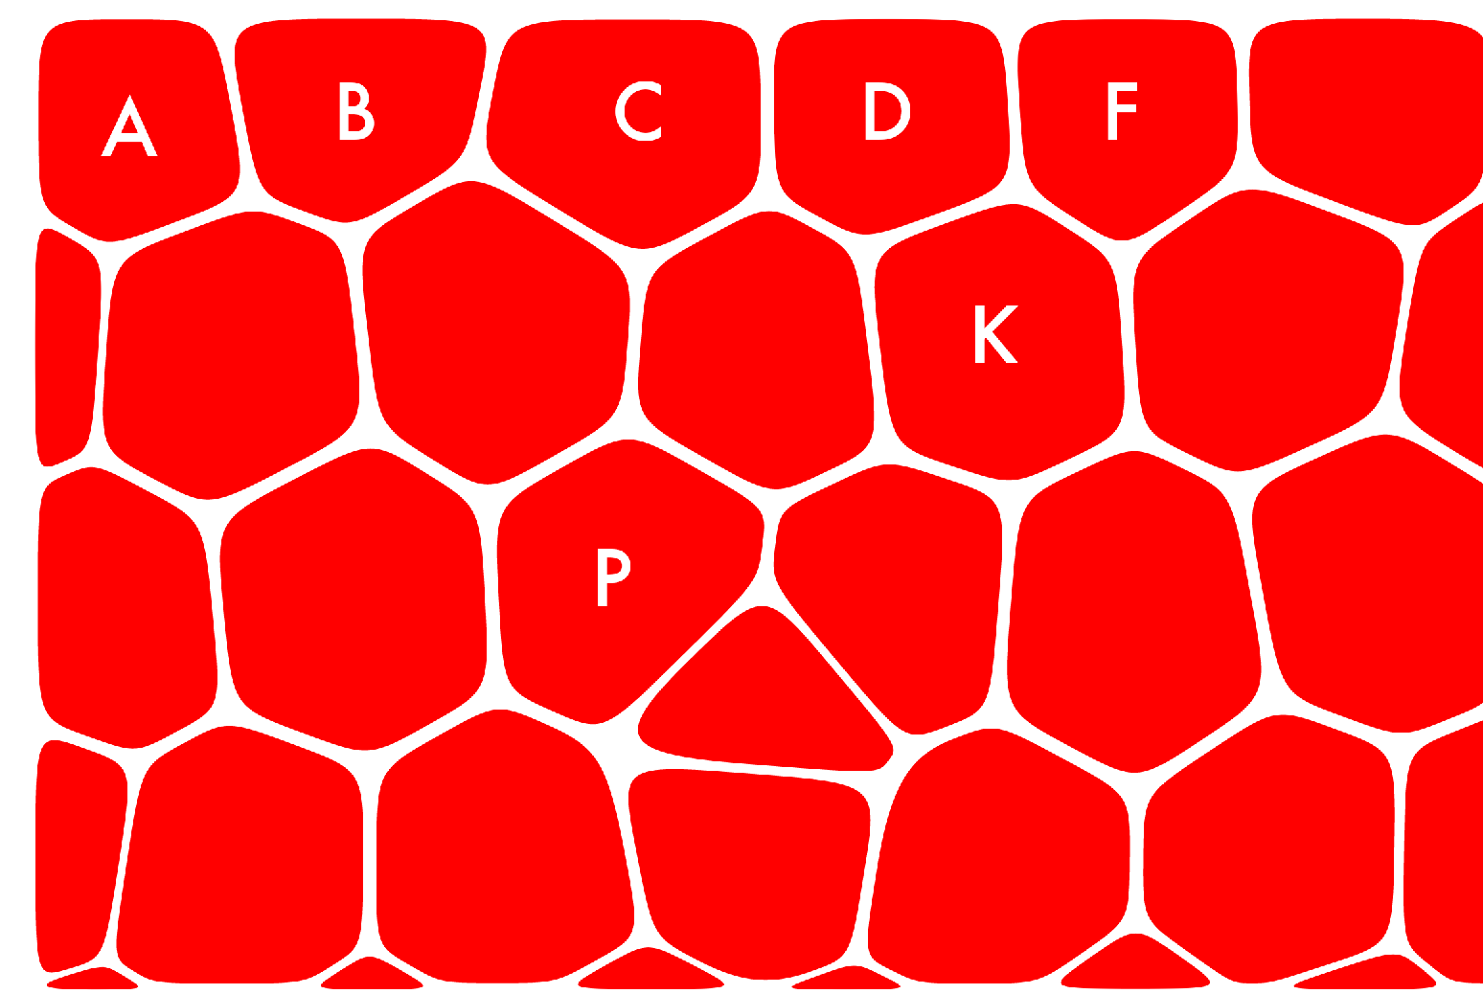
Finding the Mouse

Slide 4
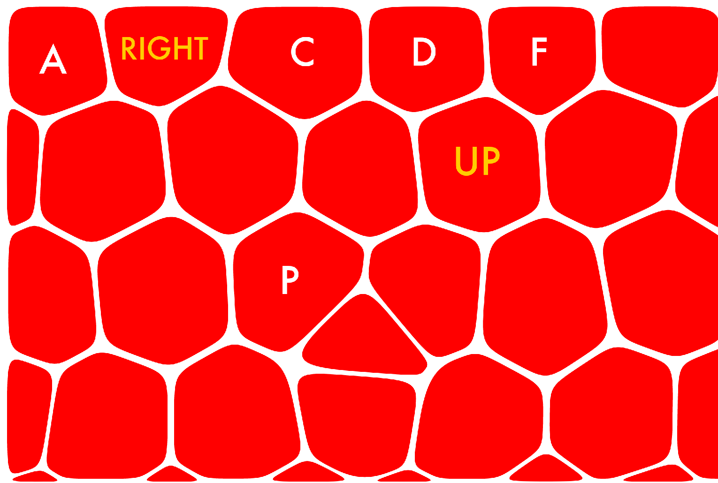
Finding the Mouse

Slide 5



Library
Besides the logic written in Javascript with JQuery, the graphics will be created in a 2D graphics library. Two.js , Bounce.js, or Paper.js might be the ideal choice.

Slide 6
Challenges
How to obtain the mouse position on the screen?
How to efficiently write the logic to compare each pair of positions?
Using the library

