Slide 1
Simple OnlineCompiler
By 周宗翔

Slide 2
Motivation
There are a lot of online compiler inside the internet, coding ground, onlinegdb, etc. However, start from scratch to design a compiler is very difficult things. By this, I decide to try other way to create my own online compiler.
1

Slide 3
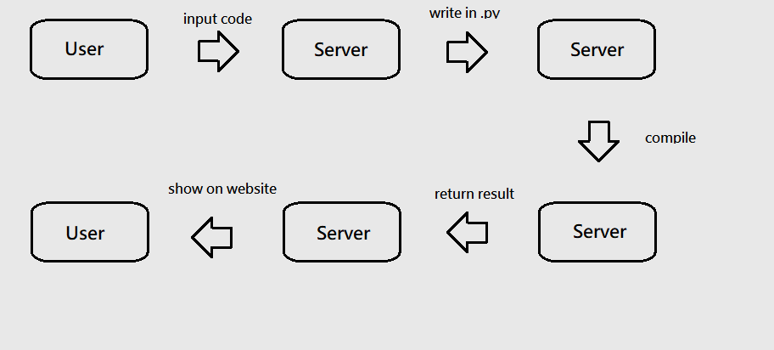
Process
2

Slide 4
Enviroment
Docker
Laravel
Composer
Python
3

Slide 5
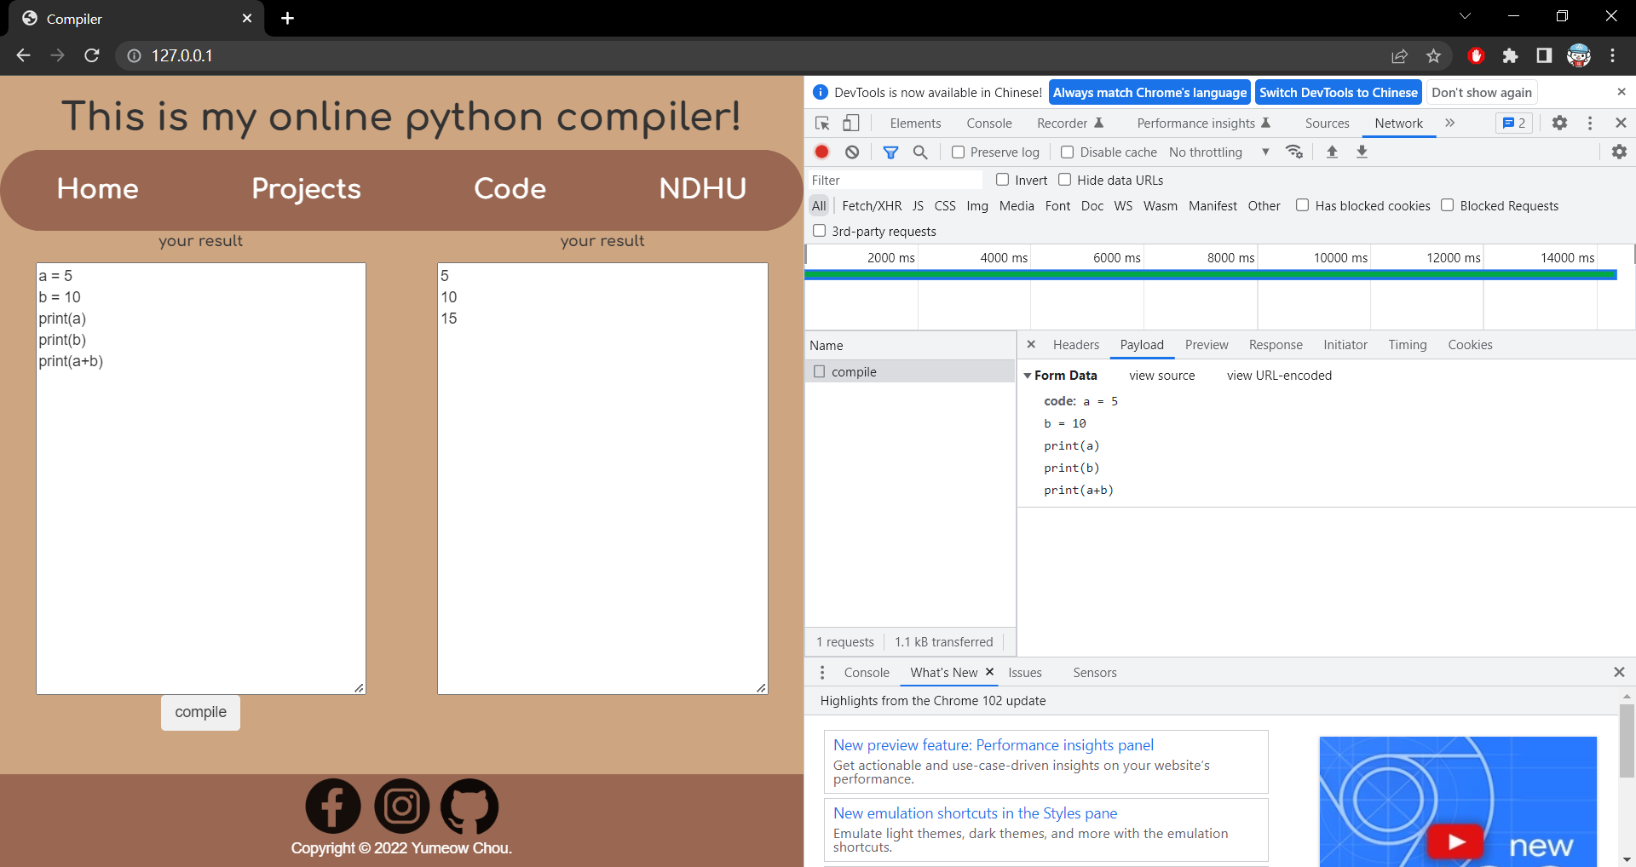
Sample
4

Slide 6
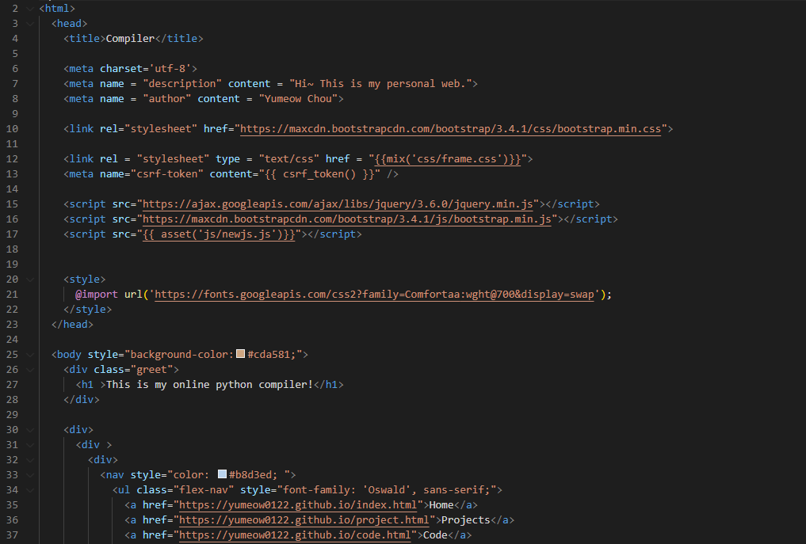
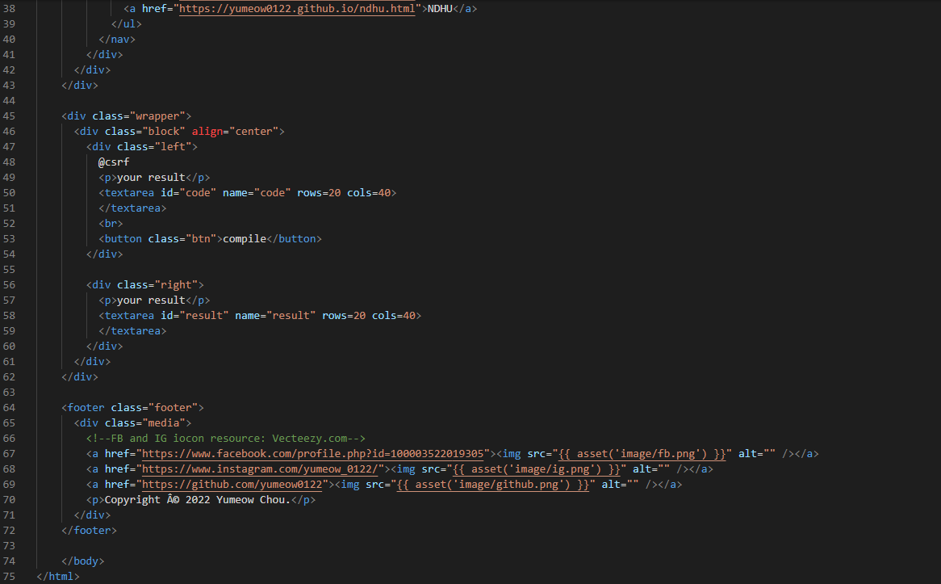
HTML
5

Slide 7
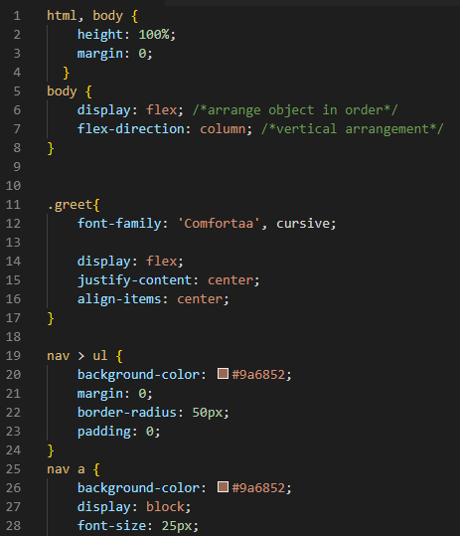
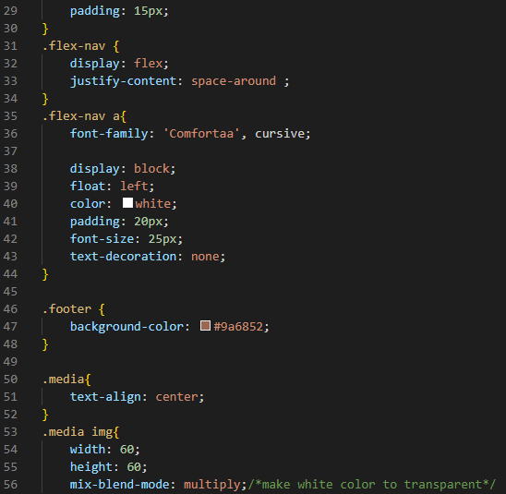
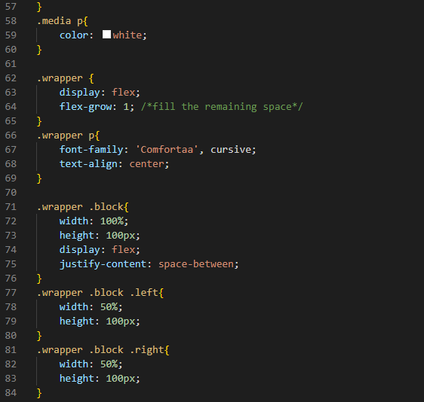
CSS
6

Slide 8
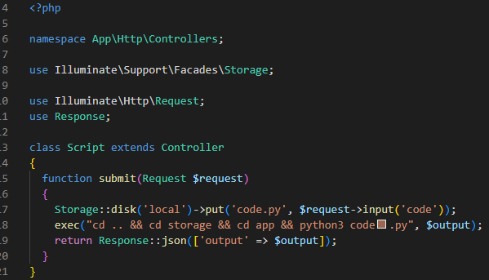
PHP
7

Slide 9
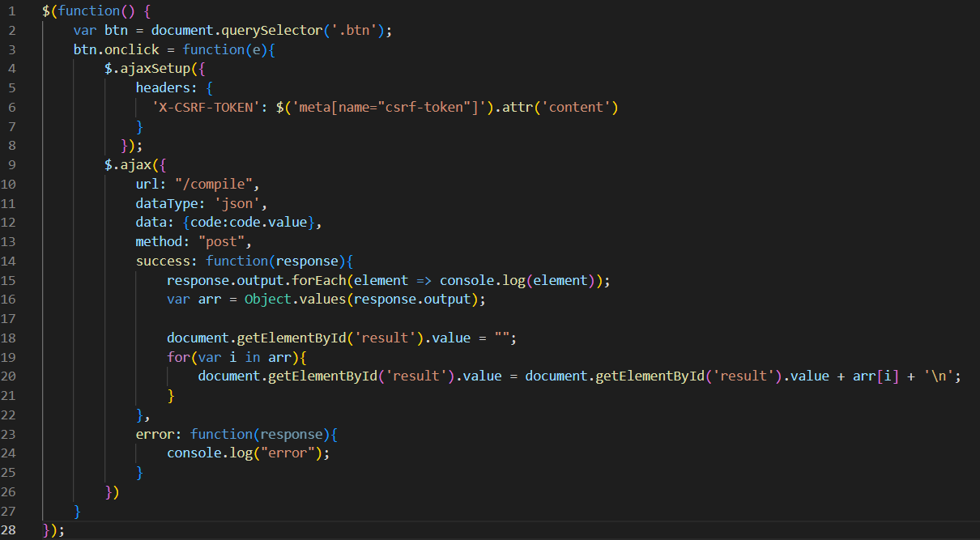
JavaScript
8

Slide 10

End

