Slide 1
卷積神經網路
(Convolutional Neural Networks, CNNs or ConvNets)

Slide 2
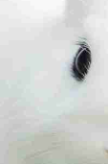
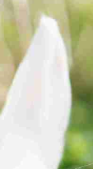
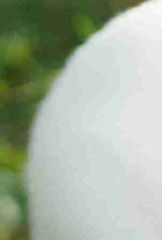
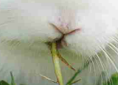
先備經驗

Slide 3
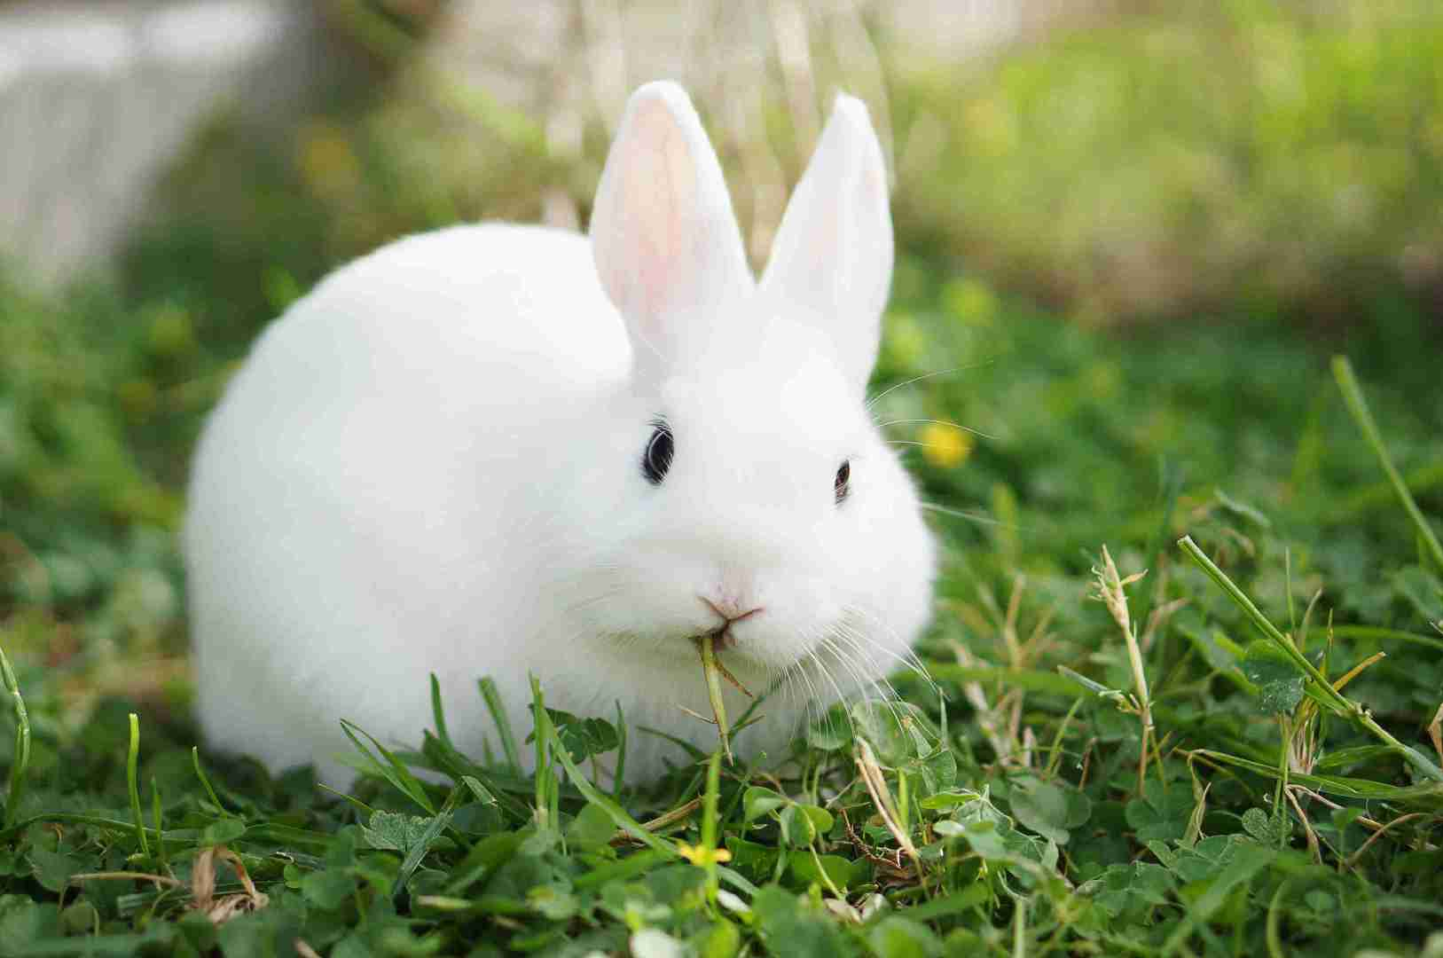
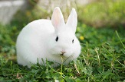
解析度不同

Slide 4
CNN's are really effective for image classification as the concept of:
dimensionality reduction. (能夠有效的將大資料量的影像降維成小資料量)
effectively retain the characteristics of the image. (能夠有效的保留影像特徵，符合影像處理的原則)
影像分類、人臉識別、自動駕駛、目標分割等

Slide 5
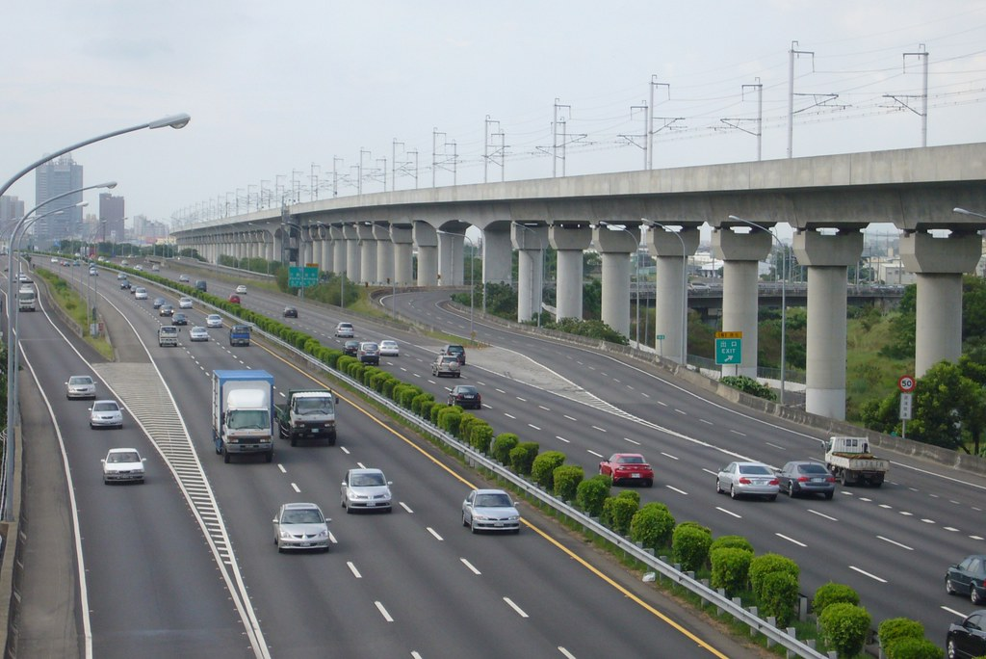
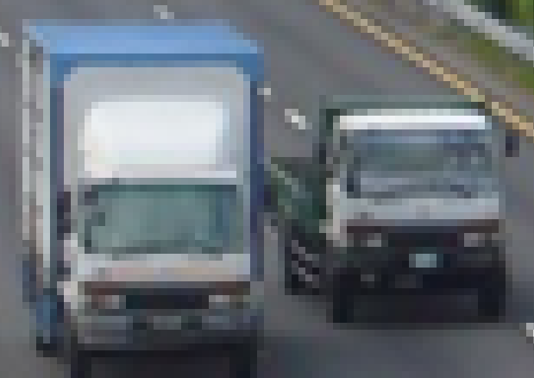
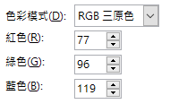
1024 x 684 x 3 (RGB) = 2,101,248
dimensionality reduction
將複雜問題簡化

Slide 6
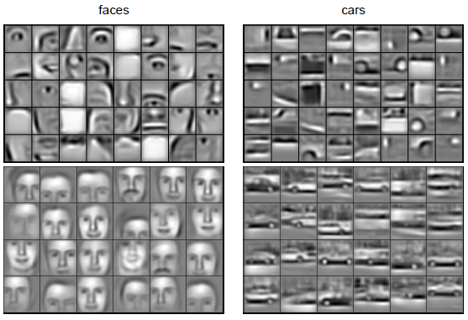
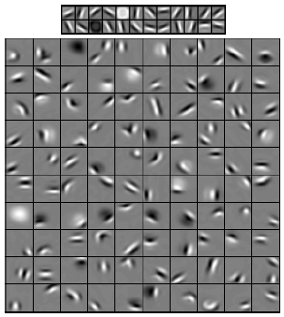
characteristics
pixels
Object parts
Object models
edges
類似視覺的方式保留了影像的特徵，當影像做旋轉或者變換位置時，它也能有效的識別出來是類似的影像
H. Lee, R. Grosse, R. Ranganath, and A. Y. Ng,. (2009). Convolutional deep belief networks for scalable unsupervised learning of hierarchical representations. In Proceedings of the Twenty-sixth International Conference on Machine Learning (ICML'09), (L. Bottou and M. Littman, eds.), Montreal (Qc), Canada:ACM.

Slide 7
典型的CNN由3個部分組成
Fully connected
(根據不同任務輸出結果)
Convolution
(提取影像中的局部特徵)
(Normalization)
Pooling
(降維、避免過度擬合)

Slide 8
A toy ConvNet: X’s & O’s
CNN
X
CNN
O
Reference: https://end-to-end-machine-learning.teachable.com/p/how-deep-neural-networks-work

Slide 9
Trickier Cases
translation
scaling
rotation
weight

Slide 10
Deciding is hard
?
=

Slide 11
What computers see
?
=

Slide 12
Features match pieces of the image

Slide 13
Filtering: The math behind the match
Line up the feature and the image patch.
Multiply each image pixel by the corresponding feature pixel.
Add them up.
Divide by the total number of pixels in the feature.

Slide 14
Convolution
1 x 1 = 1

Slide 15
Convolution
-1 x -1 = 1

Slide 16
Convolution
-1 x -1 = 1

Slide 17
Convolution
1 x 1 = 1

Slide 18
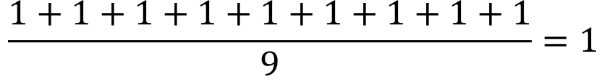
Convolution
$$\frac{1+1+1+1+1+1+1+1+1}{9}=1$$

Slide 19
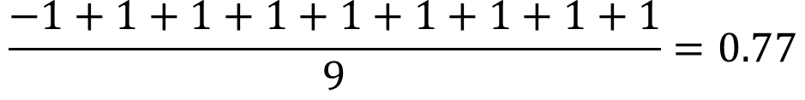
Convolution
$$\frac{−1+1+1+1+1+1+1+1+1}{9}=0.77$$
=

Slide 20
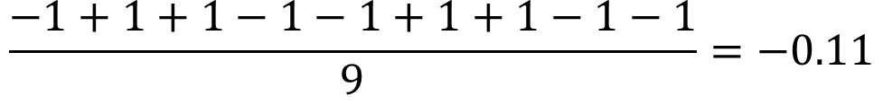
Convolution
$$\frac{−1+1+1−1−1+1+1−1−1}{9}=−0.11$$
=

Slide 21
=
=
=

Slide 22
Convolution layer Feature extraction
One image becomes a stack of filtered images

Slide 23
Pooling: Shrinking the image stack
Pick a window size (usually 2 or 3).
Pick a stride (usually 2).
Walk your window across your filtered images.
From each window, take the maximum value.

Slide 24
Max Pooling or Average Pooling
maximum

Slide 25

Max Pooling or Average Pooling
maximum

Slide 26
Max Pooling or Average Pooling

Slide 27
Pooling Layer
A stack of images becomes a stack of smaller images.

Slide 28
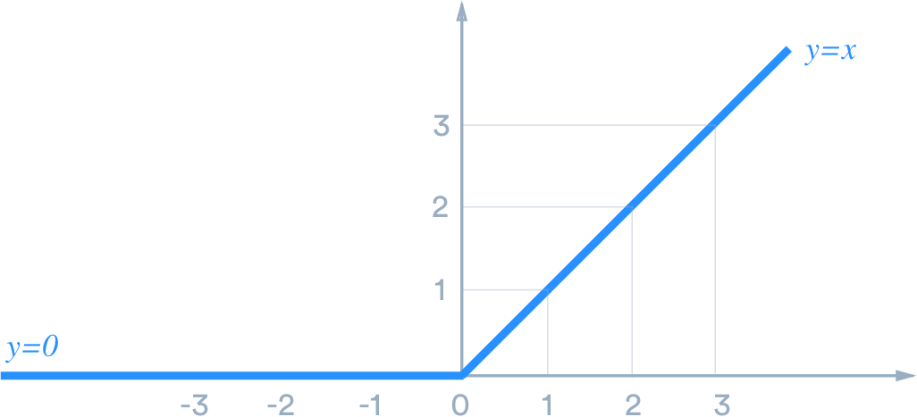
Normalization
Keep the math from breaking by tweaking each of the values just a bit.
Change everything negative to zero.

Slide 29
ReLUs
Rectified Linear Units (ReLUs)

Slide 30
ReLUs
Rectified Linear Units (ReLUs)

Slide 31
ReLUs
Rectified Linear Units (ReLUs)

Slide 32
ReLU Layer
A stack of images becomes a stack of images with no negative values.

Slide 33
Layers get stacked
Convolution
Pooling
ReLU

Slide 34
Deep stacking
Convolution
ReLU
Convolution
ReLU
Pooling
Convolution
ReLU
Pooling

Slide 35
Flatten & Fully connected layer
Every value gets a vote depends on how strongly a value predicts X or O.
X
O

Slide 36
Flatten & Fully connected layer
Future values vote on X or O.
X
.91
O
.52

Slide 37
.91
X
Convolution
ReLU
Fully
connected
Fully
connected
Convolution
ReLU
Convolution
ReLU
Pooling
Pooling
O
.52

