Slide 1
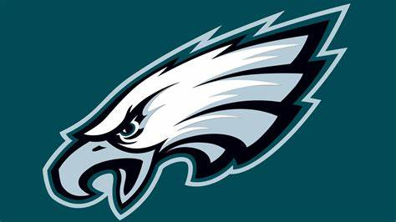
The Philadelphia Eagles
By Max Orenstein

Slide 2
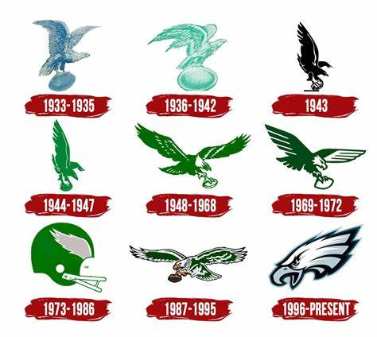
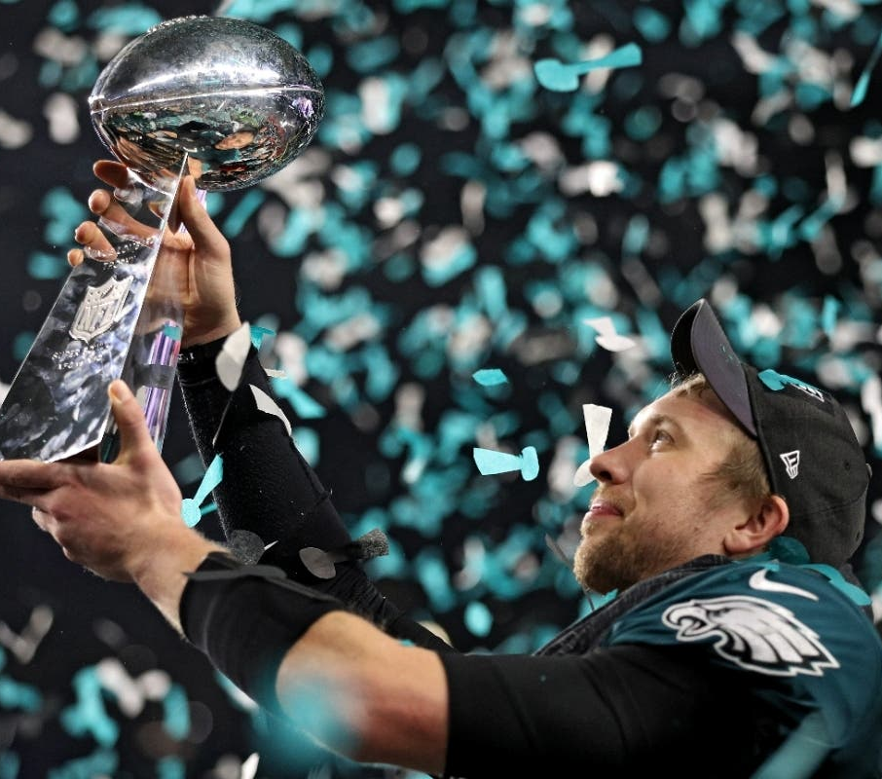
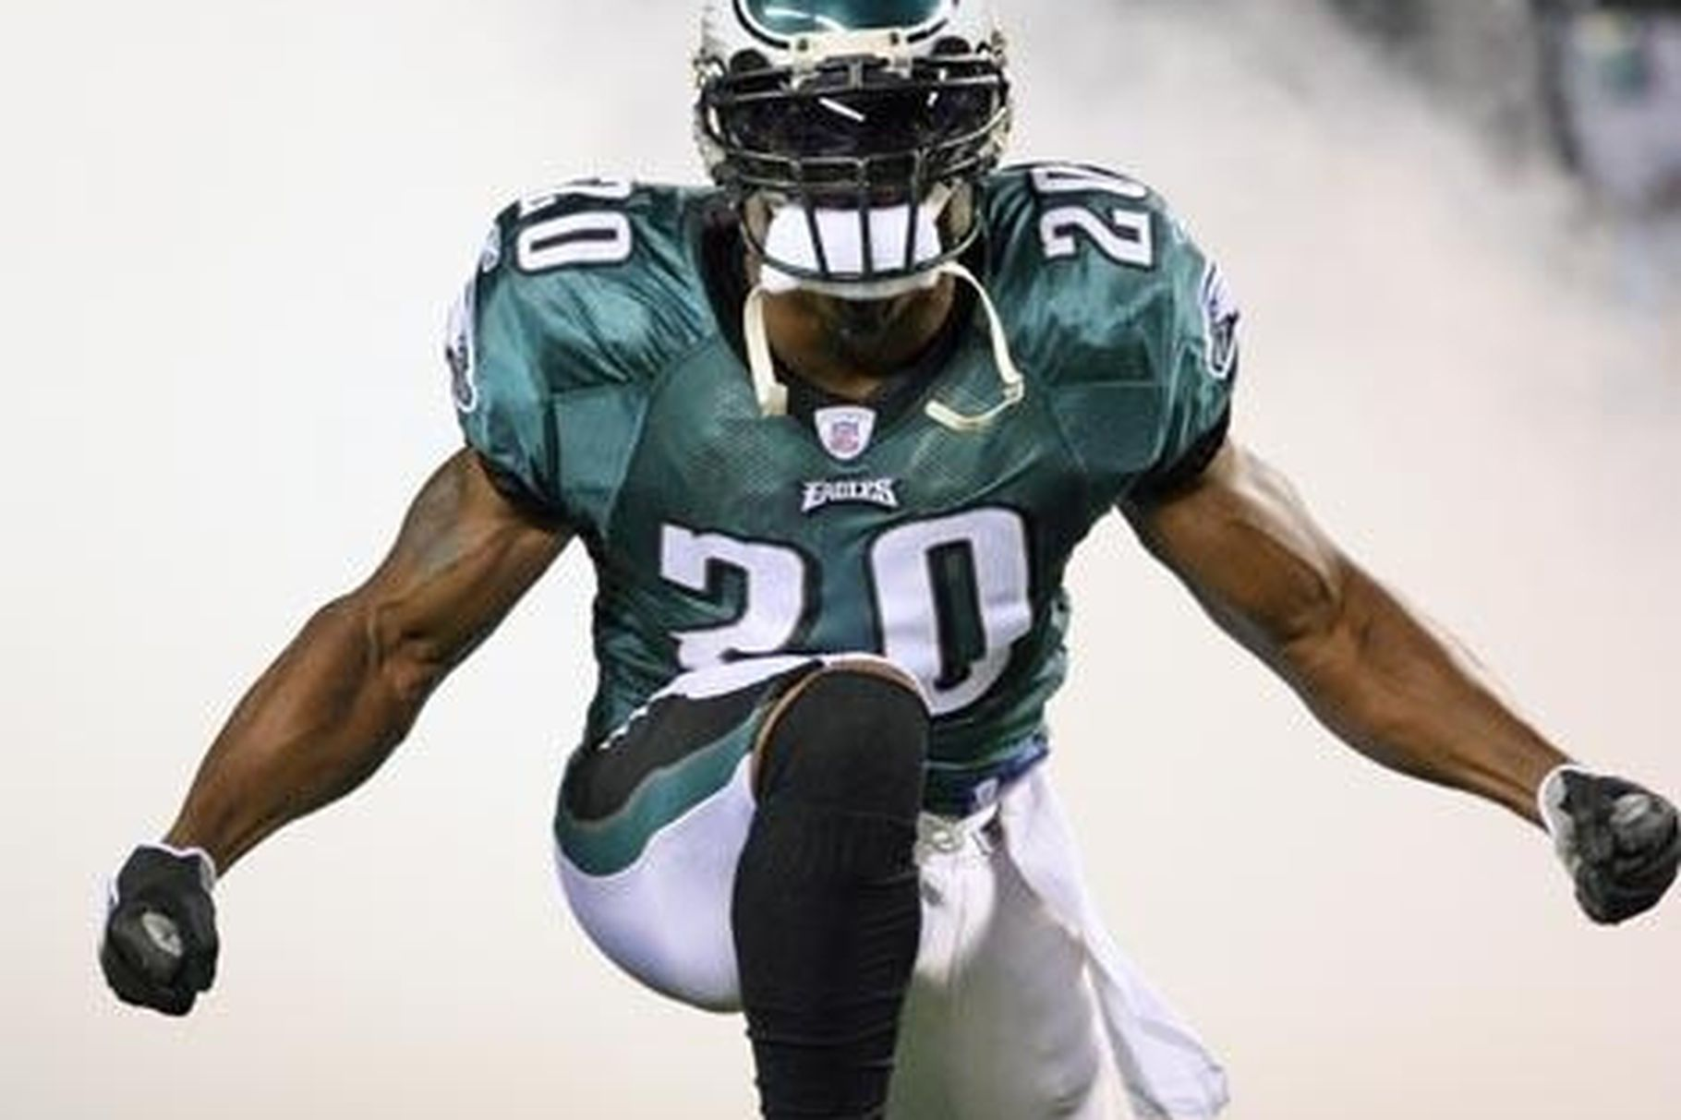
History and Players
Founded in 1933
Has boasted many star players notable Reggie Bush, Brian Dawkins, Harold Carmichael, Terrell Owens, and Randall Cunningham
2017 Superbowl Champions

Slide 3
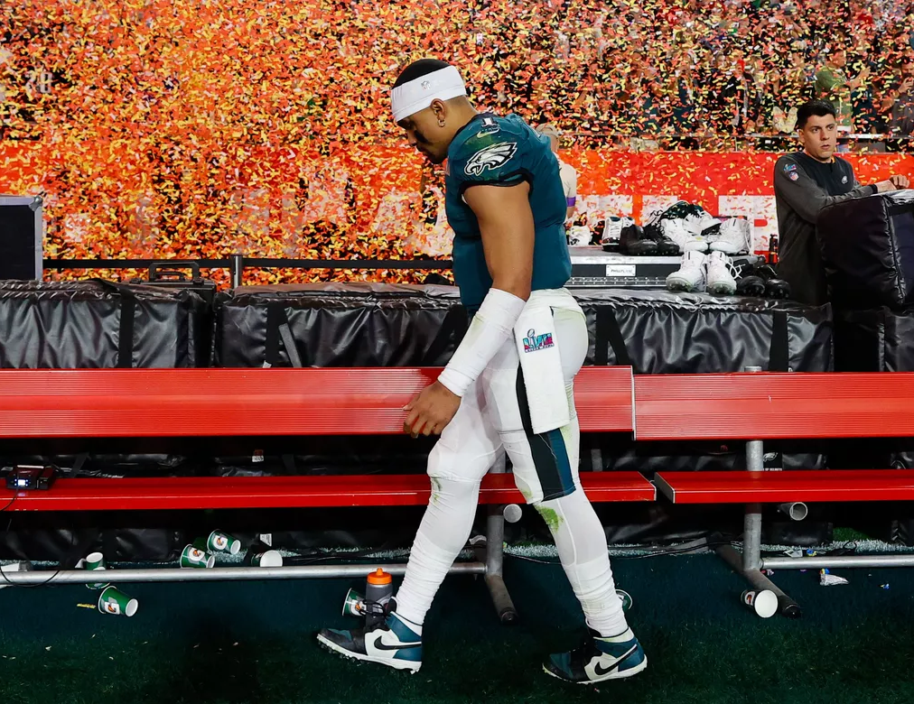
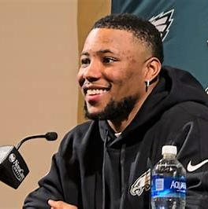
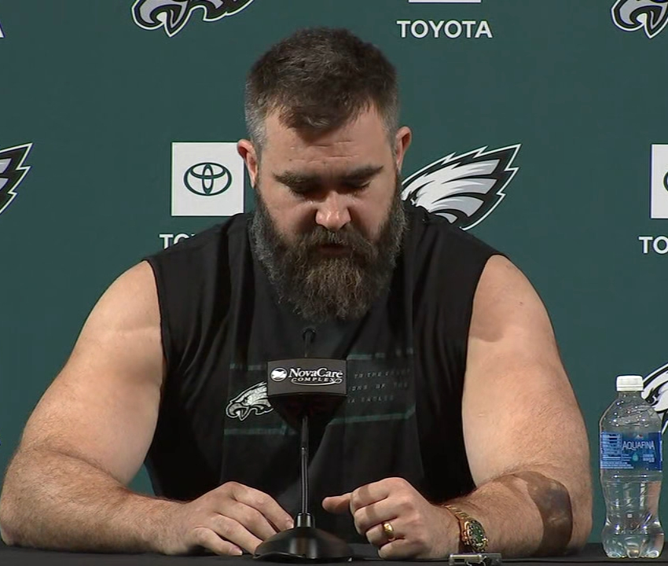
The Current Team
2022 Superbowl Loss + 2023 Late-season burn out
Offseason Loss Hall of Fame of Veterans
Exciting New Weapons + Coaches

Slide 4
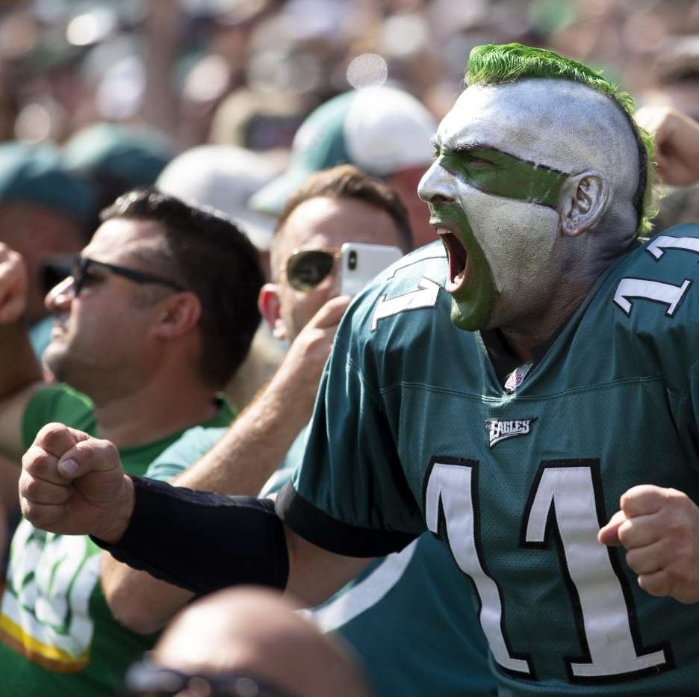
Why The Eagles Matter
There are ups and downs as an Eagles fan
The most passionate fanbase of any team
A sense of a community in a culturally diverse city

