Slide 1
Lab 5: Building PostgreSQL Server from Source Code
and
Modifying Source Code

Slide 2
Prerequisite Packages
SSH: http://www.ccs.uottawa.ca/download/ssh/ssh329.exe
click on the exe file and follow the instructions
PostgreSQL: http://www.postgresql.org/ftp/source/v9.0.0
choose the file postgresql-9.0.0.tar.gz
(The version we will be using is ver 9.0.0)
pgAdmin III: http://www.postgresql.org/ftp/pgadmin3/release/v1.8.4/win32/
choose the .zip file

Slide 3
Download/unzip
Log in the SITE UNIX computing environment using your site account and password
$ ssh Linux
$mkdir csi3130
  Install under the directory $HOME/csi3130
In your home directory, obtain the source zip file from (save to $HOME/csi3130)
http://wwwmaster.postgresql.org/download/mirrors-ftp/source/v9.0.1/postgresql-9.0.1.tar.gz
$cd home/infofa/h/users/you_user_name
$gunzip postgresql-9.0.1.tar.gz
    May take few minutes
$ tar xvf postgresql-9.0.1.tar
    Directory postgresql-9.0.1 will be created (with source codes)
    May take few minutes

Slide 4
Installation
Configure:
    On different systems, the C compiler might be in a different place, the program might need to know your host name and a whole bunch of other things. You used to do this configuring by editing Makefile.
  Create a pgbuild directory to store PostgreSQL binaries and libraries once they have been built
    $cd postgresql-9.0.1
    $./configure --prefix=$HOME/csi3130/pgbuild --enable-debug --enable-cassert --with-maxbackends=3
Make
    Build PostgreSQL
    $make
    Wait for this message:
    All of PostgreSQL successfully made. Ready to install.
Install
    Install PostgreSQL to $HOME/pgbuild directory
    $make install
    Wait for this message:
    PostgreSQL installation complete.

Slide 5
An Example of a Makefile
  all: createFolder
  first:
  gcc hello.c -o b.out
  ./b.out
  # *** File hello.c Compiled and executed ***
  createFolder:
  rm -rf newfolder
  mkdir newfolder
  second:
  gcc second.c
  ./a.out
  # *** File calculations.c Compiled and executed ***
  clean:
  rm -rf *.out
  rm -rf newfolder
  Try these examples and observe the output:
  make –f makefile-5.txt
  make –f makefile-5.txt first
  make –f makefile-5.txt clean
  make –f makefile-5.txt second
  make –f makefile-5.txt all
Note that Makefile has no extension.

Slide 6
Setup Environment
Set the PATH and LD_LIBRARY_PATH for PostgreSQL
$ cd <HOME directory>
$ vi .bashrc
Append the following to the file
    PATH=$HOME/csi3130/pgbuild/bin:$PATH
    export LD_LIBRARY_PATH=$HOME/csi3130/pgbuild/lib
logout the SSH and then login again
  $exit
  $ssh linux
check if you have set them up correctly
$ PATH
$ LD_LIBRARY_PATH

Slide 7
PostgreSQL multiuser database server
postmaster is the PostgreSQL multiuser database server.
In order for a client application to access a database it connects to a running postmaster.
The postmaster then starts a separate server process postgres to handle the connection.
The postmaster also manages the communication among server processes.

Slide 8
Running the Server
Before you can do anything, you must initialize a database storage area on disk (database cluster).
$ mkdir $HOME/csi3130/data
$ initdb -D $HOME/csi3130/data
Before anyone can access the database, you must start the database server.
  $ cd $HOME/csi3130/pgbuild/bin
  $ postgres -p <port-number> -D $HOME/csi3130/data
You might get this error:
    LOG: could not bind IPv4 socket: Address already in use
    HINT: Is another postmaster already running on port 5432? If not, wait a few seconds and retry.
    WARNING: could not create listen socket for "localhost"
    FATAL: could not create any TCP/IP sockets
  Try a different port!

Slide 9
Running the Server
Each of you should use different port number; to minimize the likelihood of conflicts, use number with 5 digits.
You may expect a message like this:
LOG: database system was shut down at 2008-10-21 23:34:14 EDT
  LOG: autovacuum launcher started
  LOG: database system is ready to accept connections
Use Control+C, in case you need to stop the server.

Slide 10
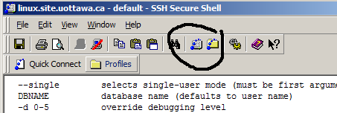
Running a PostgreSQL client
Open a new terminal window in SSH Secure Shell
Create a new database named ‘dbname’
$ createdb –p <your port-number> <dbname>
Run PSQL
$ psql -p <port-number> <dbname>
You may get this message:
    Welcome to psql 8.3.4, the PostgreSQL interactive terminal.
    Type: \copyright for distribution terms
    \h for help with SQL commands
    \? for help with psql commands
    \g or terminate with semicolon to execute query
    \q to quit
postgres=#

Slide 11
Working around the Database
You can now interactively create tables, insert data, and issue queries, etc.
Use the psql command \q to quit the client
<your database>#= create table Owns(Client-number char(30), Acc-number integer);
<your database>#= <insert rows from a file>
<your database>#= select * from Owns;

Slide 12
Inserting Data
If you have a single file with all of the inserts in it, from your postgres home directory use:
psql -d myDataBase -a -f myInsertFile
The -a parameter echos the results to the screen.
If your data file is just data (ie no SQL) use the COPY command from your home directory.
    COPY tablename [ ( column [, ...] ) ]
    FROM { 'filename' | STDIN }
    [ [ WITH ]
    [ BINARY ]
    [ OIDS ]
    [ DELIMITER [ AS ] 'delimiter' ]
    [ NULL [ AS ] 'null string' ]
    [ CSV [ HEADER ]
    [ QUOTE [ AS ] 'quote' ]
    [ ESCAPE [ AS ] 'escape' ]
    [ FORCE NOT NULL column [, ...] ]

Slide 13
Modifying Source Code
Before modifying any codes, make a backup copy of the original file, so that you can always undo your modifications.
Delete all files that are normally created by running the previous make, before making the modified code.
  In the postgresql-8.1.4 directory
  $ make clean (In the postgresql-9.0.1 directory)
  $ make install
gbd postgres can be used for debugging.

Slide 14
Debugging PostgreSQL
Print out debugging information using elog() (instead of printf())
  Example:
  elog (NOTICE, "script name: %s", script_name);
  elog (NOTICE, "script argc: %d", script_argc);

Slide 15
Exercise
Make and install the source code of postgresql-9.0.1.
Add simple log information in the code.
Make and install the modified source code.

Slide 16
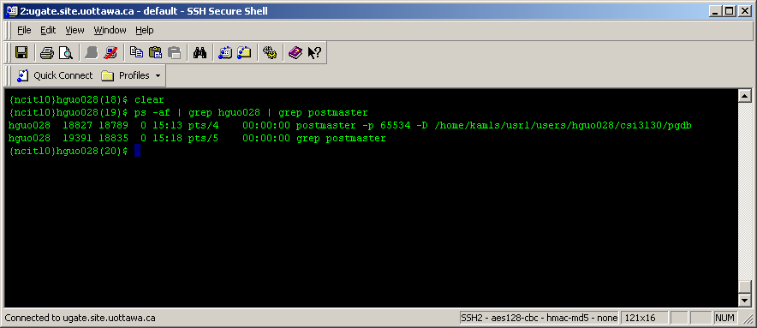
Debugging PostgreSQL (Cont’d)
Do not set the breakpoint in the postmaster process, it does not propagate to child backends.
Start the client psql job
Determine the PID of the backend serving it
  ps –af | grep <your user id> | grep postmaster
Start time
Process id

Slide 17
Debugging PostgreSQL (Cont’d)
Attach to that process in gdb
gdb postgres
attach <process-id>
…
Debugging with gdb
Quit gdb
  detach
  quit

Slide 18
Source code structure
All the source code at $HOME/postgresql-9.0.1/src
    /Backend
      /parser
      /optimizer
      /executor
      /catalog
      /storage
      /utils
Documentation of the files can be found at:
http://doxygen.postgresql.org/

Slide 19
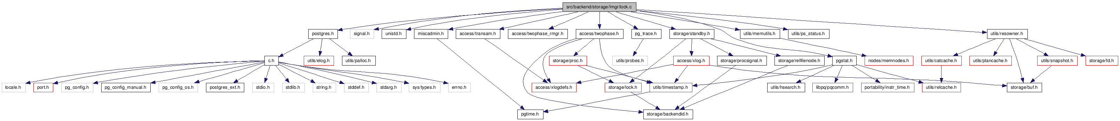
lock.c File Reference
Browse
http://doxygen.postgresql.org/lock_8c.html
Data Structures
struct | TwoPhaseLockRecord

Slide 20
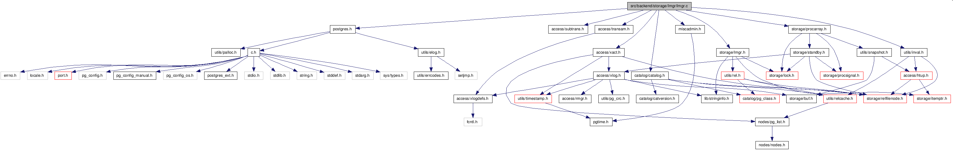
lmgr.c File Reference
Browse
http://doxygen.postgresql.org/lock_8c.html

