Slide 1
Diamonds Project

Slide 2
Yumna Al Shalak

Slide 3
The dataset :Diamonds
This classic dataset contains the prices and other attributes of almost 54,000 diamonds. It's a great dataset for beginners learning to work with data analysis and visualization.

Slide 4
price price in US dollars (\$326--\$18,823)
carat weight of the diamond (0.2--5.01)
cut quality of the cut (Fair, Good, Very Good, Premium, Ideal)
color diamond colour, from J (worst) to D (best)
clarity a measurement of how clear the diamond is (I1 (worst), SI2, SI1, VS2, VS1, VVS2, VVS1, IF (best))
x length in mm (0--10.74)
y width in mm (0--58.9)
z depth in mm (0--31.8)
depth total depth percentage = z / mean(x, y) = 2 * z / (x + y) (43--79)
table width of top of diamond relative to widest point (43--95)

Slide 5
The problem is Regression
Type of machine learning system: Supervised - Batch Learning - Model Based

Slide 6
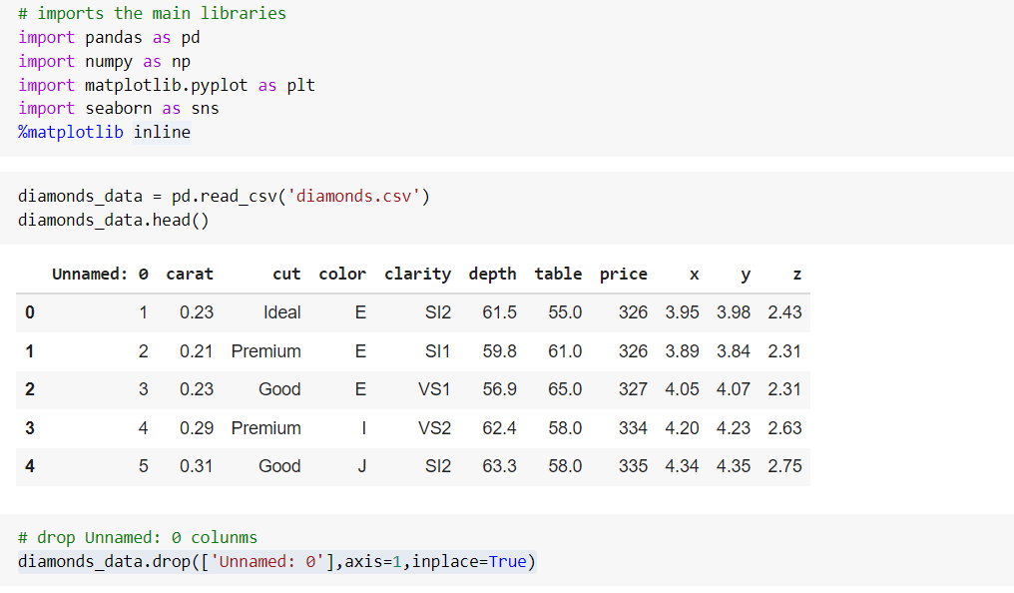
Get the data:

Slide 7
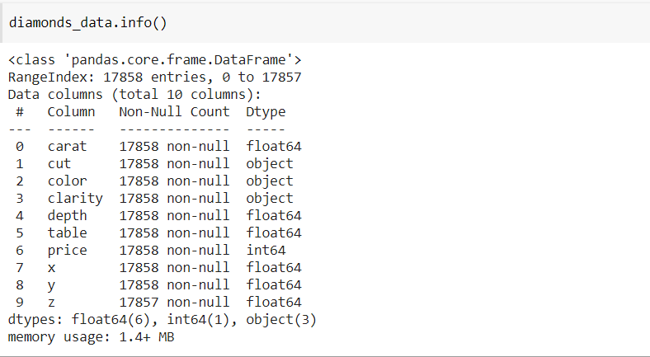
Discover and visualize the data
Data discovery:
from data information we don't have any null value in our data

Slide 8
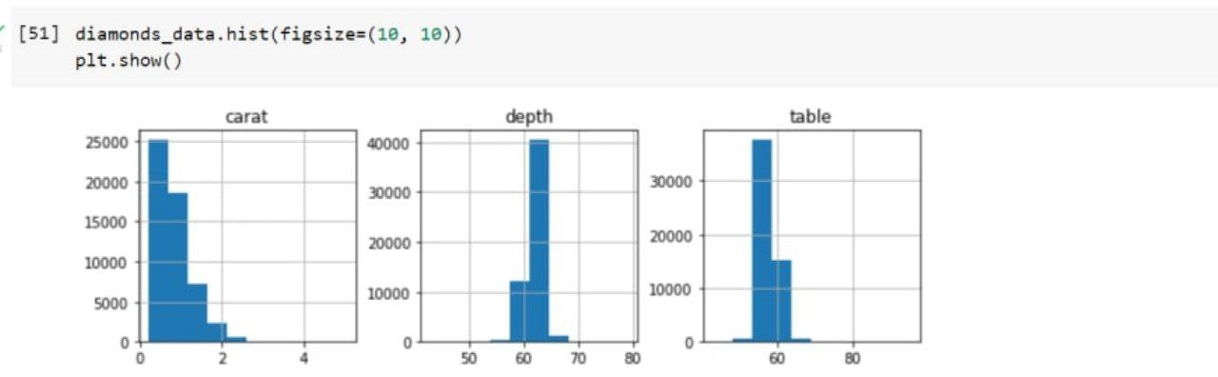
Discover and visualize the data
Data visualization:
Create a hist plot for diamonds dataframe as shown down

Slide 9
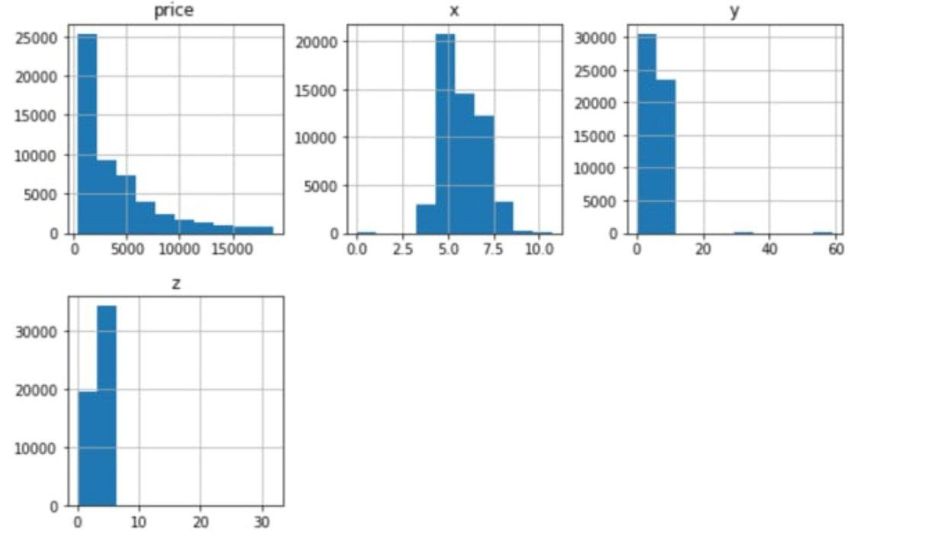
Discover and visualize the data
Data visualization:

Slide 10
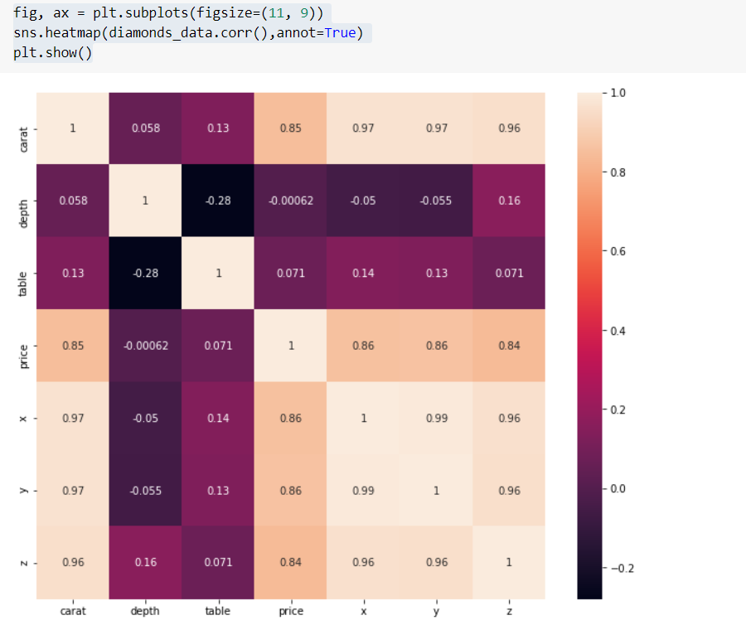
Discover and visualize the data
Data visualization:
Carat has a strong relationship to price
x, y and z have a very strong relationship with price but surprisingly depth (which comes from x, y and z) has little to do with price.

Slide 11
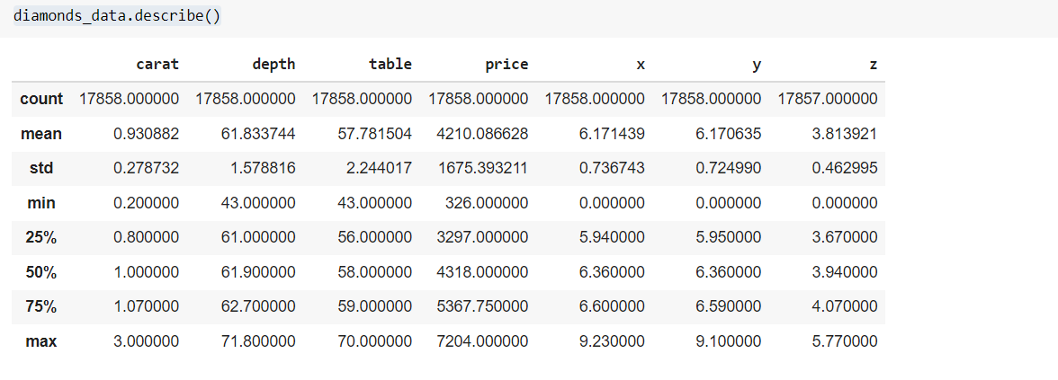
Title Prepare the data for machine learning algorithms
The minimum values for x,y and z here are 0 but it is not possible because according to the data description they are the length, width and depth

Slide 12
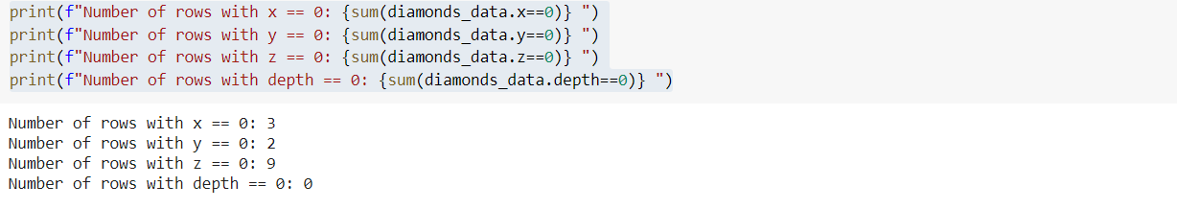
Title Prepare the data for machine learning algorithms
A zero value in these rows means that data is lost, so we can replace the zeros with nan after that we will drop nan values .

Slide 13
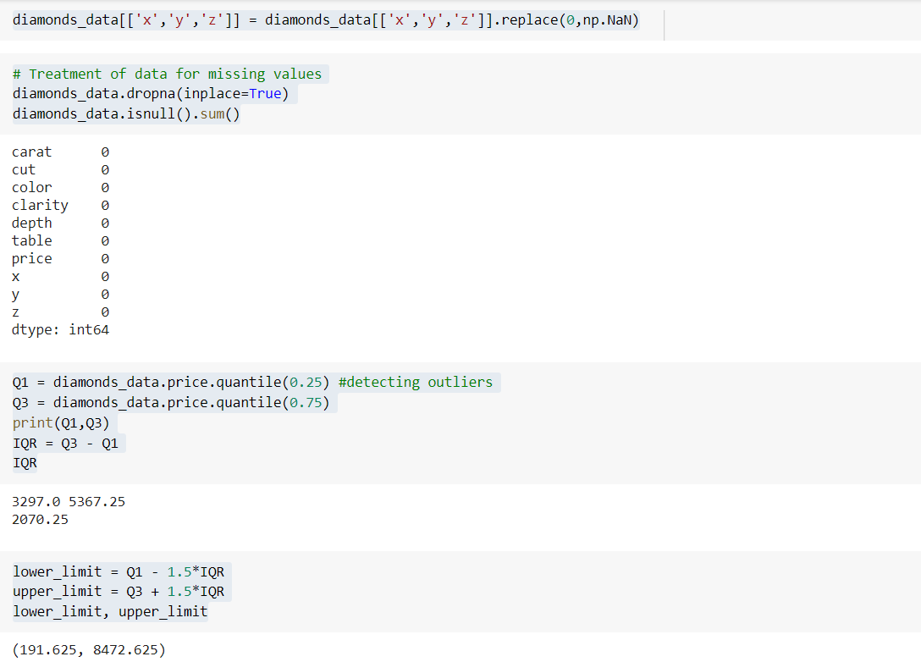
Title Prepare the data for machine learning algorithms

Slide 14
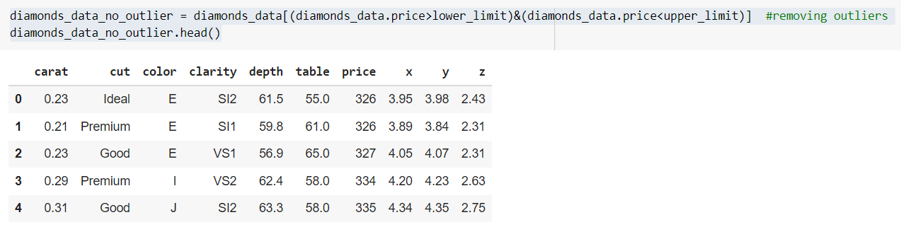
Title Prepare the data for machine learning algorithms

Slide 15
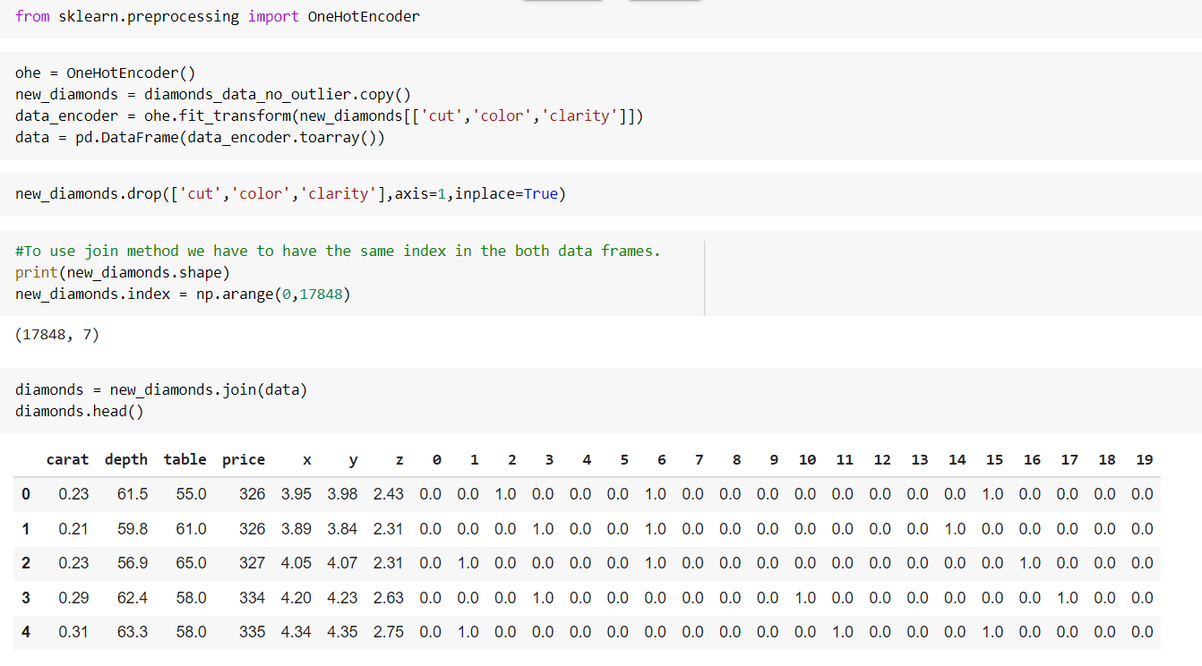
One hot encoding

Slide 16
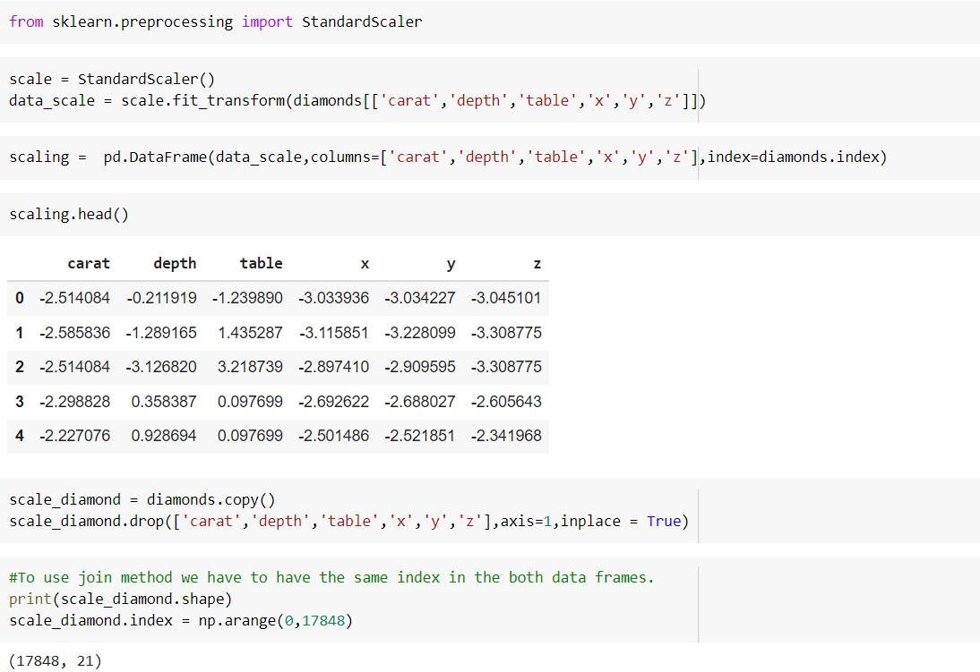
Data Scaling

Slide 17
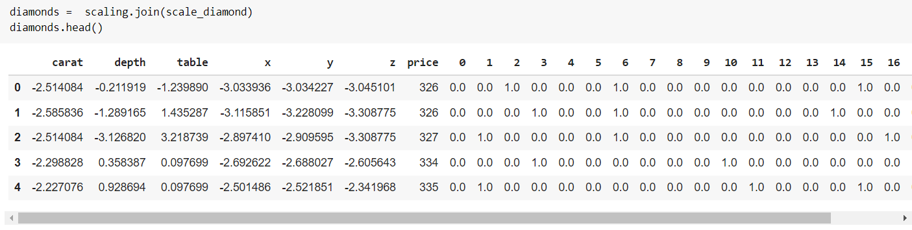
Data Scaling

Slide 18
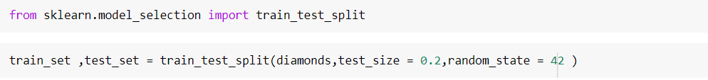
Model Training
Split diamond data into train and test set

Slide 19
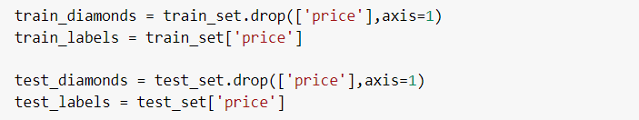
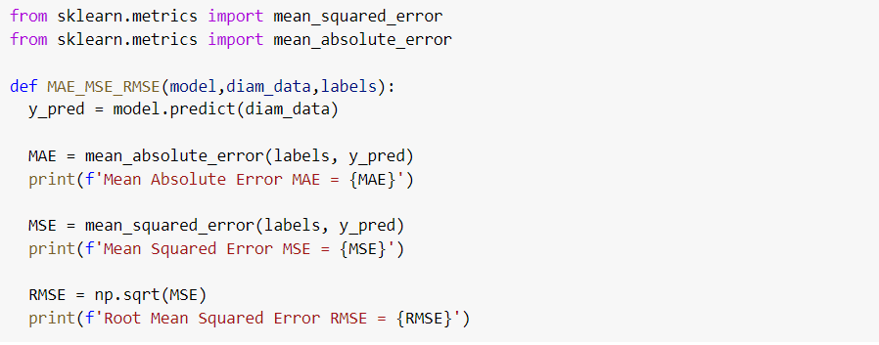
Model Training
Split diamond data into data & labels

Slide 20
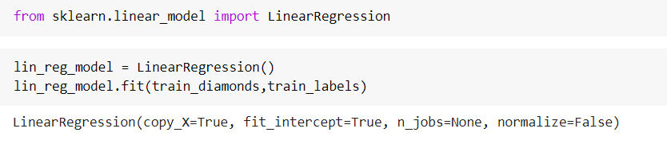
Model Training
Regression model

Slide 21
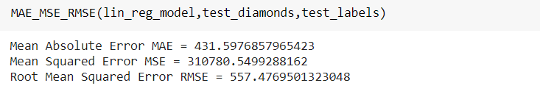
Model Training
Evaluate model:
MAE & MSE & RMSE:

Slide 22
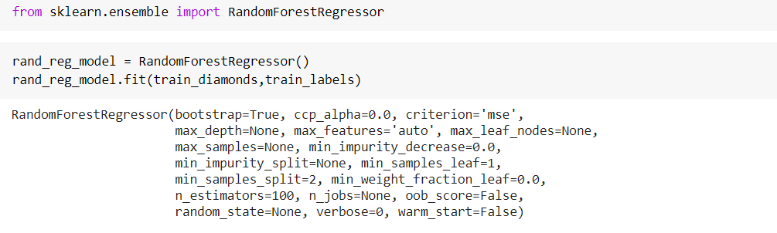
Model Training
Random forest model:

Slide 23
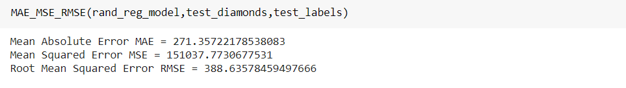
Model Training
Evaluate model:
MAE & MSE & RMSE:

Slide 24
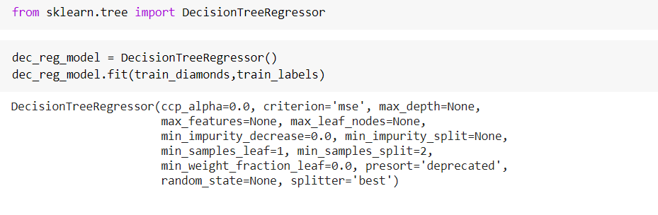
Model Training
DecisionTree Regressor model:

Slide 25
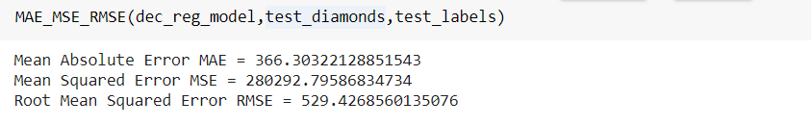
Model Training
Evaluate model
MAE & MSE & RMSE

Slide 26
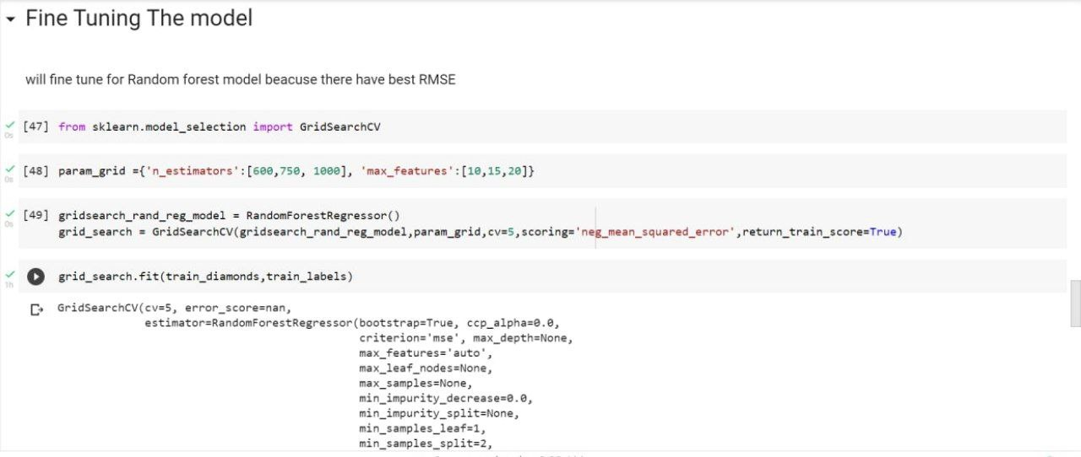
Model Training
Fine Tuning The model

Slide 27
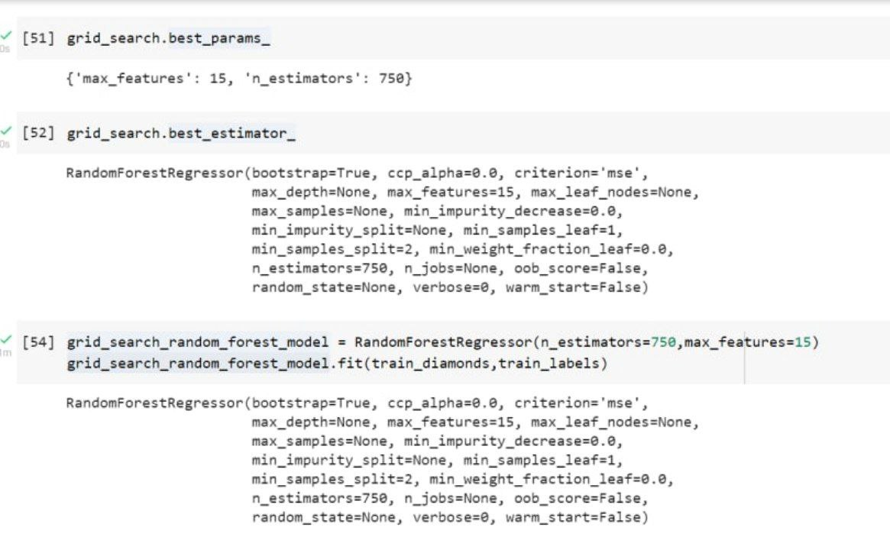
Model Training
Fine Tuning The model

Slide 28
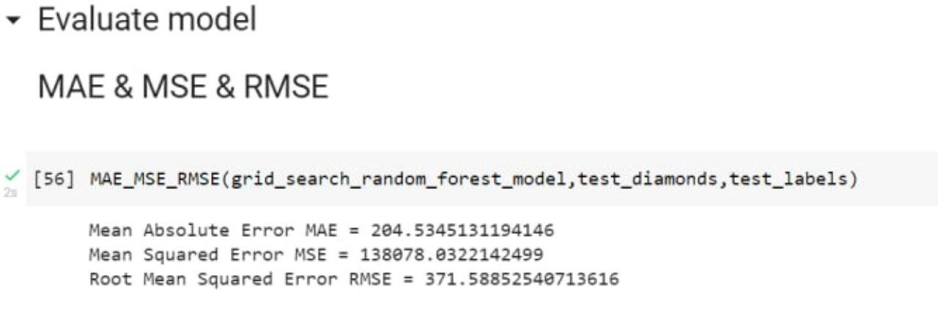
Model Training
Evaluate model
MAE & MSE & RMSE

