Slide 1
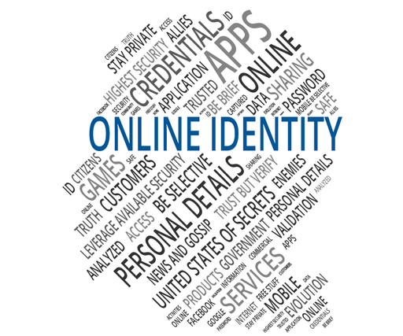
HOW REAL IS YOUR
ONLINE PERSONALITY?
An Analysis of Online vs Real life Personas

Slide 2

Group Members
Zaineb
Iqra Sarfraz
Yumna Bint E Akhtar
Meerab Usman
Ayesha Sarwar
2025-CS-244
2025-CS-255
2025-CS-260
2025-CS-275
2025-CS-281

Slide 3

Introduction
In the modern digital age, social media plays a central role in daily life, fundamentally influencing how we connect with others and express our identities. This presentation explores a key question: how authentic is the personality we project online compared to our true, offline selves? By analyzing user behavior and self-perception, we seek to understand the relationship between our digital and real-world identities.

Slide 4

Research Objectives
Compare real-life vs online behaviors.
Understand why people modify their personality online.
Explore how authenticity changes on social platforms.
Determine whether online identity boosts self-expression or hides insecurities.

Slide 5
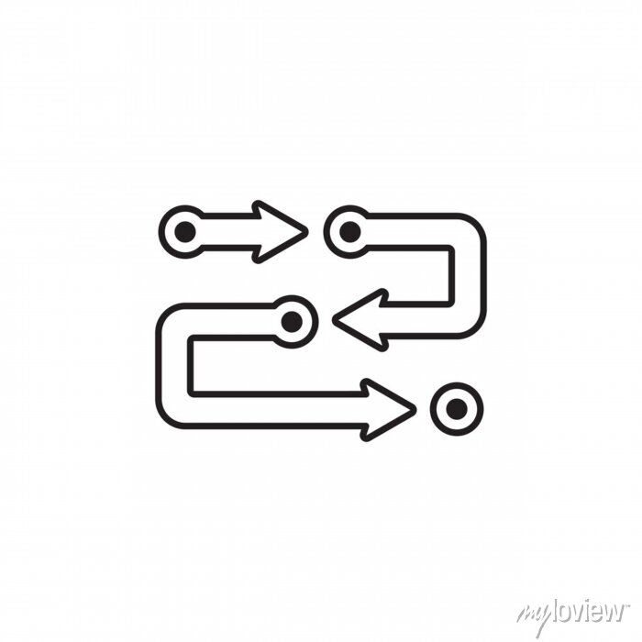
Methodology
A survey was conducted to gather data on online behavior and self-perception.
Respondents were asked questions about their social media usage, identity presentation, and confidence.
Key topics included the use of real names and photos, the similarity between online and real-life personalities, and how often content is edited.
The collected data was analyzed and visualized using charts and graphs to identify trends and patterns.

Slide 6

Graphical Representation
Majority of respondents were 18–25 years old.
The next largest group was under 18 years.
6% of responses came from 26–35 years old.
Only 3% of respondents were 35+ years old.
The majority of respondents were female, while a smaller portion were male.

Slide 7
Most respondents only sometimes use their real name and photo online, showing a preference for partial anonymity.
While a significant majority often edits content, a notable segment of respondents “Never” filter their posts, suggesting a preference for complete authenticity online.

Slide 8
The results show that 54% of respondents feel more confident on social media, while 45% feel more confident in real life. This indicates that both views are almost equally represented, with a slight tilt toward online confidence.
Most respondents believe they are what they present themselves online while a very few people disagree with authenticity of their online personality.

Slide 9
The data shows that most people feel their online personality is very similar to their real-life one, with only a small minority believing it is significantly different.
The pie chart shows that 37% of respondents believe their real-life version is better than their online personality.

Slide 10
📉Survey Questions and Responses
Questions | Answers
What motivates you to use social media everyday? | Most respondents said they use social media to pass time or for entertainment, while some use it to share their creativity.
How often do you post content (photos, updates, videos) online? | According to the survey, 52% of respondents said they sometimes post online, 25% never post, and 14% post often.
Do you think people judge others on based on their online personality? | Almost half(45.5%) respondents think people judge others while others were unsure about it.
How do you think people should represent themselves on social media? | Some respondents believe people should present themselves as they truly are, while others think they should present themselves in whatever way feels comfortable.

Slide 11

Findings
Level of Authenticity:
The majority of participants do not behave 100% the same online as in real life. This indicates that online spaces allow selective self-presentation.
Confidence Factor:
The data suggests that online platforms give users a sense of safety, making them more confident and expressive.
Social Image Building:
Many respondents intentionally present a polished version of themselves (enhanced self-presentation, highlighting select achievements). This shows that social platforms promote impression management.
Privacy Concerns:
Some participants are cautious about oversharing or receiving negative feedback, leading them to hide personal traits. This illustrates how social pressures influence online behavior.

Slide 12
📜Analysis / Interpretation
Most people do not present their full, real selves online.
Many participants said they sometimes edit their posts or act differently to appear more confident or likable.
This shows that social media often encourages people to show a “best version” of themselves rather than their true personality.
Some participants also shared that being online gives them the freedom to express thoughts they cannot share in real life.
Therefore, while the internet can create fake or improved impressions, it can also allow people to reveal hidden parts of their personality.

Slide 13
🏷️ Conclusion
In conclusion, the survey reveals a strong trend toward authenticity, with a majority of users presenting an online personality that closely mirrors their real-life identity and using their original photos. However, the data also shows a nuanced reality, where a significant portion of individuals feel more confident online or occasionally adapt their image for reasons of privacy, comfort, or social perception. This indicates that while the digital self is largely genuine, it can also be a subtly curated version of reality.

