Slide 1
COVID-19 Global Data Analysis
🌍
📊 Dataset: Worldometer COVID-19 Data
Source: Kaggle
📅 Date: April 2026
🛠 Tools: Python · Pandas · NumPy · Matplotlib
ITI Power BI Development Track

Slide 2
Project Overview
🎯 Problem Statement
📦 Dataset
Analyze global COVID-19 data to uncover trends in confirmed cases, deaths, and recoveries across countries.
Worldometer data sourced from Kaggle — includes cases, deaths, recoveries, active cases, tests, and population by country.
🔍 Scope
💡 Goal
Country-level analysis covering all continents with engineered features like death rate, recovery rate, and per-million metrics.
Identify high-risk regions, key health indicators, and actionable insights to support data-driven healthcare decisions.

Slide 3
Dataset at a Glance
Key metrics and engineered features from the cleaned dataset
🌐
🗺️
📋
209
6
16
Countries / Regions
Continents Covered
Features in Dataset
⚙️
✅
🔧
4
0
Mode-Median-Zero
Engineered Rates
Duplicate Records
Null Imputation Method

Slide 4
Engineered Features & Derived Metrics
Death Rate
Recovery Rate
Active Rate
TotalDeaths / TotalCases
TotalRecovered / TotalCases
ActiveCases / TotalCases
Measures the fatality ratio — key indicator of healthcare system strain.
Proportion of recovered patients — reflects healthcare capacity.
Share of currently active cases — signals ongoing transmission pressure.
Tests Rate
Cases/1M Pop
Deaths/1M Pop
TotalTests / TotalCases
TotalCases / Population × 1,000,000
TotalDeaths / Population × 1,000,000
Testing intensity — higher rates indicate better surveillance capability.
Normalizes cases by population for fair cross-country comparison.
Population-adjusted mortality — better severity indicator than raw totals.

Slide 5
Data Pipeline & Preprocessing
01
02
03
04
05
Load & Inspect
Fix & Clean
Handle Nulls
Feature Engineering
Type Casting
Read worldometer_data.csv with Pandas. Ran .info(), .describe(), and .head() to understand structure and types.
Renamed 'Country/Region' → 'Country'. Dropped high-null columns (NewCases, NewDeaths, NewRecovered).
Filled categorical columns (Continent, WHO Region) with mode. Filled numeric columns (Population, Deaths, etc.) with median.
Computed DeathRate, RecoveryRate, ActiveRate, Tests/1M pop, Cases/1M pop, and Deaths/1M pop.
Cast all numeric columns to int for consistency.
›
›
›
›

Slide 6
EDA: Correlations
Tests vs Total Cases
Tests vs Recovered Cases
Strong positive correlation — more tests correlate with more detected cases.
Similar positive trend — higher testing enables more recoveries to be tracked.
Recovery Rate vs Death Rate
Active vs Critical Cases
Inverse relationship — countries with high recovery rates generally have lower death rates.
Strong linear link — countries with high active caseloads report more critical/serious cases.

Slide 7
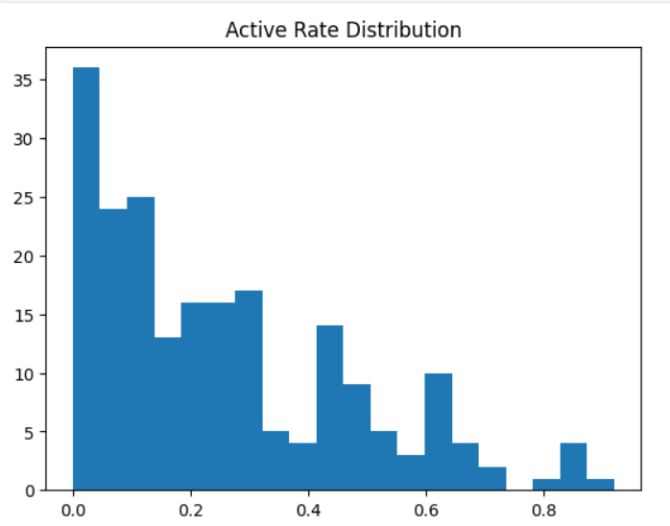
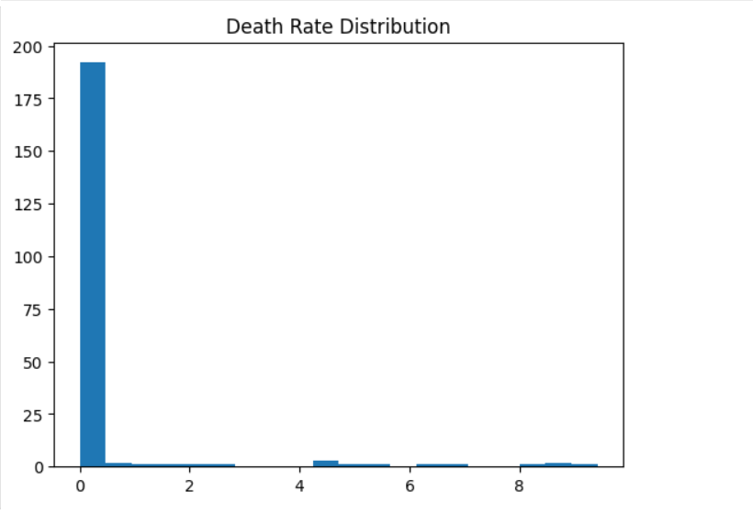
EDA: Distributions
Active Rate Distribution
Death Rate Distribution
Most countries had active rates between 0.1–0.2, while death rates were concentrated in the 1–2% range.

Slide 8
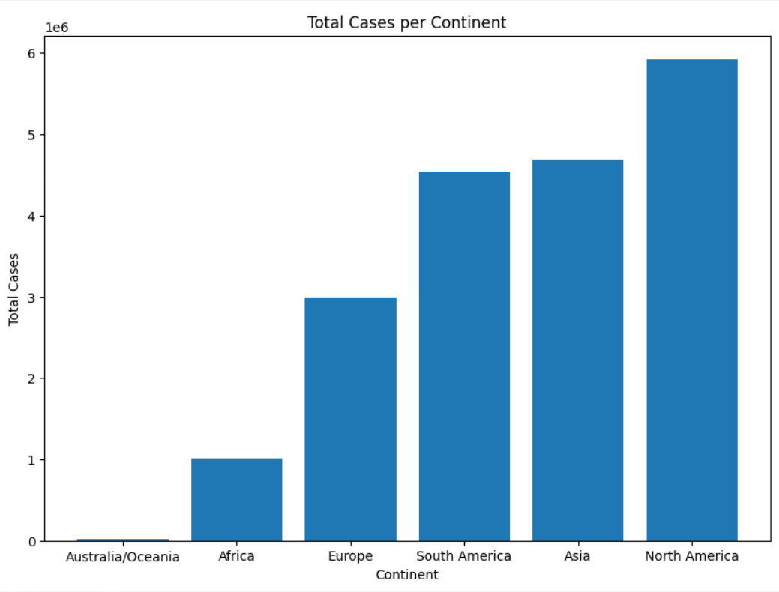
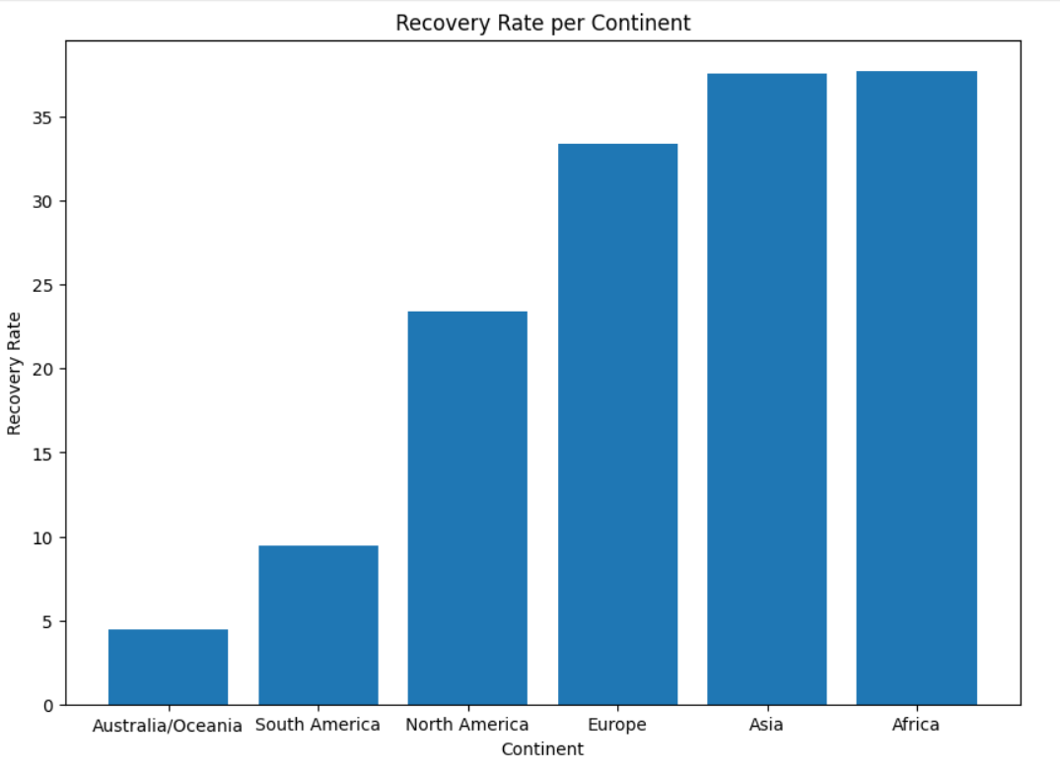
Continental Analysis
Total Cases per Continent
Recovery Rate per Continent
1
Asia & N. America had the highest total case counts
2
Africa showed highest recovery rate

Slide 9
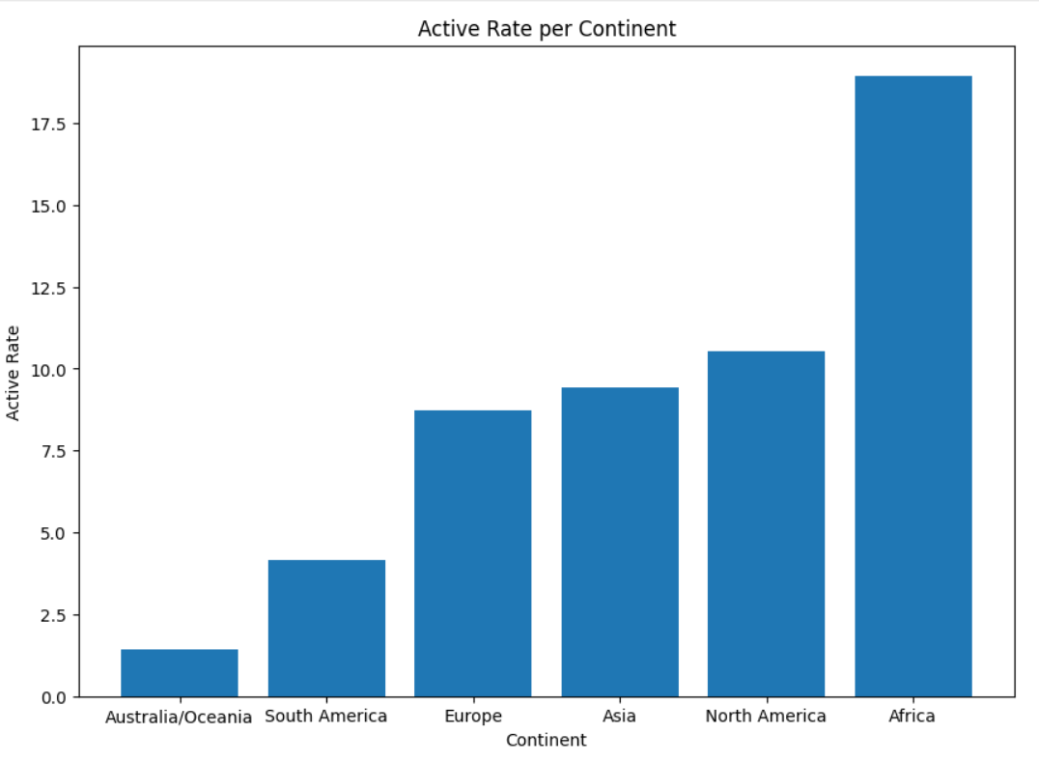
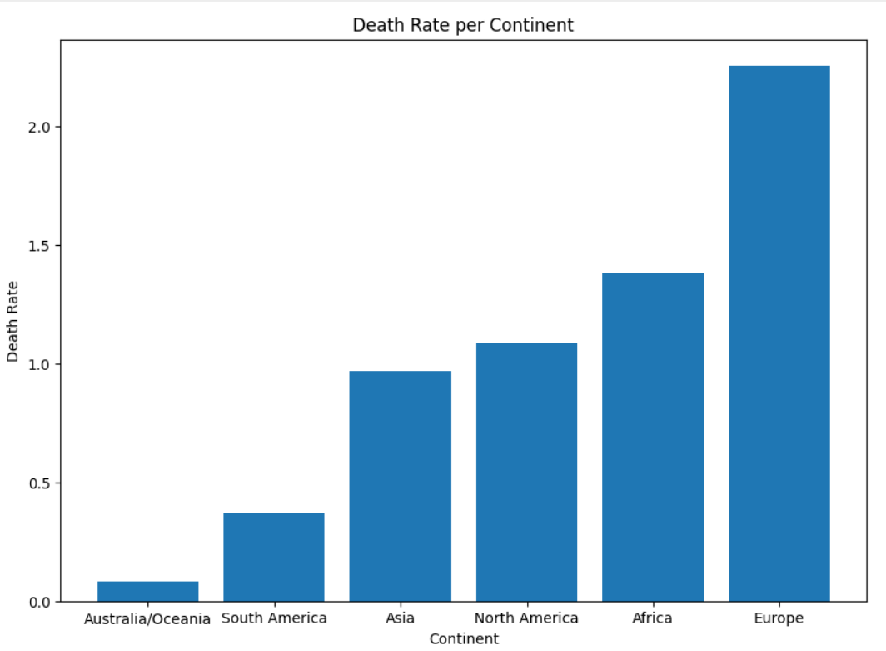
Continental Analysis
Active Rate per Continent
Death Rate per Continent
3
Africa & N. America had the highest active rate
4
Europe showed highest death rate

Slide 10
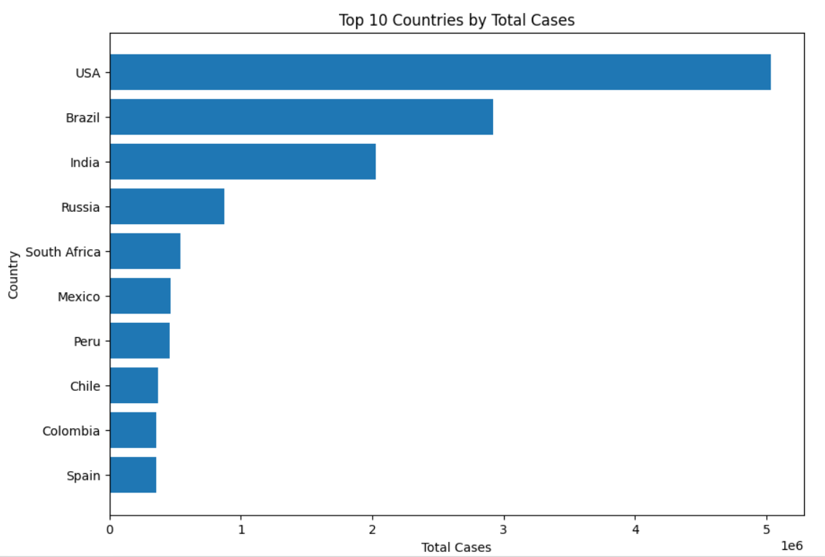
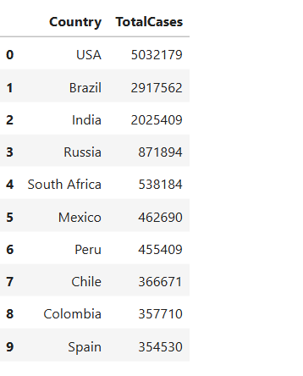
Top 10 Countries – Total Cases
Country Spotlight

Slide 11
Insights & Recommendations
🔍 Key Insights
📌 Recommendations
→ Continent with high cases tend to have higher death rate
1
Focus healthcare resources on high-risk, high-death-rate countries
→ Death rate varies significantly across Continent
2
Monitor death rate as a primary KPI alongside active cases
→ Some Continent show strong recovery performance
→ USA led all countries with 5.03M cases— far ahead of Brazil (2.9M) and India (2.0M)
3
Improve data reporting consistency across regions for better comparisons
4
Invest in testing capacity — it directly enables accurate case tracking

Slide 12
Thank You
COVID-19 Global Data Analysis

