Slide 1

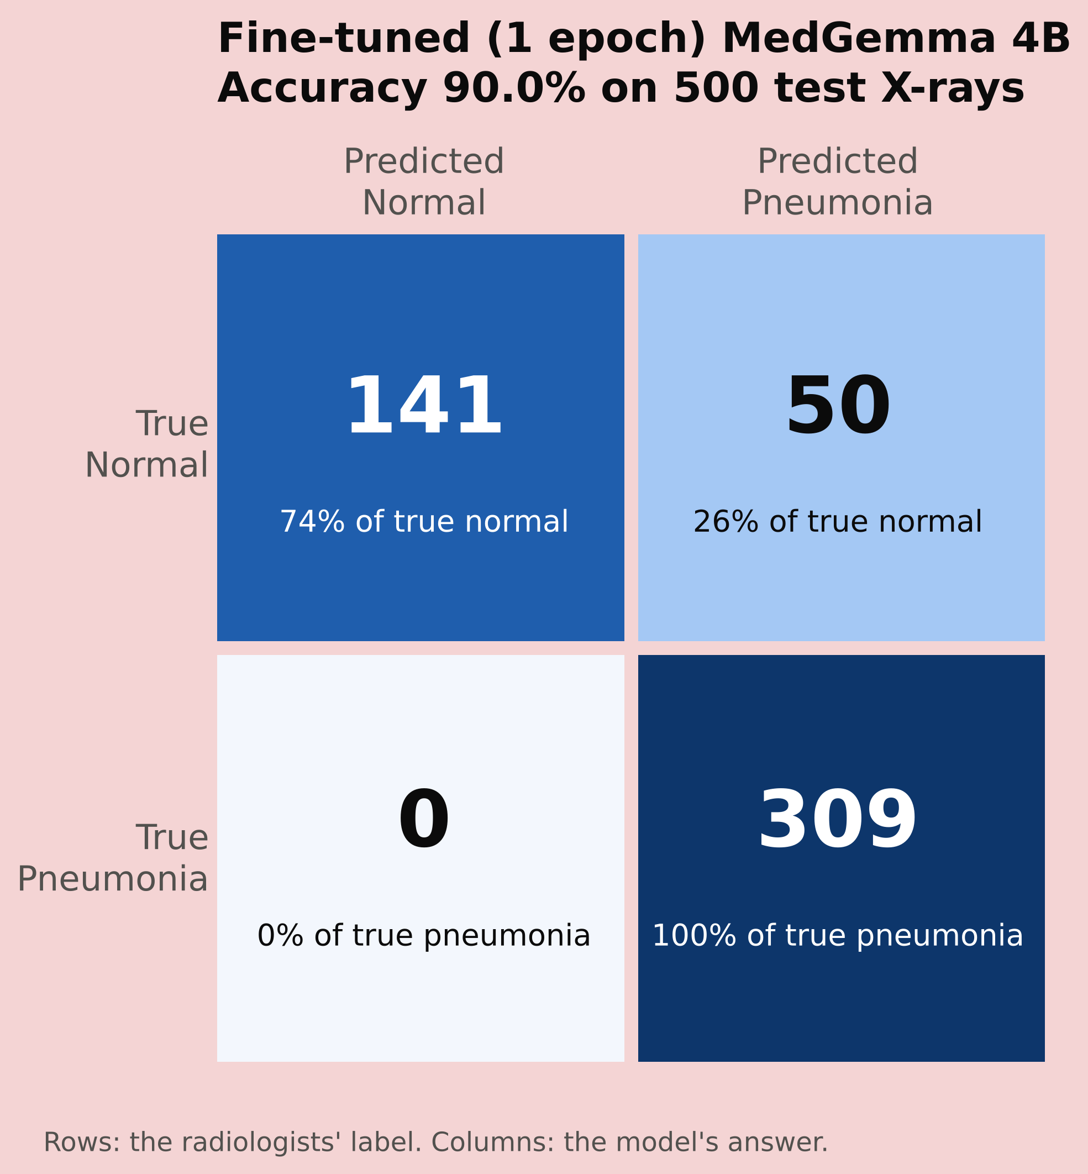
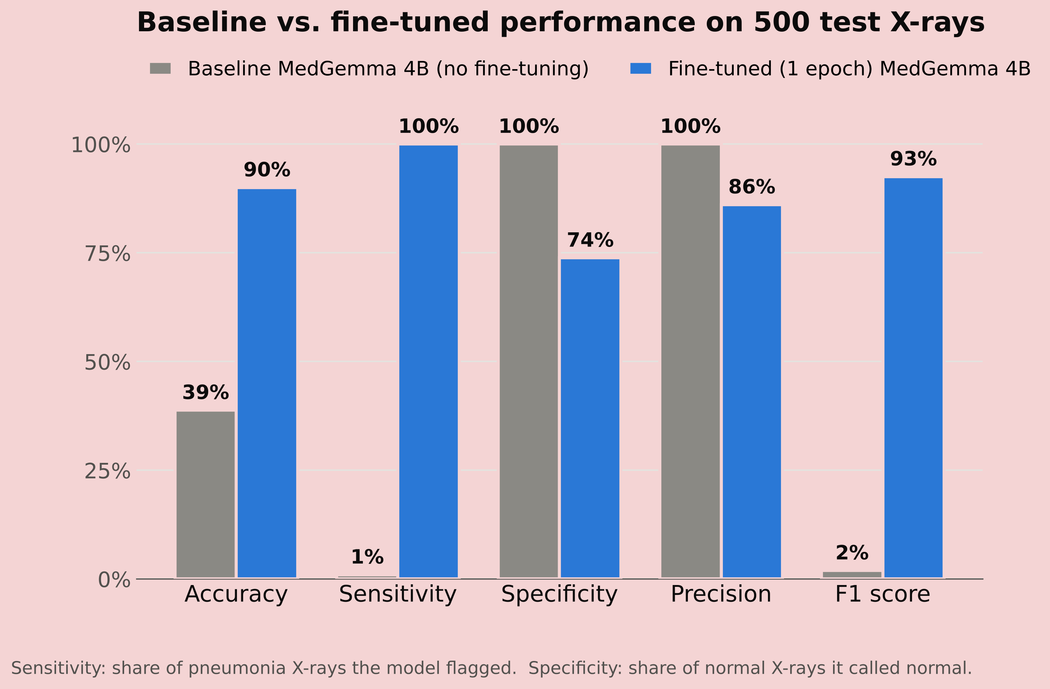
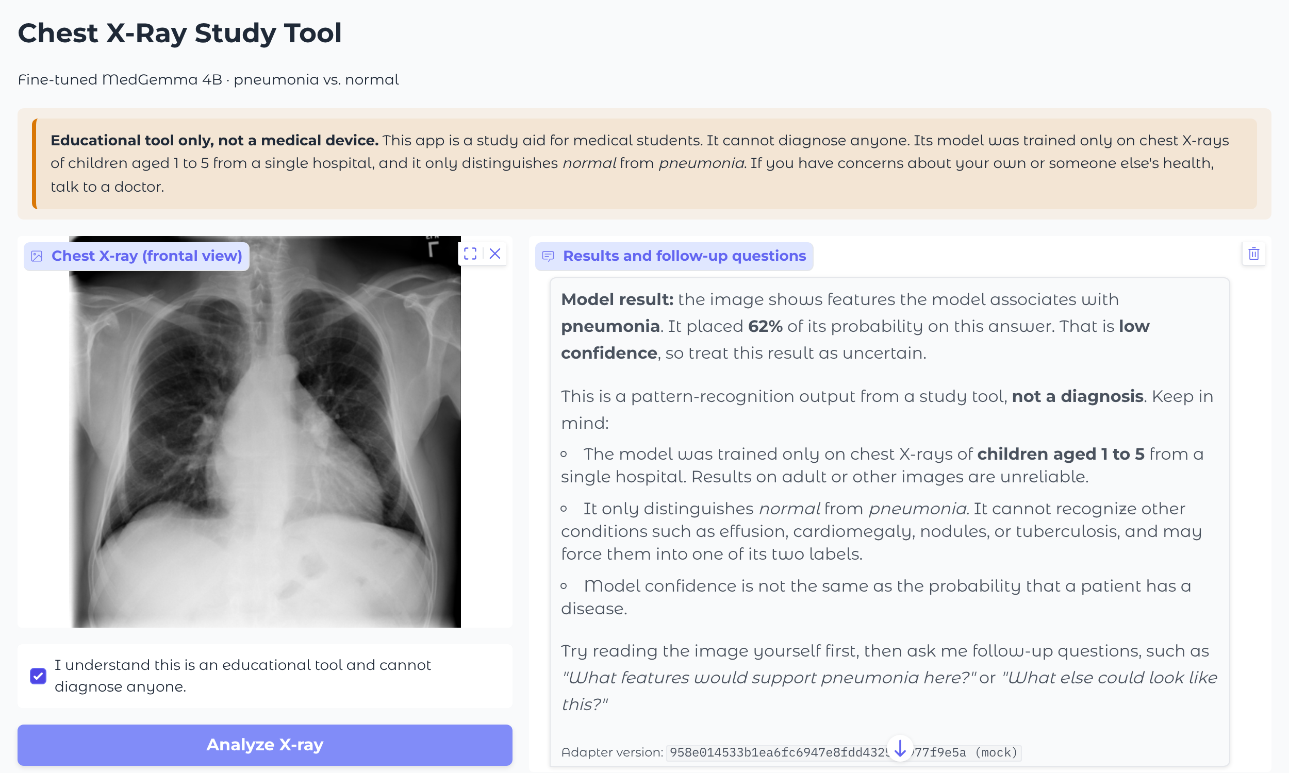
Fine-Tuning MedGemma to Detect and Explain Pneumonia on Chest X-Rays
Yumna Hussain
Department of Computer Science, University of Illinois Chicago
Introduction
Results
Conclusions
Reading chest X-rays is a core skill for medical students, but it is learned slowly, through many supervised examples. Pneumonia is one of the most common findings, yet its signs can be subtle and easy to confuse with normal variation.
Medical vision-language models such as Google's MedGemma can look at an image and answer questions about it, which makes them a natural fit for a study tool. Out of the box, however, they are not tuned for any single task, and their answers can sound more certain than the evidence supports.
Purpose
To fine-tune MedGemma 4B to detect pneumonia on chest X-rays, and connect it to a chatbot that explains its findings in plain language. The tool is meant as a study aid for medical students, not a diagnostic system.
Before fine-tuning, MedGemma 4B almost never recognized pneumonia: it flagged only 3 of 309 pneumonia X-rays.
One epoch of QLoRA fine-tuning raised accuracy from 38.8% to 90.0% (F1 0.02 to 0.93). It caught all 309 pneumonia cases and correctly called 141 of 191 normal X-rays normal (Fig. 1–2).
Eight epochs did worse (77.6% accuracy): it still caught every pneumonia case, but called 112 of 191 normal X-rays pneumonia.
Validation loss stopped improving after epoch 1.
Model | Accuracy | Sensitivity | Specificity | F1
Base | 38.8% | 1.0% | 100% | 0.019
1 epoch | 90.0% | 100% | 73.8% | 0.925
8 epochs | 77.6% | 100% | 41.4% | 0.847
One epoch of fine-tuning turned a general medical model into a strong pneumonia classifier on this dataset (38.8% to 90.0% accuracy). Training longer did not help: by epoch 8 the model over-called pneumonia even more, and the 16-image validation set was too small to catch it.
Limitations
Only children aged 1–5 from one hospital
Only two labels (normal vs. pneumonia)
No heatmap yet, so we can't confirm which parts of the image the model uses
Ethical considerations
Users may treat the output as a diagnosis
Fluent explanations can make wrong answers more convincing
Accuracy may be uneven across patient groups
Future work
Rate the chatbot's explanations for reading level and with blinded human reviewers, add Grad-CAM heatmaps, and test on adult X-rays.
Table 1: All three models scored on the same 500 test X-rays (309 pneumonia, 191 normal). Pneumonia is the positive class.
Methods & Materials
Figure 1: Confusion matrix for the 1-epoch model on 500 test X-rays (309 pneumonia, 191 normal).
Figure 2: Base vs. 1-epoch fine-tuned model on the same 500 test X-rays. Fine-tuning traded some specificity for sensitivity.
References
Dataset
Pediatric chest X-rays from Kermany et al. (2018): 5,856 images labeled normal or pneumonia, from children aged 1–5 at one hospital. 4,000 images were used for training and 500 for testing.
Fine-tuning
Model: MedGemma 4B (multimodal)
QLoRA: 4-bit weights, LoRA rank 16, learning rate 2e-4
Prompt: “Does this chest X-ray show signs of pneumonia?” with options A: No / B: Yes
Training: 8 epochs on Google Colab Pro, with the model saved after epoch 1 and epoch 8
Why quantization?
Training at full precision ran out of GPU memory. Storing weights in 4 bits, and running test images one at a time, made the model fit.
Evaluation
Accuracy and F1 score (pneumonia = positive class), base model vs. fine-tuned model.
Dettmers, T., et al. (2023). QLoRA: Efficient finetuning of quantized LLMs. NeurIPS.
Hu, E. J., et al. (2022). LoRA: Low-rank adaptation of large language models. ICLR.
Kermany, D. S., et al. (2018). Identifying medical diagnoses and treatable diseases by image-based deep learning. Cell, 172(5).
Sellergren, A., et al. (2025). MedGemma technical report. arXiv:2507.05201.
Zech, J. R., et al. (2018). Variable generalization performance of a deep learning model to detect pneumonia in chest radiographs. PLOS Medicine, 15(11).
Code: github.com/yumnahussain/pneumonia-xray-detection
Study Tool
Users upload an X-ray, see the fine-tuned model's reading, and ask follow-up questions. Follow-ups are answered by the base model, which keeps MedGemma's ability to explain.
Safety layers
Must confirm it is an educational tool before anything runs
Rejects uploads that are not chest X-rays
Hedged result with a confidence score (under 75% is flagged as low)
Emergency or self-harm messages get a fixed 911 / 988 reply
Overconfident wording is softened and doses are removed
Acknowledgements
I would like to thank my faculty advisor, Dr. Natalie Parde, for her guidance throughout this project, and my Honors College faculty fellow, Dr. Joseph Walker, for his guidance throughout my time in the Honors College and at UIC. I would also like to thank the Department of Computer Science and the Honors College at the University of Illinois Chicago for their support.
Figure 3: The Gradio web app (shown with its built-in test model).

