Slide 1
BEVSpread: Spread Voxel Pooling for Bird’s-Eye-View Representation in Vision-based Roadside 3D Object Detection

Slide 2
PDF 條列摘要（第 1 部分）
- - The paper introduces BEVSpread, a novel voxel pooling strategy for vision-based roadside 3D object detection, aiming to mitigate the position approximation error often overlooked in existing methods that primarily focus on depth or height estimation in 2D-to-3D mapping. This error significantly impacts the accuracy of 3D object localization.
- - BEVSpread addresses the position approximation error by spreading the image features of a frustum point across surrounding BEV grids, instead of aggregating them solely to the central grid. The weights assigned to these surrounding grids are dynamically adjusted based on distance and depth, prioritizing information from nearby grids and compensating for the reduced feature richness of distant objects.

Slide 3
PDF 條列摘要（第 2 部分）
- - The proposed weight assignment scheme in BEVSpread incorporates two key principles: weight decay with distance, which preserves location information for better learning; and depth-dependent weighting, which assigns larger weights to surrounding grids for distant objects to compensate for their smaller feature representation in the image.
- - An intuitive experiment is presented to demonstrate that the network can effectively learn precise position coordinates from the BEV features generated by BEVSpread. This experiment visually confirms the effectiveness of the proposed spread voxel pooling in improving position accuracy.

Slide 4
PDF 條列摘要（第 3 部分）
- - Experimental results on the DAIR-V2X-I dataset showcase the superior performance of BEVSpread compared to state-of-the-art methods. Specifically, it achieves significant improvements in Average Precision (AP) across vehicle, pedestrian, and cyclist detection categories, with AP gains of 1.12, 5.26, and 3.01 respectively. This quantitatively validates the effectiveness of the proposed approach.
- - The core idea of BEVSpread lies in its improvement over traditional voxel pooling. Traditional methods directly aggregate features to a single grid, resulting in significant position error. BEVSpread's spread operation significantly reduces this Mean Squared Error (MSE), decreasing it from 0.095 to 0.003 in their experiments, highlighting the effectiveness of the proposed method in mitigating the position approximation error inherent in traditional voxel pooling.

Slide 5
PDF 詳細整理（第 1 部分）
## BEVSpread: Spread Voxel Pooling for Bird’s-Eye-View Representation in Vision-based Roadside 3D Object Detection - Detailed Summary This paper introduces BEVSpread, a novel voxel pooling strategy designed to improve the accuracy of vision-based roadside 3D object detection. The authors address the limitations of existing methods in accurately mapping 2D image features to a Bird's Eye View (BEV) representation, specifically focusing on the positional approximation error inherent in traditional voxel pooling.

Slide 6
PDF 詳細整理（第 2 部分）
**1. Background:** Existing 3D object detection methods, predominantly focusing on ego-vehicle perspectives, suffer from limited perception range and blind spots. Roadside 3D object detection, utilizing cameras mounted on poles, offers advantages in overcoming these limitations by providing a broader, less occluded view of the surrounding environment. While progress has been made in depth and height estimation for 2D-to-3D mapping, the positional accuracy during the voxel pooling stage – the process of aggregating image features into a BEV representation – remains a significant challenge. The paper highlights that current voxel pooling methods often approximate the position of features, leading to inaccuracies that negatively impact detection performance. The goal of this research is to propose a new voxel pooling method that mitigates this positional approximation error, ultimately enhancing the accuracy of roadside 3D object detection.

Slide 7
PDF 詳細整理（第 3 部分）
**2. Methods:** BEVSpread tackles the positional approximation error by employing a "spread" voxel pooling strategy. Unlike traditional methods that map image features from a frustum point to a single corresponding BEV grid cell, BEVSpread distributes these features across *neighboring* BEV grid cells. This distribution is weighted, with weights dynamically determined by a function considering both the distance and depth of the frustum point. The weight function is designed to decay with increasing distance, ensuring that closer grid cells receive higher weights, and to increase with depth, reflecting the larger 3D size represented by deeper, more distant objects. This allows for a more accurate representation of the object's position in the BEV space. The authors also utilize CUDA parallel acceleration to maintain comparable inference speed to the original voxel pooling method. The core innovation lies in this adaptive weighting scheme that explicitly addresses the positional imprecision inherent in the original voxel pooling approach.

Slide 8
PDF 詳細整理（第 4 部分）
**3. Results:** The paper presents experimental results on the DAIR-V2X-I dataset. A key finding is a significant performance improvement achieved by BEVSpread compared to state-of-the-art methods. Specifically, BEVSpread shows a considerable margin of improvement in Average Precision (AP) across different object categories: (1.12, 5.26, 3.01) AP increase for vehicles, pedestrians, and cyclists, respectively. Furthermore, a proof-of-concept experiment demonstrates the ability of the network to learn accurate positional coordinates from the spread BEV features. This experiment visually confirms the effectiveness of the spread pooling in reducing the positional error. Quantitative results, such as a reduction in Mean Squared Error (MSE) loss from 0.095 to 0.003 when comparing original and spread voxel pooling, further supports the method's efficacy in improving positional accuracy.

Slide 9
PDF 詳細整理（第 5 部分）
**4. Conclusion and Discussion:** BEVSpread offers a significant contribution to the field of vision-based roadside 3D object detection by effectively addressing the positional approximation error in the voxel pooling process. The adaptive weighting scheme based on distance and depth proves crucial in improving the accuracy of 2D-to-3D mapping and overall detection performance. The significant AP gains across multiple object classes demonstrate the effectiveness of BEVSpread as a plug-in module for enhancing existing frustum-based BEV methods. While the paper showcases excellent performance improvements, potential limitations could include the computational cost associated with spreading features to multiple grid cells, although the use of CUDA acceleration mitigates this. Future research directions could explore more sophisticated weighting functions, investigating different decay profiles, or incorporating additional contextual information to further refine the spread operation. The public availability of the source code fosters reproducibility and encourages further development in this area.

Slide 10
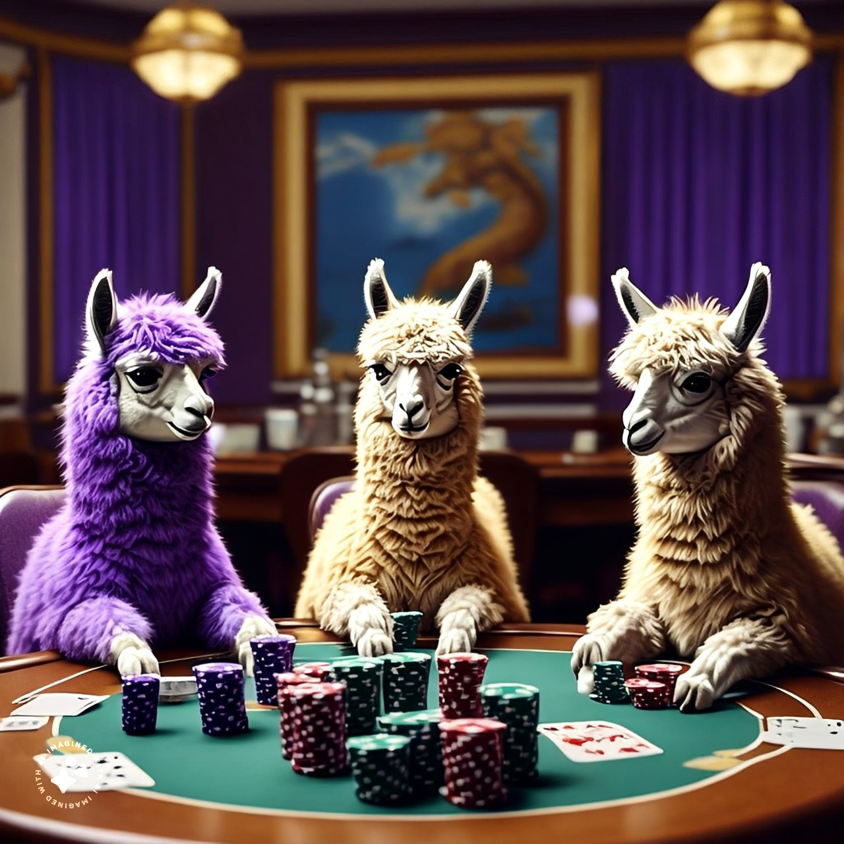
當然，以下是一段簡短的圖片描述：
三隻擬人化羊駝坐在賭桌前，似乎正玩著撲克。他們圍著一圈籌碼坐著，表情嚴肅。場景看起來很奢華，背景是賭場。

