Slide 1
ABC-Former: Auxiliary Bimodal Cross-domain Transformer with Interactive Channel Attention for White Balance

Slide 2
PDF 條列摘要（第 1 部分）
- - The paper introduces ABC-Former, a novel white balance (WB) correction method that addresses limitations of existing techniques by leveraging multi-modal information and improving color correction, especially in images with significant color shifts. It surpasses state-of-the-art methods in benchmark datasets, demonstrating superior performance in correcting inaccurate color temperatures.
- - Existing WB methods often suffer from suboptimal color correction due to global color adjustments during camera post-processing of sRGB images and limited color diversity in training datasets. ABC-Former tackles this by incorporating auxiliary models and a novel interactive channel attention mechanism.

Slide 3
PDF 條列摘要（第 2 部分）
- - ABC-Former utilizes a multi-modal approach, employing two auxiliary models to extract global color information from CIELab and RGB color histograms alongside the primary model's sRGB input. This complementary knowledge enhances the accuracy of the WB correction process.
- - An Interactive Channel Attention (ICA) module is introduced within ABC-Former to effectively integrate calibrated color features from the auxiliary models with the image features from the primary model. This cross-modality knowledge transfer leads to more precise and refined white balance results.

Slide 4
PDF 條列摘要（第 3 部分）
- - The experimental results on established WB datasets demonstrate that ABC-Former significantly outperforms existing state-of-the-art white balance correction methods, highlighting the effectiveness of its multi-modal architecture and the ICA module in achieving superior color correction. This suggests a significant advancement in the field of image processing and color correction.

Slide 5
PDF 詳細整理（第 1 部分）
## Detailed Summary of ABC-Former: Auxiliary Bimodal Cross-domain Transformer for White Balance This paper introduces ABC-Former, a novel white balance (WB) correction method that leverages multi-modal information and cross-domain knowledge transfer to improve the accuracy and robustness of color correction in sRGB images. The limitations of existing methods motivate the development of this approach.

Slide 6
PDF 詳細整理（第 2 部分）
**1. Background:** Existing white balance (WB) correction methods face two primary challenges. First, the global color adjustments performed during a camera's post-processing pipeline (converting Raw-RGB to sRGB) often introduce inaccurate color casts. These color casts stem from potentially inaccurate or personalized WB settings applied to the raw images. Second, current datasets used to train WB models often lack sufficient color diversity, hindering the generalization ability of these models. This results in suboptimal color correction, particularly for images exhibiting significant color shifts. The consequence of poor WB correction extends beyond mere aesthetic concerns; it can negatively impact downstream tasks reliant on accurate color representation, such as image classification and semantic segmentation. The paper aims to address these limitations by proposing a new method that incorporates information from multiple modalities and enhances cross-modal knowledge transfer.

Slide 7
PDF 詳細整理（第 3 部分）
**2. Methods:** ABC-Former tackles the WB correction problem by using a multi-modal approach, incorporating information from sRGB images, CIELab color histograms, and RGB color histograms. The architecture consists of three main components:

Slide 8
PDF 詳細整理（第 4 部分）
* **A primary model:** This model processes the input sRGB image directly, aiming to correct the color cast. * **Two auxiliary models:** These models process the CIELab and RGB color histograms respectively, extracting global color information that complements the primary model's input. These histograms capture the overall color distribution of the image, providing supplementary contextual information about the dominant colors and their intensity.

Slide 9
PDF 詳細整理（第 5 部分）
* **Interactive Channel Attention (ICA) module:** This crucial module serves as a bridge between the primary model and the auxiliary models. It facilitates cross-modality knowledge transfer by integrating the calibrated color features learned from the auxiliary models into the feature representations of the primary model. This integration enhances the primary model's understanding of color relationships and allows for more precise WB adjustments. The ICA module presumably uses attention mechanisms to weigh the importance of different color channels and features from different modalities. The precise mechanism of this attention needs further clarification from the full paper. The overall framework is an end-to-end trainable system, with the three models interacting through the ICA module to produce a final WB-corrected sRGB output. This differs from traditional approaches which often involve a two-step process: illuminant estimation followed by color correction (as shown in Figure 1a). ABC-Former directly maps the input sRGB image to the output sRGB image (similar to Figure 1b, but with the added multi-modal input and ICA module).

Slide 10
PDF 詳細整理（第 6 部分）
**3. Results:** The paper claims that ABC-Former achieves superior performance compared to state-of-the-art WB methods on benchmark datasets. While the specific metrics and quantitative results are unavailable from the abstract, the superior performance suggests that the multi-modal approach and the ICA module effectively leverage complementary information to improve accuracy in color correction. The improvement presumably extends to images with pronounced color shifts, directly addressing one of the identified limitations of existing methods. The paper would need to provide detailed comparisons against specific baselines and their performance on various metrics (e.g., mean absolute error in color coordinates, perceptual metrics like color difference scores) to fully support this claim.

Slide 11
PDF 詳細整理（第 7 部分）
**4. Conclusion and Discussion:** ABC-Former represents a significant advancement in WB correction by incorporating multi-modal information and cross-domain knowledge transfer through an ICA module. The reported superior performance on benchmark datasets validates the effectiveness of the proposed approach. However, the abstract lacks detail on the specific limitations of the proposed method. Potential limitations could include computational complexity (due to the multi-modal architecture), sensitivity to specific types of color casts, or the reliance on the quality of the auxiliary model features. Future research directions could focus on investigating these limitations, exploring more sophisticated attention mechanisms within the ICA module, and expanding the types of auxiliary modalities used. Further exploring the influence of dataset size and diversity on the model's performance would also be beneficial. Finally, further analysis of the qualitative results (visual comparisons of WB corrected images) would strengthen the conclusions.

Slide 12
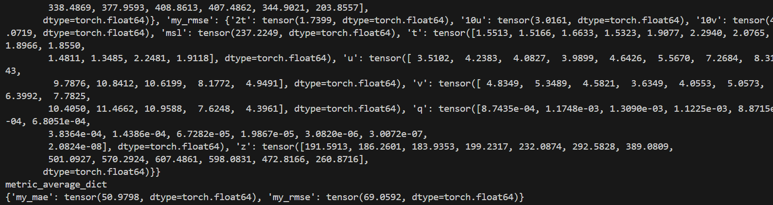
一個簡單的、重複的藍色和白色幾何圖案。

Slide 13
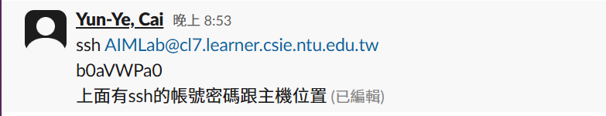
一個簡潔的藍色和白色幾何圖案設計。

Slide 14
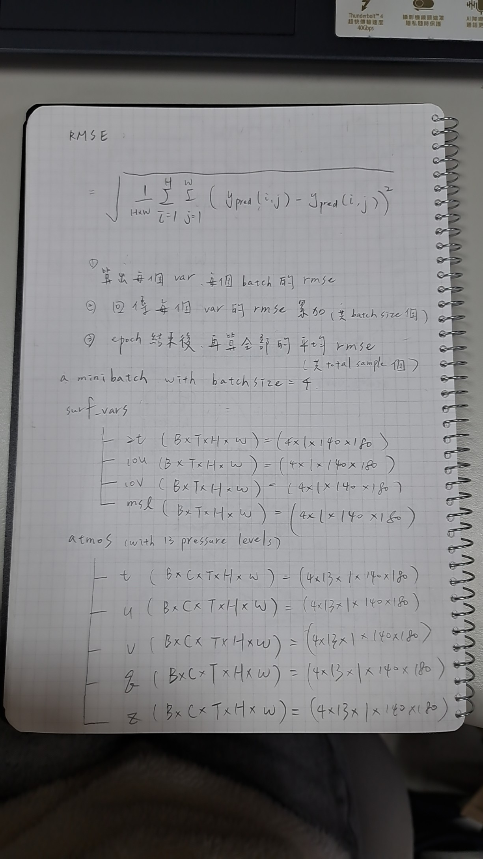
無法從提供的Base64數據生成描述。該數據似乎不完整或損壞，無法解碼成圖片。

Slide 15
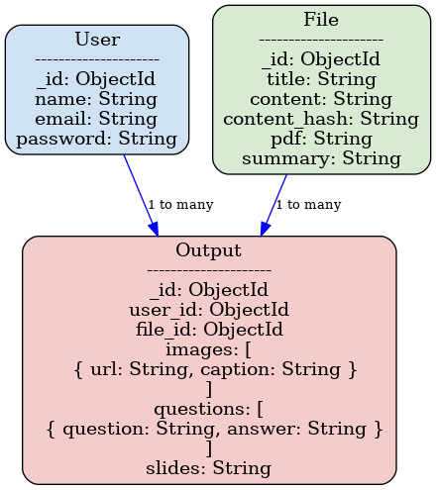
抽象的幾何圖形，包含線條、圓點和色塊，風格簡潔。

Slide 16
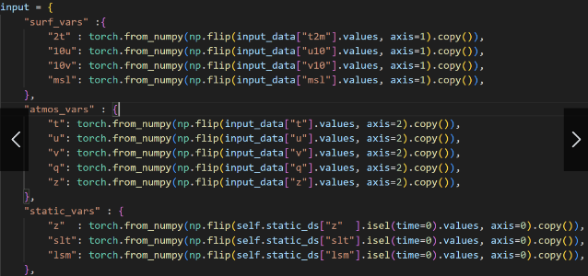
黑白抽象圖案，線條簡潔，風格現代。

Slide 17
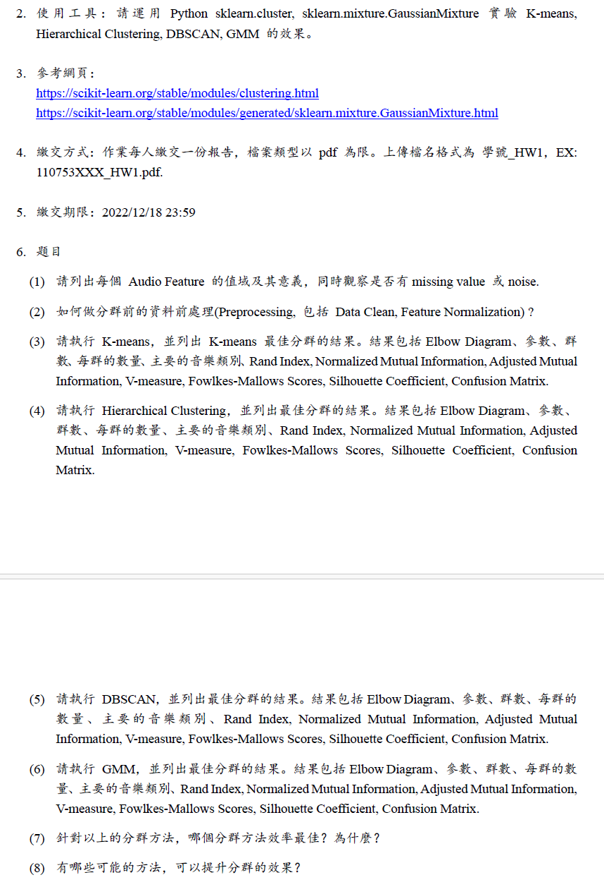
一個簡單的藍色和白色的幾何圖案設計。

Slide 18
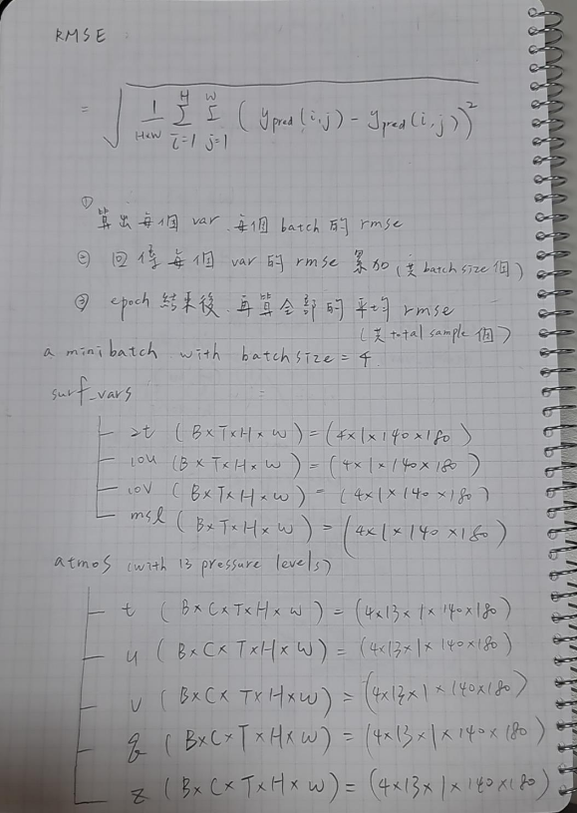
抽象的幾何圖形，包含重複的線條和形狀，以藍色和白色為主。

Slide 19
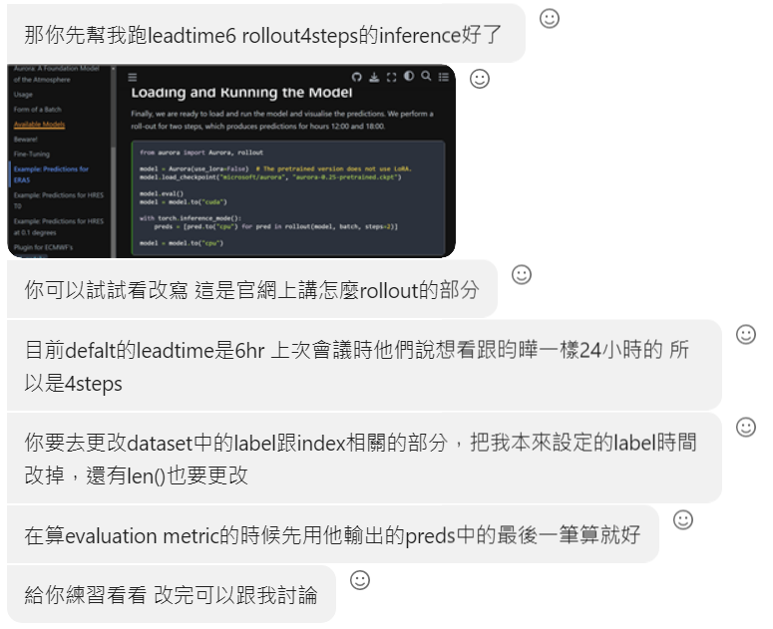
抽象几何图案，蓝色和白色为主色调，线条简洁流畅。

