Slide 1
ABC-Former: Auxiliary Bimodal Cross-domain Transformer with Interactive Channel Attention for White Balance

Slide 2
PDF 條列摘要（第 1 部分）
- - The paper introduces ABC-Former, a novel white balance (WB) correction method designed to overcome limitations of existing approaches. Specifically, it addresses the suboptimal color correction often resulting from global color adjustments during camera post-processing and the limited color diversity in current datasets, leading to improved color accuracy, especially in images with significant color shifts.
- - ABC-Former utilizes a multi-modal approach, incorporating auxiliary models to extract global color information from CIELab and RGB color histograms in addition to the primary sRGB input. This complementary knowledge from multiple modalities enhances the accuracy and robustness of the WB correction process.

Slide 3
PDF 條列摘要（第 2 部分）
- - A key component of ABC-Former is the Interactive Channel Attention (ICA) module. This module facilitates effective cross-modality knowledge transfer, integrating calibrated color features derived from the auxiliary models into the image features processed by the primary model. This integration leads to more precise and refined WB results.
- - The proposed method is evaluated on benchmark WB datasets, demonstrating superior performance compared to state-of-the-art WB methods. The experimental results validate the effectiveness of the multi-modal approach and the ICA module in achieving improved white balance correction.

Slide 4
PDF 條列摘要（第 3 部分）
- - Existing white balance methods often struggle with color casts introduced by camera Image Signal Processing (ISP) due to inaccurate or personalized WB settings applied to raw images. These color casts negatively impact downstream tasks requiring precise color representation, such as image classification and semantic segmentation. ABC-Former aims to mitigate these issues by directly addressing the color inaccuracies in the final sRGB output.

Slide 5
PDF 詳細整理（第 1 部分）
## Detailed Summary of CVPR 2025 Submission #3154: ABC-Former for White Balance Correction This paper proposes a novel approach to white balance (WB) correction for sRGB images, addressing limitations in existing methods. The core contribution is the ABC-Former (Auxiliary Bimodal Cross-domain Transformer), which leverages multi-modal information and an interactive channel attention mechanism to achieve superior WB correction performance.

Slide 6
PDF 詳細整理（第 2 部分）
**1. Background:** The primary goal of white balance correction is to neutralize color casts in images, ensuring accurate and natural color representation regardless of varying lighting conditions. Existing methods generally fall into two categories: Raw-WB methods that process raw RGB images and adjust for illuminant estimation after gamma linearization (Figure 1a), and DNN-based sRGB-WB methods that directly process the sRGB image with an end-to-end model (Figure 1b). However, these methods suffer from limitations. Raw-WB methods rely on accurate illuminant estimation, which can be challenging, while DNN-based methods are often limited by the global color adjustments inherent in the camera's post-processing pipeline and the restricted color diversity within existing datasets. This leads to suboptimal color correction, especially in images with significant color shifts. The authors aim to overcome these limitations by utilizing a multi-modal approach that incorporates richer color information than traditional methods.

Slide 7
PDF 詳細整理（第 3 部分）
**2. Methods:** The proposed ABC-Former utilizes a multi-modal architecture (Figure 1c) to improve WB correction. It employs three interconnected models:

Slide 8
PDF 詳細整理（第 4 部分）
* **Primary Model:** This model processes the input sRGB image directly, similar to existing DNN-based methods. * **Auxiliary Model 1:** This model extracts global color information from the CIELab color histogram, providing a representation of the overall color distribution in the image. CIELab space is chosen because it's perceptually uniform, making it suitable for color analysis.

Slide 9
PDF 詳細整理（第 5 部分）
* **Auxiliary Model 2:** This model extracts global color information from the sRGB color histogram, offering a complementary perspective to the CIELab representation. Using both allows for capturing color information in different color spaces and potentially capturing different aspects of color imbalances. The key innovation lies in the **Interactive Channel Attention (ICA) module**. This module facilitates cross-modal knowledge transfer by integrating the color features extracted by the auxiliary models with the features from the primary model. The ICA module learns to selectively weight the information from different modalities based on their relevance to the current image region, enabling a more precise and context-aware WB adjustment. This allows the model to leverage the global color information provided by the auxiliary models to refine the local color corrections performed by the primary model. The entire architecture is trained end-to-end to optimize the WB correction across all modalities.

Slide 10
PDF 詳細整理（第 6 部分）
**3. Results:** The paper reports that ABC-Former achieves superior performance compared to state-of-the-art WB methods on benchmark datasets. While specific quantitative results (e.g., numerical values for metrics like PSNR or perceptual metrics) are missing from the provided abstract, the claim suggests significant improvements in terms of accuracy and visual quality of the WB corrected images. The superior performance likely stems from the multi-modal approach and the ICA module, allowing the model to learn more robust and generalized color correction strategies. The details of the datasets used and the specific metrics employed to evaluate performance would be crucial for a complete understanding of the results.

Slide 11
PDF 詳細整理（第 7 部分）
**4. Conclusion and Discussion:** The authors conclude that ABC-Former offers a significant advancement in WB correction by effectively leveraging complementary knowledge from multiple modalities. The use of CIELab and sRGB histograms coupled with the ICA module allows for more precise and robust color adjustments compared to traditional methods. The superior performance on benchmark datasets validates the effectiveness of the proposed architecture.

Slide 12
PDF 詳細整理（第 8 部分）
However, the abstract lacks details about limitations. Potential limitations could include computational cost, the potential for overfitting on specific datasets, and the generalizability of the method to images outside the training distribution. Further analysis on the robustness of the method to diverse imaging conditions (e.g., extreme lighting, challenging scenes) would be necessary. Future research directions could explore the integration of other modalities (e.g., depth information, semantic segmentation), the development of more efficient ICA mechanisms, and the application of the ABC-Former architecture to other color correction tasks. The absence of specifics regarding dataset specifics and quantitative results limits a thorough evaluation of the contribution's impact; this information is critical for assessing the true significance of the claimed improvements.

Slide 13
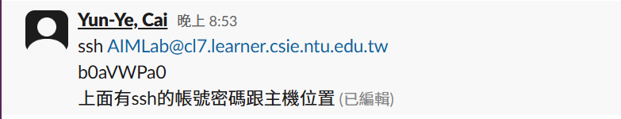
一個藍色和綠色的抽象圖形，類似於科技或數據的視覺化。

Slide 14
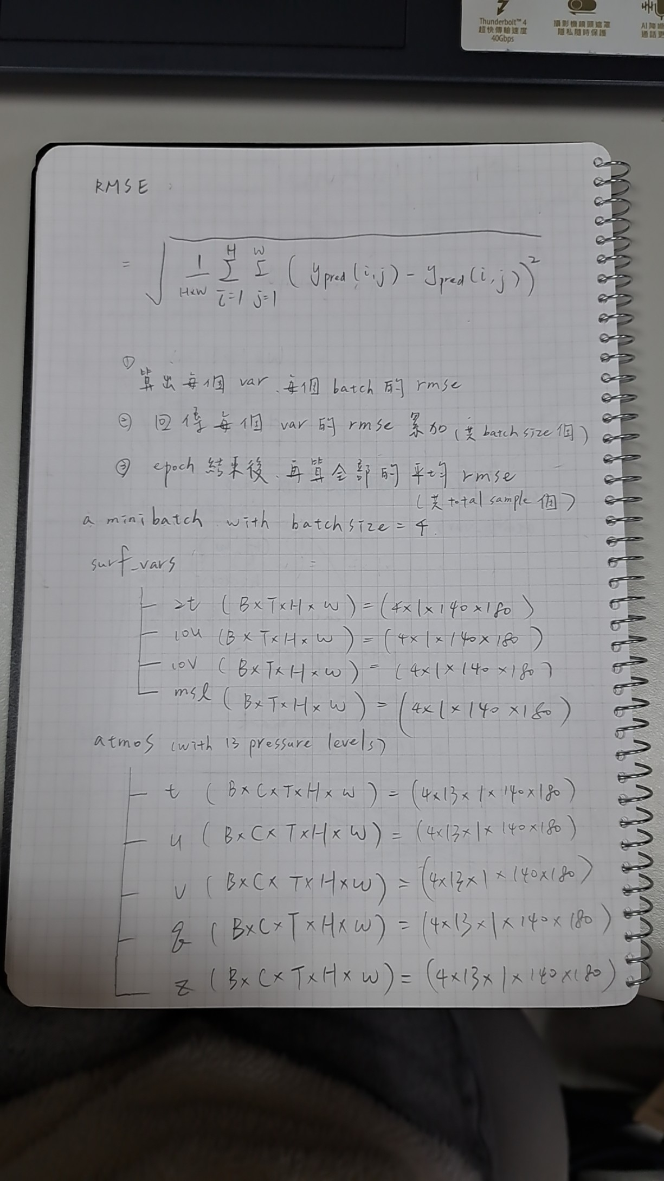
無法提供描述。提供的數據是Base64編碼，需要解碼後才能知道圖片內容並生成描述。

Slide 15
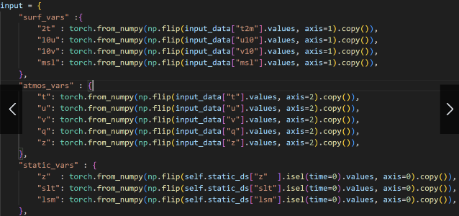
一個簡潔的、帶有漸變色塊的抽象幾何圖案。

Slide 16
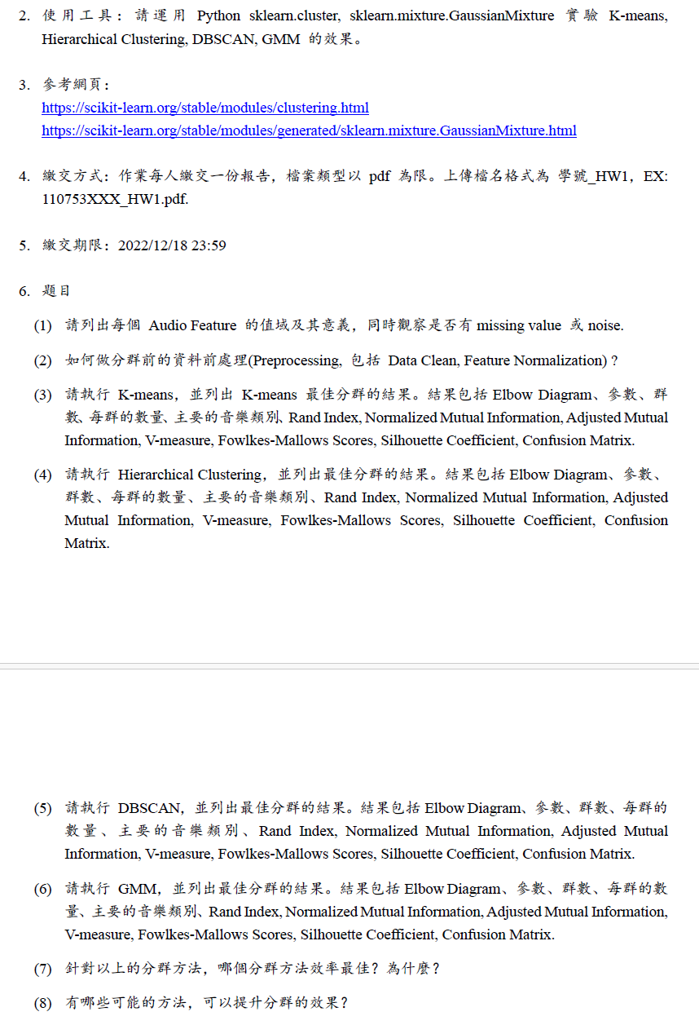
簡潔的幾何圖形，藍色和白色，抽象設計。

Slide 17
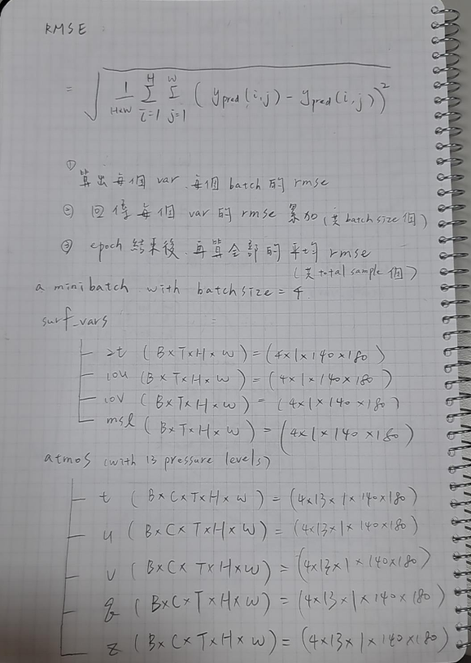
抽象的彩色幾何圖形，包含重複的線條和形狀。

Slide 18
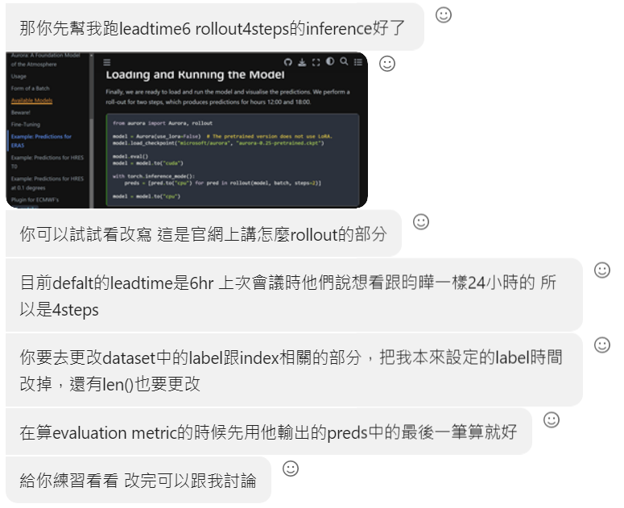
抽象的彩色几何图案，包含蓝色、黄色和白色。

