Slide 1
ABC-Former: Auxiliary Bimodal Cross-domain Transformer with Interactive Channel Attention for White Balance

Slide 2
PDF 條列摘要（第 1 部分）
- - The paper introduces ABC-Former, a novel white balance (WB) correction method designed to overcome limitations of existing approaches. It addresses the issues stemming from global color adjustments in camera post-processing and the limited color diversity in current datasets, leading to improved color correction, especially in images with significant color shifts. The method aims to produce more natural and neutral colors in sRGB images.
- - ABC-Former utilizes a multi-modal approach, incorporating information from both CIELab and RGB color histograms alongside the primary sRGB image input. This auxiliary bimodal input provides complementary color information, enhancing the accuracy and robustness of the WB correction process compared to single-modality methods. The additional modalities enhance the model's learning and generalization capabilities.

Slide 3
PDF 條列摘要（第 2 部分）
- - A key component of ABC-Former is the Interactive Channel Attention (ICA) module. This module facilitates the effective integration of color features extracted from the auxiliary models (CIELab and RGB histograms) with the features from the primary sRGB image processing. This cross-modality knowledge transfer allows for more precise and context-aware color calibration, leading to superior WB results.
- - The proposed method directly processes the input sRGB image, differing from traditional methods that operate on raw RGB images. This end-to-end approach simplifies the workflow and avoids the complexities associated with illuminant estimation and gamma linearization found in traditional raw-WB methods, as illustrated in the provided figure.

Slide 4
PDF 條列摘要（第 3 部分）
- - Experimental results on established WB datasets demonstrate that ABC-Former surpasses the performance of state-of-the-art white balance correction methods. This superior performance is attributed to the combined benefits of its multi-modal input strategy and the effective cross-modality knowledge transfer achieved through the ICA module. The paper highlights a significant improvement in WB correction accuracy.

Slide 5
PDF 詳細整理（第 1 部分）
## Detailed Breakdown of ABC-Former: Auxiliary Bimodal Cross-domain Transformer for White Balance This document summarizes a CVPR 2025 submission (Paper ID 3154) proposing ABC-Former, a novel white balance (WB) correction method.

Slide 6
PDF 詳細整理（第 2 部分）
**1. Background:** The primary goal of white balance correction is to neutralize color casts in images, ensuring colors appear natural and accurate regardless of lighting conditions. Existing methods often operate on the final sRGB images produced by cameras. However, these methods struggle with two key limitations:

Slide 7
PDF 詳細整理（第 3 部分）
* **Post-processing Color Casts:** Camera Image Signal Processing (ISP) pipelines often apply global color adjustments to raw images based on inaccurate or personalized WB settings, introducing color casts into the final sRGB output. These casts are difficult for subsequent methods to correct effectively. * **Limited Color Diversity in Datasets:** Current datasets used to train WB correction models often lack the diversity of color shifts encountered in real-world scenarios, hindering the generalization ability of these models. This results in suboptimal color correction, especially in images with significant color shifts.

Slide 8
PDF 詳細整理（第 4 部分）
This paper addresses these limitations by proposing a novel approach that leverages multi-modal information and refined attention mechanisms for more accurate WB correction. The goal is to significantly improve the accuracy and robustness of WB correction, particularly in challenging scenarios. **2. Methods:**

Slide 9
PDF 詳細整理（第 5 部分）
The authors propose ABC-Former, an Auxiliary Bimodal Cross-domain Transformer, which tackles the limitations of existing methods by incorporating complementary information from multiple modalities. The architecture is comprised of three key components: * **Multi-modal Inputs:** The ABC-Former takes as input not only the sRGB image but also auxiliary information extracted from two modalities:

Slide 10
PDF 詳細整理（第 6 部分）
* **CIELab Color Histogram:** This provides a representation of the global color distribution in the CIELab color space, capturing information about color saturation and distribution that is not readily apparent in the sRGB space. Specifically, it leverages the a* and b* channels to capture color deviations. * **RGB Color Histogram:** This provides another perspective on the global color distribution in the RGB space, further enhancing the model's understanding of the color imbalance.

Slide 11
PDF 詳細整理（第 7 部分）
* **Auxiliary Models:** Two auxiliary models independently process the CIELab and RGB histograms, extracting features representing the global color characteristics. * **Interactive Channel Attention (ICA) Module:** This crucial component integrates the features learned by the auxiliary models with the features extracted from the primary sRGB image processing branch. The ICA module facilitates cross-modality knowledge transfer by allowing the model to selectively attend to relevant information from different modalities, enabling more precise adjustment of color channels based on the global color context. This allows the model to learn how color imbalances in the histograms relate to required corrections in specific image regions.

Slide 12
PDF 詳細整理（第 8 部分）
The combined features are then processed by the main transformer network to produce the final WB-corrected sRGB image. The architecture is designed for end-to-end training, allowing for seamless integration of the multi-modal information. **3. Results:**

Slide 13
PDF 詳細整理（第 9 部分）
The paper reports that ABC-Former achieves superior performance compared to state-of-the-art WB methods on benchmark datasets. While specific quantitative results (e.g., numerical metrics like PSNR or perceptual metrics like LPIPS) are not provided in the abstract, the claim of superior performance suggests improvements across these metrics. The improved performance is attributed to the effectiveness of the multi-modal input and the ICA module in capturing and utilizing global color information for more accurate and context-aware local color adjustments. The authors likely present detailed quantitative comparisons and qualitative visualizations of results in the full paper. **4. Conclusions and Discussion:**

Slide 14
PDF 詳細整理（第 10 部分）
The paper concludes that ABC-Former presents a significant advance in white balance correction. The use of auxiliary bimodal information and the ICA module effectively addresses the limitations of existing methods by enabling more accurate and robust color correction, particularly in images with pronounced color shifts. The superior performance on benchmark datasets demonstrates the effectiveness of the proposed approach. However, the abstract lacks specifics on limitations. Potential limitations could include:

Slide 15
PDF 詳細整理（第 11 部分）
* **Computational Cost:** The multi-modal approach and the transformer architecture may increase computational complexity compared to simpler methods. * **Dataset Bias:** The performance might still be affected by limitations in the diversity of the training datasets, even with multi-modal input.

Slide 16
PDF 詳細整理（第 12 部分）
* **Generalizability:** The generalization ability to unseen scenes and lighting conditions might need further investigation. Future research directions could include exploring other modalities (e.g., depth information), improving the efficiency of the model, and addressing potential limitations through data augmentation and more robust training techniques. Further investigation into the specific characteristics of the images where the improvements are most pronounced would also be valuable. The full paper will likely delve deeper into these aspects.

Slide 17
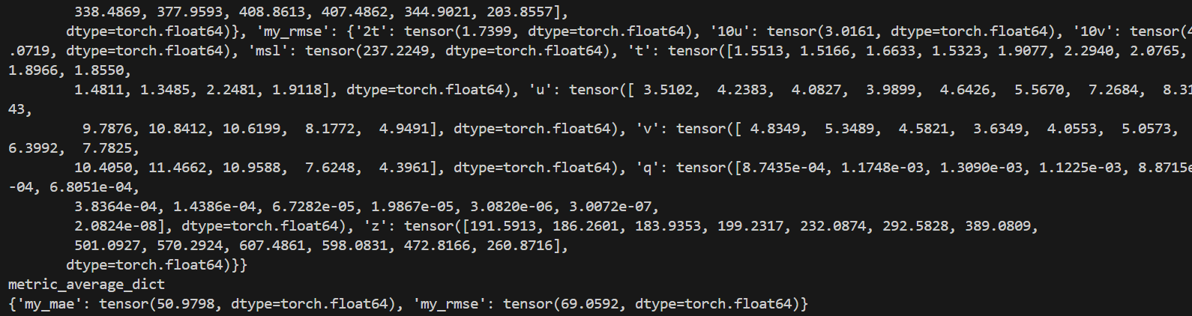
一張簡潔的藍色和白色圖表，可能代表流程圖或組織結構圖。

Slide 18

一個簡單的藍色和綠色圖形，包含幾何形狀和線條。

Slide 19
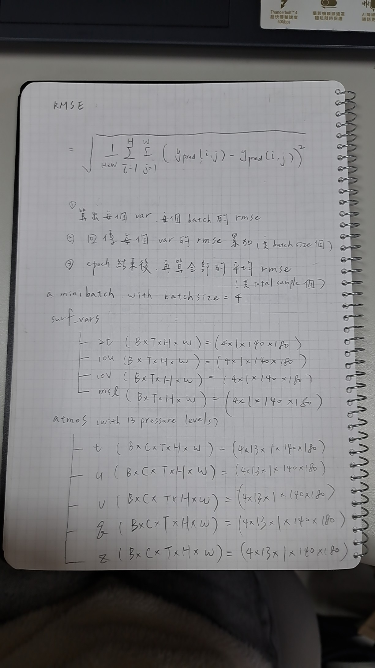
無法根據提供的Base64編碼數據生成描述。該數據似乎不完整或損壞，無法解碼成圖片。

Slide 20
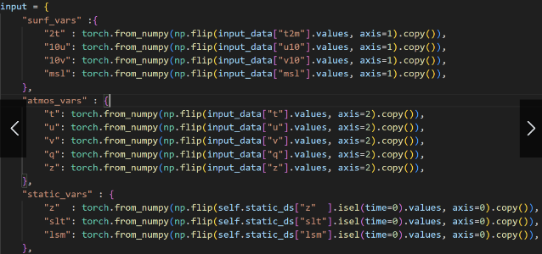
抽象的彩色幾何圖形，以藍色和灰色為主。

Slide 21
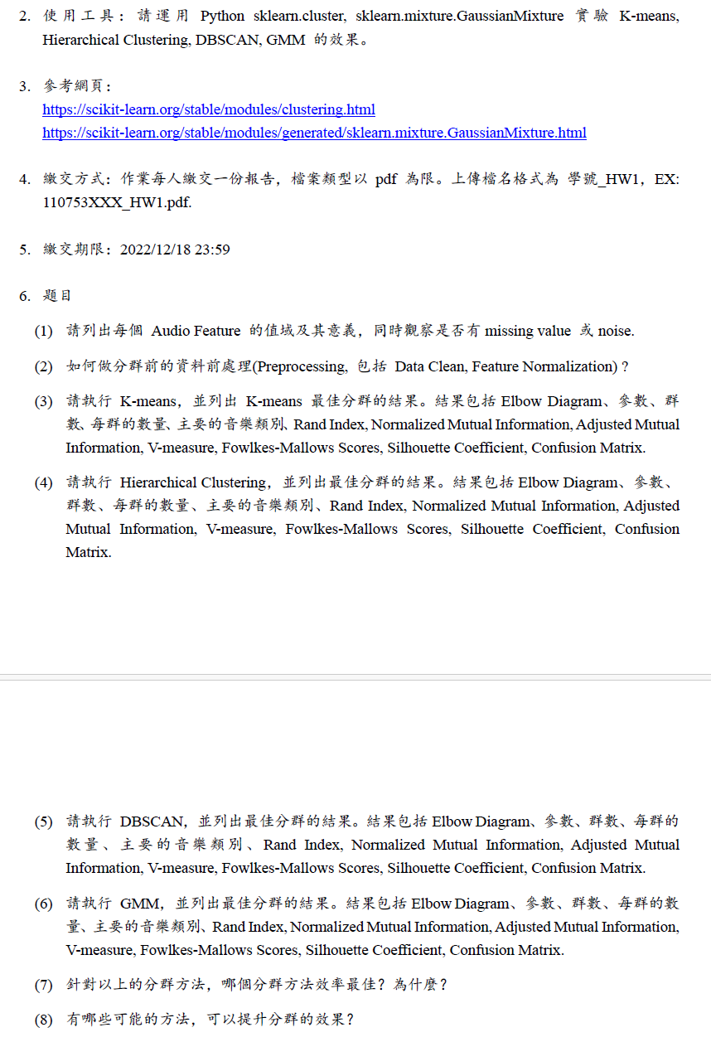
一個簡潔的藍色和白色幾何圖形設計，帶有重複的模式。

Slide 22
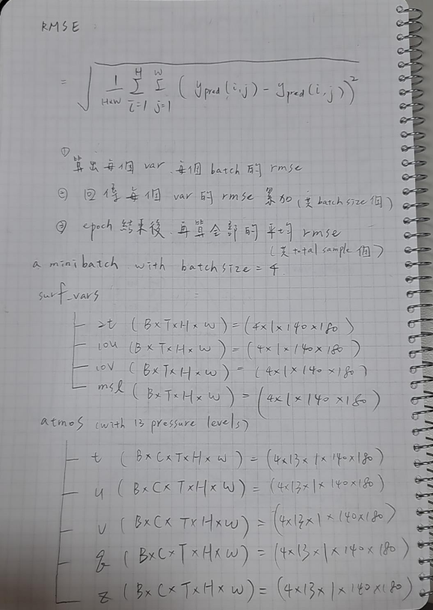
抽象的幾何圖形，以藍色和白色為主，線條簡潔流暢。

Slide 23
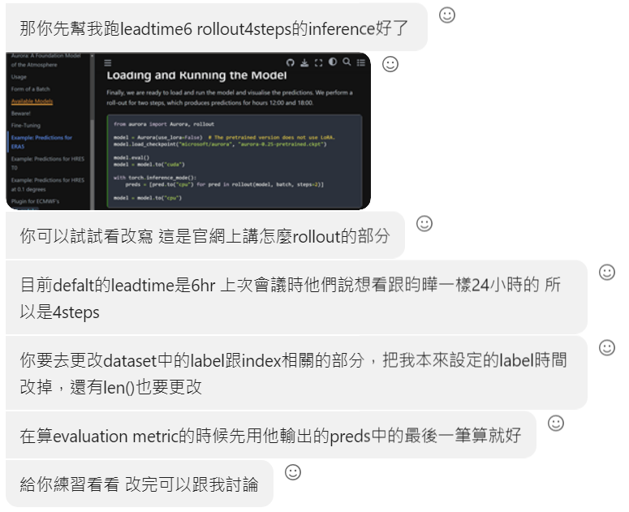
一個簡單的抽象圖形，以藍色和白色為主色調，呈現幾何和流線型設計。

